Slide 1
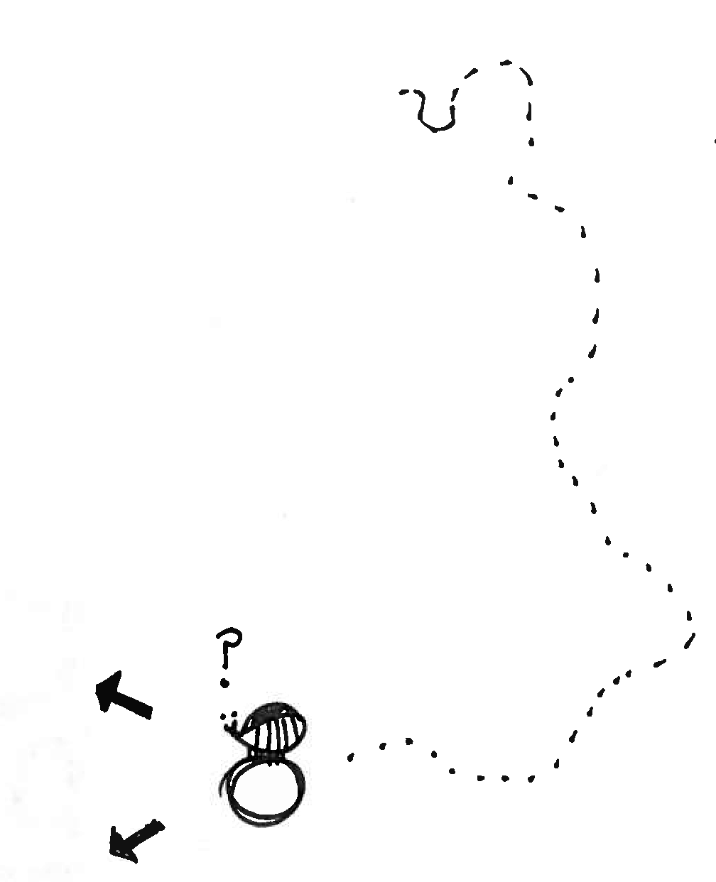

Poster best practices:
Mastering the decision tree
Jen Nguyen
Tony Kulesa
Notes:
We need to introduce affiliation with writing lab
Explanation of who we are – establish credibility (we are grad students, we’ve made posters!)
Outline/overview slide (here’s our plan for our time with you) + we will give you these slides, no need for note taking
Save selling the Writing lab for end
Its okay if you haven’t done a poster before, just sketch something out , give it a shot (put them at ease, encourage them)
- 1st one partner activity,

Slide 2

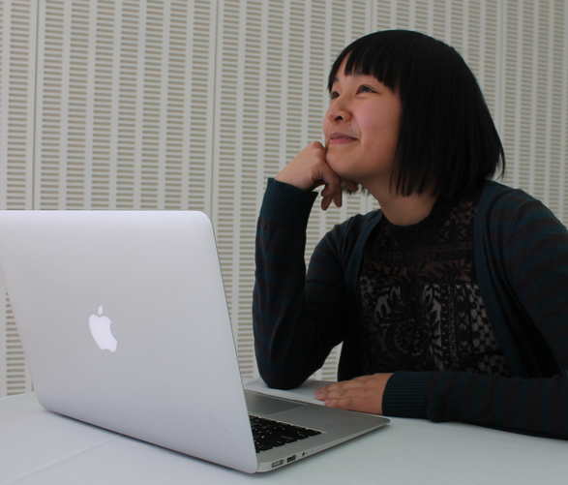
Who are we?
Tony Kulesa
2nd Year Grad Student, BE
BS Biomed Eng, Math, Chinese; Rutgers 2012
4 Posters given
Jen Nguyen
2nd Year Grad Student, Microbiology
BS Biology; UCSD 2010
3 Posters given

Slide 3
A brief overview of this talk
Opening activity: Poster sketch
Our take on effective posters
Design strategy
Final points

Slide 4
A brief overview of this talk
Opening activity: Poster sketch
Our take on effective posters
Design strategy
Final points
Don’t bother taking notes – we can give you the slides afterwards

Slide 5
Poster sketch: Dung beetles use the Milky Way for Orientation
Notes:
For the real thing, we should use a higher res image.

Slide 6
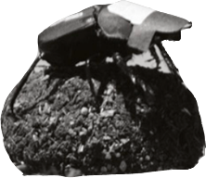
Question: How do dung beetles travel in straight lines?

Slide 7
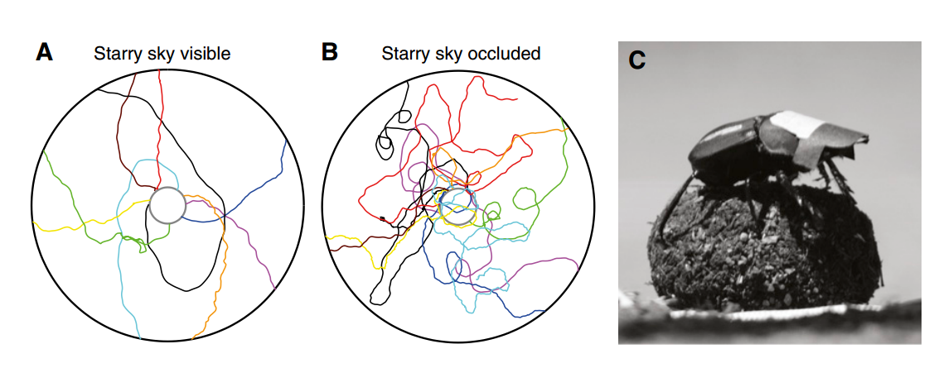
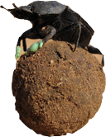
Hypothesis: Dung beetles use starlight to navigate in straight lines

Slide 8
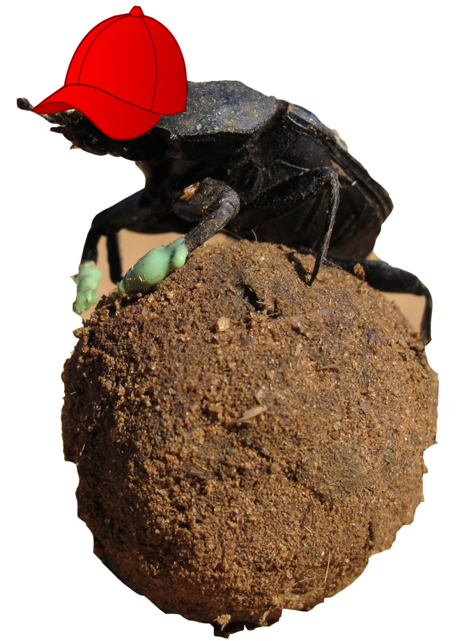
Method Pt 1: Making dung beetles wear hats to occlude the starlight shows night sky is necessary

Slide 9
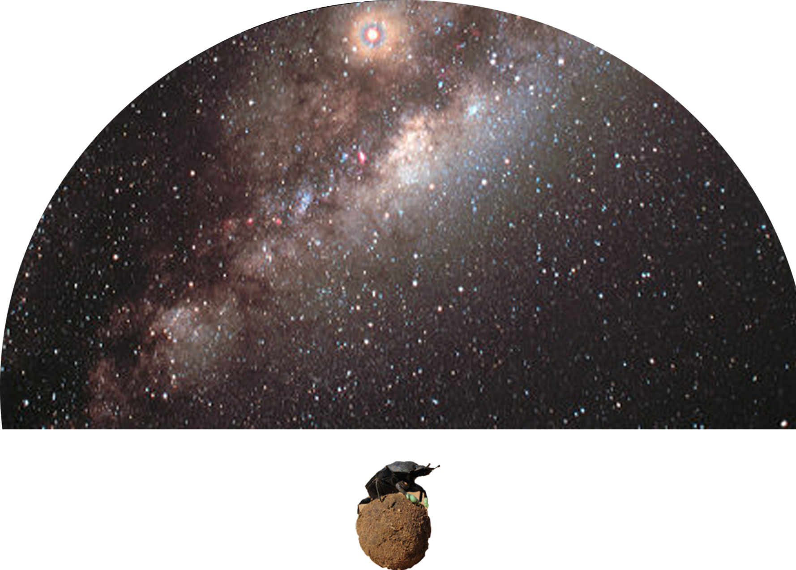
Method Pt 2: Projecting different star patterns in a planetarium shows Milky Way is sufficient
MILKY WAY
PLANETARIUM

Slide 10
Activity: Spend 3-4 minutes sketching out a poster you might make for this project
MILKY WAY
PLANETARIUM
Notes:
Notes from Jaime: what are big picture things that need to be on a poster?
Generate this list together, then a little spend time planning poster on own

Slide 11

The possibilities are plenty: choose your own adventure
Communicate new results
Engage with collaborators
Look for new applications of a technology
Network
What do you want to get out of presenting?
What will most interest your audience?

Slide 12
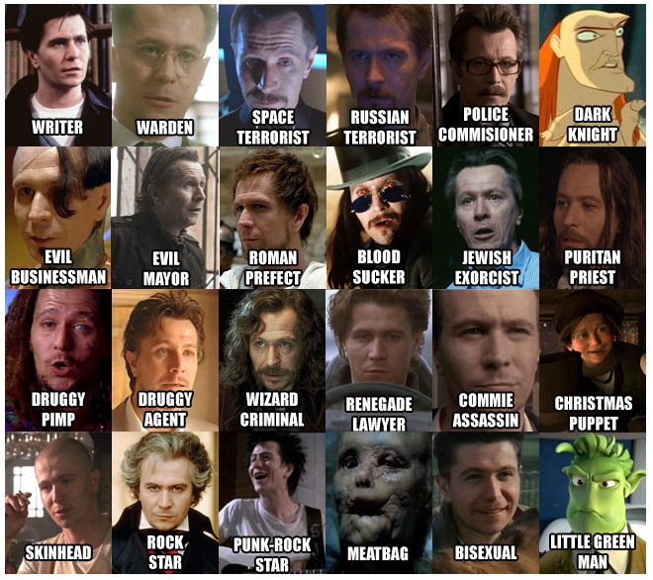
Posters are a unique opportunity for diverse solutions

Slide 13
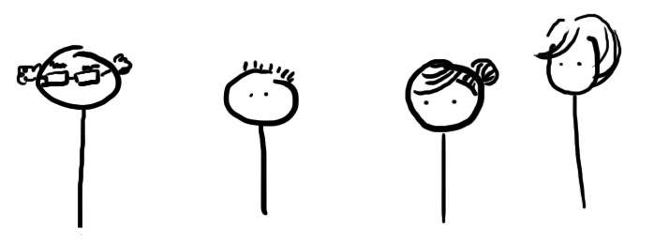
Be prepared to to take advantage of diversity
Friends from similar program
Prof in totally different field
Grad student with similar research interests
Your advisor
What is important and unique about a poster session is the diversity of people there
Your oral presentation of the poster should be targeted to capitalize on this opportunity

Slide 14
Some possible goals you might have for the dung beetle poster
Communicate new results
  “Beetles use the Milky Way to orient in straight lines”
Engage with other beetle scientists
  “Comparative beetle strategies of avoiding predators at night”
Look for new applications of a technology
“Insect hats for studying dependence on starlight for navigation”

Slide 15
Discussion: Spend 3-4 minutes sketching out a poster which emphasizes the hat technology
MILKY WAY
PLANETARIUM
Notes:
Insert blank slide afterwards for brainstorming

Slide 16
Practices for a successful poster
Check yourself at every step of poster planning
Appeal: do I catch and hold attention?
Clarity: am I easy to understand?
Relevance: do I speak to my audience?
Let’s go through an example!
Notes:
Jen starts

Slide 17
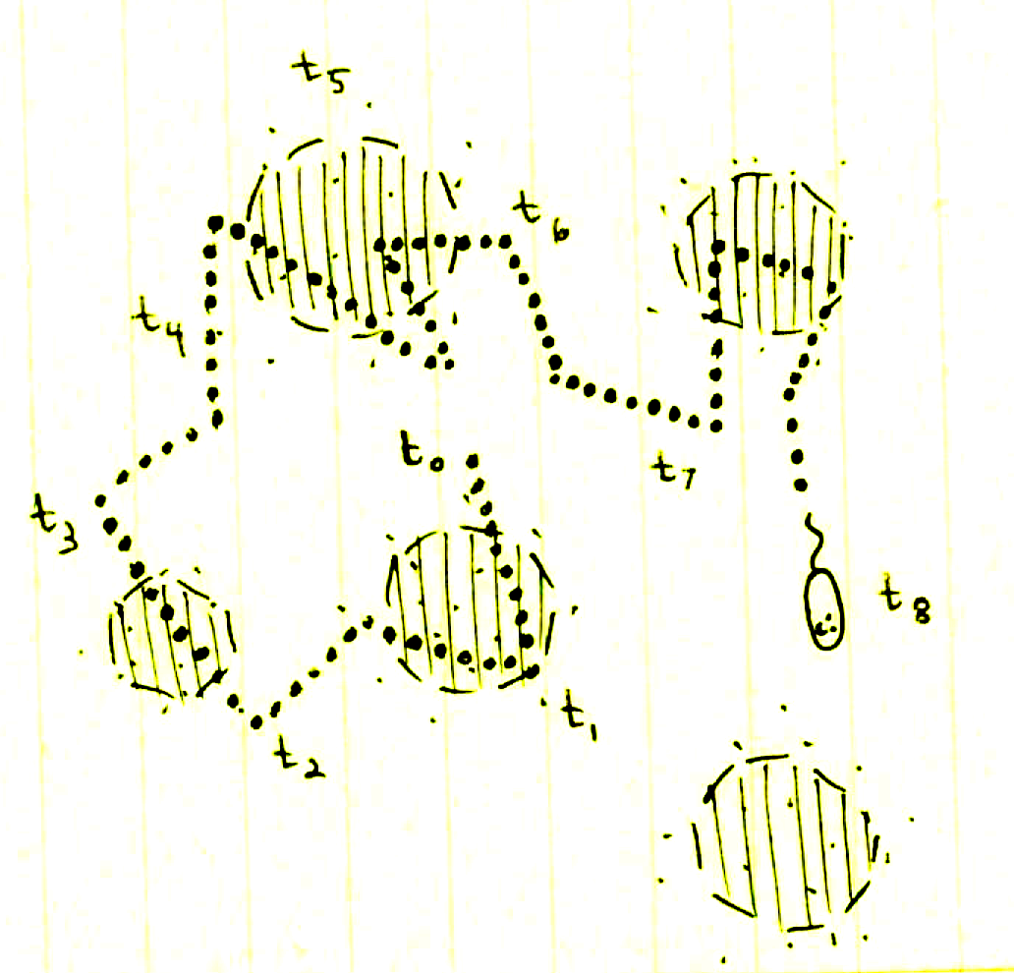
Planning Jen’s poster
Project: Growth in fluctuating environments
Meeting: International Society of Microbial Ecology (ISME)
Purpose: ???
Notes:
Lay off context → keep to big picture

Slide 18
Planning Jen’s poster
Step 1: Identify poster purpose
Purpose: Solicit feedback on the ecological relevance of my work!
  Appeal
  Clarity
  Relevance
Reflect this purpose in every section of poster.

Slide 19
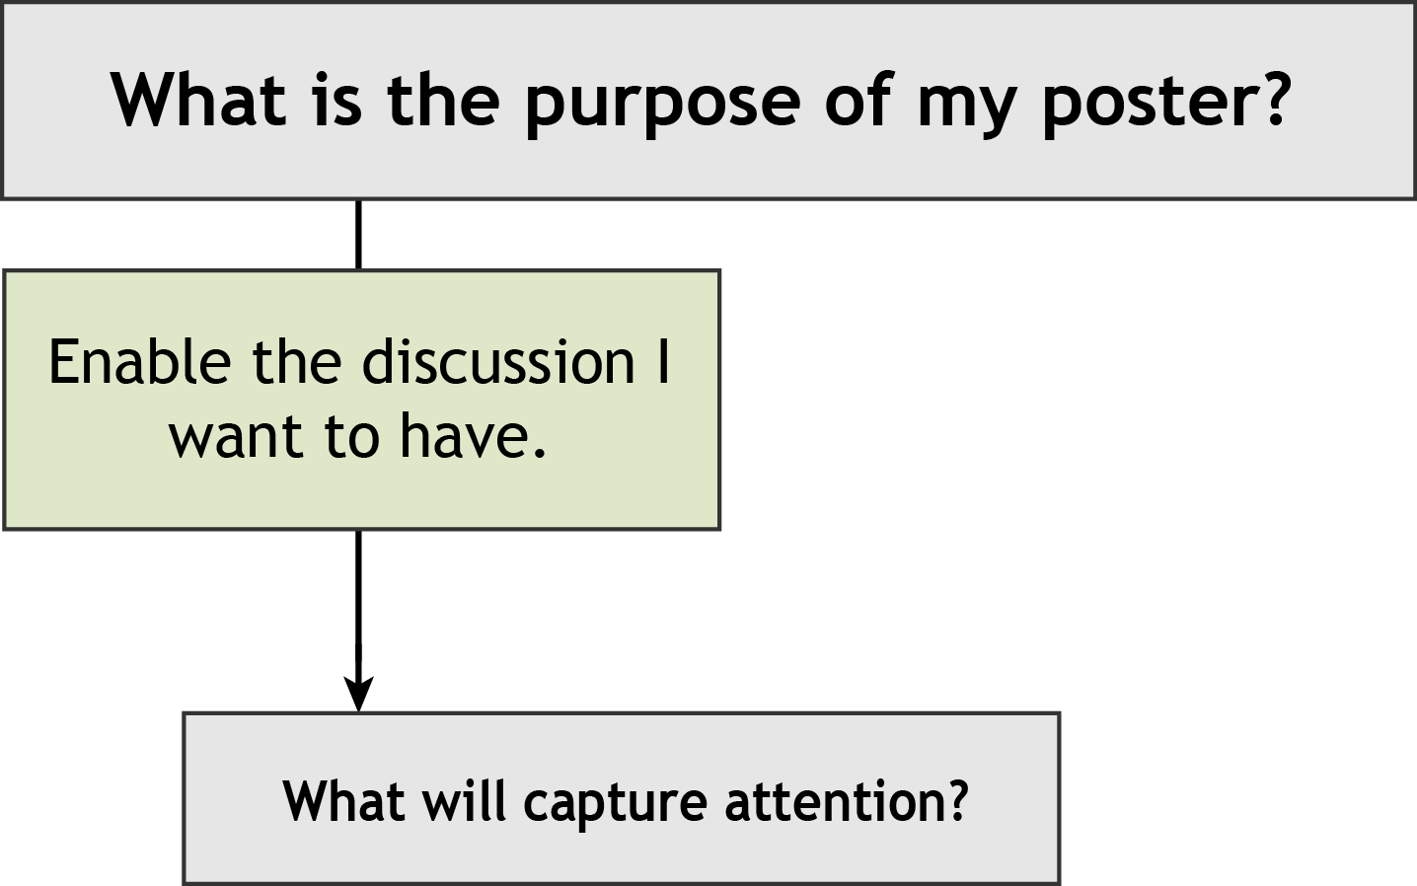
Make choices that increase appeal, clarity, and relevance
But we can’t have a discussion by ourselves….!
Notes:
Decide: what will capture attention?
How do we draw in an audience of ecologists?

Slide 20
Titles: clearly convey your message
Directly connect key concepts to create an efficient title
Key concepts
Microbial growth
Stochastic, fluctuating environments
Microfluidic simulation of naturally occurring environmental conditions
Growth
… in fluctuating environments:
microfluidic-based insights to natural variability
Notes:
Titles: one of the first points of focus.
Key concepts written here have an ecological swing.

Slide 21
Remember, relevance is appealing!
Ecological emphasis:
  Growth in fluctuating environments: microfluidics-based insights to natural variability
Methods emphasis:
  A novel microfluidic pulse generator delivers pulsatory chemical cues to free swimming bacteria
Dull and uninformative:
  Quantification of Marinobacter adhaerens growth within a microfluidic chamber reveals the importance of environmental factors on bacterial physiology

Slide 22
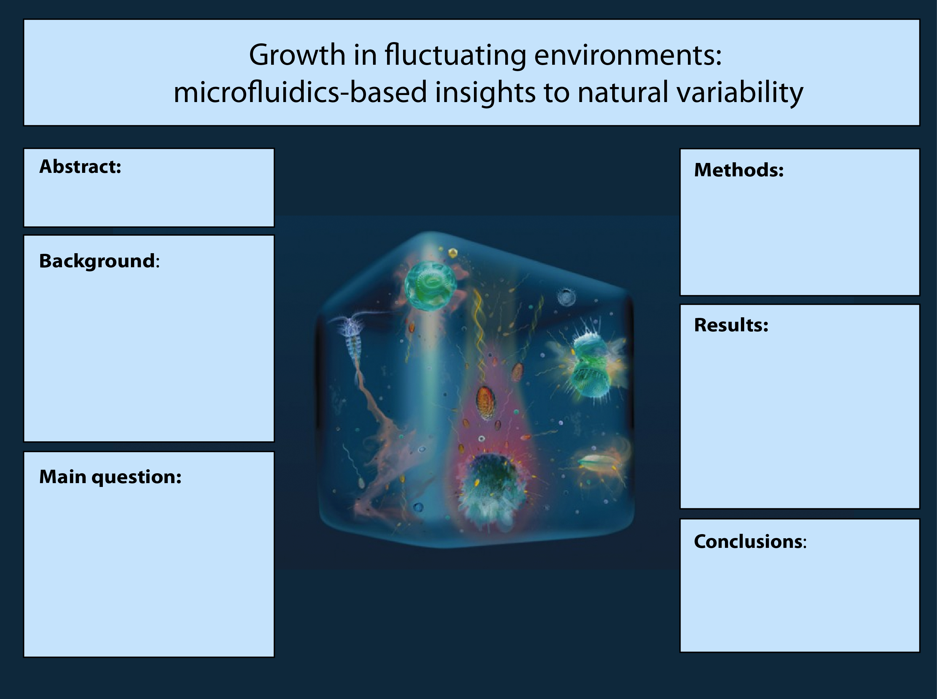
Central figure: a visually appealing means of clear communication
Notes:
Formatting? → more nicely align boxes?

Slide 23
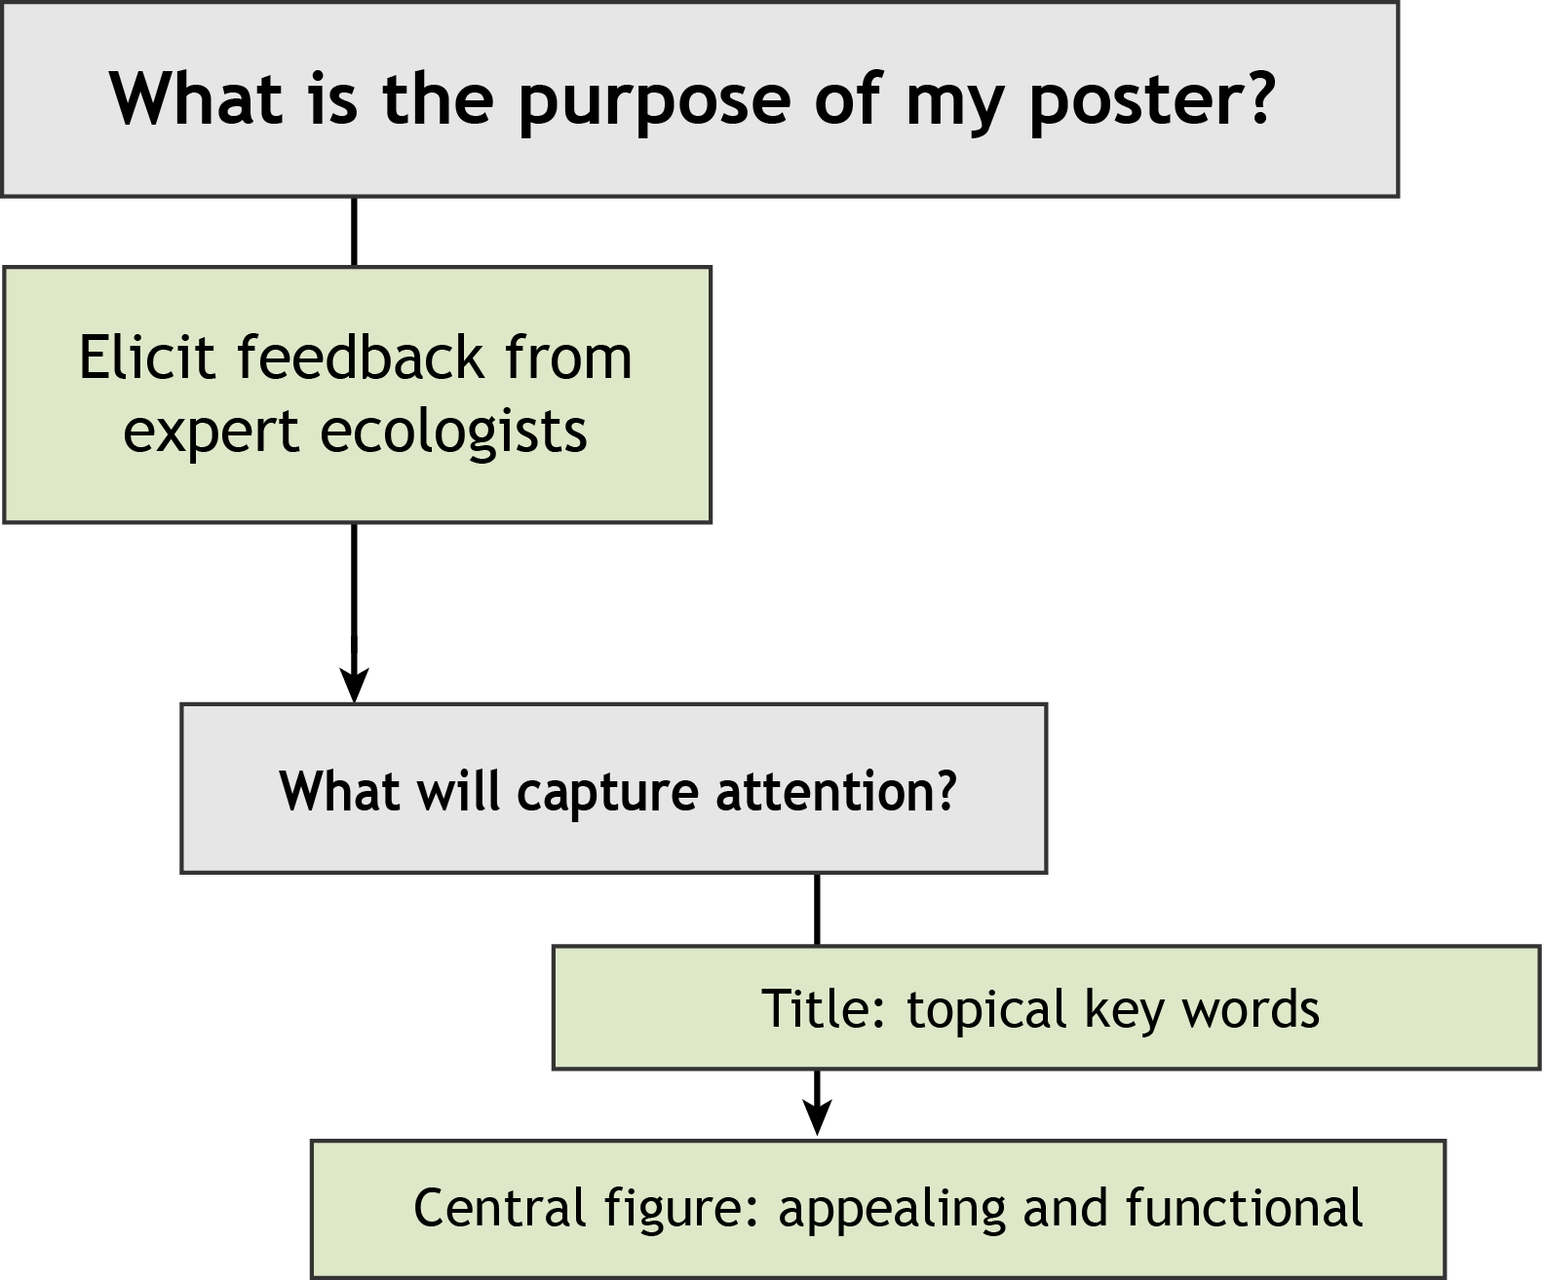
Make choices that increase appeal, clarity, and relevance

Slide 24
Make choices that increase appeal, clarity, and relevance
Notes:
Title and central figure rapidly convey take home message.
How to convey info in the other sections?

Slide 25
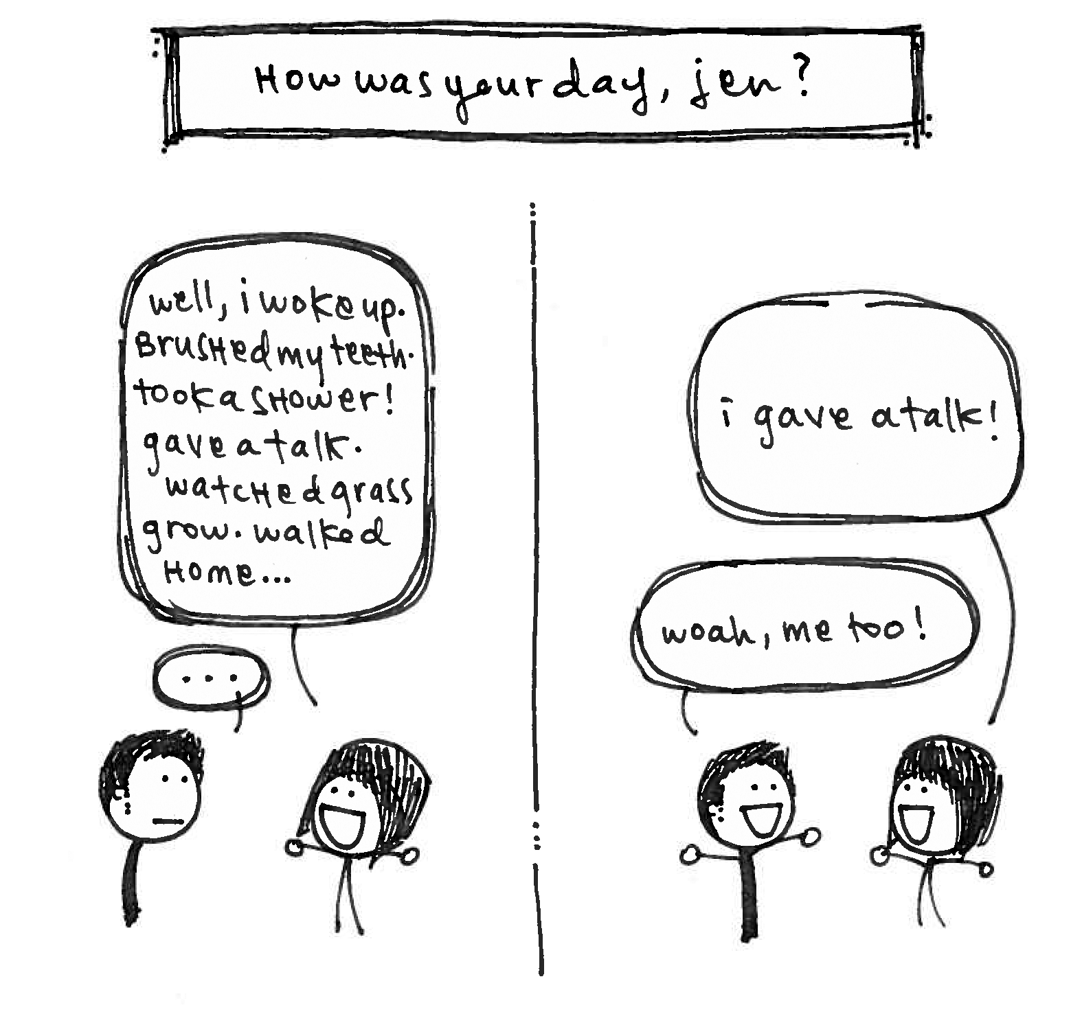
Identifying main points
Distinguish between critical and clutter

Slide 26
Identifying main points
Which points are critical for understanding my message?
Potential methods information:
- mimic fluctuations in natural environments
- use microfluidics to deliver nutrient pulses
- build devices are built by casting PDMS into molds
- quantify growth rate by imaging cells over time

Slide 27
Identifying main points
Which points are critical for understanding my message?
Critical information:
mimic fluctuations in natural environments
use microfluidics to deliver nutrient pulses
quantify growth rate by imaging cells over time
Clutter:
devices are built by casting PDMS into molds
What is critical vs. clutter depends on your audience!

Slide 28
Make choices that increase appeal, clarity, and relevance
Notes:
How will we represent our main points?

Slide 29
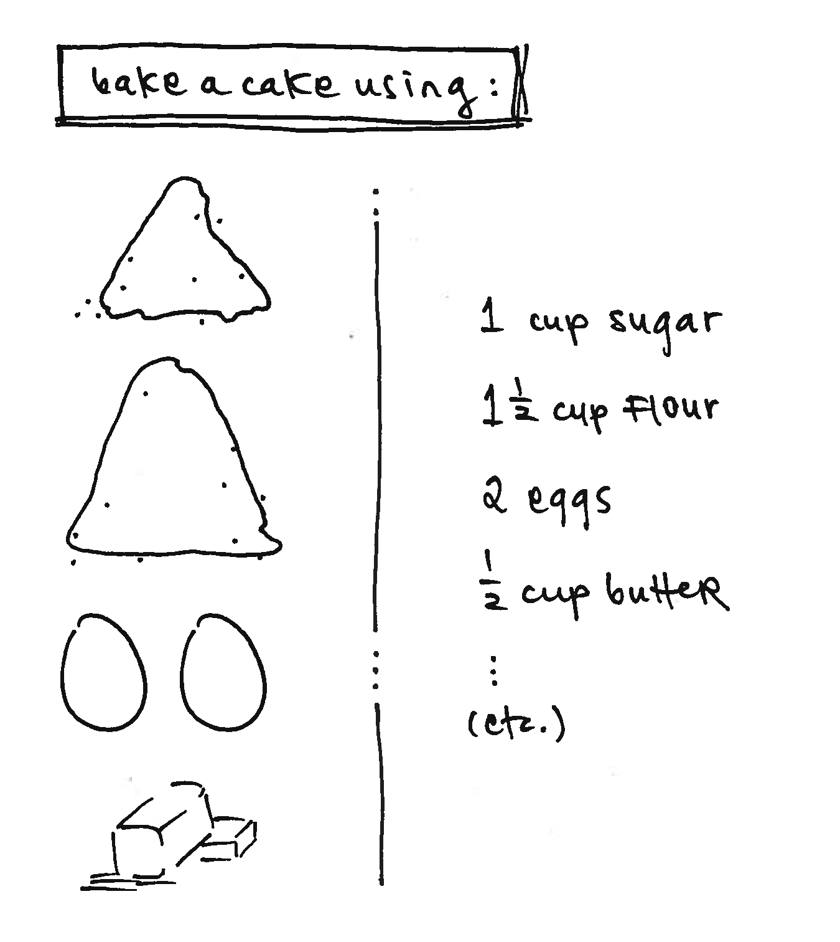
Text vs. graphics: when to choose what?
Notes:
Re-state point to convey
Explain process of how to convey: graphics vs. text

Slide 30
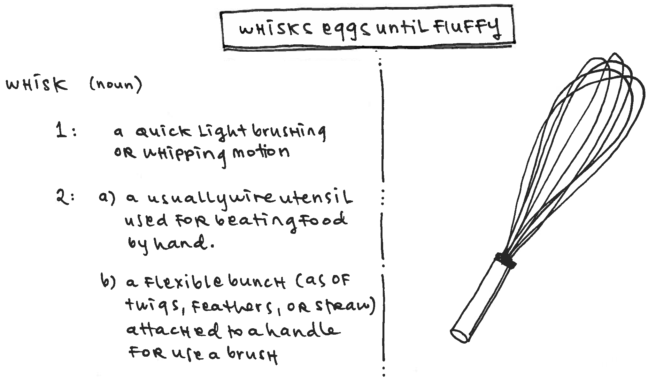
Text vs. graphics: when to choose what?
Notes:
Re-state point to convey
Explain process of how to convey: graphics vs. text

Slide 31
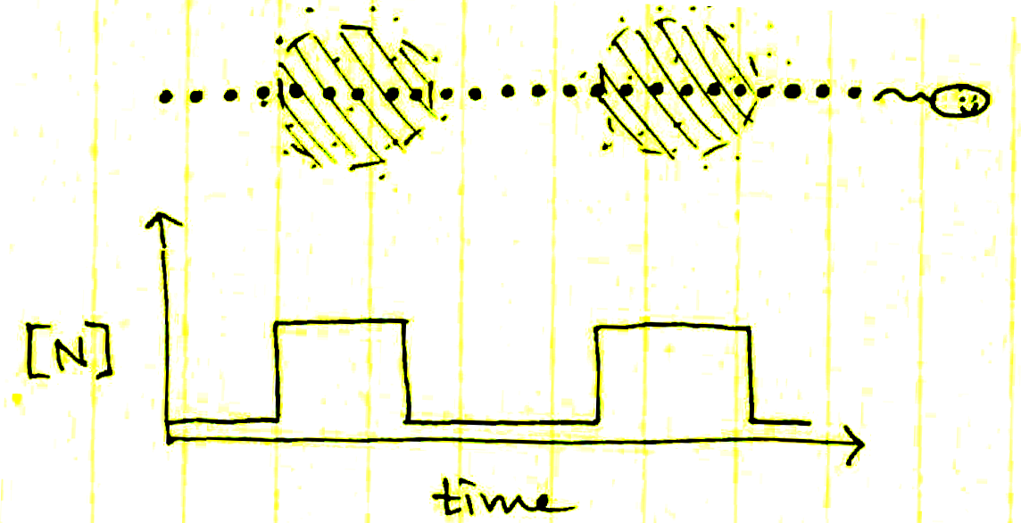
Text vs. graphics: specificity vs. adaptability
In aquatic environments, nutrient patches are short lived. Cells migrating through these patches experience quick nutrient pulses, which vary in concentration, longevity, and abundance.
Text locks your word choice.
Graphics have variable interpretations!
Notes:
Re-state point to convey
Explain process of how to convey: graphics vs. text

Slide 32
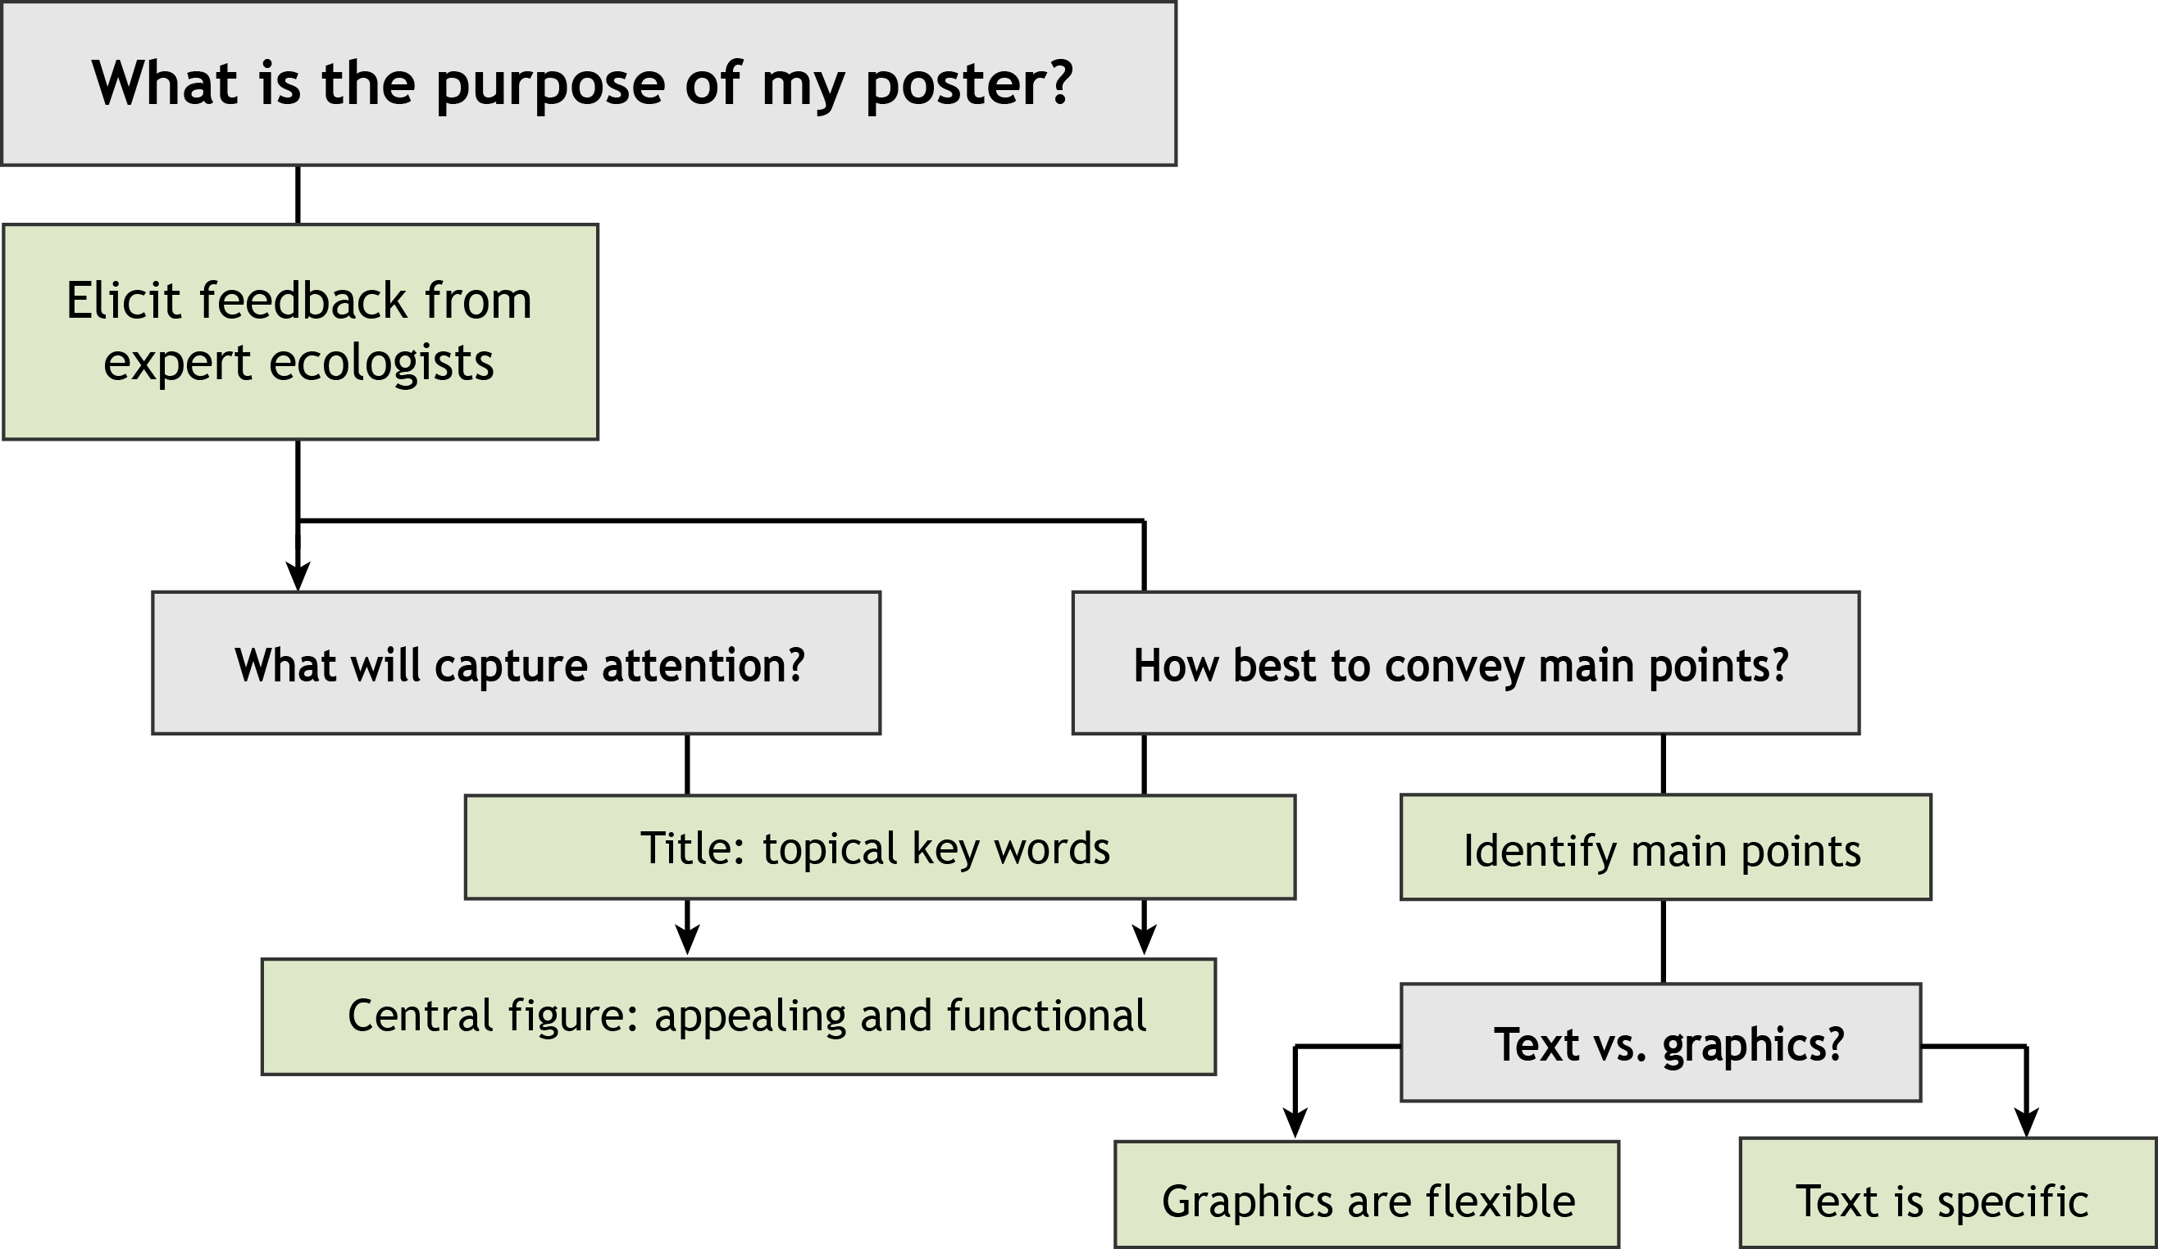
Make choices that increase appeal, clarity, and relevance
Notes:
Title and central figure rapidly convey take home message.
How to convey info in the other sections?

Slide 33
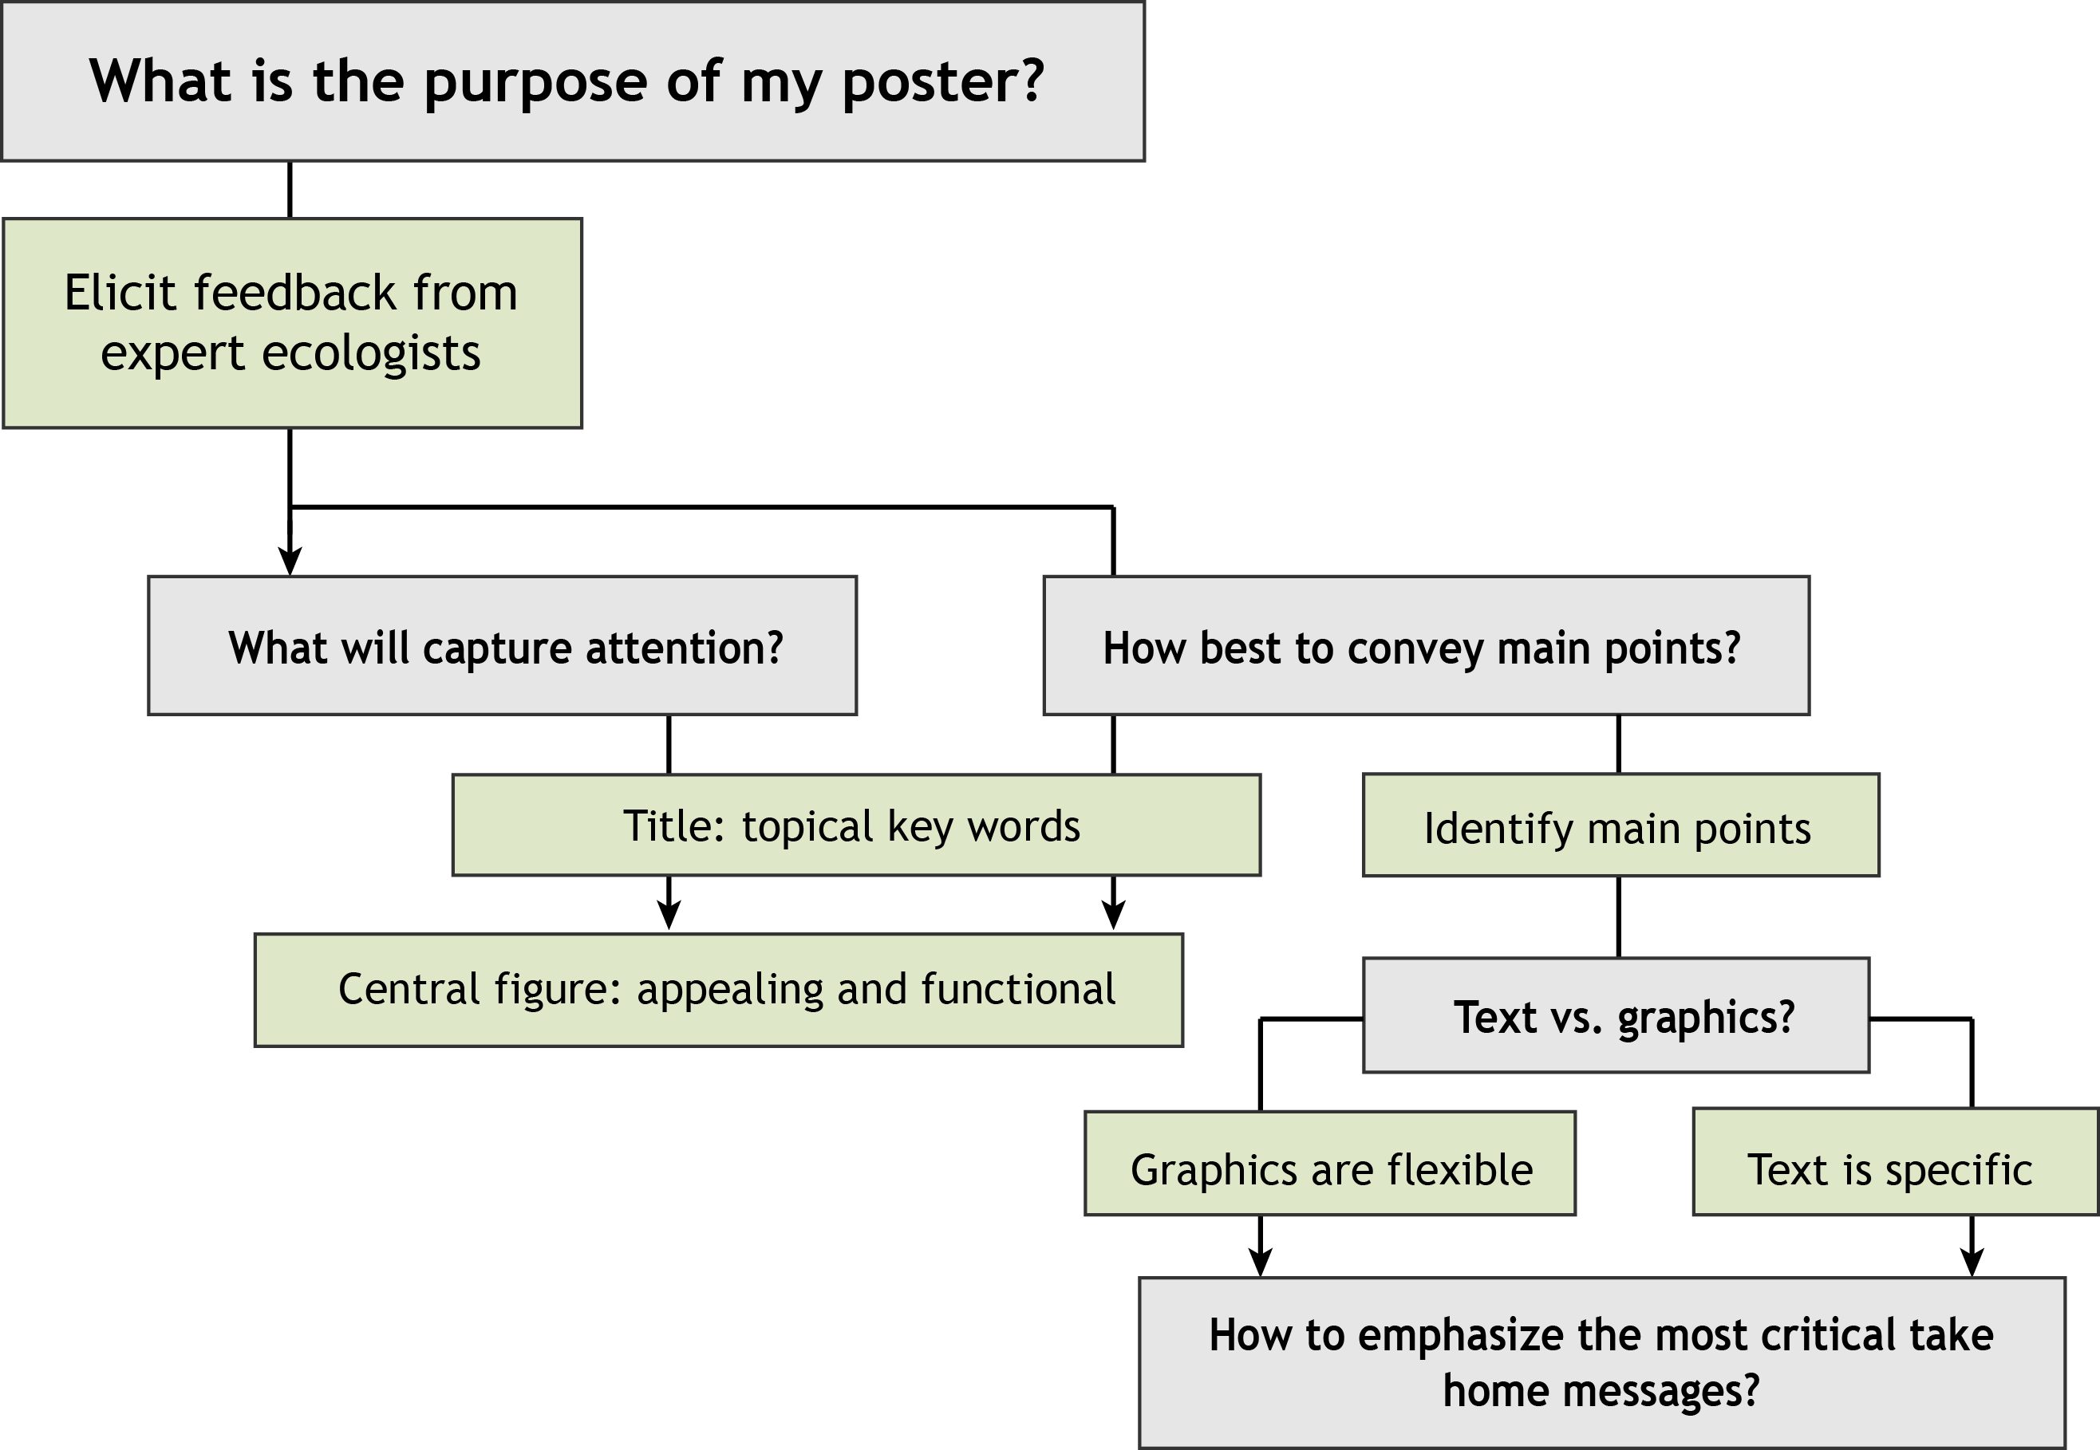
Make choices that increase appeal, clarity, and relevance
Notes:
Title and central figure rapidly convey take home message.
How to convey info in the other sections?

Slide 34
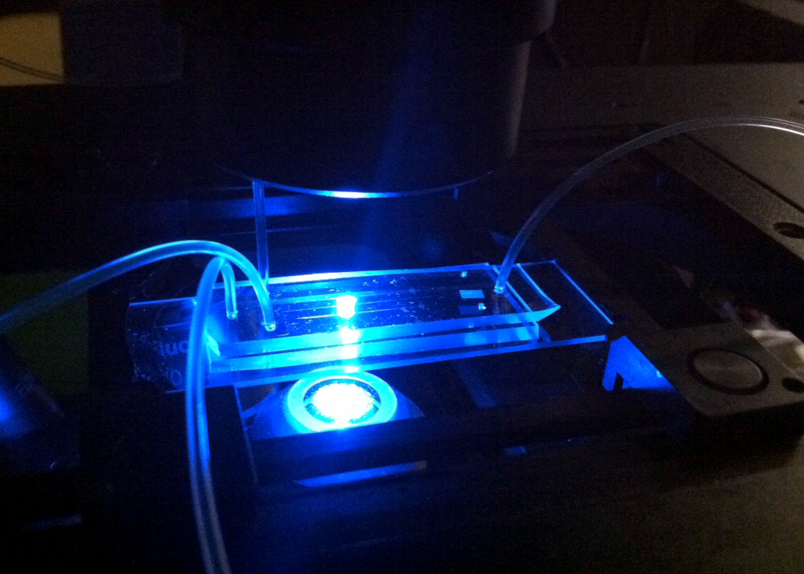
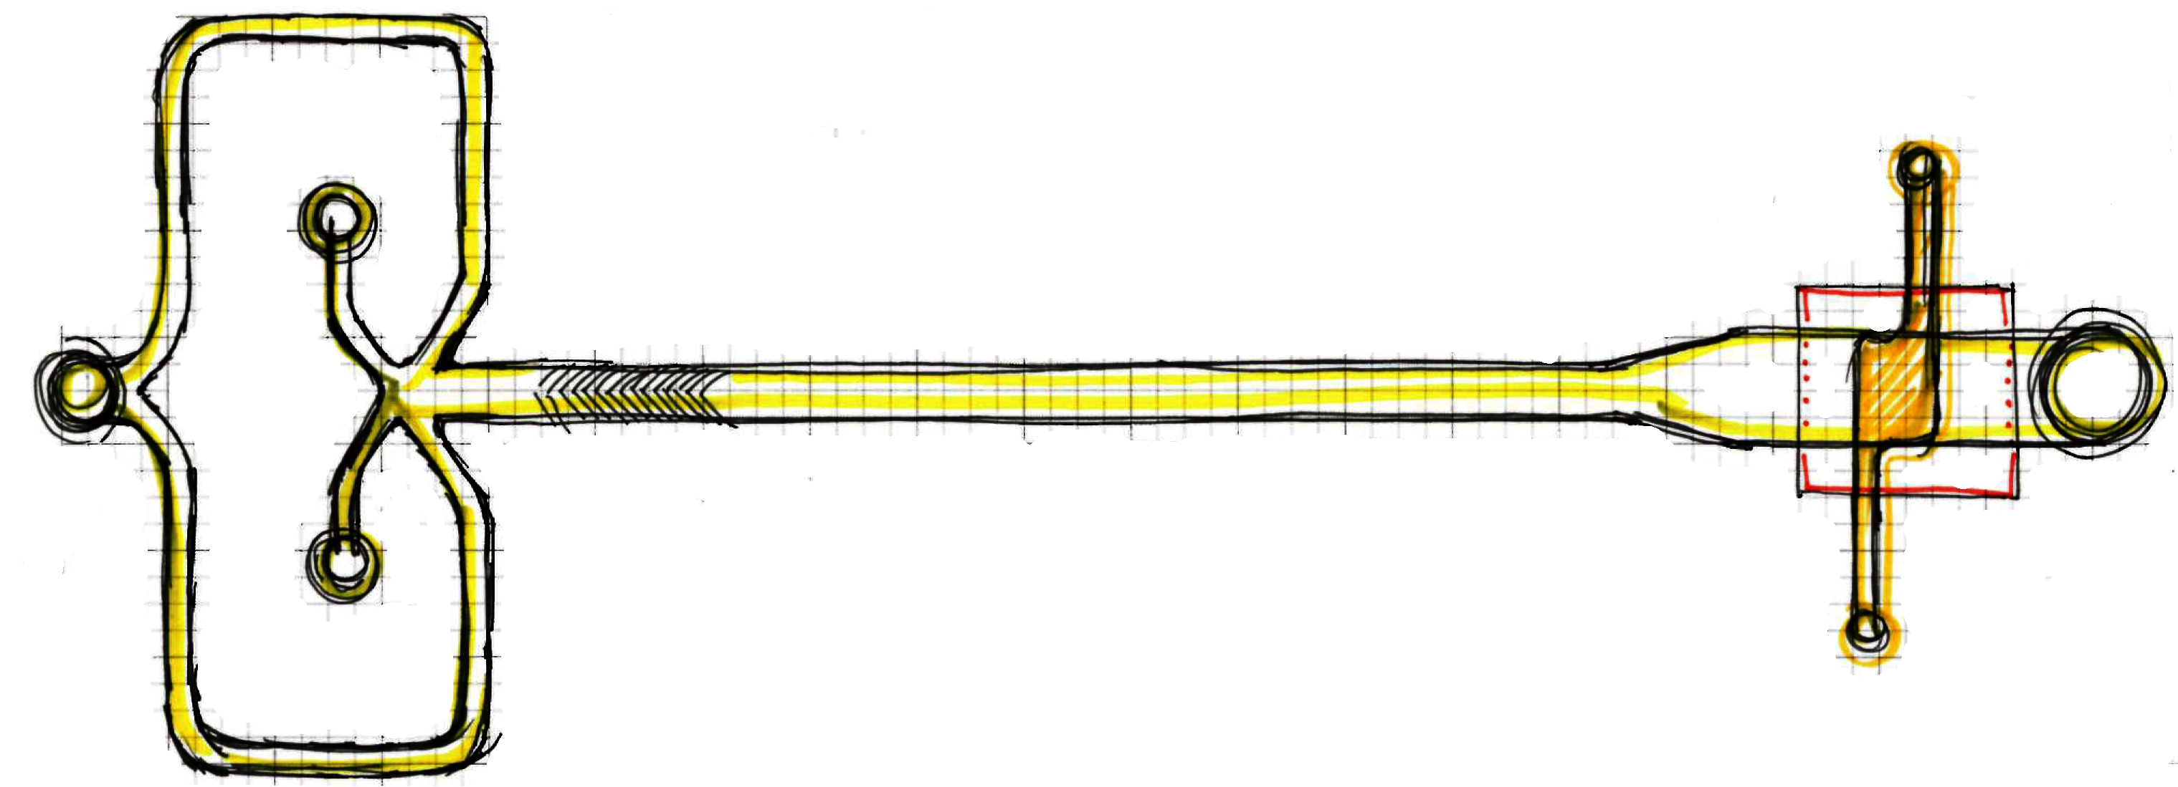
Optimize your ratio of signal-to-noise
Which image best conveys how the device functions?
Nutrient
Cells
Buffer
Notes:
Practice explanation and thought process

Slide 35
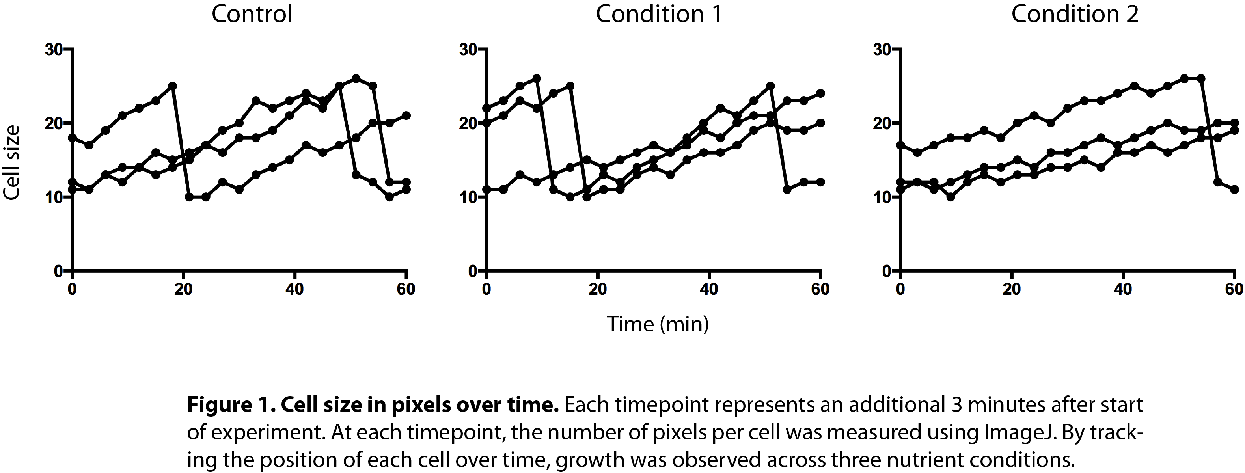
Data: another example of signal-to-noise
Notes:
Graphical representation

Slide 36
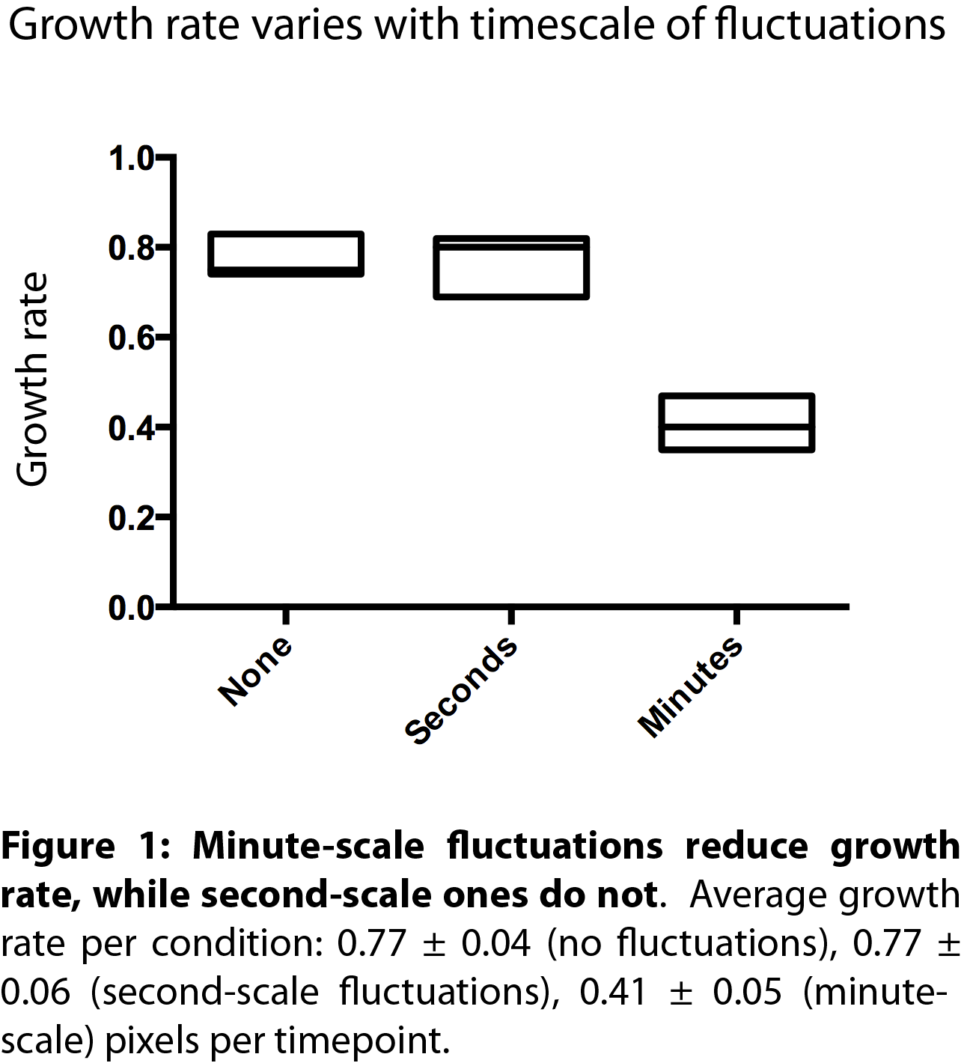
Data: another example of signal-to-noise
Visually appealing
Clearly states key finding
Interpretation highlights relevance

Slide 37
Contrasts: tools to direct attention
White space
Too frequently, posters contain several blocks of text. Who has the time to read it all? Don’t let your message get lost amidst it all.
Use white space to showcase key points.
Don’t make your audience work so hard just to understand you! Contrasts are a useful tool to attract attention to all the right places.
Font size
Bolding
Color
… can also enhance signal : noise!
Notes:
White space, bolding, font size

Slide 38
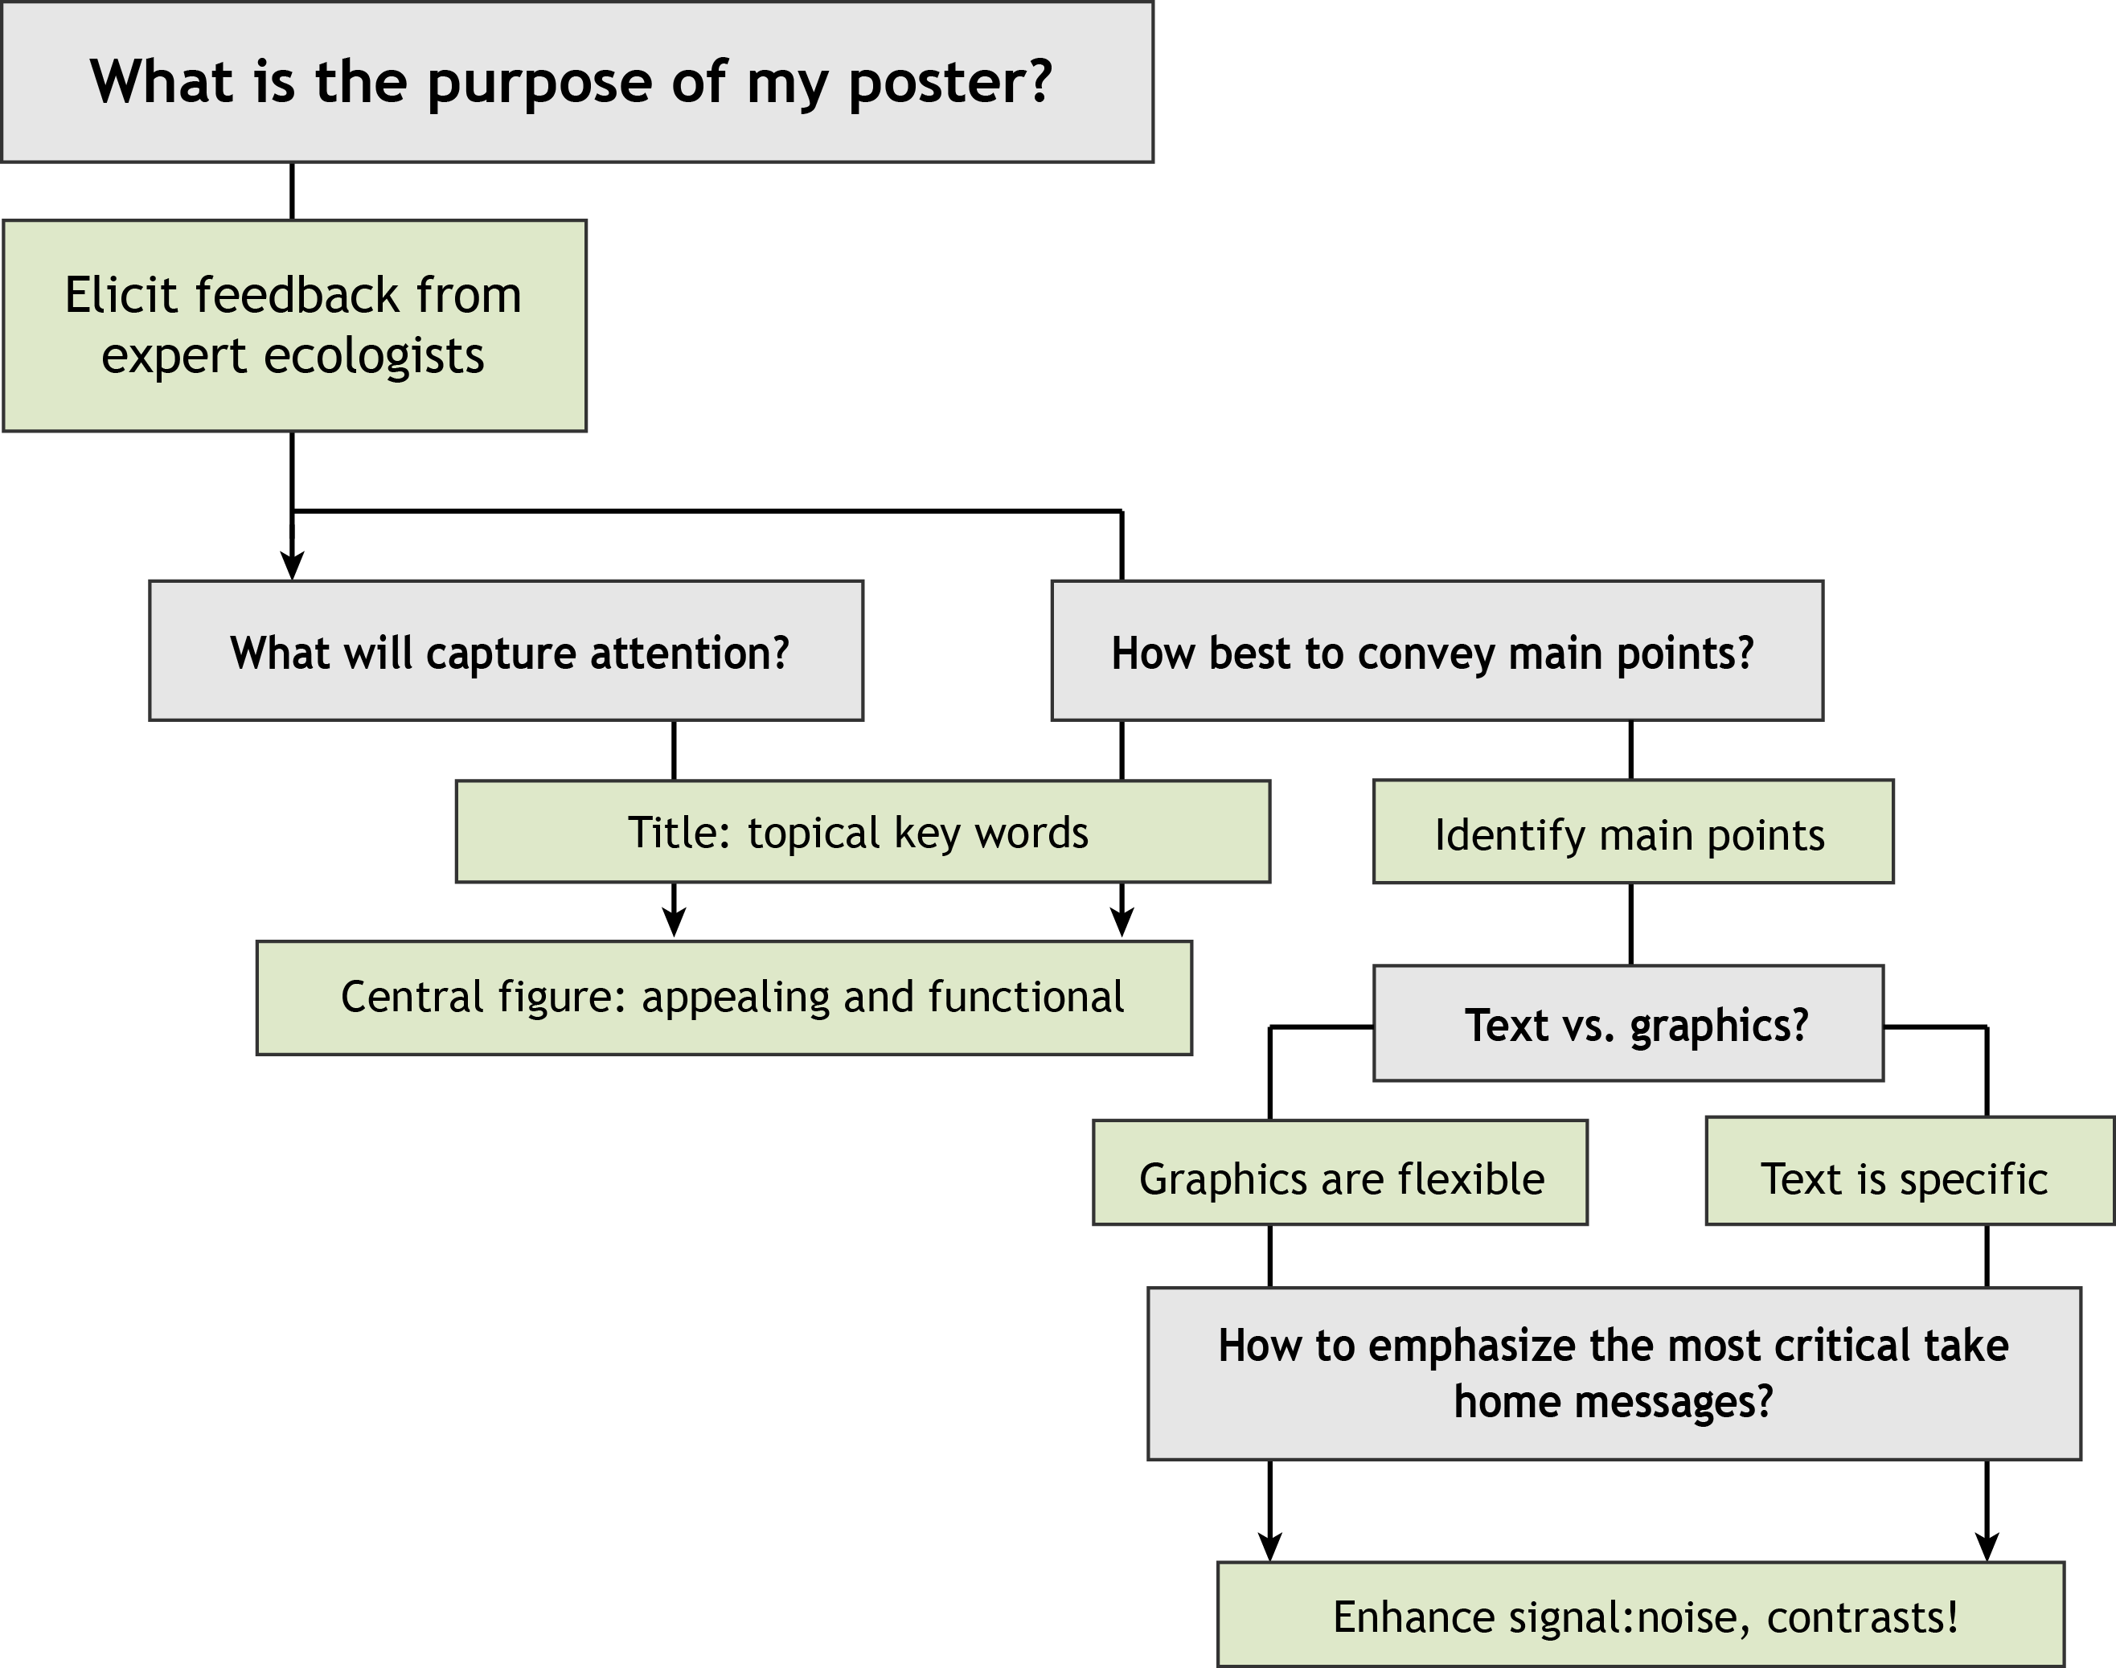
Make choices that increase appeal, clarity, and relevance
Notes:
Title and central figure rapidly convey take home message.
How to convey info in the other sections?

Slide 39
Finished poster!
Notes:
Scott’s a fellow, also went through this process → product of that

Slide 40
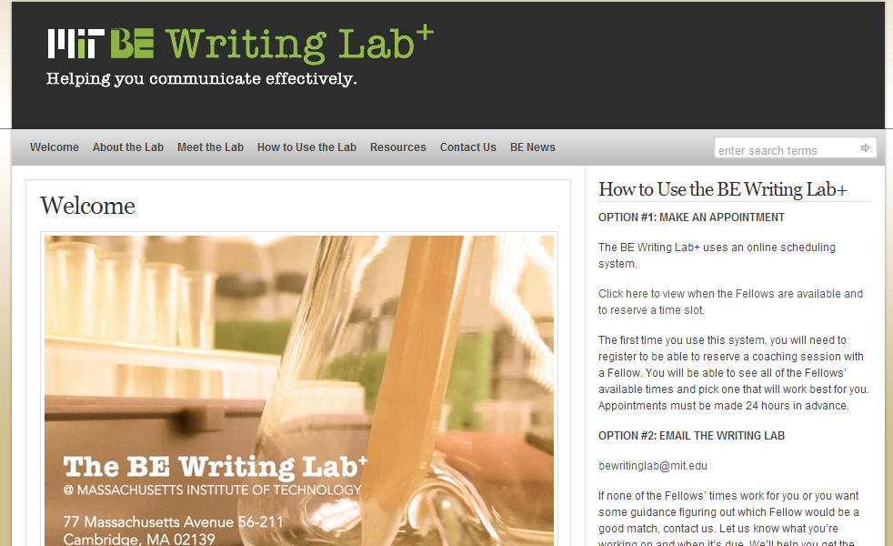
Come brainstorm with us!
We’re happy to help at any point in the process.
Notes:
Pull up website, describe immediate next steps (esp. with brainstorming)
----- Meeting Notes (7/2/14 19:05) -----
other examples of different posters?
example of bad poster at beginning?

