Slide 1
Trivial Pursuits
G
What sea separates Italy from Yugoslavia?
E
What word was intentionally omitted from the screenplay of The Godfather?
H
What play was Abraham Lincoln watching when he was assassinated?
What novel has the ghost of Catherine appearing to Mr. Lockwood?
AL
SN
What's a group of kittens called?
SL
What two Scrabble Crossword Game letters have eight-point values?

Slide 2
And the answers are …
G
What sea separates Italy from Yugoslavia?
The Adriatic
What word was intentionally omitted from the screenplay of The Godfather?
Mafia
E
H
What play was Abraham Lincoln watching when he was assassinated?
Our American Cousin
What novel has the ghost of Catherine appearing to Mr. Lockwood?
Wuthering Heights
AL
SN
What's a group of kittens called?
A kindle
SL
What two Scrabble Crossword Game letters have eight-point values?
J & X

Slide 3
2014 Year End Support Pack Project
SAPbiz
Update
November 19, 2014

Slide 4
Agenda
Quick Review of the Project Scope
Update on Project Risks
High Level Time Line (& where are we now?)
Testing
Important Dates Revisited
Next Steps

Slide 5
Project Scope Update
What are we updating?
  Let’s jump to the project wiki
    https://2014_SAP_Support_Packs

Slide 6
Project Risks
Identified Risks
  Delay in SAP Releases
  QC Upgrade
    Application has been upgraded during the summer
    This will be the first time a lot of folks will have been in the upgraded system
  Two Phase Testing Approach
    Requires tight coordination and resource availability between the Business & IS&T
    But … we have four years experience with this approach
  Resource availability for the project (both Business & IS&T)
  Delay of implementation of pre-Support Pack Projects
    OE (scheduled for October)
  Impacts from other requested updates
    Atlas 4.0
    Potential others
      GuiXT Upgrade

Slide 7
High Level Timeline
Now - October - Plan, convert/create/update test scripts in QC, move pending support & project work into production
10/9/2014 – SAP release of year end base level support pack
10/20/2014 - End of day production snapshot to be used to refresh test environments
10/20/2014 - Development Freeze begins
10/28/2014 - Last date to implement support & enhancement changes until freeze ends on 12/10/2014
10/24/2014 - 10/31/2014 Unit test
11/3/2014 - 11/26/2014 System Integration Test
12/5/2014 - 12/7/2014 Go-live weekend!
12/10/2014 - Development Freeze ends

Slide 8
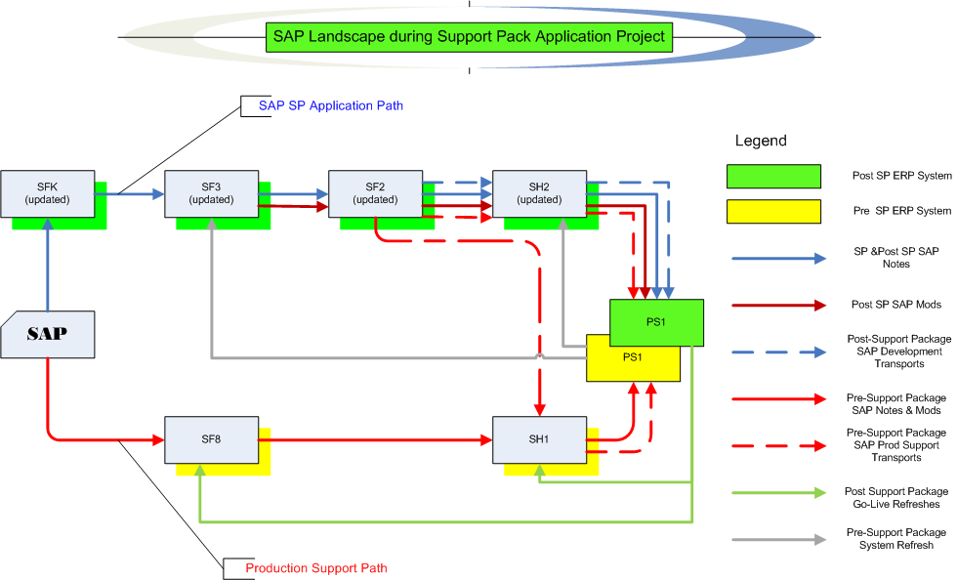
Where are we now?
Project Landscape

Slide 9
Testing Timeline Details
  Let’s look at the Plans and Schedule on the wiki …
  https://2014_SAP_Support_Packs

Slide 10
Where are we now? Test execution
Test Status
  Let’s look at the Test Plan page on the wiki …
  https://2014_SAP_Support_Packs
    Some testing details …
  Quality Center (QC)

Slide 11
Testing Recap
(continued)
  If I find an issue during testing how do I report it?
  - let’s go back to the wiki …
  https://2014_SAP_Support_Packs

Slide 12
Issues
Is it worth it?
Well, yes …
  We can jump to RT for details: https://help.mit.edu/
Phases Issues were identified in …
(as of 11/16/14)
Issue type | Unit | SIT |  | Open
Required an SAP fix | 6 | 12 |  | 6
Required an MIT fix | 8 | 12 |  | 7
Infrastructure Related | 1 | 9 |  | 3
User/Data Error | 0 | 1
Duplicate | 0 | 0
Production Issue - to be addressed after SP | 0 | 2
Totals | 15 | 36 | 51 | 16

Slide 13
Important Dates Revisited
Now - October - Plan, convert/create/update test scripts in QC, move pending support & project work into production
10/9/2014 – SAP release of year end base level support pack
10/20/2014 - End of day production snapshot to be used to refresh test environments
10/20/2014 - Development Freeze begins
10/28/2014 - Last date to implement support & enhancement changes until freeze ends on 12/10/2014
10/24/2014 - 10/31/2014 Unit test
11/3/2014 - 11/26/2014 System Integration Test
12/5/2014 - 12/7/2014 Go-live weekend!
12/10/2014 - Development Freeze ends

Slide 14
Next Steps
Now - 11/21/2014 Complete SI/UA Testing (Business & IS&T)
11/24/2014 - 11/26/2014 Retest of any outstanding issue resolutions
Prepare go-live (All) – identify go-live validations/validators
12/3/2014 – SAPbiz (Review cut-over plan)
12/5/2014 (after 5pm) - 12/7/2014 Go-live weekend!

Slide 15
Not-soTrivial Pursuits
G
What environment are we testing in?
E
When should we have our testing complete?
H
How do I a report an issue?
Where can I find project related information?
AL
SN
What’s our completion rate so far?
SL
When is go-live weekend?

Slide 16
Questions?
Any additional questions? Please contact:
Frank Quern Bart Dahlstrom
X2-4512 x3-9605
fquern@mit.edu bartd@mit.edu
OR
Your SAP testing team coordinator:
HR-Payroll (HRP): Mary Donovan
Financial-Logistics-EHS (FLE): Lee Collier

Slide 17
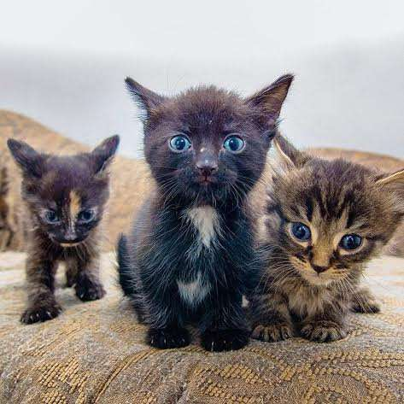
Support Packs are Coming!
Support Packs are Coming!
(a kindle …)
We’re ready (aren’t we?)

