Slide 1
Trivial Pursuits
G
What’s the capital of Morocco?
E
Who wrote White Christmas?
H
What gangster’s business card read: “Second hand furniture dealer”?
What do the English call a garbage man?
AL
SN
Do beavers eat fish?
SL
How high is the center of a tennis net?

Slide 2
And the answers are …
G
What’s the capital of Morocco?
Rabat
Who wrote White Christmas?
Irving Berlin
E
H
What gangster’s business card read: “Second hand furniture dealer”?
Al Capone’s
What do the English call a garbage man?
A dustman
AL
SN
Do beavers eat fish?
No
SL
How high is the center of a tennis net?
Three feet

Slide 3
2014 Year End Support Pack Project
SAPbiz Update
(cutover)
December 3, 2014

Slide 4
Agenda
High Level Time Line (& where are we now?)
Testing
Issues
Cutover Plan
Next Steps

Slide 5
High Level Timeline
Now - October - Plan, convert/create/update test scripts in QC, move pending support & project work into production
10/9/2014 – SAP release of year end base level support pack
10/20/2014 - End of day production snapshot to be used to refresh test environments
10/20/2014 - Development Freeze begins
10/28/2014 - Last date to implement support & enhancement changes until freeze ends on 12/10/2014
10/24/2014 - 10/31/2014 Unit test
11/3/2014 - 11/26/2014 System Integration Test
12/5/2014 - 12/7/2014 Go-live weekend!
12/10/2014 - Development Freeze ends

Slide 6
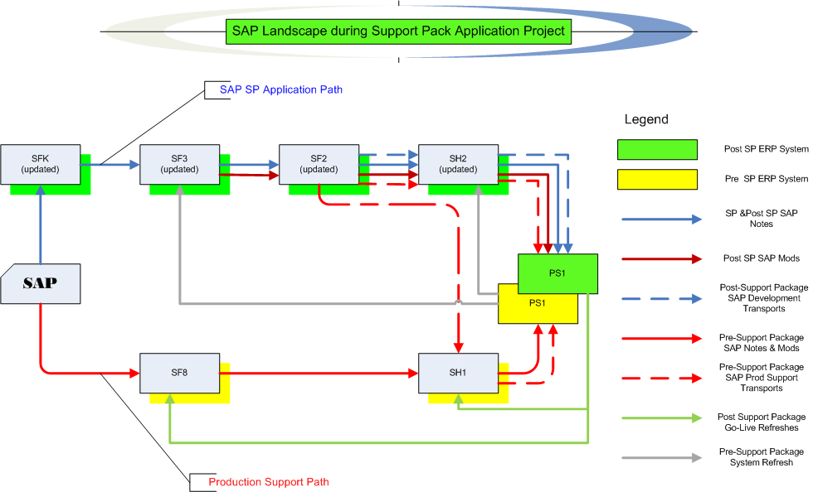
Where are we now?
Project Landscape

Slide 7
Where are we now? Test execution
Test Status
  Let’s look at the Test Plan page on the wiki …
  https://2014_SAP_Support_Packs
    Some testing details …
  Quality Center (QC)

Slide 8
Issues
Is it worth it?
Well, yes …
  We can jump to RT for details: https://help.mit.edu/
Phases Issues were identified in …
(as of 12/1/14)
Issue type | Unit | SIT |  | Open
Required an SAP fix | 6 | 16 |  | 2
Required an MIT fix | 8 | 13 |  | 1
Infrastructure Related | 1 | 10
User/Data Error | 0 | 2
Duplicate | 0 | 0
Production Issue - to be addressed after SP | 0 | 2
Totals | 15 | 43 | 58 | 3

Slide 9
Issues (cont.)
How does it compare to prior years?
 | 2010 | 2011 | 2012 | 2013 | 2014
Issues | 64 | 41 | 54 | 86 | 58
SAP fix required | 3 | 8 | 9 | 23 | 22
MIT fix required | 23 | 17 | 17 | 19 | 21
Total fixes required | 26 | 25 | 26 | 42 | 43

Slide 10
Next Steps
12/3/2014 SAPbiz (2:00pm)
12/5/2014 (5:00pm) - 12/7/2014 Go-live weekend!
Meaning … we’ll have to execute a cutover plan!!

Slide 11
Cutover
Preparation work
System Isolation
Support Pack Application
Post Upgrade Processes (conversions, validations)
Go-live
  Let’s jump to the project wiki’s Cutover Plan page and take a look at the plan …

Slide 12
Not-soTrivial Pursuits
G
How can I find out the status of the cutover?
Call this number 617-324-7468
E
Who performs the validations?
Assigned business personnel as defined in the cutover plan.
H
When will the SAP system be brought down?
5:00 PM Friday 12/5/2014
Where can I find the cutover plan?
On the project wiki
AL
SN
What are we updating?
The SAP ERP System (including Portal & ADS)
SL
When is go-live weekend?
12/5 (5:00pm) -12/7/2014

Slide 13
Questions?
Any additional questions? Please contact:
Frank Quern Bart Dahlstrom
X2-4512 x3-9605
fquern@mit.edu bartd@mit.edu
OR
Your SAP testing team coordinator:
HR-Payroll (HRP): Mary Donovan
Financial-Logistics-EHS (FLE): Lee Collier

Slide 14

Support Packs are Coming!
Support Packs are Coming!
We’re ready (are you?)

