Slide 1
2015 SAP HANA Migration
H2O
(Year End Support Packs)
SAPbiz
Kickoff
August 13, 2015

Slide 2
Agenda
Project Overview
Project Organization
System Landscape
Support Packs
Important Dates
Next Steps

Slide 3
H2O - Project Overview
The H2O project is an enabling project that will move our core ERP to a next generation cloud platform. This migration will support/provide:
    Future cloud integrations with best in class software providers
    Bi-coastal disaster recovery
    Real time queries for all ECC reporting needs
    The ability to move to simple finance and logistics in the future
    Mobile first development with built in integration and security capability
The H2O project plan aims to use the support pack regression testing window:
    In order to minimize the impact of the migration on the business
    Ensure the timely delivery of dependent enterprise projects (Coupa, Work Manager & e-Builder)

Slide 4
H2O - Project Overview (cont’d)
Why are we doing this?
  A continuation of our commitment to keep MIT’s SAP investment current and sustainable
  Introduces tools that can quickly build, extend, and integrate modern, mobile-enabled applications
  Provides a unique in memory database
  Aligns with MIT’s Platform as a Service Initiative

Slide 5
H2O - Project Overview (cont’d)
Why are we doing this?
  Reduction in ERP systems from 10 to 4
  Database (oracle) size before migration 1.5 TB -> Database (HANA) size after migration 800 GB

Slide 6
H2O - Governance Model
Executive Sponsorship
John Charles, VP IS&T, MIT
Marianne Heer, Sr. VP SAP America
Level 1
  Quarterly Meetings
Program Steering Committee
MIT Sponsor/Senior Leadership
SAP Account Management
Level 2
  Monthly Meetings
Level 3
H2O
MIT/SAP
  Weekly Meetings
Level 4
  Daily Task Progress
Atlas
HCM
FLE
Basis
Reporting Discovery
MIT & SAP Leads
MIT & SAP Leads
MIT & SAP Leads
MIT & SAP Leads
MIT & SAP Leads
Project Teams
Business Analysts, SMEs, Testing, Integration, Data Migration

Slide 7
H2O - Steering Committee
Organization | Name | Position | Representing
MIT | Mark Silis | Associate VP of IS&T | MIT Project Sponsor
MIT | Eamon Kearns | Sr Director Emerging Solutions | MIT Project Sponsor
MIT | Siobhan Cunningham | Enterprise Architect | MIT Program Management
MIT | Olu Brown | Data Science Director | MIT Program Management
MIT | Garry Zacheiss | Director Sys Optimization & Int Solutions | MIT Technical Architecture
MIT | Faith Hill | Manager Data Warehouse, BI & Reporting | MIT Program Management
MIT | Wayne Turner | Senior Director Operations | Human Resources Department
MIT | Gilles Simler | Senior BI Solutions Analyst | Vice President Finance Office
MIT | Michael Parkin | Director IT, Campus Construction | Department of Facilities
SAP | Chris Holness | Delivery Executive | SAP Program Management
SAP | Mike Marsh | Account Executive | SAP Account Management
SAP | John Solms | Client Partner | SAP Services
SAP | Frank Ciannella | HANA Ambassador | HANA Ambassador

Slide 8
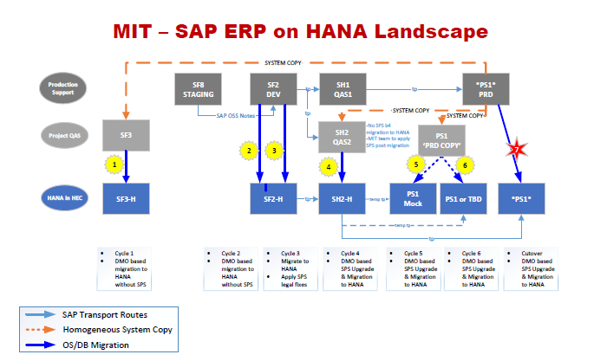
H2O - Overview Landscape

Slide 9
H2O - Timeline
July | August | September | October | November | December
Project Start 7/6/2015
Project End 12/18/2015
Project Prep & Kickoff 7/6/15 - 7/17/15
Cycle 1 - Copy from PS1 to SF3; Migrate SF3 to HEC 7/6/15 – 9/4/15
POC Decision for December 9/8/15
Cycle 2 – Migrate SF2 to HEC 8/3/15 – 9/24/15
SP on HEC for December? 10/2/15
Cycle 4 – QA Cutover to HEC 10/12/15 to 11/20/15
Cycle 5 – PRD Mock Cutover 11/2/15 to 11/20/15
Cycle 6 – PRD Dress Rehearsal Cutover 11/30/15 to 12/6/15
Cycle 7 – PRD Cutover 12/7/15 to 12/13/15
Go-Live 12/14/15
Production Support 12/7/15 to 12/18/15

Slide 10
H2O - Important Dates
8/3 – Functional testing on SF3 in HEC for 3 weeks
8/24 – Fully-integrated testing on SF2 in HEC for 3 weeks
9/10 – Proof of concept phase (cycles 1 and 2) complete
          decision to move forward with a HANA Go-Live Goal of December
10/2 – Decision on platform for support pack go live in December
          HANA in HEC or Support pack on premise with HANA in HEC on a date TBD
12/14 – Go Live

Slide 11
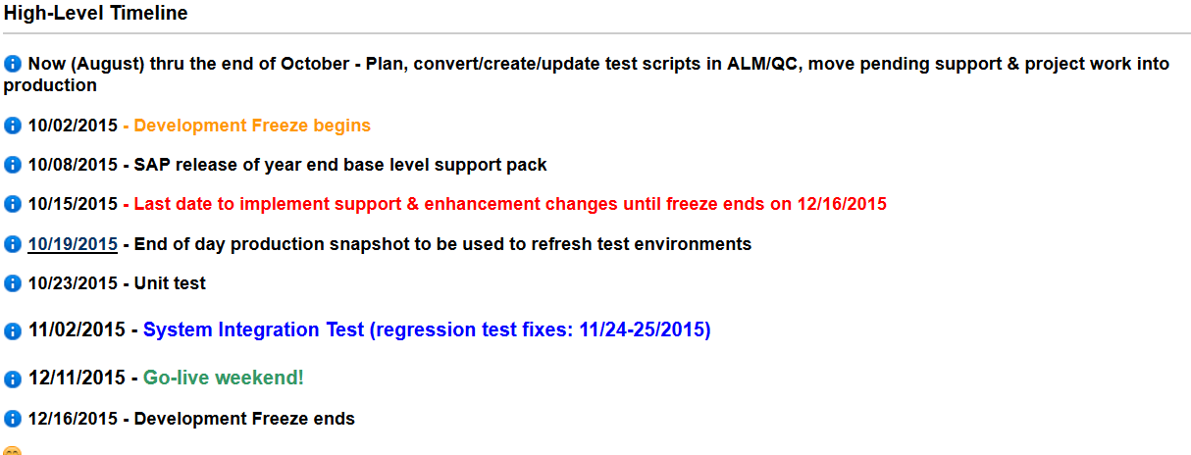
Support Packs

Slide 12
Support Packs
Communication
  Project Kickoff Meetings
    Steering Committee
    IS&T – Core Team & Extended Team
    SAPbiz – mid September
  Weekly Meetings
    Core Team
    Test Coordination - Business & IS&T Project Teams
  Email lists
  Project wiki
    https://wikis.mit.edu/confluence/pages/viewpage.action?pageId=109837297
    Contains project plans, general information, etc …; great source – use it!
    Don’t have access please contact Bob Casey (rcasey@mit.edu) or Frank Quern (fquern@mit.edu)

Slide 13
Support Pack Planning
Lets jump to the project wiki …
to look at the Project Scope
to look at the Schedule
to look at the Cut-over Plan Draft
https://wikis.mit.edu/confluence/pages/viewpage.action?pageId=109837297

Slide 14
Important Dates
8/03/2015 – Functional testing on SF3 in HEC for 3 weeks
8/24/2015 – Fully-integrated testing on SF2 in HEC for 3 weeks
9/10/2015 – Proof of concept phase (cycles 1 and 2) complete
        decision to move forward with a HANA Go-Live Goal of December
10/02/2015 – Decision on platform for support pack go live in December
        HANA in HEC or Support pack on premise with HANA in HEC on a date TBD
      10/02/2015 - Development Freeze begins
      10/15/2015 - Last date to implement support & enhancement changes until freeze ends on 12/16/2015
      10/23/2015 - Unit test
      11/02/2015 - System Integration Test
12/11/2015 - 12/13/2015 Go-live weekend!

Slide 15
Next Steps
  Completion of H2O POC Cycles 1 & 2
  Support Pack Kick Off - September
  Support Pack Planning - October

Slide 16

Where can I get project information? Ah …

Slide 17
Questions?
Any additional questions? Please contact:
Contact | Email | Phone extension
Bob Casey | rcasey@mit.edu | x3-1844
Siobhan Cunningham | snc@mit.edu | x5-4596
Kevin Lyons | klyons@mit.edu | x8-6483
Ron Parker | rep@mit.edu | x3-1339
Frank Quern | fquern@mit.edu | x2-4512

