Slide 1
2015 SAP HANA Migration
H2O
(Year End Support Packs)
Update
September 16, 2015

Slide 2
Agenda
Project Overview
Project Update
Support Packs
Important Dates
Next Steps

Slide 3
H2O - Project Overview
The H2O project is an enabling project that will move our core ERP to a next generation cloud platform. This migration will support/provide:
    Future cloud integrations with best in class software providers
    Bi-coastal disaster recovery
    Real time queries for all ECC reporting needs
    The ability to move to simple finance and logistics in the future
    Mobile first development with built in integration and security capability
Why are we doing this?
    A continuation of our commitment to keep MIT’s SAP investment current and sustainable
    Introduces tools that can quickly build, extend, and integrate modern, mobile-enabled applications
    Provides a unique in memory database
    Aligns with MIT’s Platform as a Service Initiative

Slide 4
H2O - Governance Model
Executive Sponsorship
John Charles, VP IS&T, MIT
Marianne Heer, Sr. VP SAP America
Level 1
  Quarterly Meetings
Program Steering Committee
MIT Sponsor/Senior Leadership
SAP Account Management
Level 2
  Monthly Meetings
Level 3
H2O
MIT/SAP
  Weekly Meetings
Level 4
  Daily Task Progress
Atlas
HCM
FLE
Basis
Reporting Discovery
MIT & SAP Leads
MIT & SAP Leads
MIT & SAP Leads
MIT & SAP Leads
MIT & SAP Leads
Project Teams
Business Analysts, SMEs, Testing, Integration, Data Migration

Slide 5
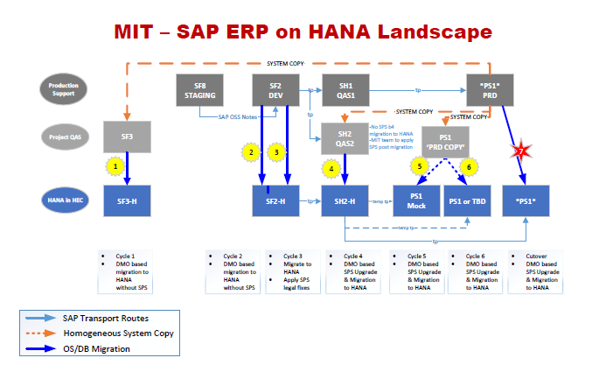
H2O - Overview Landscape

Slide 6
H2O - Timeline
Project Start 7/6/2015
Project End 12/18/2015
July | August | September | October | November | December
Project Prep & Kickoff 7/6/15 - 7/17/15
Cycle 1 - Copy from PS1 to SF3; Migrate SF3 to HEC 7/6/15 – 9/4/15
POC Decision for December 9/8/15
Cycle 2 – Migrate SF2 to HEC 8/3/15 – 9/24/15
SP on HEC for December? 10/2/15
Cycle 4 – QA Cutover to HEC 10/12/15 to 11/20/15
Cycle 5 – PRD Mock Cutover 11/2/15 to 11/20/15
Cycle 6 – PRD Dress Rehearsal Cutover 11/30/15 to 12/6/15
Cycle 7 – PRD Cutover 12/7/15 to 12/13/15
Go-Live 12/14/15
Production Support 12/7/15 to 12/18/15

Slide 7
Cycle 1 approach
We assigned 4 scrum teams the responsibility of developing and executing Cycle 1.
    Infrastructure buildout and configuration management.
    Human Resources, Payroll, and E-Learning.
    Finance, Logistics, Plant Maintenance, and EHS.
    Atlas and other web applications.
Each team determined a comprehensive approach, based on past experience managing the SAP year-end support pack process and similar large-scale application updates, to ensure the integrity of all critical applications as well as testing all integration methodologies in use across our system.
Specific areas of attention during the validation process include:
    Integration with MIT Kerberos for GSSAPI authentication.
    Customized B2B solution enabling secure file transfers into and out of SAP (“SAP Dropbox”)
    Integration with MIT printing and network infrastructure.
    Porting of MIT-specific notification mechanisms to ensure seamless e-mail and fax functionality.
    Implementing MIT ERP and SAP ancillary components in the cloud while minimizing the need for ABAP code changes.

Slide 8
Cycle 1 Testing Results – SF3 POC
System | Owner | Status
DataWarehouse | Ron/Elena | Delivered
ATLAS JCO applications | Dudley | Delivered
GUIXT | Lee/Sharon | Delivered
SAP Gui Logon | Sarah Q | Delivered
MITID | Ron | Delivered
FaxServer | Ron | Delivered
ADS | Qian | Delivered
RolesDB | George | in progress
EDI/XML outbound | Elda/Ron | in progress
SAP Dropbox | Ron/Qian | Delivered
Archive Server | Ron/Qian | Delivered
BSI (both SF3 and SF2) | Ron | in progress
OpenText | Ron/Garry | in progress
Apiserver/Mendix | Qian | in progress
Bank of America - Bottomline IP addresses | Bob Casey | in progress
Bank of America - Pcard transactions | Bob Casey | in progress
SciQuest | Elda | Delivered
Concur | Ron/Qian | SF2

Slide 9
Project Status
SF3: Proof of Concept Environment
    GUI, GUIXT, ITS, WDA and ATLAS testing is complete and successful, including integration with MIT authentication systems (Touchstone and Kerberos).
    Successful testing of data transfers / integration with MIT Data Warehouse.
    All tests are documented and will be replicated or expanded for testing in additional HANA environments.
    Operational documentation started and will be maintained on the SAP JAM site in order to support handoffs between MIT and SAP, i.e. provisioning of future HEC environments with MIT customizations.
SF2: Development Environment:
    Provisioned, began GUI testing on September 10th
    We are expecting to have completed full integration testing by Sept 25th
      This is dependent on completing testing of all integration solutions in SF3
      SF2 tests will include Concur, ATLAS JV, & SciQuest outbound which couldn’t be tested in SF3
    Full cookbook version 1 is a deliverable of this cycle.

Slide 10
Project Going Forward
The decision to continue our HANA / HEC migration process has been approved.
Our criteria for recommending migrating the production environment to this environment will be based on:
Successful migration of MIT’s non-production SAP data to HEC-hosted environments.
Validation of all critical SAP transactions / reports, including weekly and monthly payroll processing, summary statement, etc.
Successful integration of HEC-hosted SAP environments with MIT’s infrastructure: authentication (Kerberos, Touchstone) and authorization (Roles).
Success integration of HEC-hosted SAP environments with ancillary business systems: SAP Dropbox, CUPS printing, Data Warehouse, etc.
Disaster recovery for all existing SAP solutions (ECC, GRC, Solution Manager) and ancillary systems (SAP Dropbox, OpenText) designed and expected to be available by 11/2015.

Slide 11
H2O - Important Dates
8/3 – Functional testing on SF3 in HEC for 3 weeks (+)
9/10 – Proof of concept phase (cycle 1 complete)
          decision to move forward with a HANA migration
9/10 – Fully-integrated testing on SF2 in HEC for 3 weeks (in process)
10/2 – Decision on platform for support pack go live in December
          HANA in HEC or Support pack on premise (with HANA in HEC on a date TBD)
12/14 – Go Live

Slide 12
H2O & Support Packs
Where H2O intersects with Support Packs …
10/2 – Decision on which platform will be used for a December go live with support packs
    HANA in HEC or Support pack on premise (with HANA in HEC on a date TBD)
The H2O project plan aims to use the support pack regression testing window:
    In order to minimize the impact of the migration on the business
    Ensure the timely delivery of dependent enterprise projects (Coupa, Work Manager & e-Builder)

Slide 13
Background
Support Packs
  We all know what they are, periodic releases of system changes and corrections by SAP.
  Rather than apply these support packs when released we collect the Support Packs for a single installation at year end in an effort to minimize business interruption.
  The timing of our process is driven by SAP’s release of its year end support pack, typically in mid-October, which contains the base level necessary for the successful execution of SAP’s delivered year end tax reporting functionality (AP and Payroll) and stages the system for regulatory changes for the upcoming calendar year.

Slide 14
Background
What are the benefits of applying Support Packs and the process itself?
  MIT will be able to successfully file its year end tax returns (W2s, 1099s, 1042s).
  MIT will be able to apply future regulatory changes with minimal interruption.
  It is an opportunity to keep all functional areas current.
  It adheres to SAP’s support recommendations.
  It provides a solid organizational exercise in testing.
  Ensures up to date test scripts for chosen transaction.

Slide 15
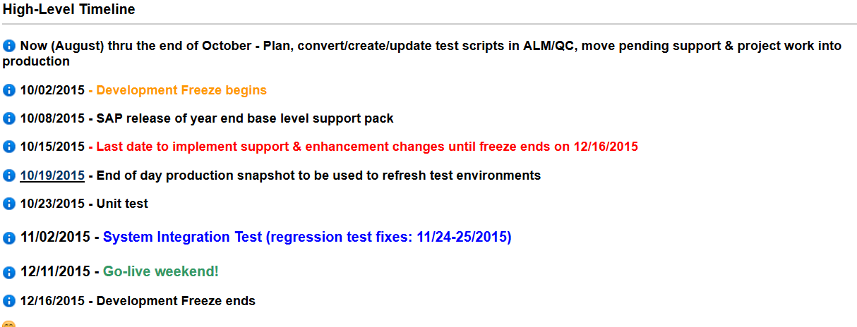
Support Packs

Slide 16
Support Pack Planning
Lets jump to the project wiki …
to look at the Team Roles & Responsibilities
to look at the Project Scope
to look at the Technical Landscape
to look at the Schedule
to look at the Project Transport Management Process
to look at the Project Testing Plan
https://wikis.mit.edu/confluence/pages/viewpage.action?pageId=109837297

Slide 17
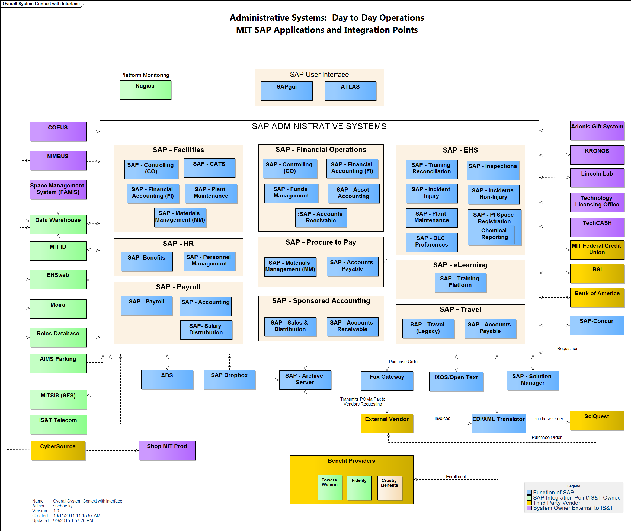
Present Day Administrative Systems Landscape

Slide 18
Important Dates
8/03/2015 – Functional testing on SF3 in HEC for 3 weeks
9/10/2015 – Proof of concept phase (cycles 1) complete
        decision to move forward with a HANA Go-Live Goal of December
9/10/2015 – Fully-integrated testing on SF2 in HEC for 3 weeks
10/02/2015 – Decision on platform for support pack go live in December
        HANA in HEC or Support pack on premise with HANA in HEC on a date TBD
      10/02/2015 - Development Freeze begins
      10/15/2015 - Last date to implement support & enhancement changes until freeze ends on 12/16/2015
      10/23/2015 - Unit test
      11/02/2015 - System Integration Test
12/11/2015 - 12/13/2015 Go-live weekend!

Slide 19
Next Steps
  Completion of H2O POC Cycles 2 & 3
  Support Pack Planning – Now thru October
    Validate Participant list
    Schedule planning meetings with your BSA(s)
    Review feeds/interfaces with your BSA(s)
  SAPbiz - October

Slide 20

Where can I get project information? Ah …

Slide 21
Questions?
Any additional questions? Please contact:
Contact | Email | Phone extension
Bob Casey | rcasey@mit.edu | x3-1844
Siobhan Cunningham | snc@mit.edu | x5-4596
Kevin Lyons | klyons@mit.edu | x8-6483
Ron Parker | rep@mit.edu | x3-1339
Frank Quern | fquern@mit.edu | x2-4512

