Slide 1
2015 SAP HANA Migration
H2O
(Year End Support Packs)
Update
October 7, 2015

Slide 2
Agenda
Project Overview
Project Update
Support Packs
Important Dates
Next Steps

Slide 3
H2O - Project Overview
The H2O project is an enabling project that will move our core ERP to a next generation cloud platform. This migration will support/provide:
    Future cloud integrations with best in class software providers
    Bi-coastal disaster recovery
    Real time queries for all ECC reporting needs
    The ability to move to simple finance and logistics in the future
    Mobile first development with built in integration and security capability
Why are we doing this?
    A continuation of our commitment to keep MIT’s SAP investment current and sustainable
    Introduces tools that can quickly build, extend, and integrate modern, mobile-enabled applications
    Provides a unique in memory database
    Aligns with MIT’s Platform as a Service Initiative

Slide 4
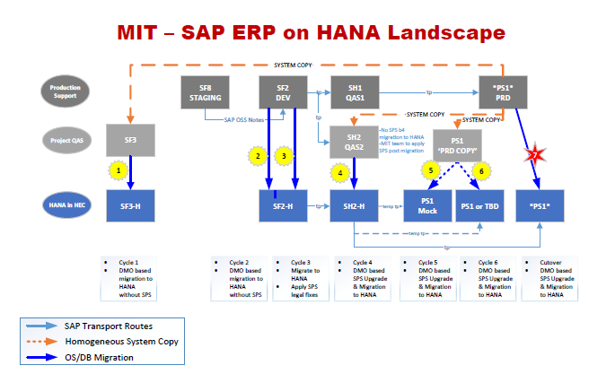
H2O - Overview Landscape

Slide 5
Estimated Timeline
July | August | September | October | November | December
Project Start 7/6/2015
Project End 12/18/2015
Project Prep & Kickoff 7/6/15 - 7/17/15
Cycle 1 - Copy from PS1 to SF3; Migrate SF3 to HEC 7/6/15 – 9/4/15
POC Decision for moving forward w/ HANA 9/8/15
Cycle 2 – Migrate SF2 to HEC 8/3/15 – 10/5/15
SP on HEC for December? 10/15/15
Cycle 3 – DEV Cutover to HEC 10/5/15 to 10/23/15
Cycle 4 – QA Cutover to HEC 10/12/15 to 11/25/15
Cycle 5/6 – PRD Mock Cutover 11/2/15 to 11/25/15
Cycle 7 – PRD Cutover 12/7/15 to 12/13/15
Go-Live 12/14/15
Production Support 12/7/15 to 12/18/15
12/5/14
Notes:
Pat Casey speaks to this slide

Slide 6
Cycle 1&2 approach
We assigned 4 scrum teams the responsibility of developing and executing Cycle 1.
    Infrastructure buildout and configuration management.
    Human Resources, Payroll, and E-Learning.
    Finance, Logistics, Plant Maintenance, and EHS.
    Atlas and other web applications.
Each team determined a comprehensive approach, based on past experience managing the SAP year-end support pack process and similar large-scale application updates, to ensure the integrity of all critical applications as well as testing all integration methodologies in use across our system.
Specific areas of attention during the validation process include:
    Integration with MIT Kerberos for GSSAPI authentication.
    Customized B2B solution enabling secure file transfers into and out of SAP (“SAP Dropbox”)
    Integration with MIT printing and network infrastructure.
    Porting of MIT-specific notification mechanisms to ensure seamless e-mail and fax functionality.
    Implementing MIT ERP and SAP ancillary components in the cloud while minimizing the need for ABAP code changes.

Slide 7
Cycle 1 Testing Results – SF3 POC
System | Owner | Status
DataWarehouse | Ron/Elena | Delivered
ATLAS JCO applications | Dudley | Delivered
GUIXT | Lee/Sharon | Delivered
SAP Gui Logon | Sarah Q | Delivered
MITID | Ron | Delivered
FaxServer | Ron | Delivered
ADS | Qian | Delivered
RolesDB | George | in progress
EDI/XML outbound | Elda/Ron | in progress
SAP Dropbox | Ron/Qian | Delivered
Archive Server | Ron/Qian | Delivered
BSI (both SF3 and SF2) | Ron | in progress
OpenText | Ron/Garry | in progress
Apiserver/Mendix | Qian | in progress
Bank of America - Bottomline IP addresses | Bob Casey | in progress
Bank of America - Pcard transactions | Bob Casey | in progress
SciQuest | Elda | Delivered
Concur | Ron/Qian | SF2

Slide 8
Cycle 2 Testing Results – SF2
System | Owner | Status
DataWarehouse | Ron/Elena | Delivered
ATLAS JCO applications | Dudley | Delivered
GUIXT | Lee/Sharon | Delivered
SAP Gui Logon | Sarah Q | Delivered
MITID | Ron | Delivered
FaxServer | Ron | Delivered
ADS | Qian | Delivered
RolesDB | George | Delivered
EDI/XML outbound | Elda/Ron | Delivered
SAP Dropbox | Ron/Qian | Delivered
Archive Server | Ron/Qian | Delivered
BSI (both SF3 and SF2) | Ron | Delivered
OpenText | Ron/Garry | Delivered
Apiserver/Mendix | Qian | SF2
Bank of America - Bottomline IP addresses | Bob Casey | Delivered
Bank of America - Pcard transactions | Bob Casey | Delivered
SciQuest | Elda | Delivered
Concur | Ron/Qian | SF2

Slide 9
Project Status
SF3: Proof of Concept Environment (Cycle 1):
    GUI, GUIXT, ITS, WDA and ATLAS testing is complete and successful, including integration with MIT authentication systems (Touchstone and Kerberos).
    Successful testing of data transfers / integration with MIT Data Warehouse..
SF2: Development Environment (Cycle 2):
    Provisioned, began GUI testing on September 10th
    We are expecting to have completed full integration testing by Sept 25th (Actual Oct 5)
      This is dependent on completing testing of all integration solutions in SF3
      SF2 tests will include Concur, ATLAS JV, & SciQuest outbound which couldn’t be tested in SF3
    Full cookbook version 1 is a deliverable of this cycle.
  SF2: Development Environment (Cycle 3):
    Migration of Frozen environment begun
    Application of Support Packs will be applied
    Unit Testing Begins 10/19/2015

Slide 10
H2O - Important Dates
8/3 – Functional testing on SF3 in HEC for 3 weeks (+)
9/10 – Proof of concept phase (cycle 1 complete)
          decision to move forward with a HANA migration
9/10 – Fully-integrated testing on SF2 in HEC for 4 weeks (complete)
10/15 – Decision on platform for support pack go live in December
          HANA in HEC or Support pack on premise (with HANA in HEC on a date TBD)
11/25 – Mock Cut-over/Disaster Recover Test (cycle 5/6 complete)
12/14 – Go Live

Slide 11
H2O & Support Packs
Where H2O intersects with Support Packs …
10/15 – Decision on which platform will be used for a December go live with support packs
    HANA in HEC or Support pack on premise (with HANA in HEC on a date TBD)
The H2O project plan aims to use the support pack regression testing window:
    In order to minimize the impact of the migration on the business
    Ensure the timely delivery of dependent enterprise projects (Coupa, Work Manager & e-Builder)

Slide 12
Background
Support Packs
  We all know what they are, periodic releases of system changes and corrections by SAP.
  Rather than apply these support packs when released we collect the Support Packs for a single installation at year end in an effort to minimize business interruption.
  The timing of our process is driven by SAP’s release of its year end support pack, typically in mid-October, which contains the base level necessary for the successful execution of SAP’s delivered year end tax reporting functionality (AP and Payroll) and stages the system for regulatory changes for the upcoming calendar year.

Slide 13
Background
What are the benefits of applying Support Packs and the process itself?
  MIT will be able to successfully file its year end tax returns (W2s, 1099s, 1042s).
  MIT will be able to apply future regulatory changes with minimal interruption.
  It is an opportunity to keep all functional areas current.
  It adheres to SAP’s support recommendations.
  It provides a solid organizational exercise in testing.
  Ensures up to date test scripts for chosen transaction.

Slide 14
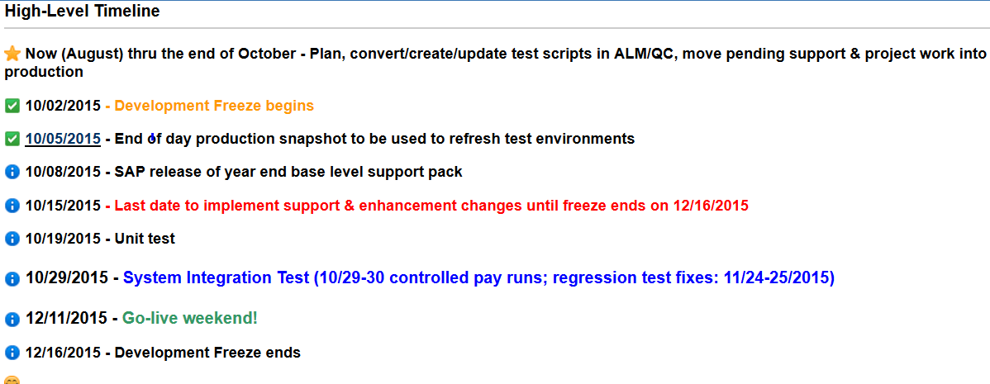
Support Packs

Slide 15
Support Pack Planning
Lets jump to the project wiki …
to look at the Team Roles & Responsibilities
to look at the Project Scope
to look at the Technical Landscape
to look at the Schedule
to look at the Project Transport Management Process
to look at the Project Testing Plan
https://wikis.mit.edu/confluence/pages/viewpage.action?pageId=109837297

Slide 16
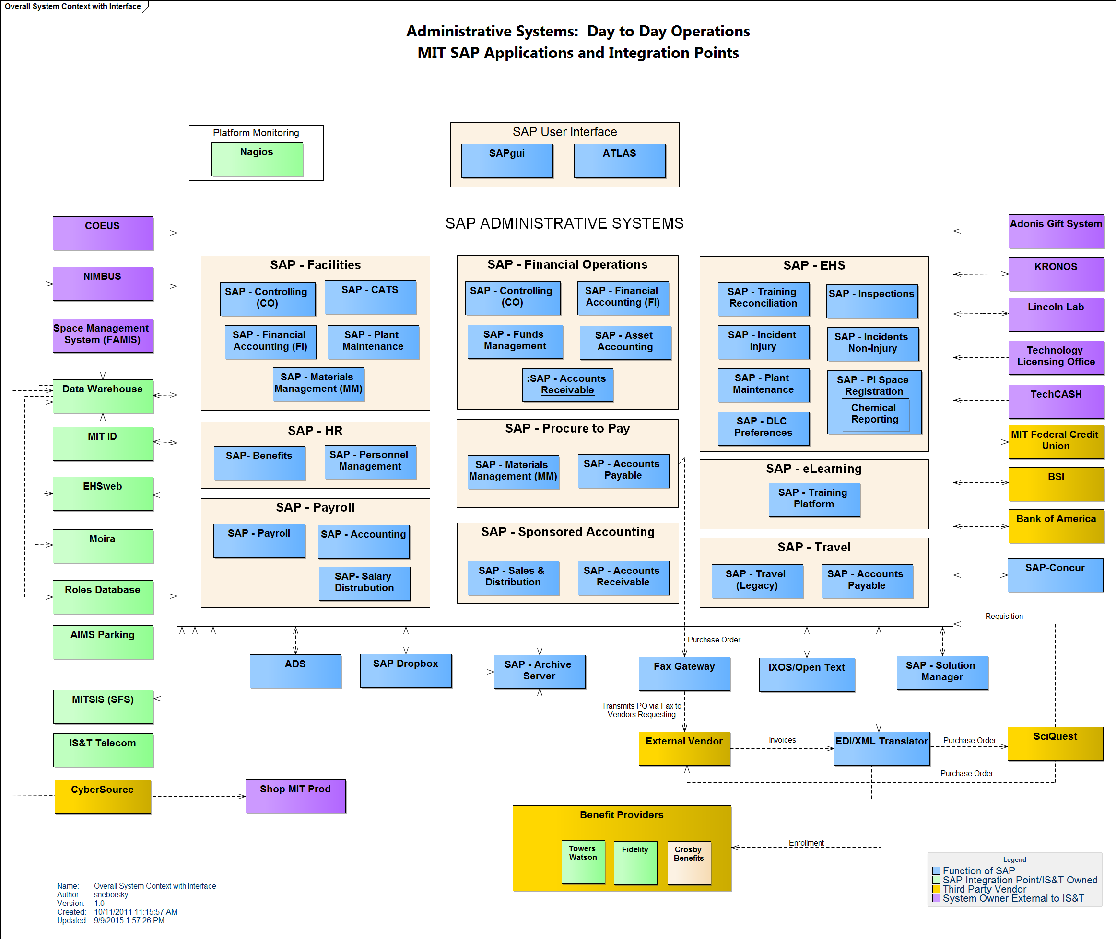
Present Day Administrative Systems Landscape

Slide 17
Important Dates
8/03/2015 – Functional testing on SF3 in HEC for 3 weeks
9/10/2015 – Proof of concept phase (cycles 1) complete
        decision to move forward with a HANA Go-Live Goal of December
10/05/2015 – Fully-integrated testing on SF2 in HEC for 4 weeks
      10/02/2015 - Development Freeze begins
10/15/2015 – Decision on platform for support pack go live in December
        HANA in HEC or Support pack on premise with HANA in HEC on a date TBD
      10/15/2015 - Last date to implement support & enhancement changes until freeze ends on 12/16/2015
      10/19/2015 - Unit test
      10/29/2015 - System Integration Test
12/11/2015 - 12/13/2015 Go-live weekend!

Slide 18
Next Steps
  Completion of H2O POC Cycles 3
  Support Pack Planning – Now thru October
    Validate Participant list
    Schedule planning meetings with your BSA(s)
    Review feeds/interfaces with your BSA(s)
  SAPbiz – October 20th

Slide 19

Where can I get project information? Ah …

Slide 20
Questions?
Any additional questions? Please contact:
Contact | Email | Phone extension
Bob Casey | rcasey@mit.edu | x3-1844
Siobhan Cunningham | snc@mit.edu | x5-4596
Kevin Lyons | klyons@mit.edu | x8-6483
Ron Parker | rep@mit.edu | x3-1339
Frank Quern | fquern@mit.edu | x2-4512

