Slide 1
Trivial Pursuits
G
What's the world's southernmost national capital?
E
Which witch is flattened by a house in The Wizard of Oz?
H
What explorer was nicknamed Iberia's Pilot?
What phenomenon appeared the day Mark Twain was born and the day he died?
AL
SN
What do dates grow on?
SL
What are the Golden Nugget, Horseshoe, Lucky Stride and Jackpot?

Slide 2
And the answers are …
G
What's the world's southernmost national capital?
Wellington, New Zealand
Which witch is flattened by a house in The Wizard of Oz?
The Wicked Witch of the East
E
H
What explorer was nicknamed Iberia's Pilot?
Christopher Columbus
What phenomenon appeared the day Mark Twain was born and the day he died?
Halley's comet
AL
SN
What do dates grow on?
Palm trees
SL
What are the Golden Nugget, Horseshoe, Lucky Stride and Jackpot?
Las Vegas casinos

Slide 3
2015 SAP HANA Migration
H2O
(Year End Support Packs)
Update
October 20, 2015

Slide 4
Agenda
Project Overview
Project Update
Support Packs
Important Dates
Next Steps

Slide 5
H2O - Project Overview
The H2O project is an enabling project that will move our core ERP to a next generation cloud platform. This migration will support/provide:
    Future cloud integrations with best in class software providers
    Bi-coastal disaster recovery
    Real time queries for all ECC reporting needs
    The ability to move to simple finance and logistics in the future
    Mobile first development with built in integration and security capability
Why are we doing this?
    A continuation of our commitment to keep MIT’s SAP investment current and sustainable
    Introduces tools that can quickly build, extend, and integrate modern, mobile-enabled applications
    Provides a unique in memory database
    Aligns with MIT’s Platform as a Service Initiative

Slide 6
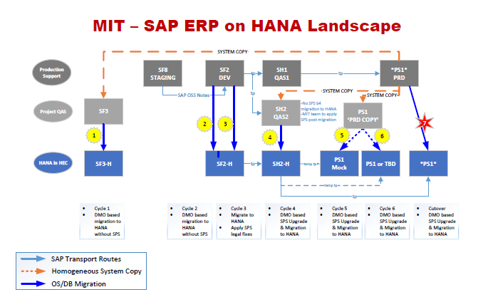
H2O - Overview Landscape

Slide 7
Estimated Timeline
July | August | September | October | November | December
Project Start 7/6/2015
Project End 12/18/2015
Project Prep & Kickoff 7/6/15 - 7/17/15
Cycle 1 - Copy from PS1 to SF3; Migrate SF3 to HEC 7/6/15 – 9/4/15
POC Decision for moving forward w/ HANA 9/8/15
Cycle 2 – Migrate SF2 to HEC 8/3/15 – 10/5/15
SP on HEC for December? 10/15/15
Cycle 3 – DEV Cutover to HEC 10/5/15 to 10/23/15
Cycle 4 – QA Cutover to HEC 10/12/15 to 11/25/15
Cycle 5/6 – PRD Mock Cutover 11/2/15 to 11/25/15
Cycle 7 – PRD Cutover 12/7/15 to 12/13/15
Go-Live 12/14/15
Production Support 12/7/15 to 12/18/15
12/5/14
Notes:
Pat Casey speaks to this slide

Slide 8
Cycle 1&2 approach
We assigned 4 scrum teams the responsibility of developing and executing Cycle 1.
    Infrastructure buildout and configuration management.
    Human Resources, Payroll, and E-Learning.
    Finance, Logistics, Plant Maintenance, and EHS.
    Atlas and other web applications.
Each team determined a comprehensive approach, based on past experience managing the SAP year-end support pack process and similar large-scale application updates, to ensure the integrity of all critical applications as well as testing all integration methodologies in use across our system.
Specific areas of attention during the validation process include:
    Integration with MIT Kerberos for GSSAPI authentication.
    Customized B2B solution enabling secure file transfers into and out of SAP (“SAP Dropbox”)
    Integration with MIT printing and network infrastructure.
    Porting of MIT-specific notification mechanisms to ensure seamless e-mail and fax functionality.
    Implementing MIT ERP and SAP ancillary components in the cloud while minimizing the need for ABAP code changes.

Slide 9
Cycle 1 Testing Results – SF3 POC
System | Owner | Status
DataWarehouse | Ron/Elena | Delivered
ATLAS JCO applications | Dudley | Delivered
GUIXT | Lee/Sharon | Delivered
SAP Gui Logon | Sarah Q | Delivered
MITID | Ron | Delivered
FaxServer | Ron | Delivered
ADS | Qian | Delivered
RolesDB | George | in progress
EDI/XML outbound | Elda/Ron | in progress
SAP Dropbox | Ron/Qian | Delivered
Archive Server | Ron/Qian | Delivered
BSI (both SF3 and SF2) | Ron | in progress
OpenText | Ron/Garry | in progress
Apiserver/Mendix | Qian | in progress
Bank of America - Bottomline IP addresses | Bob Casey | in progress
Bank of America - Pcard transactions | Bob Casey | in progress
SciQuest | Elda | Delivered
Concur | Ron/Qian | SF2

Slide 10
Cycle 2 Testing Results – SF2
System | Owner | Status
DataWarehouse | Ron/Elena | Delivered
ATLAS JCO applications | Dudley | Delivered
GUIXT | Lee/Sharon | Delivered
SAP Gui Logon | Sarah Q | Delivered
MITID | Ron | Delivered
FaxServer | Ron | Delivered
ADS | Qian | Delivered
RolesDB | George | Delivered
EDI/XML outbound | Elda/Ron | Delivered
SAP Dropbox | Ron/Qian | Delivered
Archive Server | Ron/Qian | Delivered
BSI (both SF3 and SF2) | Ron | Delivered
OpenText | Ron/Garry | Delivered
Apiserver/Mendix | Qian | SF2/Cycle 3
Bank of America - Bottomline IP addresses | Bob Casey | Delivered
Bank of America - Pcard transactions | Bob Casey | Delivered
SciQuest | Elda | Delivered
Concur | Ron/Qian | SF2/Cycle 3

Slide 11
Project Status
SF3: Proof of Concept Environment (Cycle 1):
    GUI, GUIXT, ITS, WDA and ATLAS testing is complete and successful, including integration with MIT authentication systems (Touchstone and Kerberos).
    Successful testing of data transfers / integration with MIT Data Warehouse..
SF2: Development Environment (Cycle 2):
    Provisioned, began GUI testing on September 10th
    We are expecting to have completed full integration testing by Sept 25th (Actual Oct 5)
      This is dependent on completing testing of all integration solutions in SF3
      SF2 tests will include Concur, ATLAS JV, & SciQuest outbound which couldn’t be tested in SF3
    Full cookbook/cutover plan version 1 is a deliverable of this cycle.
  SF2: Development Environment (Cycle 3):
    Migration of Frozen environment begun
    Application of Support Packs will be applied
    Unit Testing planned to begin 10/19/2015

Slide 12
H2O & Support Packs
Where H2O intersects with Support Packs …
10/15 – Decision on which platform will be used for a December go live with support packs
    HANA in HEC or Support pack on premise (with HANA in HEC on a date TBD)
The H2O project plan aims to use the support pack regression testing window:
    In order to minimize the impact of the migration on the business
    Ensure the timely delivery of dependent enterprise projects (Coupa, Work Manager & e-Builder)
  Support Packs on HANA
    Recommendation was to move forward with Support Packs on HANA
    Given the OK to move forward with the plan
    Unit Testing will be begin with the execution of Cycle 3

Slide 13
Cycle 3 – More Unit Testing
Cycle 3 is much the same as cycle 2
We re-executed the migration of our copy of our SAP development system (SF2) to the HEC space
Brings our HANA dev system into sync with our on premise dev system
  Catches all the development that’s been done in the past month
  Makes sure we have all development that’s gone to production
Applied SAP Year End Support Packs
Testing will be done by your IS&T partners

Slide 14
Cycle 4 – User Acceptance Testing
System integration and user acceptance testing
  Testing Support Packs on an upgraded HANA environment
Testing by both the business and IS&T
Similar time frame as prior years
Testing & QA environment
  HEC (HANA Enterprise Cloud) Testing & QA environment SH2
  Copy of SAP production from 10/5/15

Slide 15
Cycle 4 Test Planning
Work with your BSAs to plan testing, just like prior years
Atlas, SAP dropbox, EDI/Fax, SciQuest, BSI, OpenText, etc. will all point to SH2 on HANA
Test any problems areas and important transactions and processes from prior years
Test feeds and interfaces, uploads and downloads, ‘Z’ transactions and programs, and standard functionality
  Negotiate with external vendors where necessary
Test early and often, there’s moving pieces this year
Automated Test Cases from prior years will be used where possible

Slide 16
Cycle 4 Test Execution
Execution timeframe similar to prior years
  Starts 11/2, ends 11/18, but we’d really like to be done ASAP
  Why ASAP? We have a steering committee meeting 11/19!
  Wayne Turner, Gerry O’Toole, Basil Stewart, Gilles Simler, Mike Parkin, Mark Silis, Eamon Kearns, Olu Brown, Garry Zacheiss, Faith Hill, they all really want to know when we will go live
Test more rather than less, we’re testing two things this year
  Support packs AND
  How our SAP system operates in the cloud

Slide 17
Support Pack Planning
Lets jump to the project wiki …
to look at the Team Roles & Responsibilities
to look at the Project Scope
to look at the Technical Landscape
* to look at the Schedule
* to look at the Project Transport Management Process
* to look at the Project Testing Plan (reporting issues; testers)
https://wikis.mit.edu/confluence/pages/viewpage.action?pageId=109837297

Slide 18
New Gui Version
New GUI version 7.4.3
  Will need to be installed
  Special Launchpad configuration file will need to be installed on all testers’ desktops/laptops

Slide 19
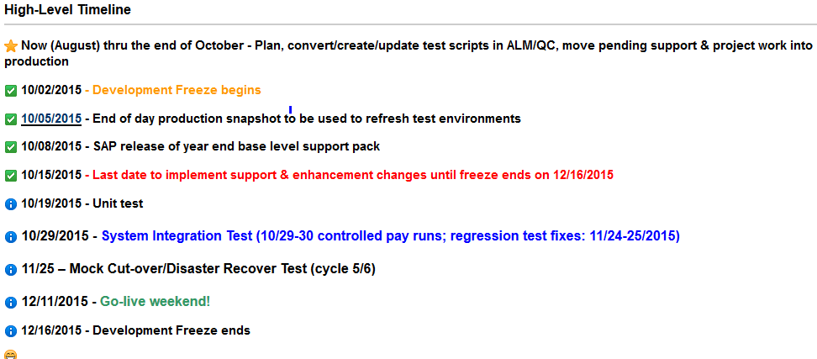
Important Dates

Slide 20
Next Steps
  Completion of H2O/SP Cycle 3
  Support Pack Planning – Now thru the end of October
    Validate Participant list
    Schedule planning meetings with your BSA(s)
    Review feeds/interfaces with your BSA(s)
  Begin SIT/UAT 11/2/2015 (10/29 – controlled payruns)

Slide 21
Not-soTrivial Pursuits
G
What environment will we be testing in?
E
What is ALM?
H
When will testing begin?
Where can I find project related information?
AL
SN
What are we updating?
SL
When is go-live weekend?

Slide 22
Questions?
Any additional questions? Please contact:
Contact | Email | Phone extension
Bob Casey | rcasey@mit.edu | x3-1844
Siobhan Cunningham | snc@mit.edu | x5-4596
Kevin Lyons | klyons@mit.edu | x8-6483
Ron Parker | rep@mit.edu | x3-1339
Frank Quern | fquern@mit.edu | x2-4512

Slide 23

the wicked witch of the west
Happy Halloween!

