Slide 1
Trivial Pursuits
G
What sea separates Italy from Yugoslavia?
E
What word was intentionally omitted from the screenplay of The Godfather?
H
What play was Abraham Lincoln watching when he was assassinated?
What novel has the ghost of Catherine appearing to Mr. Lockwood?
AL
SN
What's a group of kittens called?
SL
What two Scrabble Crossword Game letters have eight-point values?

Slide 2
And the answers are …
G
What sea separates Italy from Yugoslavia?
The Adriatic
What word was intentionally omitted from the screenplay of The Godfather?
Mafia
E
H
What play was Abraham Lincoln watching when he was assassinated?
Our American Cousin
What novel has the ghost of Catherine appearing to Mr. Lockwood?
Wuthering Heights
AL
SN
What's a group of kittens called?
A kindle
SL
What two Scrabble Crossword Game letters have eight-point values?
J & X

Slide 3
2015 SAP HANA Migration
H2O
(Year End Support Packs)
Update
November 23, 2015

Slide 4
Agenda
Project Overview
Project Update
Important Dates
Next Steps

Slide 5
H2O - Project Overview
The H2O project is an enabling project that will move our core ERP to a next generation cloud platform. This migration will support/provide:
    Future cloud integrations with best in class software providers
    Bi-coastal disaster recovery
    Real time queries for all ECC reporting needs
    The ability to move to simple finance and logistics in the future
    Mobile first development with built in integration and security capability
Why are we doing this?
    A continuation of our commitment to keep MIT’s SAP investment current and sustainable
    Introduces tools that can quickly build, extend, and integrate modern, mobile-enabled applications
    Provides a unique in memory database
    Aligns with MIT’s Platform as a Service Initiative

Slide 6
Project Scope Update
What are we updating?
  Let’s jump to the project wiki
    H2O Project Scope

Slide 7
Estimated Timeline
July | August | September | October | November | December
Project Start 7/6/2015
Project End 12/18/2015
Project Prep & Kickoff 7/6/15 - 7/17/15
Cycle 1 - Copy from PS1 to SF3; Migrate SF3 to HEC 7/6/15 – 9/4/15
POC Decision for moving forward w/ HANA 9/8/15
Cycle 2 – Migrate SF2 to HEC 8/3/15 – 10/5/15
SP on HEC for December? 10/15/15
Cycle 3 – DEV Cutover to HEC 10/5/15 to 10/23/15
Cycle 4 – QA Cutover to HEC 10/12/15 to 11/25/15
Cycle 5/6 – PRD Mock Cutover 11/2/15 to 11/25/15
Cycle 7 – PRD Cutover 12/7/15 to 12/13/15
Go-Live 12/14/15
Production Support 12/7/15 to 12/18/15
12/5/14
Notes:
Pat Casey speaks to this slide

Slide 8
Project Status
SF3: Proof of Concept Environment (Cycle 1):
    GUI, GUIXT, ITS, WDA and ATLAS testing was complete and successful, including integration with MIT authentication systems (Touchstone and Kerberos).
    Successful testing of data transfers / integration with MIT Data Warehouse..
SF2: Development Environment (Cycle 2):
    Provisioned, began GUI testing on September 10th
    We are expecting to have completed full integration testing by Sept 25th (Actual Oct 5)
      This is dependent on completing testing of all integration solutions in SF3
      SF2 tests will include Concur, ATLAS JV, & SciQuest outbound which couldn’t be tested in SF3
    Full cookbook/cutover plan version 1 is a deliverable of this cycle.
  SF2: Development Environment (Cycle 3):
    Migration of Frozen environment complete
    Application of Y/E Support Packs
    Unit Testing complete

Slide 9
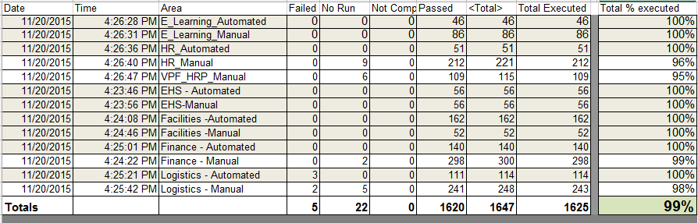
Project Status
SH2: System Integration/User Acceptance Testing (Cycle 4):
    Collaborative Business and IS&T integration and regression testing of Support Packs on HANA
    Testing included GUI Transactions, GUIXT, ITS, WDA ,ATLAS, system feeds.
Testing Results:

Slide 10
Issues
Is it worth it?
Well, yes …
  We can jump to RT for details: https://help.mit.edu/
Phases Issues were identified in …
(as of 11/20/15)
Issue type | Unit | SIT |  | Open
Required an SAP fix | 8 | 7 |  | 5
Required an MIT fix | 12 | 12
Infrastructure Related | 54 | 16 |  | 4
User/Data Error | 1 | 7
Duplicate | 4 | 2
Production Issue - to be addressed after SP | 1 | 7 |  | 1
Totals | 80 | 51 | 131 | 10

Slide 11
HANA Mock Cutover Findings
We executed a Mock cutover during the weekend of November 7th.
Our results:
We were able to successfully complete all major tasks of a cutover weekend
We are confident that we will be able to execute the production cutover on December 11-13th
We are requesting to take the system down at 4pm on Friday December 11th to ensure a smooth cutover
Our Findings:
Backup tasks took longer than expected, but this slip was mitigated by high availability failover taking less time than expected
We will be analyzing ways to optimize our cutover steps in order to accommodate the transport list
SAP analysts and developers were able to complete cutover tasks prior to 4pm on Sunday and we are aiming to deliver the system to the business for validation tentatively between noon and 4pm.
SAP should be available to the community well before 6am Monday.

Slide 12
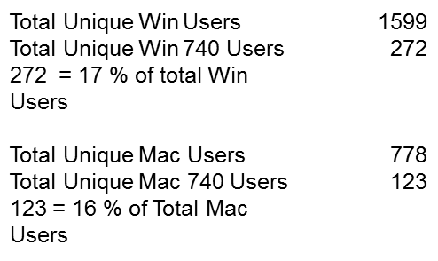
New Gui Version 7.4.3
  SAP GUI Rollout:
    In order to make the 12/14 cutover to HEC seamless to the user community
      Updated the SAPgui configuration to host system connection information centrally
      New installers have been made available to the DLC community
      A plan to update all SAPgui users is in process
      All central office testers were provided with an alternate configuration file that will grant them access to both on-premises and on HEC landscapes during UAT
      Current stats:

Slide 13
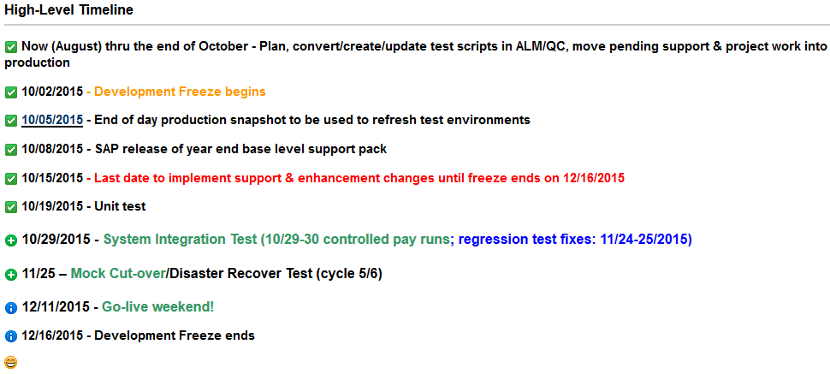
Important Dates

Slide 14
Next Steps
  Resolve & regression test open issues
  Cutover Planning – now thru the 1st week of December
    Validate participant list
    Review/define validation tasks
    System preparation
  SAP Gui upgrades
  SAPbiz cutover review

Slide 15
Not-soTrivial Pursuits
G
What version of the GUI should I be using?
E
What does HEC stand for?
H
What is HANA?
Where can I find project related information?
AL
SN
What are we updating?
SL
When is go-live weekend?

Slide 16
Questions?
Any additional questions? Please contact:
Contact | Email | Phone extension
Bob Casey | rcasey@mit.edu | x3-1844
Siobhan Cunningham | snc@mit.edu | x5-4596
Kevin Lyons | klyons@mit.edu | x8-6483
Ron Parker | rep@mit.edu | x3-1339
Frank Quern | fquern@mit.edu | x2-4512

Slide 17
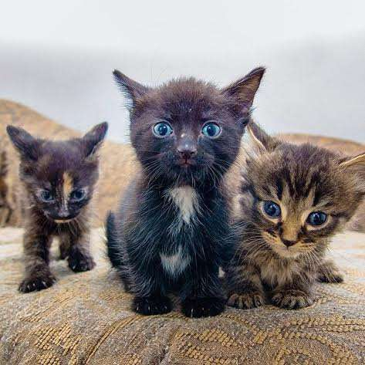
Support Packs are Coming!
Support Packs are Coming!
(a kindle …)
We’re ready (aren’t we?)

