Slide 1
Trivial Pursuits
G
What’s the capital of Morocco?
E
Who wrote White Christmas?
H
What gangster’s business card read: “Second hand furniture dealer”?
What do the English call a garbage man?
AL
SN
Do beavers eat fish?
SL
How high is the center of a tennis net?

Slide 2
And the answers are …
G
What’s the capital of Morocco?
Rabat
Who wrote White Christmas?
Irving Berlin
E
H
What gangster’s business card read: “Second hand furniture dealer”?
Al Capone’s
What do the English call a garbage man?
A dustman
AL
SN
Do beavers eat fish?
No
SL
How high is the center of a tennis net?
Three feet

Slide 3
2015 SAP HANA Migration
H2O
(Year End Support Packs)
Cutover Review
December 7, 2015

Slide 4
Agenda
Project Overview
Project Update
Next Steps
Cutover Review

Slide 5
H2O - Project Overview
The H2O project is an enabling project that will move our core ERP to a next generation cloud platform. This migration will support/provide:
    Future cloud integrations with best in class software providers
    Bi-coastal disaster recovery
    Real time queries for all ECC reporting needs
    The ability to move to simple finance and logistics in the future
    Mobile first development with built in integration and security capability
Why are we doing this?
    A continuation of our commitment to keep MIT’s SAP investment current and sustainable
    Introduces tools that can quickly build, extend, and integrate modern, mobile-enabled applications
    Provides a unique in memory database
    Aligns with MIT’s Platform as a Service Initiative

Slide 6
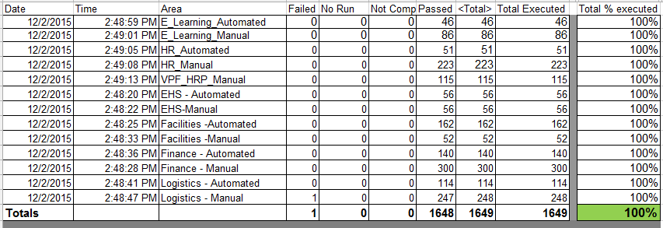
Project Status
SH2: System Integration/User Acceptance Testing (Cycle 4):
    Collaborative Business and IS&T integration and regression testing of Support Packs on HANA
    Testing included GUI Transactions, GUIXT, ITS, WDA ,ATLAS, system feeds.
Testing Results:

Slide 7
Issues
Is it worth it?
Well, yes …
  We can jump to RT for details: https://help.mit.edu/
Phases Issues were identified in …
(as of 11/20/15)
Issue type | Unit | SIT |  | Open
Required an SAP fix | 8 | 8 |  | 3
Required an MIT fix | 12 | 13
Infrastructure Related | 54 | 17 |  | 1
User/Data Error | 1 | 8
Duplicate | 4 | 2
Production Issue - to be addressed after SP | 1 | 7 |  | 1
Totals | 80 | 55 | 135 | 5

Slide 8
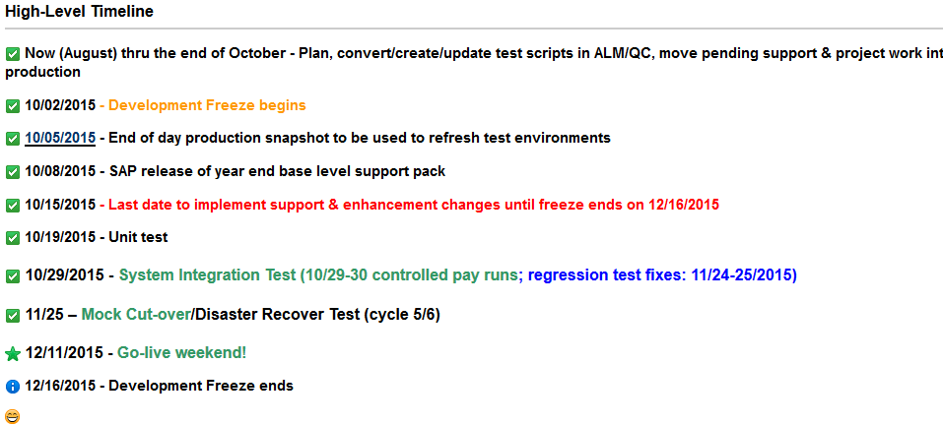
Important Dates

Slide 9
Next Steps
  Resolve & regression test remaining open issues
  Cutover Planning – now thru Wednesday
    Validate participant list
    Review/define validation tasks
    System preparation
  SAP Gui upgrades (7.4.3)
  12/11/2015 (4:00pm) - 12/13/2014 Go-live weekend!
Meaning … we’ll have to execute a cutover plan!!

Slide 10
Cutover
Preparation work
System Isolation
Support Pack Application
Post Upgrade Processes (validations)
Go-live
  Let’s jump to the project wiki’s Cutover Plan page and take a look at the plan …

Slide 11
Not-soTrivial Pursuits
G
How can I find out the status of the cutover?
Call this number 617-324-7468
E
Who performs the validations?
Assigned business personnel as defined in the cutover plan.
H
When will the SAP system be brought down?
4:00 PM Friday 12/11/2015
Where can I find the cutover plan?
On the project wiki
AL
SN
What are we updating?
The SAP ERP System (including a migration to HEC)
SL
When is go-live weekend?
12/11 (4:00pm) -12/13/2015

Slide 12
Questions?
Any additional questions? Please contact:
Contact | Email | Phone extension
Bob Casey | rcasey@mit.edu | x3-1844
Siobhan Cunningham | snc@mit.edu | x5-4596
Kevin Lyons | klyons@mit.edu | x8-6483
Ron Parker | rep@mit.edu | x3-1339
Frank Quern | fquern@mit.edu | x2-4512

Slide 13

Support Packs are Coming!
Support Packs are Coming!
We’re ready (are you?)

