Slide 1
Using the e-Builder Home Page
Self Paced Training

Slide 2
E-Builder Home Page
Open Modules, Search
Open Your Projects
See
  Workflow in Your Court
  your first 10 tasks
  Submittal Items in Your Court
  Items Pending Approval
Recent Pages and Quick Start
Announcements and Calendar
Notes:
Tip: Add your own speaker notes here.

Slide 3
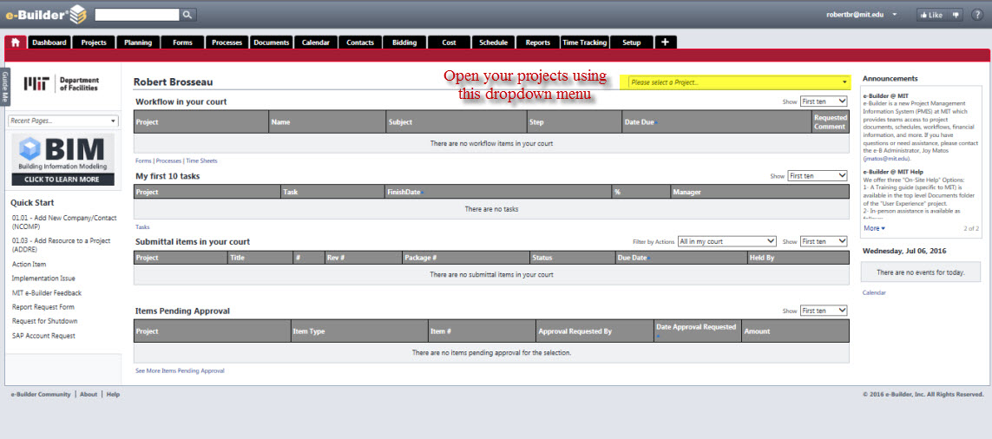
Home Page – Open Projects

Slide 4
Training Outline
Lesson 1: Name
  Provide brief description, if desired.
Lesson 2: Name
  Provide brief description, if desired.
Lesson 3: Name
  Provide brief description, if desired.

Slide 5
Lesson 1: Objectives
List the intended outcomes for this training session.
Each objective should be concise, contain a verb, and have measurable results.
Notes:
Tip: Add your own speaker notes here.

Slide 6
Lesson 1: Content
Add text here.
To add a picture, chart, or other content in the right column, click the appropriate icon.
To add a slide, click the Slides tab, then click the New Slide gallery.

Slide 7
Lesson 1: Wrap-up
Summarize important points.
Allow time for questions.

Slide 8
Lesson 2: Objectives
List the intended outcomes for this training session.
Each objective should be concise, contain a verb, and have measurable results.
Notes:
Tip: Add your own speaker notes here.

Slide 9
Lesson 2: Content
Add text here.
To add a picture, chart, or other content in the right column, click the appropriate icon.
To add a slide, click the Slides tab, then click the New Slide gallery.

Slide 10
Lesson 2: Wrap-up
Summarize important points.
Allow time for questions.

Slide 11
Lesson 3: Objectives
List the intended outcomes for this training session.
Each objective should be concise, contain a verb, and have measurable results.
Notes:
Tip: Add your own speaker notes here.

Slide 12
Lesson 3: Content
Add text here.
To add a picture, chart, or other content in the right column, click the appropriate icon.
To add a slide, click the Slides tab, then click the New Slide gallery.

Slide 13
Lesson 3: Wrap-up
Summarize important points.
Allow time for questions.

Slide 14
Summary of Training
List important points from each lesson.
Provide resources for more information about the subject.
  List resources on this slide.
  Provide handouts with additional resource material.

Slide 15
Assessment and Evaluation
Prepare a quiz or challenge to assess how much information participants learned.
Survey participants to see if they found the training beneficial.

