Slide 1
Trivial Pursuits
G
What's the world's southernmost national capital?
E
Which witch is flattened by a house in The Wizard of Oz?
H
What explorer was nicknamed Iberia's Pilot?
What phenomenon appeared the day Mark Twain was born and the day he died?
AL
SN
What do dates grow on?
SL
What are the Golden Nugget, Horseshoe, Lucky Stride and Jackpot?

Slide 2
And the answers are …
G
What's the world's southernmost national capital?
Wellington, New Zealand
Which witch is flattened by a house in The Wizard of Oz?
The Wicked Witch of the East
E
H
What explorer was nicknamed Iberia's Pilot?
Christopher Columbus
What phenomenon appeared the day Mark Twain was born and the day he died?
Halley's comet
AL
SN
What do dates grow on?
Palm trees
SL
What are the Golden Nugget, Horseshoe, Lucky Stride and Jackpot?
Las Vegas casinos

Slide 3
2016 Year End Support Pack Project
SAPbiz
Update
October 26, 2016

Slide 4
Agenda
Quick Review of the Project Scope
Update on Project Risks
High Level Time Line (& where are we now?)
Testing
Important Dates Revisited
Next Steps

Slide 5
Project Scope Update
What are we updating?
  Let’s jump to the project wiki
    2016 SP WIKI

Slide 6
Project Risks
Identified Risks
  Delay in SAP Releases
  QC Upgrade
    Application has been upgraded during the summer
    This will be the first time a lot of folks will have been in the upgraded system
  Resource availability for the project (both Business & IS&T)
  Delay of implementation of pre-Support Pack Projects
    OE (scheduled for October)
  Impacts from other requested updates
    I-9 Outsourcing
    Cosmos Pilot
    Enriching Diversity

Slide 7
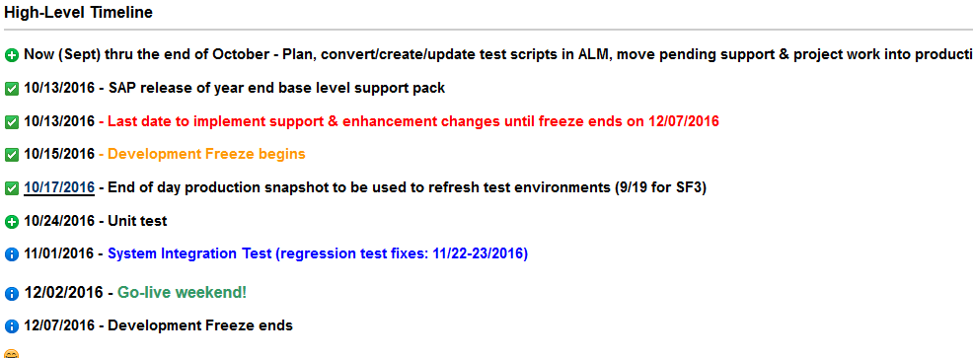
Important Dates

Slide 8
Testing Timeline Details
  Let’s look at the Plans and Schedule on the wiki …
  https: 2016 SP WIKI Calendar

Slide 9
Testing
  Two Phase Approach
    Unit Test - performed in SF2 by IS&T
    System Integration – performed in SH2 by IS&T and Business Testers as a combined pool
  Planning
    ALM/Quality Center (Central test case repository & tracking tool)
    Work with IS&T Testing Coordinators & QA
  Automated Testing
    Approximately 38% of last year’s test cases have been automated

Slide 10
Testing
(continued)
  If I find an issue during testing how do I report it?
  - let’s go back to the wiki …
  2016+Year+End+SAP+Support+Pack+Project

Slide 11
Transport Management
  So what if we have an issue in production during the freeze period that needs immediate attention?
  Let’s jump back to the wiki …
  2016+Year+End+SAP+Support+Pack+Project

Slide 12
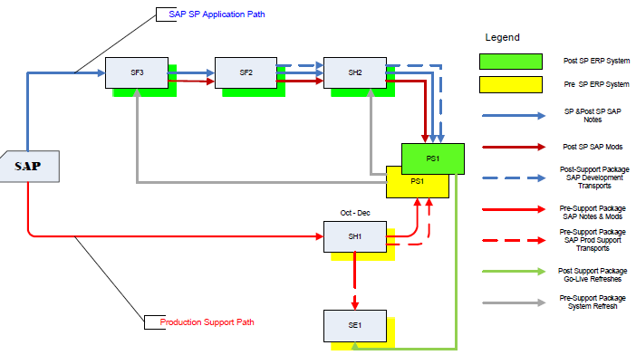
Where are we now?
Project Landscape

Slide 13
Where are we now?
(continued)
  Any issues so far?
  Yup!
  - let’s go to RT …
  Request Tracker

Slide 14
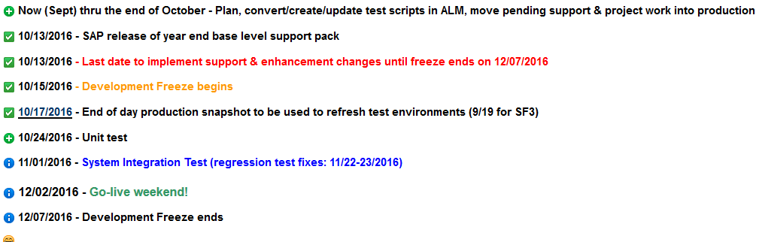
Recap of Important Dates

Slide 15
Next Steps
  Final review of your test cases (Business)
  Completion of application of support packs to the Test Systems (IS&T)
  Test Execution (Business & IS&T)
  Prepare for go-live (All)

Slide 16
Not-soTrivial Pursuits
G
What environment will we be testing in?
E
What is ALM?
H
When will testing begin?
Where can I find project related information?
AL
SN
What are we updating?
SL
When is go-live weekend?

Slide 17
Questions?
Please contact:
Contact | Email | Phone extension
Bob Casey | rcasey@mit.edu | x3-1844
Jim Fragala | jfragala@mit.edu | x4-6250
Lisa Robinson | lmrobin@mit.edu | x8-0492
Ron Parker | rep@mit.edu | x3-1339
Frank Quern | fquern@mit.edu | x2-4512

Slide 18

the wicked witch of the west
Happy Halloween!

