Slide 1
Trivial Pursuits
G
What river is spanned by the Rainbow Bridge?
E
Who wrote White Christmas?
H
Who founded Philadelphia, Pennsylvania?
What is the distinction of Erle Stanley Gardner’s The Case of the Terrified Typist?
AL
SN
Do beavers eat fish?
SL
What player uses a cesta to hurl a pelota?

Slide 2
And the answers are …
G
What river is spanned by the Rainbow Bridge?
The Niagara
Who wrote White Christmas?
Irving Berlin
E
H
Who founded Philadelphia, Pennsylvania?
William Penn
What is the distinction of Erle Stanley Gardner’s The Case of the Terrified Typist?
Perry Mason loses
AL
SN
Do beavers eat fish?
No
SL
What player uses a cesta to hurl a pelota?
A jai-alai player

Slide 3
2016 Year End Support Pack Project
SAPbiz Update
(cutover)
November 29, 2016

Slide 4
Agenda
High Level Time Line (& where are we now?)
Testing
Issues
Cutover Plan
Next Steps

Slide 5
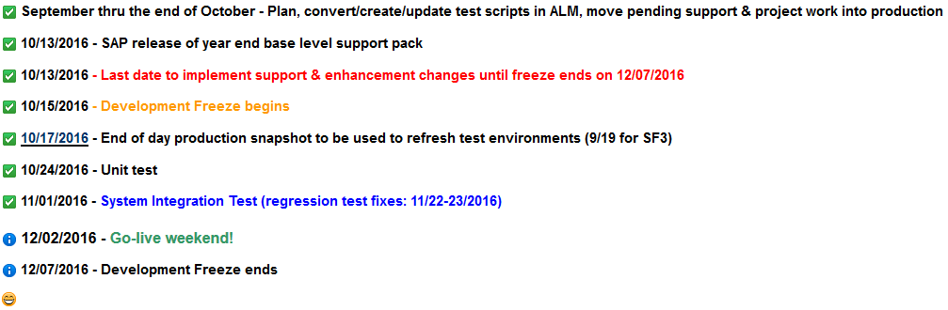
High Level Timeline

Slide 6
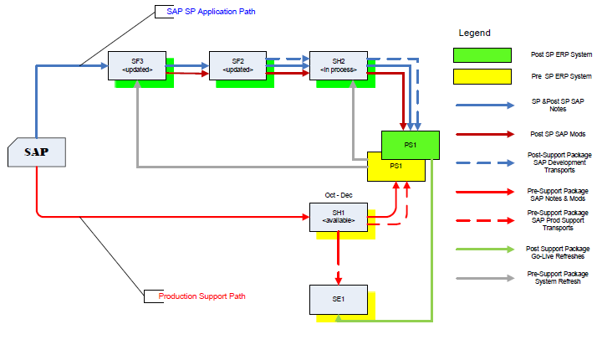
Where are we now?
Project Landscape

Slide 7
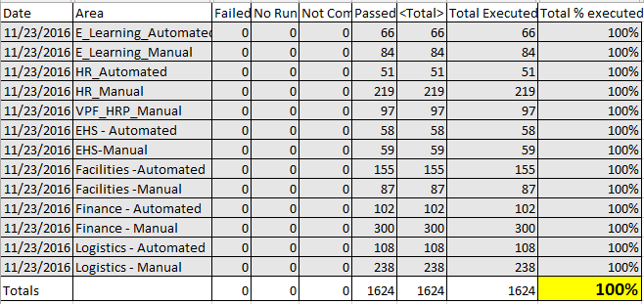
Testing Status
SH2: System Integration/User Acceptance Testing:
    Collaborative Business and IS&T integration and regression testing of Support Packs (Enh8) on HANA
Testing Results:

Slide 8
Issues
Is it worth it?
Well, yes …
  We can jump to RT for details: https://help.mit.edu/
Phases Issues were identified in …
(as of 11/23/16)
Issue type | Unit | SIT |  | Open
Required an SAP fix | 7 | 2
Required an MIT fix | 17 | 16
Infrastructure Related | 4 | 4
User/Data Error | 2 | 7
Duplicate | 1 | 2
Production Issue - to be addressed after SP | 3 | 8
Totals | 34 | 39 | 73 | 0

Slide 9
Issues (cont.)
How does it compare to prior years?
 | 2010 | 2011 | 2012 | 2013 | 2014 | 2015* | 2016
Issues | 64 | 41 | 54 | 86 | 58 | 135 | 73
SAP fix required | 3 | 8 | 9 | 23 | 22 | 16 | 9
MIT fix required | 23 | 17 | 17 | 19 | 21 | 25 | 33
Total fixes required | 26 | 25 | 26 | 42 | 43 | 41 * HEC | 42

Slide 10
Next Steps
11/30/2016 Steering Committee Review
12/2/2016 (5:00pm) - 12/5/2016 Go-live weekend!
Meaning … we’ll have to execute a cutover plan!!

Slide 11
Cutover
Preparation work
System Isolation
Support Pack Application
Post Upgrade Processes (conversions, validations)
Go-live
  Let’s jump to the project wiki’s Cutover Plan page and take a look at the plan …

Slide 12
Not-soTrivial Pursuits
G
How can I find out the status of the cutover?
Call this number 617-324-7468
E
Who performs the validations?
Assigned business personnel as defined in the cutover plan.
H
When will the SAP system be brought down?
5:00 PM Friday 12/2/2016
Where can I find the cutover plan?
On the project wiki
AL
SN
What are we updating?
The SAP ERP System (including GRC, BSI, SMP, OTP & ADS)
SL
When is go-live weekend?
12/2 (5:00pm) -12/5/2016

Slide 13
Questions?
Please contact:
Contact | Email | Phone extension
Bob Casey | rcasey@mit.edu | x3-1844
Jim Fragala | jfragala@mit.edu | x4-6250
Lisa Robinson | lmrobin@mit.edu | x8-0492
Ron Parker | rep@mit.edu | x3-1339
Frank Quern | fquern@mit.edu | x2-4512

Slide 14
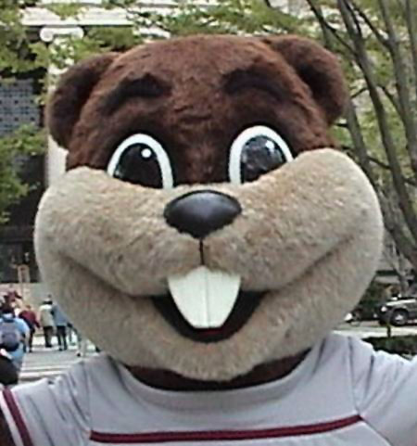
Support Packs are Coming!
Support Packs are Coming!
We’re ready (are you?)

