Slide 1
2016 Year End Support Pack Project
Steering Committee
Update
October 28, 2016

Slide 2
Agenda
Quick Review of the Project Scope
Update on Project Risks
High Level Time Line (& where are we now?)
Testing
Important Dates Revisited
Next Steps

Slide 3
Project Scope Update
What are we updating?
  Let’s jump to the project wiki
    2016 SP WIKI

Slide 4
Project Scope
Preparation Upgrades
10/8/2016
  Operating System Upgrade
    Production Database servers
    Production Application servers
  Hardware Upgrade
    Memory
    Virtual CPU
11/5/2016
  Hana database Upgrade
    Support Pack Stack 12

Slide 5
Project Risks
Identified Risks
  Delay in SAP Releases
  ALM Upgrade
    Application has been upgraded during the summer
    This will be the first time a lot of folks will have been in the upgraded system
  Resource availability for the project (both Business & IS&T)
  Delay of implementation of pre-Support Pack Projects
    OE (scheduled for October)
  Impacts from other requested updates
    I-9 Outsourcing
    Cosmos Pilot
    Enriching Diversity
    GAP Project Backend System Changes

Slide 6
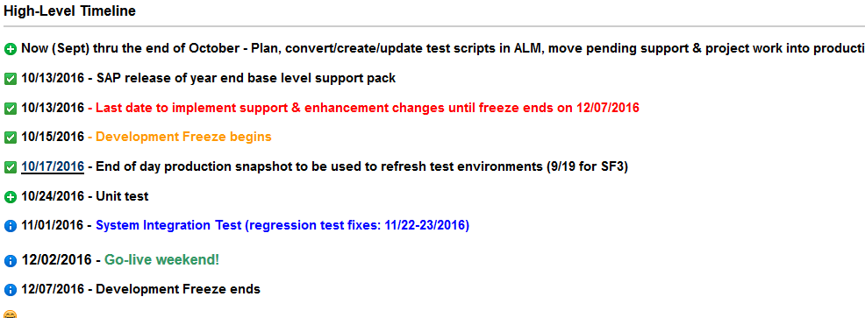
Important Dates

Slide 7
Testing
  Two Phase Approach
    Unit Test - performed in SF2 by IS&T
    System Integration – performed in SH2 by IS&T and Business Testers as a combined pool
  Planning
    ALM – Application Lifecycle Management (Central test case repository & tracking tool)
    Work with IS&T BA & SA
  Automated Testing
    Approximately 38% of last year’s test cases were been automated

Slide 8
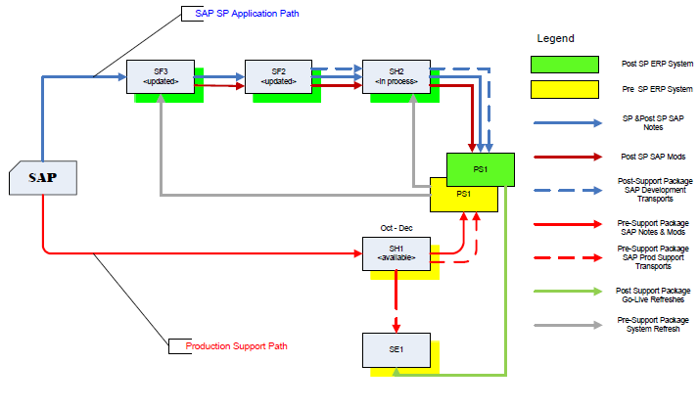
Where are we now?
Project Landscape

Slide 9
Where are we now?
(continued)
  Any issues so far?
  Yup!
  - let’s go to RT …
  Request Tracker

Slide 10
Transport Management
  So what if we have an issue in production during the freeze period that needs immediate attention?
  Let’s jump back to the wiki …
  2016+Year+End+SAP+Support+Pack+Project

Slide 11
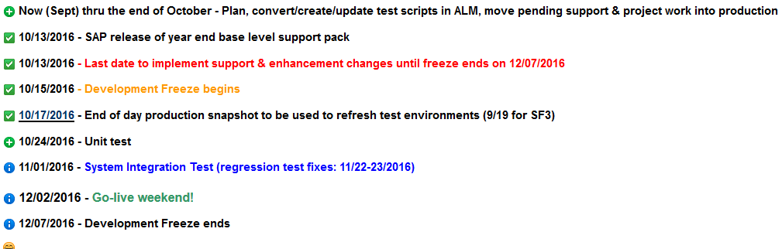
Recap of Important Dates

Slide 12
Next Steps
  Final review of your test cases (Business)
  Completion of application of support packs to the Test Systems (IS&T)
  Test Execution (Business & IS&T)
  Prepare for go-live (All)

Slide 13
Questions?
Please contact:
Contact | Email | Phone extension
Bob Casey | rcasey@mit.edu | x3-1844
Jim Fragala | jfragala@mit.edu | x4-6250
Lisa Robinson | lmrobin@mit.edu | x8-0492
Ron Parker | rep@mit.edu | x3-1339
Frank Quern | fquern@mit.edu | x2-4512

Slide 14
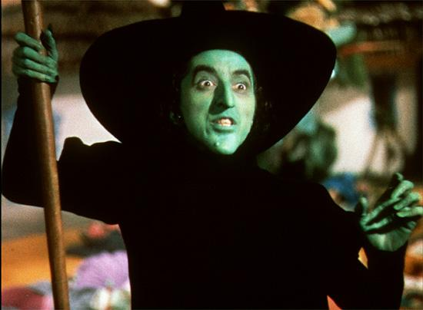
the wicked witch of the west
Happy Halloween!

