Slide 1
Trivial Pursuits
G
What country owns the Azores?
E
What Beatles album cover shows Paul walking barefoot with his eyes closed?
H
What city became the U.S. federal capital in 1789?
AL
What's the most common name in nursery rhymes?
SN
Which pole gets more sunlight, the North Pole or the South Pole?
SL
What was the first U.S. based team in the NHL?

Slide 2
And the answers are …
G
What country owns the Azores?
Portugal
E
What Beatles album cover shows Paul walking barefoot with his eyes closed?
Abbey Road
H
What city became the U.S. federal capital in 1789?
New York
What's the most common name in nursery rhymes?
Jack
AL
SN
Which pole gets more sunlight, the North Pole or the South Pole?
The North Pole
SL
What was the first U.S. based team in the NHL?
The Boston Bruins

Slide 3
2017 Year End Support Pack Project
SAPbiz
Kickoff
October 4, 2017

Slide 4
Agenda
Background
Project Organization
Project wiki
Project Risks
Important Dates
Next Steps

Slide 5
Background
Support Packs
  We all know what they are, periodic releases of system changes and corrections by SAP.
  Rather than apply these support packs when released we collect the Support Packs for a single installation at year end in an effort to minimize business interruption.
  The timing of our process is driven by SAP’s release of its year end support pack, typically in mid-October, which contains the base level necessary for the successful execution of SAP’s delivered year end tax reporting functionality (AP and Payroll) and stages the system for regulatory changes for the upcoming calendar year.

Slide 6
Background
What are the benefits of applying Support Packs and the process itself?
  MIT will be able to successfully file its year end tax returns (W2s, 1099s, 1042s).
  MIT will be able to apply future regulatory changes with minimal interruption.
  It is an opportunity to keep all functional areas current.
  It adheres to SAP’s support recommendations.
  It provides a solid organizational exercise in testing.
  Ensures up to date test scripts for chosen transaction.

Slide 7
Project Organization
Communication
Planning
Support Pack Technical Application
Testing
Go-live

Slide 8
Project Organization
Communication
  Project Kickoff Meetings
    Steering Committee – 9/22
    IS&T – Core Team & Extended Team – 9/28
    SAPbiz – 10/04
  Monthly Meetings
    Steering Committee
    SAPbiz
  Weekly Meetings
    HEC/R3 Team
    Test Coordinating - Business & IS&T
  Email lists
  Project wiki
    https://wikis.mit.edu/confluence/display/sapscripts/2017+Year+End+SAP+Support+Pack+Project
    Contains project plans, test plans, general information, etc …; great source – use it!
    Don’t have access please contact Frank Quern (fquern@mit.edu)

Slide 9
Planning
Lets jump to the project wiki …
to look at the Project Scope
to look at the Team Roles & Responsibilities
to look at the Technical Landscape
to look at the Schedule
to look at the Project Transport Management Process
to look at the Project Testing Plan
    https://wikis.mit.edu/confluence/display/sapscripts/2017+Year+End+SAP+Support+Pack+Project

Slide 10
Other Non-SP Projects
Other non-support pack project work (during SP project timeline)
  Facilities: COSMOS
  HR: I-9 E-Verify
  HR: Open Enrollment
  Payroll: SM Payroll Conversion
  Other activities
    Hana Upgrade (pre-support packs)
    Hana Migration to new server hardware - expanded memory (pre-support packs)

Slide 11
Project Risks
Identified Risks
  Delay in SAP Releases
  Resource availability for the project (both Business & IS&T)
  Delay of implementation of pre-Support Pack Projects
    OE (scheduled for October)
    COSMOS

Slide 12
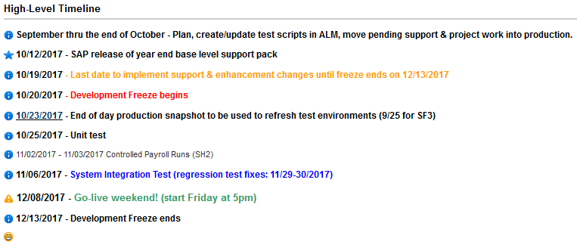
Important Dates

Slide 13
Next Steps
  Your commitment to this plan
  Finish System changes currently in the pipeline
  Test Planning
  System preparation
    Hana DB upgrades (SF3, SF2)
    SF3 Refresh
    SH2 Hana Server and DB Upgrade
    PS1 Hana Server and DB Upgrade

Slide 14
Not-soTrivial Pursuits
G
What environment will we be testing in?
E
What is ALM?
H
When will the last transports be moved to production before the freeze?
Where can I find project related information?
AL
SN
What are we updating?
SL
When is go-live weekend?

Slide 15
Questions?
Any additional questions? Please contact:
Contact | Email | Phone extension
Bob Casey | rcasey@mit.edu | x3-1844
Jim Fragala | jfragala@mit.edu | x4-6250
Lisa Robinson | lmrobin@mit.edu | x8-0492
Ron Parker | rep@mit.edu | x3-1339
Frank Quern | fquern@mit.edu | x2-4512

