Slide 1
Trivial Pursuits
G
What state can you see if you look east across the Mississippi from St. Louis?
E
Who did Lurch work for?
H
Who was the first U.S. president to appear on TV’s Meet the Press?
AL
What drug did Sherlock Holmes take at the start of his career?
SN
What did a United Nation’s organization say consisted of 356,000 metric tons in 1978?
SL
What’s Joe Namath’s nickname?

Slide 2
And the answers are …
G
What state can you see if you look east across the Mississippi from St. Louis?
Illinois
E
Who did Lurch work for?
The Addams family
H
Who was the first U.S. president to appear on TV’s Meet the Press?
Gerald Ford
What drug did Sherlock Holmes take at the start of his career?
Cocaine
AL
SN
What did a United Nation’s organization say consisted of 356,000 metric tons in 1978?
All the tea in China
SL
What’s Joe Namath’s nickname?
Broadway Joe

Slide 3
2017 Year End Support Pack Project
SAPbiz
Update
November 1, 2017

Slide 4
Agenda
Quick Review of the Project Scope
Update on Project Risks
High Level Time Line (& where are we now?)
Testing
Important Dates Revisited
Next Steps

Slide 5
Project Scope Update
What are we updating?
  Let’s jump to the project wiki
    2017 SP WIKI

Slide 6
Project Scope Update
Preparation Upgrades
10/21/2017
  ERP & OpenText HANA DB System Upgrades
    Non-production HANA DB
    Production HANA DB
  ERP Hardware Upgrade
    New servers 1TB to 2TB Memory Upgrade (deferred)
10/19/2017
  BSI Upgrade
    TaxFactory version P

Slide 7
Other Non-SP Projects
Other non-support pack project work (during SP project timeline)
  Facilities: COSMOS
  HR: I-9 E-Verify
  HR: Open Enrollment
  HR: Enriching Diversity Rollout
  Other activities
    Hana Upgrade (pre-support packs)
    Hana Migration to new server hardware - expanded memory (pre-support packs)

Slide 8
Project Risks
Identified Risks
  Delay in SAP Releases
  Resource availability for the project (both Business & IS&T)
  Delay of implementation of pre-Support Pack Projects
    OE (scheduled for October)
    COSMOS
    Production Support Hardware Availability (SH1)

Slide 9
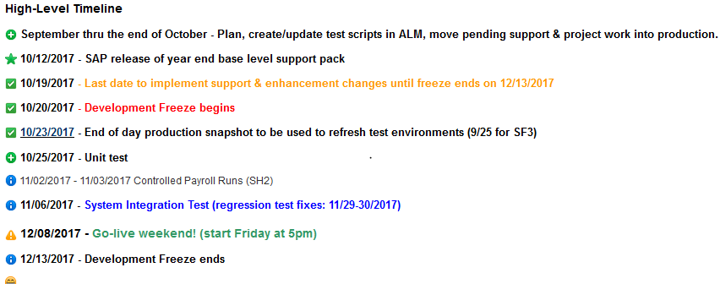
Important Dates

Slide 10
Testing
  Two Phase Approach
    Unit Test - performed in SF2 by IS&T
    System Integration – performed in SH2 by IS&T and Business Testers as a combined pool
  Planning
    ALM – Application Lifecycle Management (Central test case repository & tracking tool)
    Work with IS&T BA & SA
  Automated Testing
    Approximately 33% of last year’s test cases were automated
    Looking like approximately 35% this year (600 cases up 60 from last year)

Slide 11
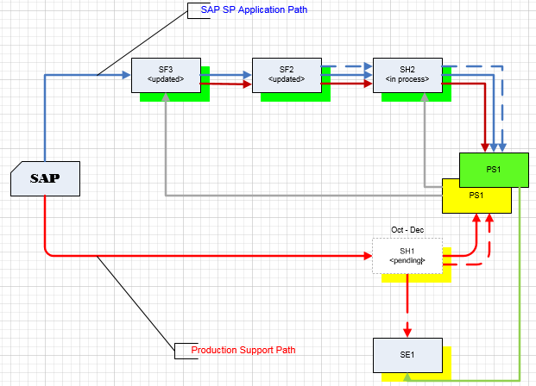
Where are we now?
Project Landscape

Slide 12
Where are we now?
(continued)
  Any issues so far?
  Yes, but surprisingly not many!
  - let’s go to RT to review …
  Request Tracker

Slide 13
Transport Management
  So what if we have an issue in production during the freeze period that needs immediate attention?
  Let’s jump back to the wiki …
  2017+Year+End+SAP+Support+Pack+Project

Slide 14
Recap of Important Dates

Slide 15
Next Steps
  Final review of test cases (Business)
  Completion of application of support packs to the Test Systems (IS&T)
  Unit Test (IS&T)
  SI/UA Test Execution (Business & IS&T)
  Prepare for go-live (All)

Slide 16
Questions?
Any additional questions? Please contact:
Contact | Email | Phone extension
Bob Casey | rcasey@mit.edu | x3-1844
Jim Fragala | jfragala@mit.edu | x4-6250
Lisa Robinson | lmrobin@mit.edu | x8-0492
Ron Parker | rep@mit.edu | x3-1339
Frank Quern | fquern@mit.edu | x2-4512

Slide 17
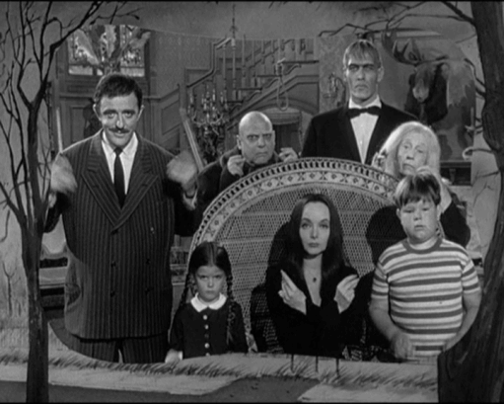
the Addams family
Happy Halloween!

