Slide 1
2017 Year End Support Pack Project
Steering Committee
Update
October 25, 2017

Slide 2
Agenda
Quick Review of the Project Scope
Update on Project Risks
High Level Time Line (& where are we now?)
Testing
Important Dates Revisited
Next Steps

Slide 3
Project Scope Update
What are we updating?
  Let’s jump to the project wiki
    2017 SP WIKI

Slide 4
Project Scope Update
Preparation Upgrades
10/21/2017
  ERP & OpenText HANA DB System Upgrades
    Non-production HANA DB
    Production HANA DB
  ERP Hardware Upgrade
    New servers 1TB to 2TB Memory Upgrade (deferred)
10/19/2017
  BSI Upgrade
    TaxFactory version P

Slide 5
Other Non-SP Projects
Other non-support pack project work (during SP project timeline)
  Facilities: COSMOS
  HR: I-9 E-Verify
  HR: Open Enrollment
  HR: Enriching Diversity Rollout
  Other activities
    Hana Upgrade (pre-support packs)
    Hana Migration to new server hardware - expanded memory (pre-support packs)

Slide 6
Project Risks
Identified Risks
  Delay in SAP Releases
  Resource availability for the project (both Business & IS&T)
  Delay of implementation of pre-Support Pack Projects
    OE (scheduled for October)
    COSMOS
    Production Support Hardware Availability (SH1)

Slide 7
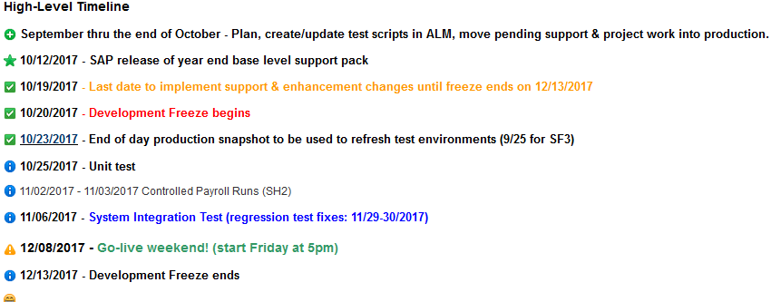
Important Dates

Slide 8
Testing
  Two Phase Approach
    Unit Test - performed in SF2 by IS&T
    System Integration – performed in SH2 by IS&T and Business Testers as a combined pool
  Planning
    ALM – Application Lifecycle Management (Central test case repository & tracking tool)
    Work with IS&T BA & SA
  Automated Testing
    Approximately 33% of last year’s test cases were automated (540 cases)

Slide 9
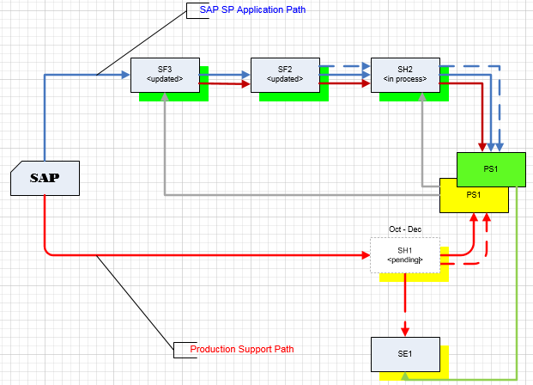
Where are we now?
Project Landscape

Slide 10
Where are we now?
(continued)
  Any issues so far?
  No! Surprisingly.
  - let’s go to RT to confirm …
  Request Tracker

Slide 11
Transport Management
  So what if we have an issue in production during the freeze period that needs immediate attention?
  Let’s jump back to the wiki …
  2017+Year+End+SAP+Support+Pack+Project

Slide 12
Recap of Important Dates

Slide 13
Next Steps
  Final review of test cases (Business)
  Completion of application of support packs to the Test Systems (IS&T)
  Unit Test (IS&T)
  SI/UA Test Execution (Business & IS&T)
  Prepare for go-live (All)

Slide 14
Questions?
Any additional questions? Please contact:
Contact | Email | Phone extension
Bob Casey | rcasey@mit.edu | x3-1844
Jim Fragala | jfragala@mit.edu | x4-6250
Lisa Robinson | lmrobin@mit.edu | x8-0492
Ron Parker | rep@mit.edu | x3-1339
Frank Quern | fquern@mit.edu | x2-4512

Slide 15

the wicked witch of the west
Happy Halloween!

