Slide 1
2017 Year End Support Pack Project
Steering Committee Update
(cutover)
December 4, 2017

Slide 2
Agenda
High Level Time Line (& where are we now?)
Testing
Issues
Cutover Plan
Next Steps

Slide 3
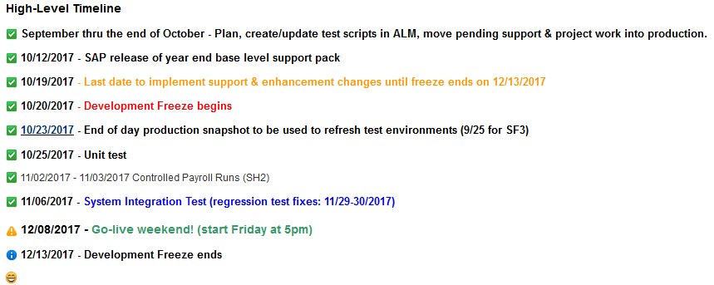
High Level Timeline

Slide 4
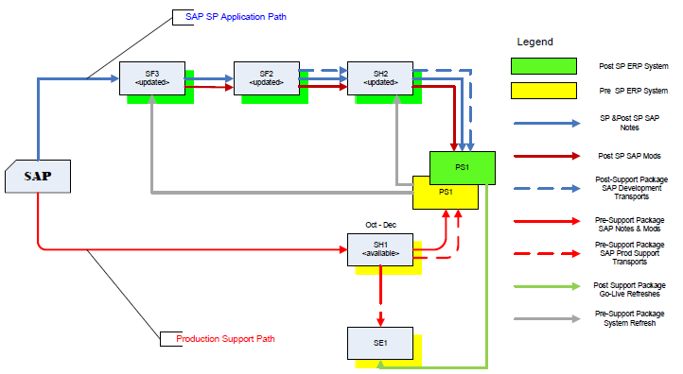
Where are we now?
Project Landscape

Slide 5
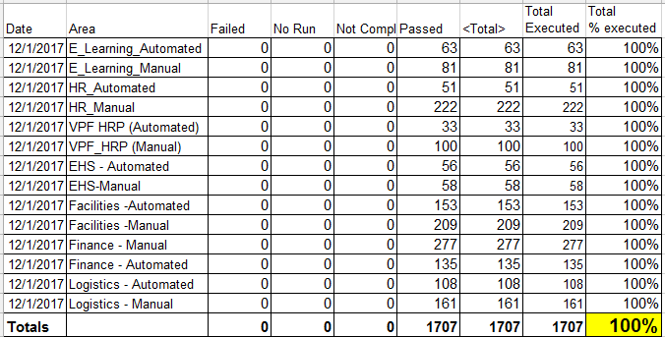
Testing Status
SH2: System Integration/User Acceptance Testing:
    Collaborative Business and IS&T integration and regression testing of Support Packs
Testing Results:

Slide 6
Issues
Is it worth it?
Well, yes …
  We can jump to RT for details: https://help.mit.edu/
Phases Issues were identified in …
(as of 11/28/17)
Issue type | Unit | SIT |  | Open
Required an SAP fix | 6 | 5
Required an MIT fix | 3 | 7
Infrastructure Related | 2 | 2
User/Data Error | 2 | 17
Duplicate |  | 1
Production Issue - to be addressed after SP | 2 | 7
Totals | 15 | 39 | 54 | 1

Slide 7
Issues (cont.)
How does it compare to prior years?
 | 2010 | 2011 | 2012 | 2013 | 2014 | 2015* | 2016 | 2017
Issues | 64 | 41 | 54 | 86 | 58 | 135 | 73 | 54
SAP fix required | 3 | 8 | 9 | 23 | 22 | 16 | 9 | 11
MIT fix required | 23 | 17 | 17 | 19 | 21 | 25 | 33 | 10
Total fixes required | 26 | 25 | 26 | 42 | 43 | 41 * HEC | 42 | 21

Slide 8
Next Steps
12/4/2017 Community notification
12/6/2017 SAPbiz
12/8/2017 (5:00pm) - 12/11/2017 Go-live weekend!
Meaning … we’ll have to execute a cutover plan!!

Slide 9
Cutover
Preparation work
System Isolation
Support Pack Application
Post Upgrade Processes (conversions, validations)
Go-live
  Let’s jump to the project wiki’s Cutover Plan page and take a look at the plan …

Slide 10
Questions?
Please contact:
Contact | Email | Phone extension
Bob Casey | rcasey@mit.edu | x3-1844
Jim Fragala | jfragala@mit.edu | x4-6250
Lisa Robinson | lmrobin@mit.edu | x8-0492
Ron Parker | rep@mit.edu | x3-1339
Frank Quern | fquern@mit.edu | x2-4512

Slide 11

Support Packs are Coming!
Support Packs are Coming!
We’re ready (are you?)

