Slide 1
Trivial Pursuits
G
What U.S. city had the first subway?
E
How many lords-a-leaping are there in the carol Twelve Days of Christmas?
H
Whose likeness is depicted on the Purple Heart?
What is the distinction of Erle Stanley Gardner’s The Case of the Terrified Typist?
AL
SN
How often are brain cells replaced?
SL
What’s the diameter of a golf hole?

Slide 2
And the answers are …
G
What U.S. city had the first subway?
Boston
How many lords-a-leaping are there in the carol Twelve Days of Christmas?
Ten
E
H
Whose likeness is depicted on the Purple Heart?
George Washington’s
What is the distinction of Erle Stanley Gardner’s The Case of the Terrified Typist?
Perry Mason loses
AL
SN
How often are brain cells replaced?
Never
SL
What’s the diameter of a golf hole?
Four and a quarter inches

Slide 3
2018 Year End Support Pack Project
IS&T Update
(cutover)
November 28, 2018

Slide 4
Agenda
High Level Time Line (& where are we now?)
Testing
Issues
Cutover Plan
Next Steps

Slide 5
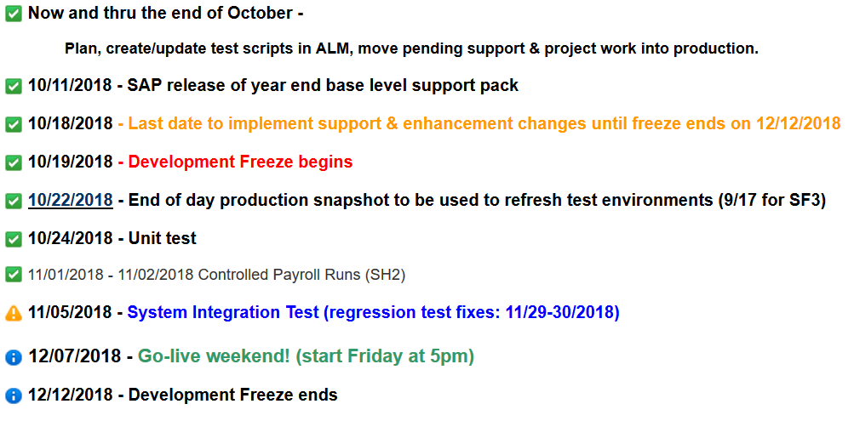
High Level Timeline

Slide 6
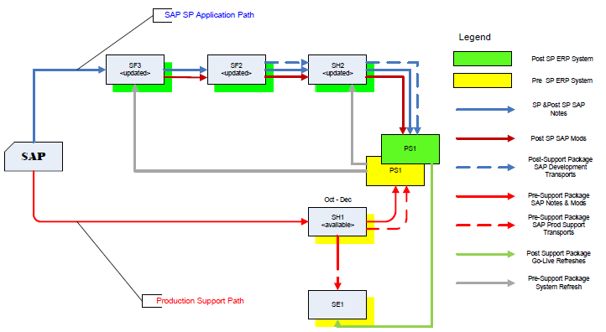
Where are we now?
Project Landscape

Slide 7
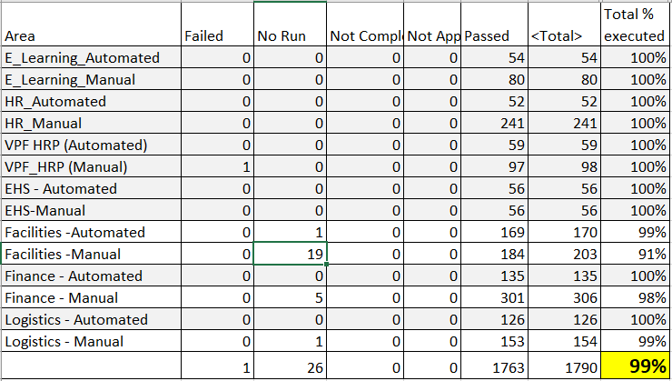
Testing Status
SH2: System Integration/User Acceptance Testing:
    Collaborative Business and IS&T integration and regression testing of Support Packs
Testing Results:

Slide 8
Issues
Is it worth it?
Well, yes …
  We can jump to RT for details: https://help.mit.edu/
Phases Issues were identified in …
(as of 11/28/17)
Issue type | Unit | SIT |  | Open
Required an SAP fix | 6 | 2
Required an MIT fix | 5 | 6
Infrastructure Related | 3 | 1
User/Data Error |  | 8
Duplicate
Production Issue - to be addressed after SP | 1 | 3
Totals | 15 | 20 | 35 | 2

Slide 9
Issues (cont.)
How does it compare to prior years?
 | 2011 | 2012 | 2013 | 2014 | 2015* | 2016 | 2017 | 2018
Issues | 41 | 54 | 86 | 58 | 135 | 73 | 54 | 35
SAP fix required | 8 | 9 | 23 | 22 | 16 | 9 | 11 | 8
MIT fix required | 17 | 17 | 19 | 21 | 25 | 33 | 10 | 11
Total fixes required | 25 | 26 | 42 | 43 | 41 * HEC | 42 | 21 | 19

Slide 10
Next Steps
11/29/2018 SAPbiz
12/05/2018 Community notification
12/07/2018 (5:00pm) - 12/10/2018 Go-live weekend!
Meaning … we’ll have to execute a cutover plan!!

Slide 11
Cutover
Preparation work
System Isolation
Support Pack Application
Post Upgrade Processes (conversions, validations)
Go-live
  Let’s jump to the project wiki’s Cutover Plan page and take a look at the plan …

Slide 12
Not-soTrivial Pursuits
G
How can I find out the status of the cutover?
Check your email; check the project wiki.
E
Who performs the validations?
Assigned business personnel as defined in the cutover plan.
H
When will the SAP system be brought down?
5:00 PM Friday 12/7/2018
Where can I find the cutover plan?
On the project wiki
AL
SN
What are we updating?
The SAP ERP System (including GRC, SMP, & ADS)
SL
When is go-live weekend?
12/7 (5:00pm) -12/10/2018

Slide 13
Questions?
Please contact:
Contact | Email | Phone extension
Bob Casey | rcasey@mit.edu | x3-1844
Jim Fragala | jfragala@mit.edu | x4-6250
Lisa Robinson | lmrobin@mit.edu | x8-0492
Ron Parker | rep@mit.edu | x3-1339
Frank Quern | fquern@mit.edu | x2-4512

Slide 14
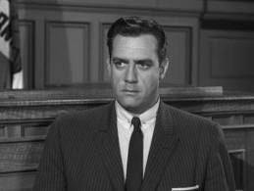
The Verdict is in …
Support Packs are coming!
We’re ready (are you?)

