Slide 1
Trivial Pursuits
G
What country owns the Azores?
E
What Beatles album cover shows Paul walking barefoot with his eyes closed?
H
Whose name, apart from the astronauts‘ is on the Apollo 11 moon plaque?
AL
What is the Japanese word for divine wind?
SN
What's the largest feline?
SL
What's a ball that hits the foul pole called?

Slide 2
And the answers are …
G
What country owns the Azores?
Portugal
E
What Beatles album cover shows Paul walking barefoot with his eyes closed?
Abbey Road
H
Whose name, apart from the astronauts‘ is on the Apollo 11 moon plaque?
Richard Nixon's
What is the Japanese word for divine wind?
Kamikaze
AL
SN
What's the largest feline?
The tiger
SL
What's a ball that hits the foul pole called?
A home run

Slide 3
2018 Year End Support Pack Project
SAPbiz
Kickoff
October 3, 2018

Slide 4
Agenda
Background
Project Organization
Project wiki
Project Risks
Important Dates
Next Steps

Slide 5
Background
Support Packs
  We all know what they are, periodic releases of system changes and corrections by SAP.
  Rather than apply these support packs when released we collect the Support Packs for a single installation at year end in an effort to minimize business interruption.
  The timing of our process is driven by SAP’s release of its year end support pack, typically in mid-October, which contains the base level necessary for the successful execution of SAP’s delivered year end tax reporting functionality (AP and Payroll) and stages the system for regulatory changes for the upcoming calendar year.

Slide 6
Background
What are the benefits of applying Support Packs and the process itself?
  MIT will be able to successfully file its year end tax returns (W2s, 1099s, 1042s).
  MIT will be able to apply future regulatory changes with minimal interruption.
  It is an opportunity to keep all functional areas current.
  It adheres to SAP’s support recommendations.
  It provides a solid organizational exercise in testing.
  Ensures up to date test scripts for chosen transaction.

Slide 7
Project Organization
Communication
Planning
Support Pack Technical Application
Testing
Go-live

Slide 8
Project Organization
Communication
  Project Kickoff Meetings
    Steering Committee – 9/19
    IS&T – Core Team & Extended Team – 9/26
    SAPbiz – 10/03
  Monthly Meetings
    Steering Committee
    SAPbiz
  Weekly Meetings
    HEC/R3 Team
    Test Coordinating - Business & IS&T
  Email lists
  Project wiki
    https://wikis.mit.edu/confluence/display/sapscripts/2018+Year+End+SAP+Support+Pack+Project
    Contains project plans, test plans, general information, etc …; great source – use it!
    Don’t have access please contact Frank Quern (fquern@mit.edu)

Slide 9
Planning
Lets jump to the project wiki …
to look at the Project Scope
to look at the Schedule
to look at the Team Roles & Responsibilities
to look at the Technical Landscape
to look at the Project Transport Management Process
to look at the Project Testing Plan
    https://wikis.mit.edu/confluence/display/sapscripts/2018+Year+End+SAP+Support+Pack+Project

Slide 10
Other Non-SP Projects
Other non-support pack project work (during SP project timeline)
  Facilities: Parking Application
  HR: I-9 APR Changes
  HR: Open Enrollment
  HR: CSP/CCSP
  HR: Job Reclassification
  Other activities
    Hana Upgrade (pre-support packs)
    Linux Upgrade (pre-support packs)

Slide 11
Project Risks
Identified Risks
  Delay in SAP Releases
  Resource availability for the project (both Business & IS&T)
  Delay of implementation of pre-Support Pack Projects
    OE (scheduled for October)

Slide 12
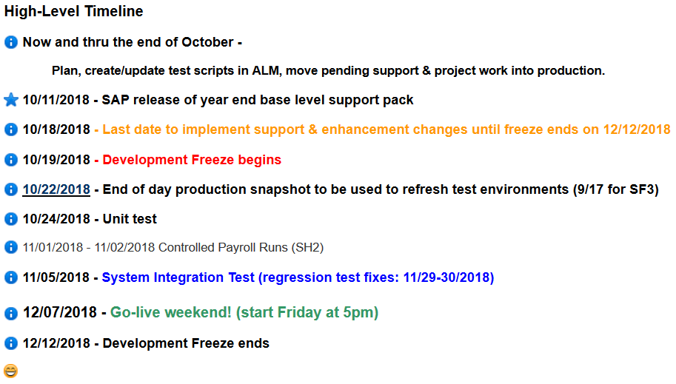
Important Dates

Slide 13
Next Steps
  Finish System changes currently in the pipeline
  Unit Test Spreadsheet
  Test Planning
  System preparation
    Hana/Linux Upgrades (SF3, SF2)
    SF3 Refresh
    SH2 Hana/Linux Upgrade
    PS1 Hana/Linux Upgrade

Slide 14
Not-soTrivial Pursuits
G
What environment will we be testing in?
E
What is ALM(QC)?
H
When will the last transports be moved to production before the freeze?
Where can I find project related information?
AL
SN
What are we updating?
SL
When is go-live weekend?

Slide 15
Questions?
Any additional questions? Please contact:
Contact | Email | Phone extension
Bob Casey | rcasey@mit.edu | x3-1844
Jim Fragala | jfragala@mit.edu | x4-6250
Lisa Robinson | lmrobin@mit.edu | x8-0492
Ron Parker | rep@mit.edu | x3-1339
Frank Quern | fquern@mit.edu | x2-4512

Slide 16
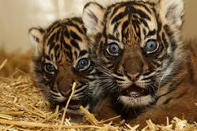
Support Packs? What support packs?

