Slide 1
Trivial Pursuits
G
What city does Beacon Hill light?
E
Who did Lurch work for?
H
What was John F. Kennedy’s 1960 campaign song?
AL
Who is Schroeder’s favorite composer?
SN
What is by far the largest organ of the human body?
SL
What college football team did Knute Rockne build into a power?

Slide 2
And the answers are …
G
What city does Beacon Hill light?
Boston
E
Who did Lurch work for?
The Addams family
H
What was John F. Kennedy’s 1960 campaign song?
High Hopes
Who is Schroeder’s favorite composer?
Ludwig van Beethoven
AL
SN
What is by far the largest organ of the human body?
The skin
SL
What college football team did Knute Rockne build into a power?
Notre Dame

Slide 3
2018 Year End Support Pack Project
SAPbiz
Update
October 31, 2018

Slide 4
Agenda
Quick Review of the Project Scope
Update on Project Risks
High Level Time Line (& where are we now?)
Testing
Important Dates Revisited
Next Steps

Slide 5
Project Scope Update
What are we updating?
  Let’s jump to the project wiki
    2018 SP WIKI

Slide 6
Project Scope Update
Preparation Upgrades
10/31/2018
  ERP HANA DB System Upgrades
    Non-production HANA DB
Production HANA DB (Saturday 11/10)

Slide 7
Other Non-SP Projects
Other non-support pack project work (during SP project timeline)
  HR: CSP/CCSP
  HR: Open Enrollment
  HR: Job Reclassification
  FAC: Parking Application
  Other activities
    None identified at this time

Slide 8
Project Risks
Identified Risks
  Delay in SAP Releases
  Resource availability for the project (both Business & IS&T)
  Delay of implementation of pre-Support Pack Projects
    OE (scheduled for October)
  Production Support Hardware Availability (SH1)

Slide 9
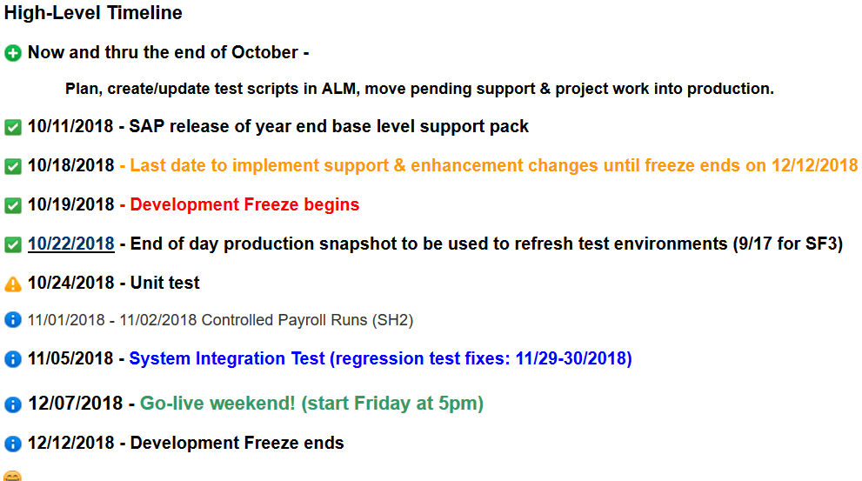
Important Dates

Slide 10
Testing
  Two Phase Approach
    Unit Test - performed in SF2 by IS&T
    System Integration – performed in SH2 by Business Testers and IS&T as a combined pool
  Planning
    ALM – Application Lifecycle Management (Central test case repository & tracking tool)
    Work with IS&T BA & SA
  Automated Testing
    Approximately 35% of last year’s test cases were automated
    Looking to be approximately 38% this year

Slide 11
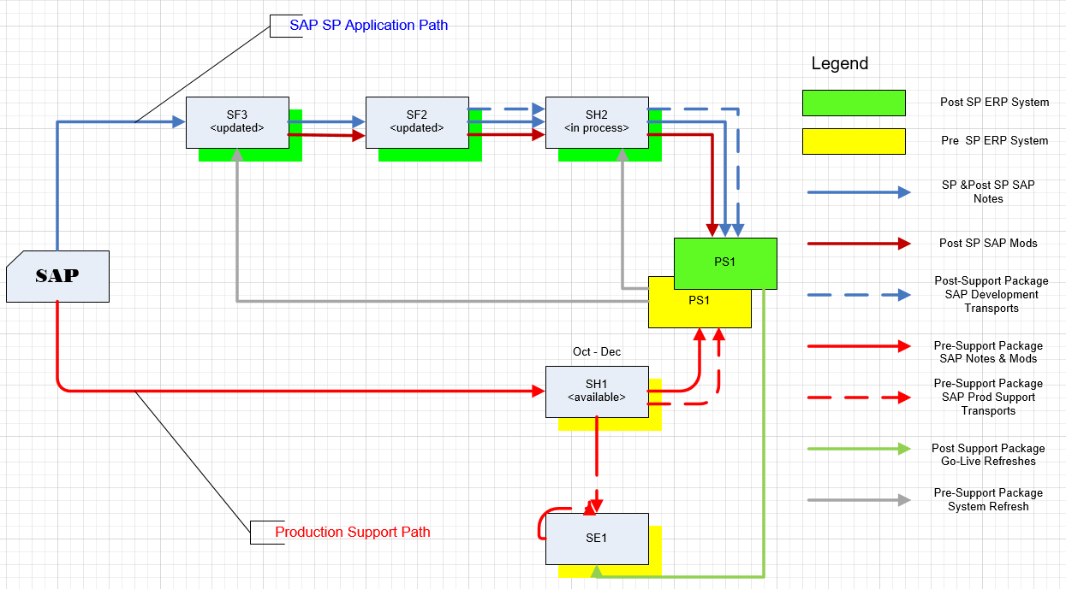
Where are we now?
Project Landscape

Slide 12
Where are we now?
(continued)
  Any issues so far?
  Yes, but surprisingly not many!
  - let’s go to RT to review …
  Request Tracker

Slide 13
Transport Management
  So what if we have an issue in production during the freeze period that needs immediate attention?
  Let’s jump back to the wiki …
  2018+Year+End+SAP+Support+Pack+Project

Slide 14
Recap of Important Dates

Slide 15
Next Steps
  Final review of test cases (Business)
  Completion of application of support packs to the Test Systems (IS&T)
  Unit Test (IS&T)
  SI/UA Test Execution (Business & IS&T)
  Prepare for go-live (All)

Slide 16
Questions?
Any additional questions? Please contact:
Contact | Email | Phone extension
Bob Casey | rcasey@mit.edu | x3-1844
Jim Fragala | jfragala@mit.edu | x4-6250
Lisa Robinson | lmrobin@mit.edu | x8-0492
Ron Parker | rep@mit.edu | x3-1339
Frank Quern | fquern@mit.edu | x2-4512

Slide 17
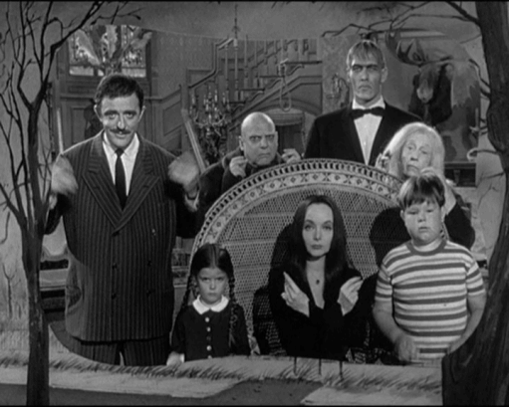
the Addams family
Happy Halloween!

