Slide 1
Introductory Points
Experience curves
are used to predict the rate of cost reduction in PV
require little data to construct, and seem to fit empirical data well
Conceptualizes experience as the sole driver of cost reduction; experience is operationalized as cumulative output
Despite a number of limitations, experience curves are frequently invoked in predicting future PV costs

Slide 2
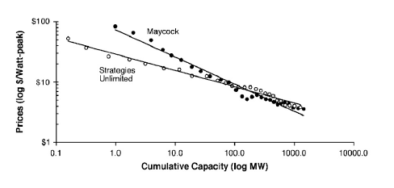
Experience Curves in PV
Source: Nemet G. (2006) Beyond the Learning Curve. Energy Policy, 34, 3218-3232
Progress Ratio (Maycock) = 0.74
Progress Ratio (Strategies Unlimited) = 0.83
Maycock is 1975-2001
Strategies Unlimited is 1976-2001
Curve updated through 2007
Note the recent discontinuity, likely due to shortage of polysilicon

Slide 3
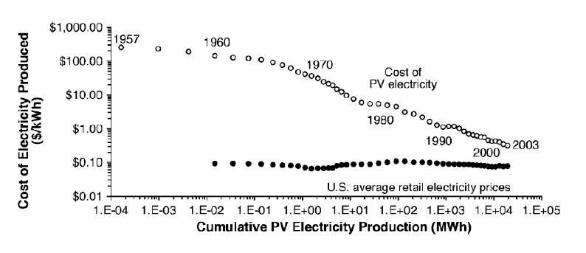
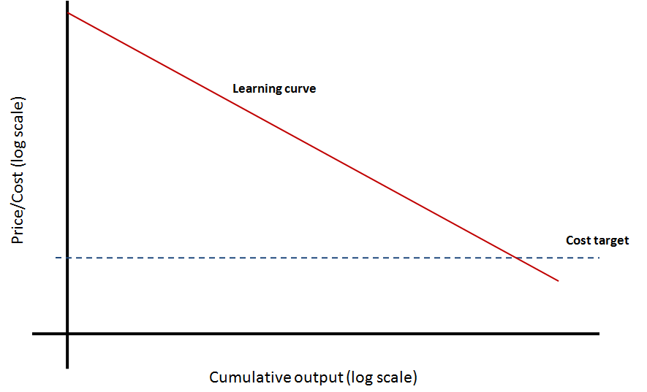
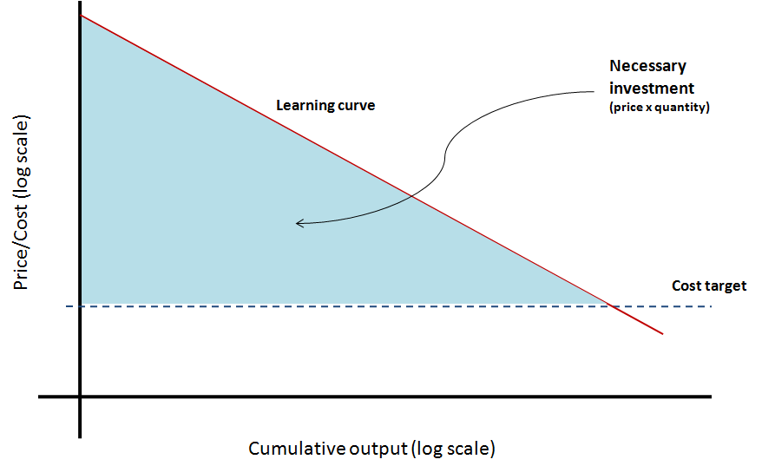
Source: Nemet G. (2006) Beyond the Learning Curve. Energy Policy, 34, 3218-3232
Cost of PV Electricity Approaching the Cost of Traditional Electricity?
Required Investment (“Buy Down”) to Reach a Cost Target

Slide 4
Mathematical Form of Experience Curves
Where:
C unit cost
q cumulative output
b learning coefficient
PR progress ratio – for every doubling of
cumulative output, the cost decreases to PR
LR learning ratio
Q: Why theorized as a logarithmic relationship?
A: Estimate of b does not depend on starting point – costs can always decrease
Q: How is b estimated?
A: b is estimated by linear regression (after log transformation)

Slide 5
Possible mechanisms behind the experience curve
Experience curves are a black box, but seem to be discussed as if a Rorschach blot
1) Learning-by-doing | “more is cheaper”
2) Economies of scale in production Economies of scale in input factors | “bigger is cheaper”
3) Increased efficiency/usefulness of product | e.g. more efficient PV modules e.g. tracking vs fixed PV systems
4) Diffusion & standardization | reduces overhead and cost from compatibility issues
Other mechanisms which may impact cost:
  Competitive vs monopolistic/oligopolistic market
  Conditions in input factor markets
References:
Lester. (2007). Lecture 20. Applications of Technology in Energy and the Environment
Woerlen. (2004). Experience Curves for Energy Technologies. Encyclopedia of Energy vol 2.

Slide 6
Issues with Experience Curves
Experience curves vs learning curves
Estimates of learning rates are sensitive to data quality and uncertainty
  Time and size of buy down investment to reach cost target is highly sensitive to learning rate
  E.g. For a target of $0.30/W, extrapolation of Maycock predicts breakeven at 2039 while extrapolation of Strategies Unlimited predicts breakeven at 2067 (Nemet, 2006)
  E.g. For a target of $0.10/kwh and a PR of 0.75, requires 48 GW of production. But with a PR of 0.85, requires 957 GW (Farmer and Trancik 2007)
Cannot predict discontinuities in curve
  e.g. recent shortage of silicon supply
Does not consider constraints like theoretical efficiency limits of specific PV technologies
Considers experience as the only determinant of cost reduction; lacks control variables
  e.g. ignores level of investment in R&D
Primary source: Nemet G. (2006) Beyond the Learning Curve. Energy Policy, 34, 3218-3232

Slide 7
(More) Issues with Experience Curves
Considers cost reduction as the only outcome of interest
  e.g. ignores reliability, potential for new applications
Observed goodness-of-fit of curves to empirical data may be the result of sampling bias (e.g. Model T, nuclear)
Ideally requires cost data, but often uses price data
  Requires assumption of unchanged market structure
  e.g. level of PV subsidy
Ignores spillover effects from related industries
  progress in semiconductors vs progress in PV
DV is non-cumulative, IV is cumulative -> autocorrelation
Must consider the level of analysis where learning occurs
  PV modules – global
  PV installation – National? State? Local?

Slide 8
History
Learning curve in aircraft production (Wright 1938)
Arrow (1962) brings learning curve concept into macroeconomic models

Slide 9
Required Investment to Reach a Cost Target
Learning curve
Price/Cost (log scale)
Cost target
Cumulative output (log scale)

Slide 10
Required Investment to Reach a Cost Target
Necessary investment
(price x quantity)
Learning curve
Price/Cost (log scale)
Cost target
Cumulative output (log scale)

