Slide 1
Air Brakes

Slide 2
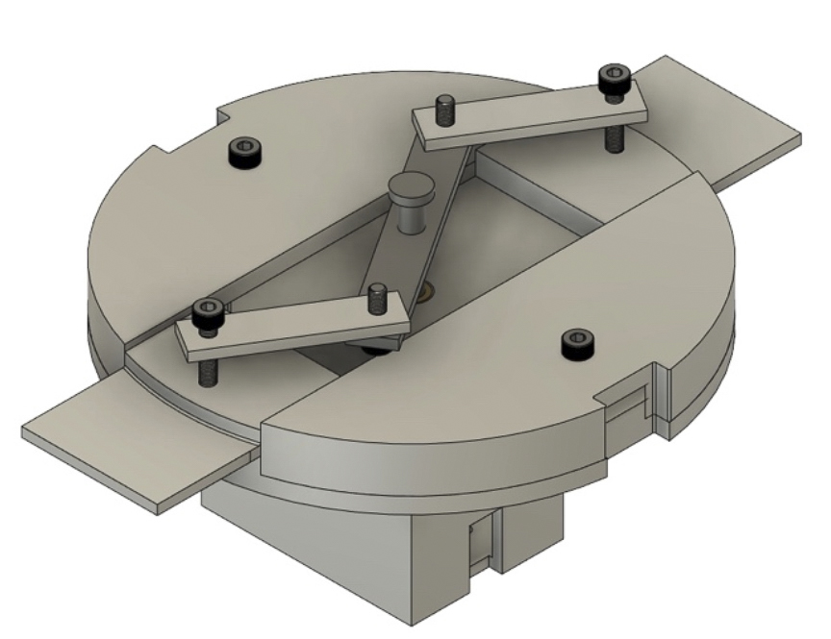
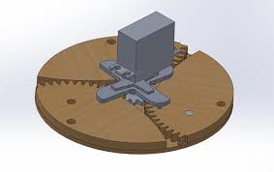
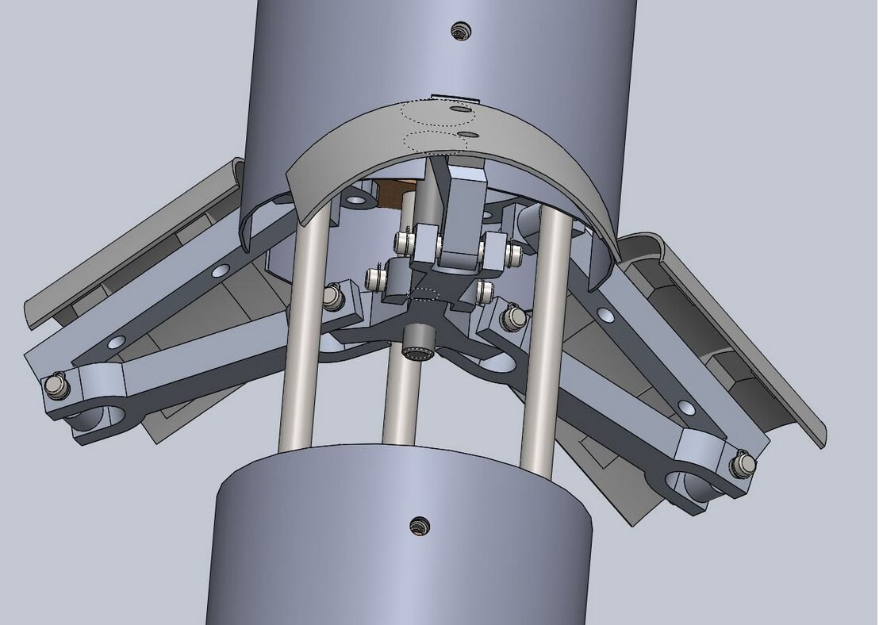
What are Air Brakes?
A mechanism that upon actuation, creates a large amount of drag to slow down the rocket
Suddenly creates a large amount of area outside the rocket which creates drag
Applications:
  Reaching target altitude with accuracy
  Drag separation

Slide 3
Functional Requirements
Actuation Time: Transition from fully retracted to fully extended within 0.5 seconds
Predictability: Produce a predictable amount of drag when fully extended
Purpose on Booster: Cause drag separation
Purpose on Sustainer: Reach target altitude with accuracy (prevent overshooting)
  Note: Avionics will be creating a feedback control loop to determine when to extend air brakes

Slide 4
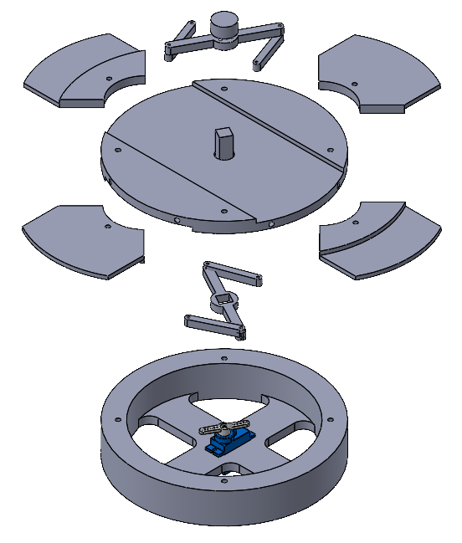
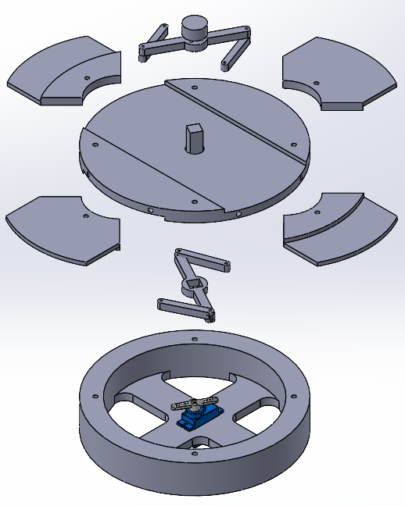
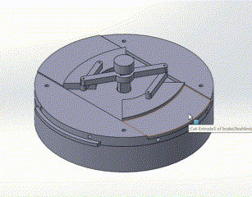
CAD

Slide 5
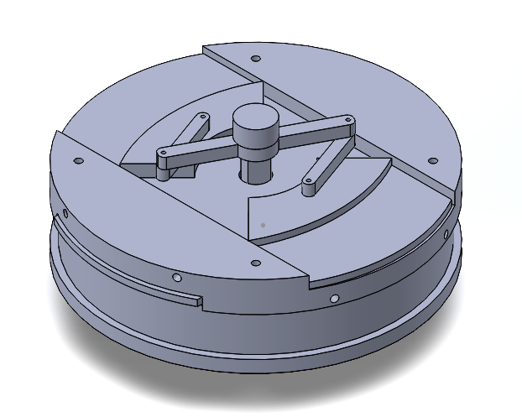
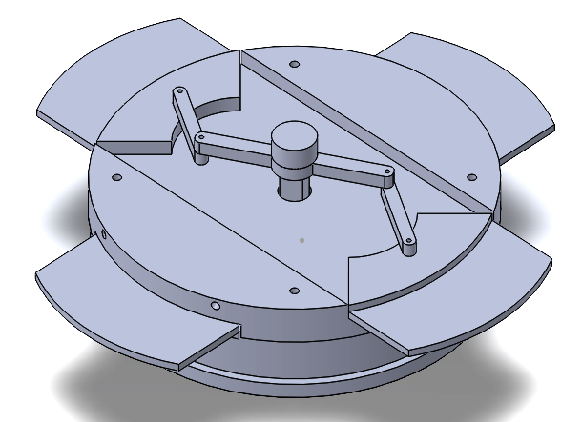
CAD

Slide 6
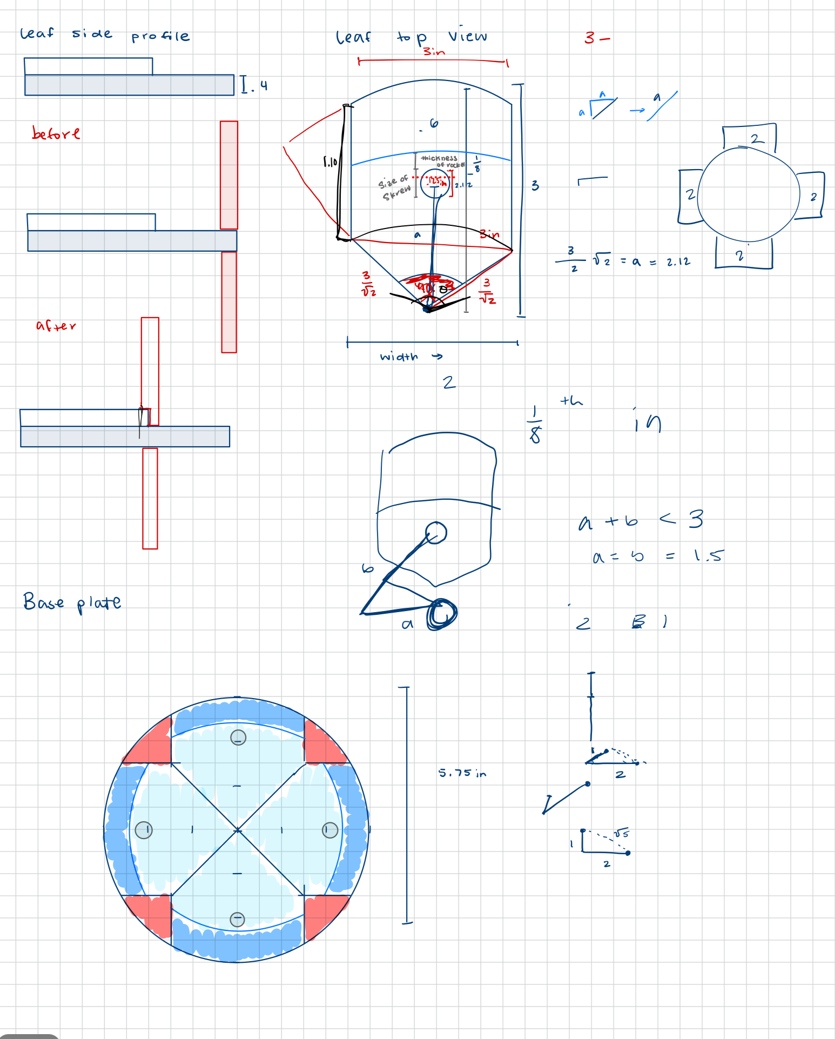
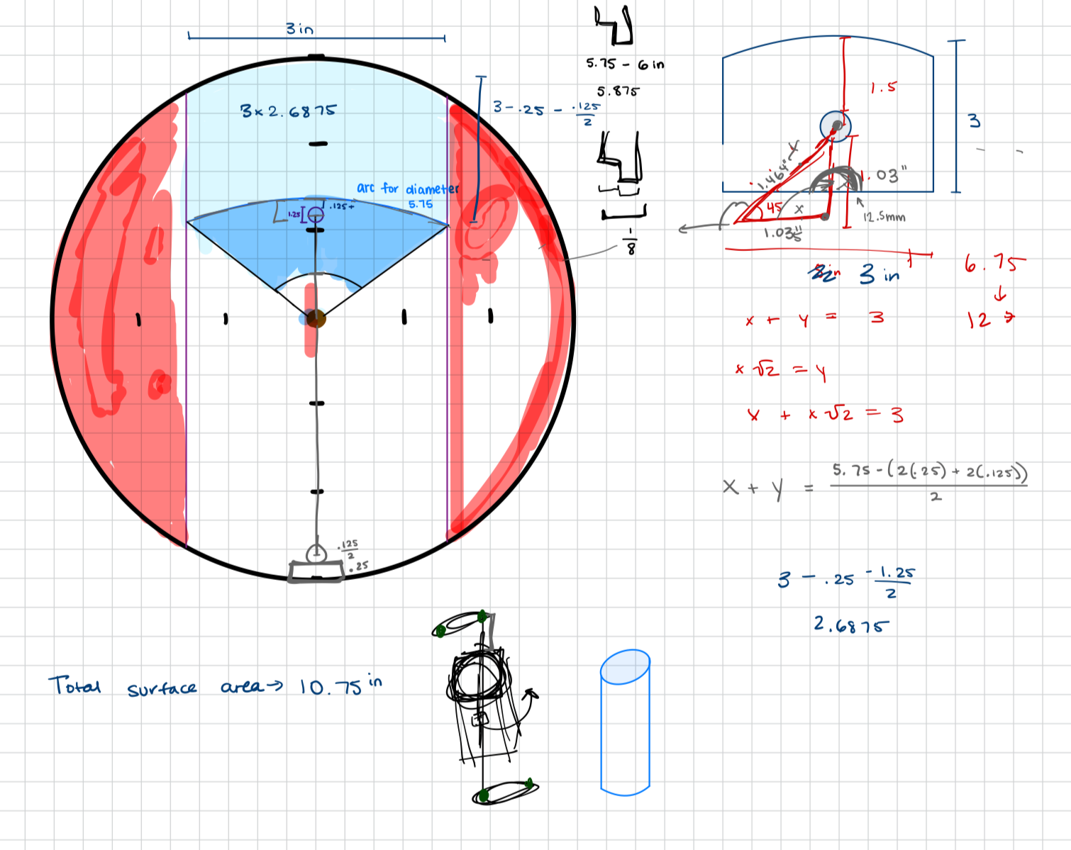
Design

Slide 7
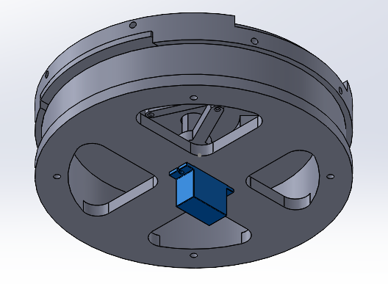
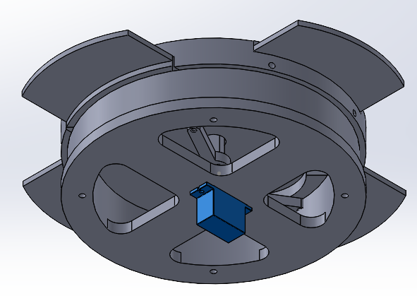
CAD Pt. 2

Slide 8
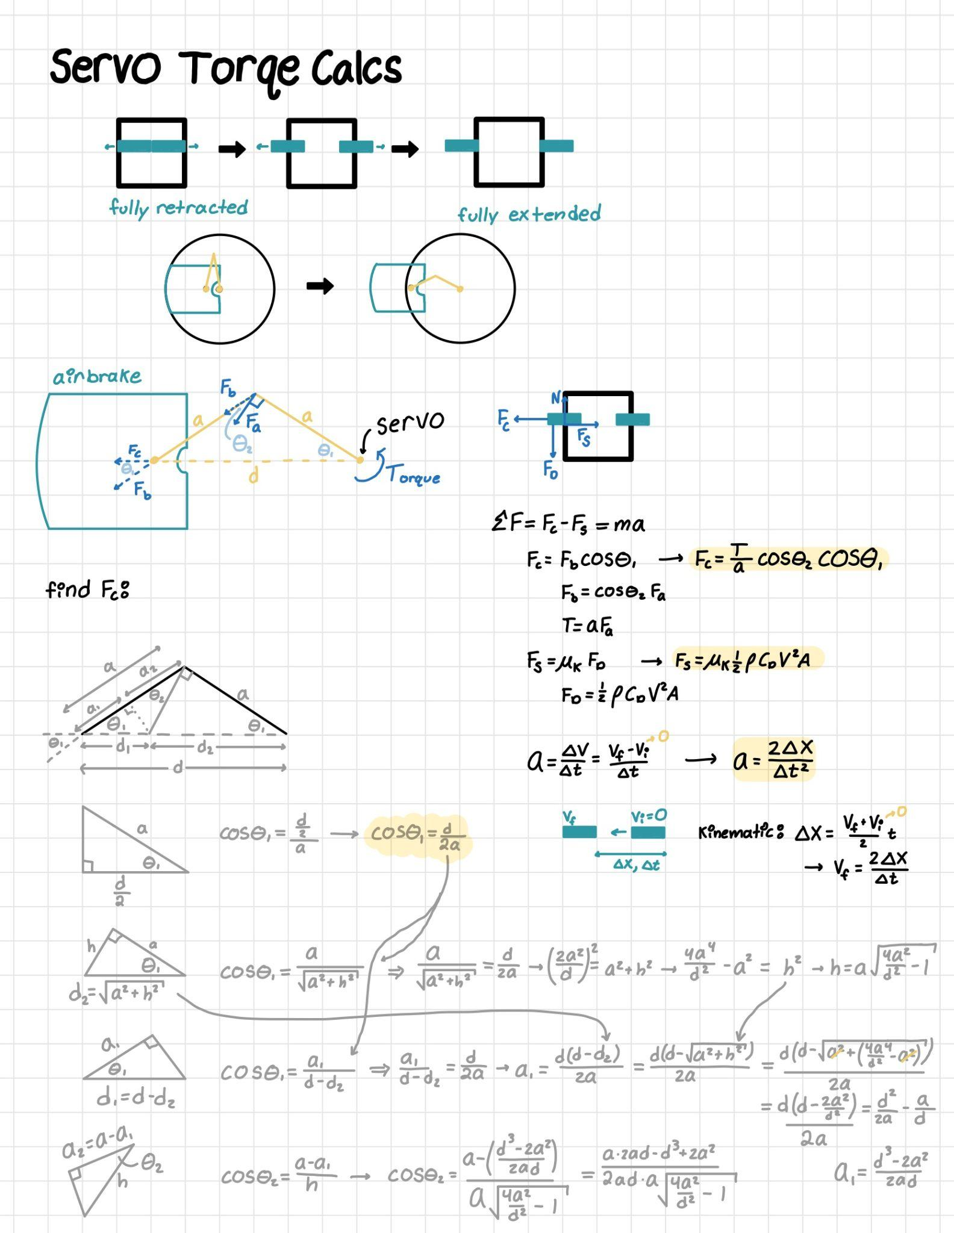
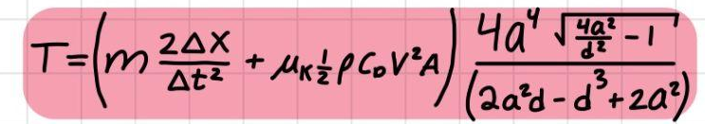
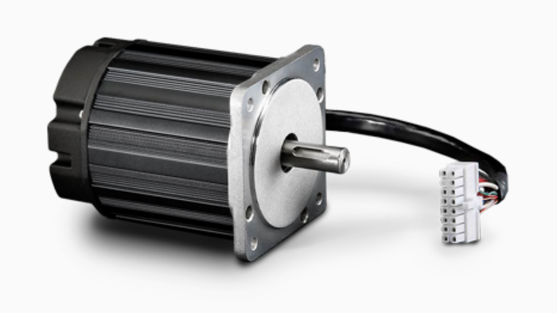
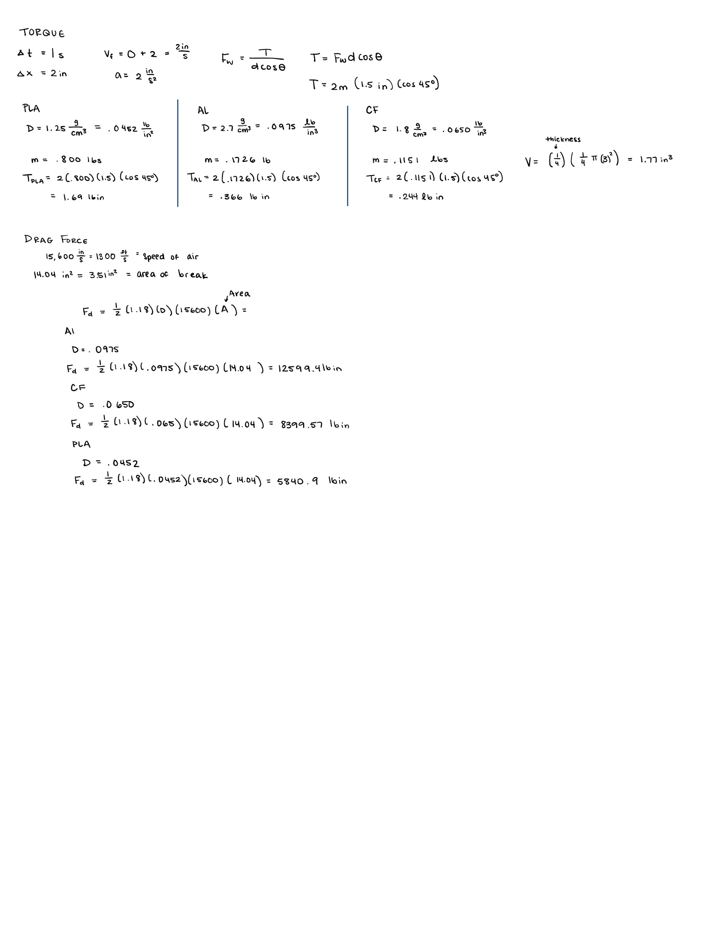
Torque Calcs
Plate experiences resistance to moving outward (deployment) due to friction with opening (drag force = normal force)
Inputs
Mass of plate
Distance extended
Time to extend
Coefficient of friction
Air density
Coefficient of drag
Velocity at deployment
Area of plate
Length of servo arms
Distance airbrake is extended
Results: 9.5 Nm = 1345 oz-in
Possible Servo:
Torque: 1435 oz-in
Size (LxW): 4.26 x 3.42 in
Notes:
https://teknic.com/products/brushless-servo-motors/hudson-motors-ready-ship/
https://teknic.com/hudson-model/M-3432S-LN-08D/?model_voltage=300
http://www.ee.ic.ac.uk/pcheung/teaching/DE1_EE/stores/sg90_datasheet.pdf

Slide 9
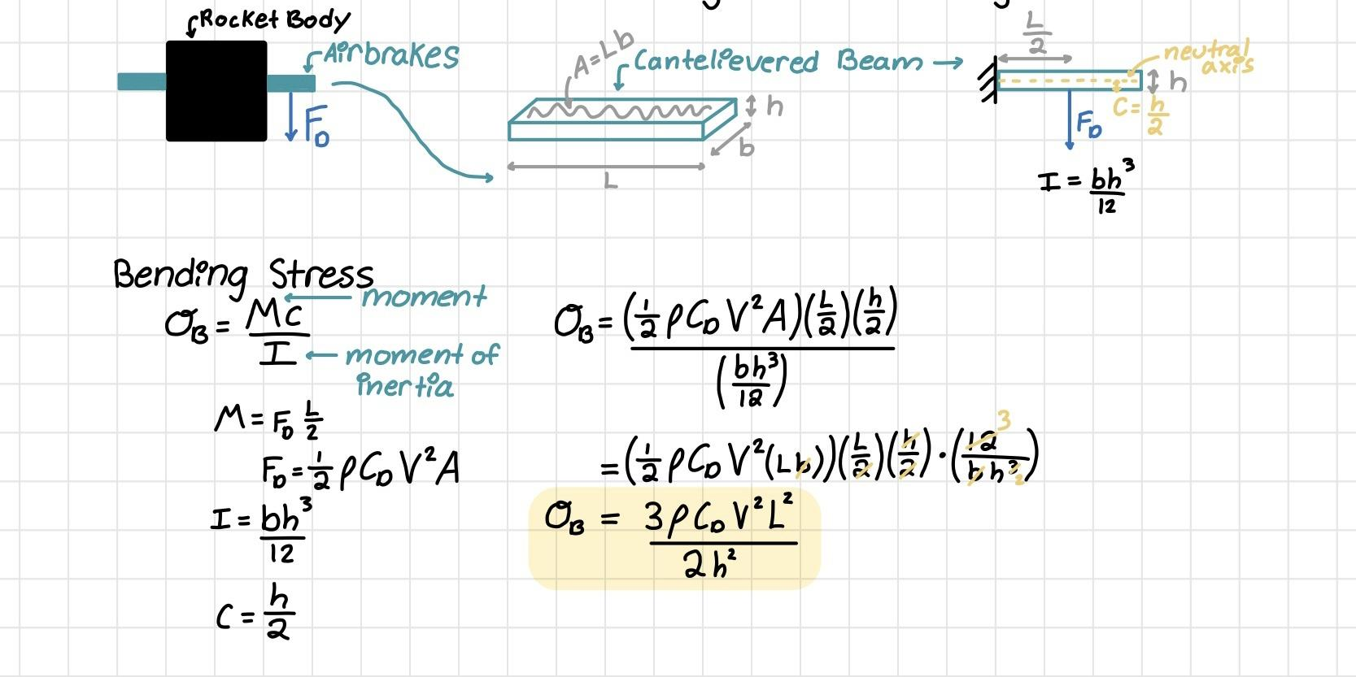
Material Selection
Finding the Bending Stress in the plate due to Drag Force when plate is fully extended
Inputs:
Coefficient of Drag (plate): 1.9
Air Density: 0.0765 lb/ft^3 (sea level)
Velocity at Deployment: 400 ft/s
Length of Plate: 3in
Thickness of Plate: 0.25in
Results
Bending Stress: 7.9 MPa
Yield Strength of Materials:
Aluminum 6061-T6: 241 MPa
PLA: 26 MPa (homogenous)

Slide 10
Air Brakes Mass Breakdown
Booster | Part | Mass (lbs) | Sustainer | Part | Mass (lbs)
 | Servo | 0.032 |  | Servo | 0.032
 | Leaf (x4) | 0.044 (0.176) |  | Leaf (x4) | 0.044 (0.176)
 | Base plate | 0.088 |  | Base plate | 0.088
 | Total: | 0.296 |  | Total: | 0.296
Total: |  |  | 0.592

Slide 11
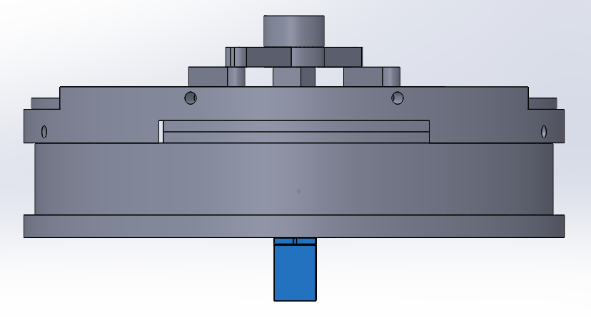
Integration
8-32 screws

Slide 12
Manufacturing
Tests will be done to determine necessary materials and if all components can be 3D printed
If needed almost all components can be machined out of aluminum

Slide 13
Possible Failure Modes
Failure Mode | Probability | Severity | Mitigation
Air brakes fail to deploy (sustainer) | Low | Medium | Choose servo with sufficient torque
Air brakes fail to deploy (booster) | Low | Medium | Choose servo with sufficient torque
Deformation or structural failure of plates | Low | Medium | Choose material and thickness to withstand sufficient bending stress
Structural failure of mission package tube at air brakes | Medium | High | Choose sufficient thickness of material within mission package tube and size of screws

