Slide 1


Making Recorded Content Accessible
Expert Strategies and Best Practices

Slide 2


Kelly Mahoney
Growth Marketing Specialist
Notes:
started as content marketing - learning a lot & creating thought leadership content
now more campaign-focused & data driven - using content as one piece of the puzzle
always happy to share what I’ve learned about accessibility

Slide 3

Agenda
Understanding accessibility requirements
Best practices for recorded content
Practical implementation tips
Case studies and success stories
Notes:
basics of accessibility requirements, legal and ethical
best practices for recorded content by accommodation type
tips for practical implementation
case studies of successful ways 3Play has worked with MIT in the past

Slide 4
Understanding accessibility requirements

Slide 5
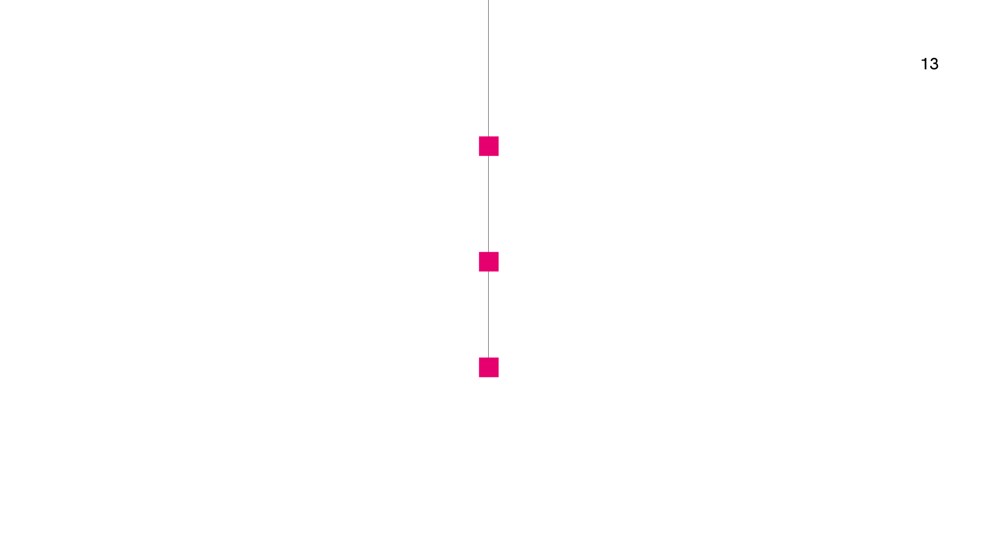
Americans with Disabilities Act
July 2023 Notice of Proposed Rulemaking
Sections 504 + 508
The Rehabilitation Act of 1973
Legal & ethical imperatives
Web Content Accessibility Guidelines
POUR principle
Notes:
key legislation overview
“big 3”
ADA
broad anti-discrimination law enacted in 1990
July 2023, Notice of Proposed Rulemaking (NPRM) = proposes more specific technical standard + reqs for web and mobile app accessibility as part of Title II
Title II = applies to state/local gov’ts; includes public education, public transit, offices like the DMV, food stamp renewal, etc.
Sections 504 + 508
applies to federal gov’t and federally funded programs
Rehabilitation Act originally emphasized equal employment practices, reasonable accommodations, and federally subsidized programming – these sections were added to include electronic and information technologies with the advent of the Internet
“little 508s” to extend requirements at state level
WCAG
not required by law, but referenced by law
industry standard, more dense and technical guidance for implementation
POUR principle = perceivable, operable, understandable, and robust
compliance is necessarily top of mind, but it doesn’t end there…
accessibility is an ethical responsibility to foster an environment where everyone has the opportunity to succeed

Slide 6

“
Equal access doesn’t look the same for everyone.
”
Rita Inman
Associate Director
Disability Resource Center
Notes:
we recently hosted a webinar featuring Rita Inman, AD of the DRC at UF, who summed it up perfectly:
“Equal access doesn’t look the same for everyone.”
even two people with the same disability may not want the same accommodation – braille vs. AD
imperative to provide equal access to information, but the ways in which we do that / the accommodations we provide will vary.
accessibility is not one size fits all; liquid takes the shape of the container its in, access takes the form of the situation you’re in
continues to evolve – as technology advances, it’s important to keep access in mind
ACCESS 2024 session Privacy, Security and Ethical AI – fireside chat with the co-founder of Global Accessibility Awareness Day, the Head of Accessibility Innovations at Fable, and the Director of Global Public Policy at AT&T (who is blind herself)

Slide 7
Improved test scores
3% increase using captions
8% increase using interactive transcripts
USF St. Petersburg
Boosted comprehension
52% say captions aid comprehension
OSU eCampus
Tangible student impact
More engaged students
20% say captions keep them engaged
OSU eCampus
Notes:
ethical considerations + importance of accessibility
simultaneously support diverse learning needs while enhancing the overall experience for everyone
define: Universal Design for Learning
example: captions may be used as an accommodation for those with learning disabilities or hearing impairments. however, 71% of students without disabilities report a preference for using captions – OSU eCampus study
leads to tangible student impact…
boosted test scores – USFSP
improved comprehension – OSU
increased engagement – OSU

Slide 8
Best practices for recorded content
Notes:
the fluid nature of accessibility can make it overwhelming – let’s break down some best practices.

Slide 9
Textual representation of all the audio within a media file
Including non-speech elements
Quality standards + regulation
FCC, DCMP Captioning Key, WCAG
Closed captioning
Best practices
Verbatim vs. clean read, placement and formatting, frame requirements
Notes:
definition/importance
define: textual representation of all the audio contained within in a media file; crucially includes non-speech elements like sound effects and speaker identifications – important because it’s critical to audience’s understanding of the media
example: Frozen – Olaf and Sven are fighting over a carrot, scene’s humor is conveyed nonverbally through character sound effects and comical music. without a visual transcription, a hearing impaired person won’t have access to the same entertaining experience that a hearing person would get out of a scene like that.
quality standards
FCC, DCMP, WCAG
FCC = requirements for broadcast media; include standards on accuracy, synchronicity, placement, completeness (running from beginning to end of program throughout)
DCMP Captioning Key = Described and Captioned Media Program; manual of guidelines, examples, and resources for closed captioning
WCAG
best practices
verbatim vs. clean read
verbatim = captures and transcribes every utterance, including “um”s and stutters; often used in scripted media
clean read = preferable! omits these utterances so users can read the caption text more cleanly
placement = not obstructing visual elements or on-screen text
other formatting options often depend on the viewing experience; customization is based on platform capabilities + user preferences
frame requirements = typically 1-3 lines, 32 characters per line, 1 second minimum on-screen

Slide 10
Audio description
Narration of relevant visual information in media content
Blind/low-vision accommodation
Quality standards + regulation
Content volume vs. content type
Audio description
Best practices
Standard vs. extended,
synthesized speech vs. VAAD
Notes:
definition/importance
define: narration of the relevant visual information in media content, used as an accommodation for blind/low-vision viewers
example: sports announcer narrating the visual action of a game over the radio
function similar to captions for a hearing impaired audience; intended to convey the same experience through audio that a sighted user would get visually
quality standards and regulations
AD requirements not as explicit as captioning requirements
“you should have AD” but no technical guidance; WCAG remains the standard for this information
FCC continues rolling compliance deadlines – based on content volume
There’s nuance in what you actually need – based on content type
best practices
standard vs. extended
standard = fits description within natural pauses of source content
extended = pauses source content to make room for description
often used for lectures, presentations, and training content
synthesized speech vs. VAAD
synthesized = produced by machine technology; scalable at lower cost BUT may not align with content tone
VAAD = produced by voice artists; more create and authentic speech patterns/tone
often a distinguishing factor for broadcast/production content

Slide 11
Timed text solution that translates spoken dialogue
Assumes audience can hear the dialogue, but can’t understand
Quality standards + regulation
Accessibility for Ontarians with Disabilities Act (AODA)
Subtitling
& localization
Best practices
SDH vs. non-SDH, Forced Narrative,
line limits and timing
Notes:
definition/importance
define: timed text solution that translates the spoken dialogue; assumes the audience can physically hear the audio but can’t understand the language
example: historically used in film, television, and other recorded/produced media
quality standards
don’t have the same technical requirements as closed captions, but could be included in the argument for providing access to all (i.e. ESOL students)
Accessibility for Ontarians with Disabilities Act (AODA)
most progressive accessibility law in the world
includes rolling compliance deadlines until 2025
example of where “providing access” necessarily includes a bilingual audience
best practices
SDH, non-SDH
Forced Narrative = clarify pertinent information that is not otherwise explained or easily understood by the viewer
placement = centered, not blocking any visual elements or on-screen text
line limits + timing = commonly support 42 characters
more flexibility in formatting
more tightly time-coded

Slide 12
Practical implementation

Slide 13
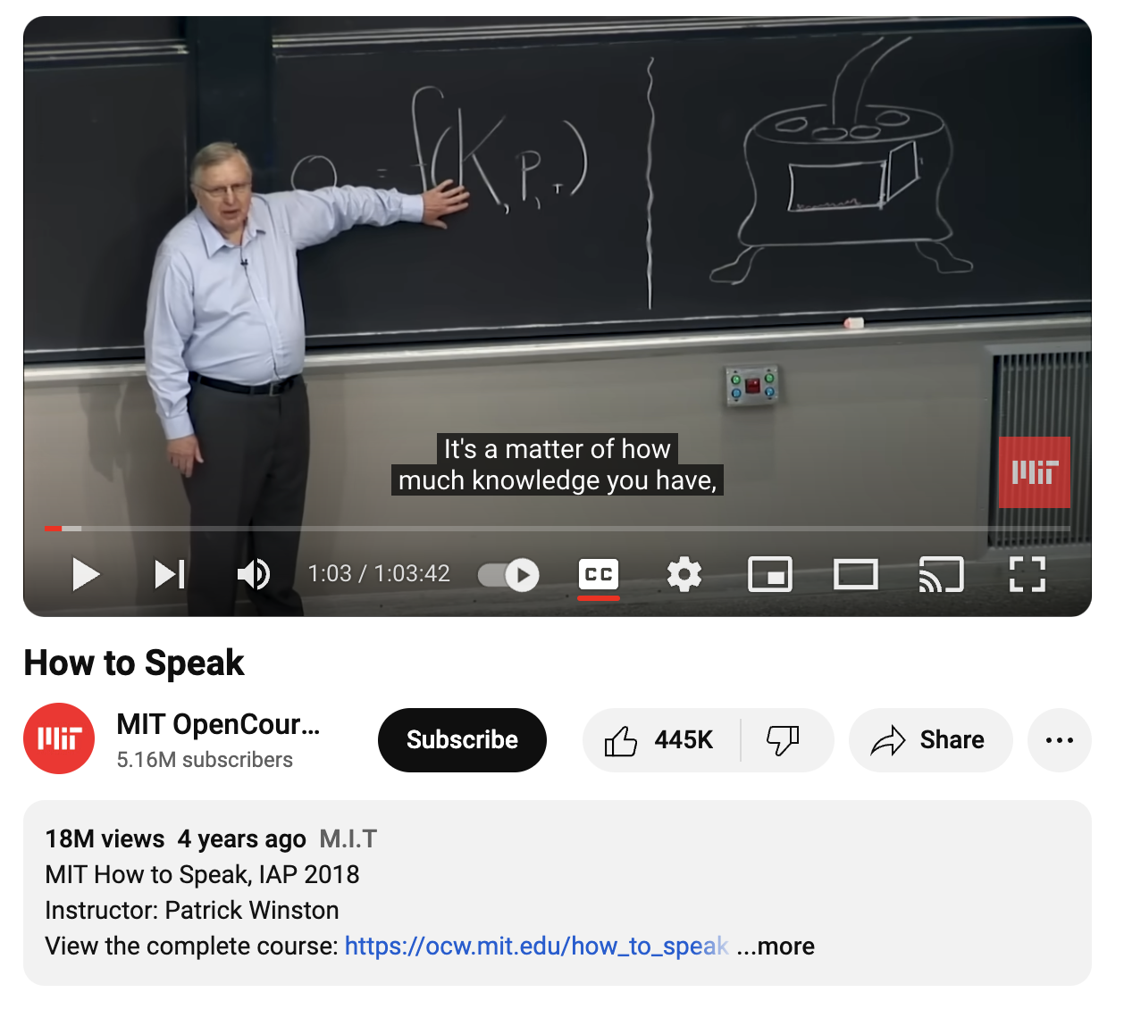
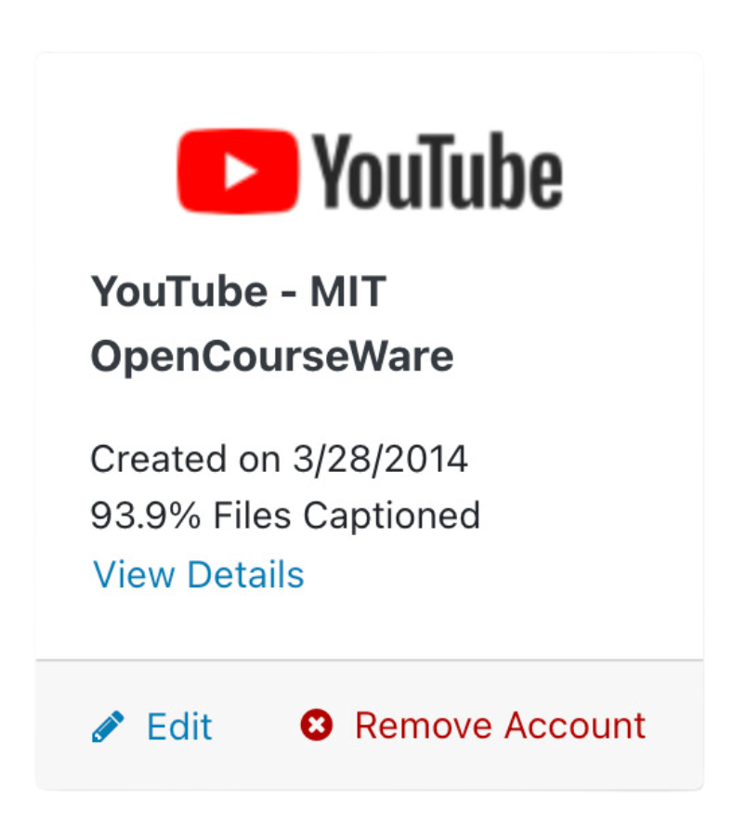
3Play at MIT
Notes:
implementation at MIT is easier than you might think, because we’re already working with you!
I took a look at a few accounts and wanted to show you what implementation actually looks like.
our integration with YouTube is definitely the most popular method of processing content, so I pulled an example from MITOCW.
this is what captions look like to your target audience
automatic pushback delivery
much easier to scale + eliminates manual intervention

Slide 14
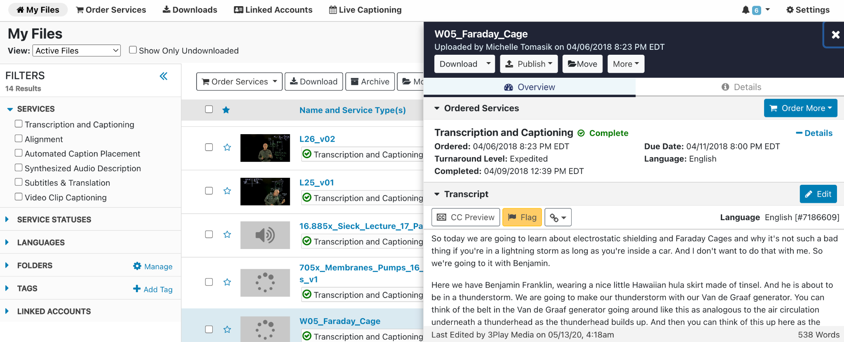
Everything you need, in one place.
Notes:
peek behind the curtain
completed transcript is editable
order instructions can be used for names, proper nouns
expedited turnaround here (2 days); varies from 10 days to 2 hours
access to more services like alignment + placement services

Slide 15
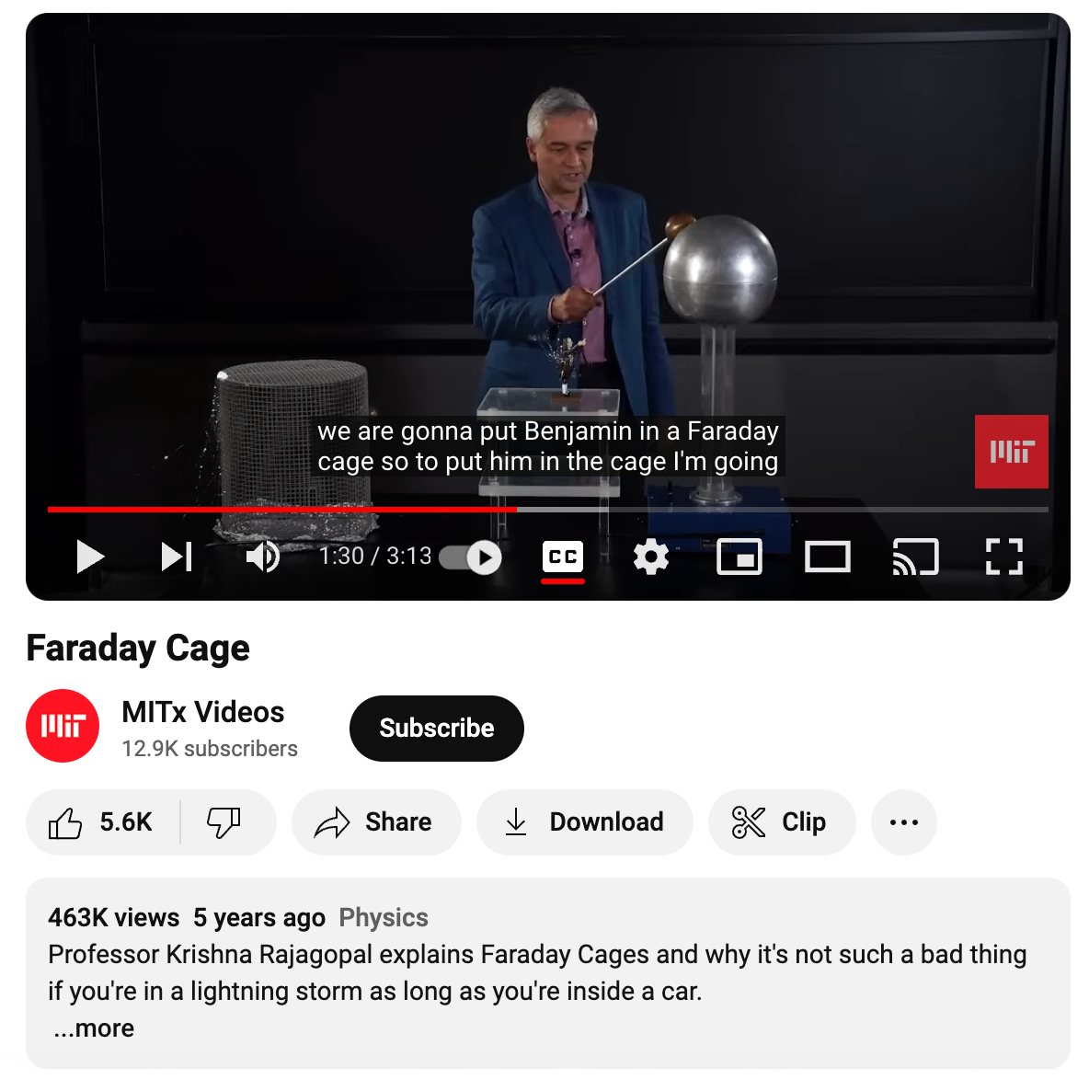
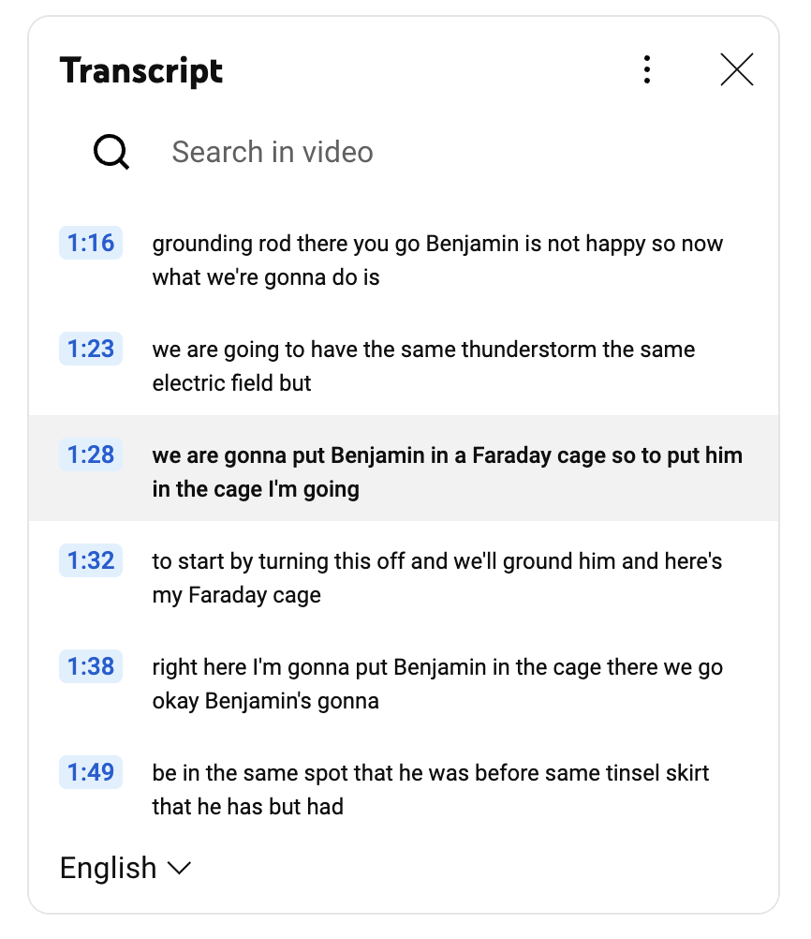
Notes:
duality of user experience
this = end user experience for the target audience consuming this content
previous slide = UX from perspective of party responsible for procuring services and making content accessible

Slide 16

Key distinctions
Measured accuracy models
NER Model = emphasizes meaning and how accurately ideas are captured
Word Error Rate (WER) =
inaccurate words / total # words
Formatted Error Rate (FER) = % of word errors in formatting elements
DIY vs. Professional
Manual transcription takes first-timers up to 5-10x longer
Notes:
quality control
understanding what the different accuracy rates actually mean
NER = Number, Edition, and Recognition Error
often used in Canada
emphasize meaning and how accurately ideas are captured in captions
makes this extremely subjective and legally risky measurement model
FCC quality standards more rigorous than NER model; WER vs. FER more commonly used
Word Error Rate = standard measure of transcription accuracy; considers number of inaccurate words vs. total number of words
Formatted Error Rate = percentage of word errors in formatting elements like punctuation, grammar, speaker IDs, non-speech elements, capitalization, and other notations
DIY vs. professional solutions
biggest distinction = TIME SAVED
to manually transcribe captions, typically takes anywhere from 5-10x content duration
we’ve noticed our transcriptionists will usually take around 4-5 hours to complete a 1 hour video – using our earlier estimation, it would take a first-timer at least double that just to write the captions (let alone time-synchronizing them)

Slide 17

AI + automation
Human-in-the-loop approach
Professional expertise ensures top-quality output
Error types & frequency
Hallucination errors, lack of logic
and contextualization
Most impactful at scale
Process large content libraries, eliminate manual intervention
Notes:
thinking about the role professionals like you play in procurement.
disadvantage to ignore the utility of AI/automation.
incredibly useful for scaling accessibility, but despite recent advancements, AI/ASR still cannot be independently relied upon for fully compliant + accessible closed captioning.
our preferred approach = human-in-the-loop
professional human expertise is still the best way to ensure top-quality output
machine technology lacks the same capacity for logic or contextualization as humans; some errors more common
State of ASR Report researches how the top ASR engines perform captioning & transcription across various use cases (edu, sports, etc)
hallucinations = text that has no basis in the audio
highlights the generative nature of AI, which is (to a certain extent) creating text based on their understanding of speech patterns

Slide 18
Case studies + success stories

Slide 19
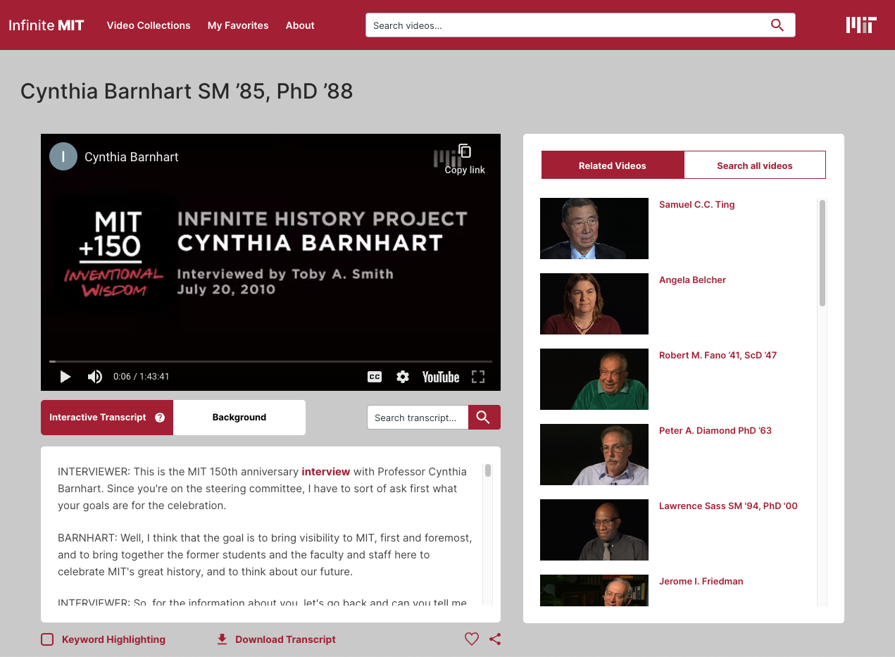
CASE STUDY
MIT150:
Infinite
History
Notes:
background
MIT’s 150th anniversary, Infinite History Project = curated an online video archive of hundreds of interviews with individuals who have made extraordinary contributions to their fields of study and to MIT
MIT Video Productions needed to make their content accessible, searchable, and engaging
outcome
We transcribed the library and worked with MIT to implement a more interactive user experience, encouraging viewers to explore the collection and engage with the video through time-coded transcripts.
watch interview videos, search accompanying transcripts, and click on any word to play the video from that exact point. users can even search all videos in the archive based on transcript keywords, so this is a perfect example of how the inclusion of captions inherently makes your content easier to search & discover.
we’re talking about a specific application within a curated video library, but these benefits apply on a macro level when we think about something like search engine optimization – your video will be easier for search engines to serve to a user when a keyword included in the transcript matches a search query.

Slide 20
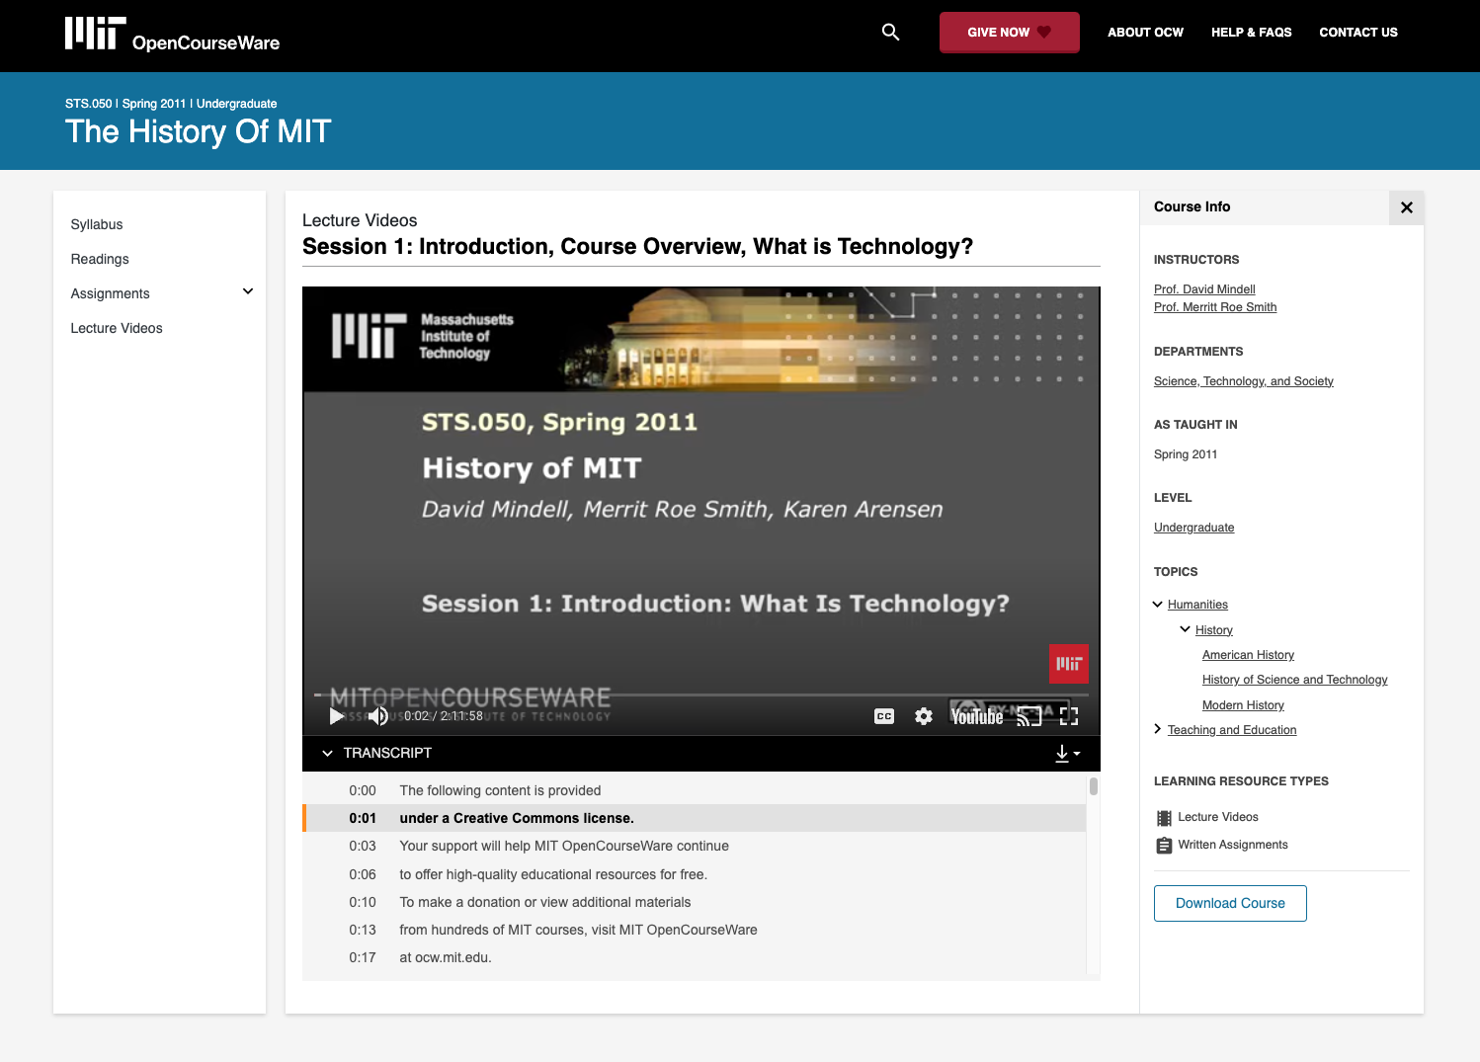
CASE STUDY
MIT: OCW
OpenCourseWare
Notes:
background
MIT OpenCourseWare employs 3Play’s interactive transcripts and captions across video lecture content
177 students surveyed on the utility of our features in video lecture courses
outcome
97% survey respondents found the addition of interactive transcripts enhances their online learning experience
top benefits:
students can move at their own pace
multi-sensory learning
study guides + derivative content
comprehension aid for complex topics
ESOL learners
stay focused on long lecture

Slide 21
Questions?
Thank you!
Frazer Kesselring
MIT Account Executive
frazer@3playmedia.com

