Slide 1
The Data Warehouse and Reporting Tools
IT Partners Conference
6/11/2024

Slide 2
Agenda
Who are we?
What is the Warehouse?
Who has access?
Getting started and getting support
Connect to the DW (Tools)
Q&A

Slide 3
Who are we?
Brandin Tumeinski
Roshni Gohil
BI Engineer IV
IS&T Data Warehouse Team
Started at MIT in 2010
Analyst
MITIMCo Portfolio Reporting Solutions
Previously RD, Reporting & Analytics
Previously IS&T, DW/BI
Previously MIT Libraries, Information Delivery & Library Access
Started at MIT in 2008

Slide 4
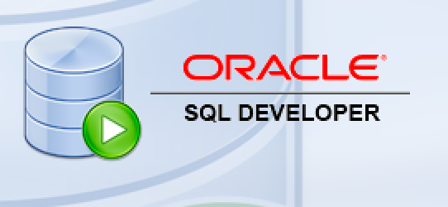






Data Warehouse a read-only database that combines information from separate systems into one easy-to-access location
Reporting and Analytical Tools (Access Layer)
Open
Interface
Data Warehouse
Data Sources / ETL (Extract, Transform, Load)
MITSIS
Batch Feeds
Other MIT data sources (Advance, Coeus, KC, Powerfaids, Roles, Nimbus, etc.)
Notes:
MIT’s Data Warehouse developed ca. 1995

Slide 5

What’s in the Warehouse?
Biographical information (E&S)
Graduate Admissions
Lots more!
Student Applicant information
Payroll (E&S)
Student Enrollment/Courses
1
2
3
4
5
6

Slide 6
Subject Areas
Education: Admissions/Graduate Admissions Enrollment Financial Aid Curriculum Academic Record Graduate Awards Classification of Instructional Programs (CIP) Course Listing Online Subject Evaluation | HR & Payroll: Employees, Positions &Appointments Benefits Training Payroll (Distributions, Deductions, Certifications) Academic Chairs Pension Vacation/Absences/Leaves | Facilities & Resources: Library (Financial, Orders, Circulations, Collection Mgmt, Serials Control Processing) Property Space Plant Maintenance Orders Keys Coop Textbook Cybersource MIT Storefront
Alumni Association and Resource Development: Alumni Bio, Occupation, Degree Resource Development Fund Data | Other: IAP Credit/Non-Credit Activities Moira Lists Publication Data (Journal Articles/Books from Academic Analytics) Request Tracker TLO Patents Zip Codes Who’s Teaching What | Student: Bio Degree Pre-registration Grades, Academic Training & Events
Finance: Budget General Ledger Procurement (Purchasing, Requisition & Credit Card) Vendor Travel | Master Data/Shared: Mit IDs, Kerberos Ids MIT ID Card Data/Pictures Orcid Organizations Time Roles & Authorizations | Research: Proposals Awards OSP Proposals, Awards, Cost Sharing

Slide 7







How does it get there?
ETL
Views
MITSIS
Data Warehouse
Oracle Sources
SDA
SAP MIT
Open Interface
Any DB connection
Feeds via System Accounts
Flat File
Data Warehouse 2.0
Notes:
Oracle Sources include COEUS/KC, FRC, Powerfaids, Roles, NIMBUS, Advance
Synthesizes data across disparate systems of record

Slide 8
Sources
ADONIS (Development Research and Systems) ADVANCE (Alumni Office) ALEPH (Libraries) AVID (Parking Office) Academic Analytics (Academic Analytics) COEUS / Kuali Coeus (MIT Office of Sponsored Programs) COOP (B&NTextbook Data) CSGold (MIT Card Office) CYBORG (Human Resources) CyberSource (MIT storefront transactions) FORRESTER (Technology Licensing Office) Grade20 (Graduate Admissions) INSIGHT (Physical Plant) MDS - Managed Data Services: AFFILIATION (Schema created for IR in MDS) FRC (Financial Review and Control) IR (Institutional Research) SPACE_ECON (Space Management) SPONSOR_BILL(Sponsored Billing) FPR (Faculty Professional Record) MITID (MIT ID Database) | MITSIS MITSIS (MIT Student Information System) OSEUSER (Online Subject Evaluation) EMMGR (Enrollment Manager) MOIRA (Moira Accounts) NIMBUS (Budget, Finance and Treasury) ORCID (Connecting Research/Researchers orcid.org) ROLES (Roles Authorization System) RT (Request Tracker) SAP Comptrollers Accounting Office Environment, Health, and Safety Office SAP HR Payroll Human Resources, SAP SAP Financial Training & Events Management, SAP Facilities TELECOM (Telecommunications) WAREHOUSE (Data Warehouse) ZIPCodeDownload (Zip Code) DAPERUSER-(Dpt of Athletics, Physical Education and Recreation) DIRUSER (Student Directory) MEDUSER (MIT Medical) MITAC (MIT Activities Committee) SMART(Singapore - MIT Alliance for Research and Technology)

Slide 9
Who has access?
DLCs
Individuals
All Employees have an account and can see “public” data and their own
Username is the same as your Kerberos account – different password
Affiliates with Kerberos accounts can request an account
System Accounts
For automation of department reports
Should not be used by individuals
Minimizes disruption when employees change positions or leave
HR, IR, VPF, Advancement (AA/RD), VPR, CSAIL, Chemical Eng, EHS, IS&T

Slide 10
How do I get access to data I can’t see?
Send requests to warehouse@mit.edu
Access must be approved by (business) data owners, not the DW Team

Slide 11

Data Security
Data is an Asset…
Data Must be Shared…
BUT…
Data Must be Secured

Slide 12
Access Control Levels in the DW
Object Level: People who can “see” an object can see all of the data in it – example, MIT Holidays
Row Level: People who can “see” an object can only see certain rows in it – example, HR data can be secured by department, so if you are in “Department A” you will NOT see data in “Department B”
Column Level: People who can “see” an object can only see only see certain columns in it – others may be “blanked out” – so maybe you have access to HR data, but you cannot see salaries

Slide 13
Data Security Responsibilities
Data access is specified by data owners during implementation – owners approve data – not IS&T
Once data is extracted from the warehouse, the extractor is responsible for keeping it secure!

Slide 14
Who supports the DW?
Source System Developers
Warehouse Team
Reporting Team
ETLs
Views
Package Layer
MITSIS
Data Warehouse
Data Loads
and Presentation
Oracle Sources
Users, DBAs, Warehouse Team
SDA
SAP MIT
Open Interface
Any DB connection
Feeds via System Accounts
Flat File
Data Warehouse 2.0
App Support & Data Owners

Slide 15
How do I get started?
Request an account – personal or System
01
Log in and see what you have access to
02
Talk to other people who are using the Warehouse
We’re happy to do 1:1 sessions for you or your team
03
Check out the standard reports - Cognos
04
Try creating your own in Cognos or Tableau
05

Slide 16

How do I get help?
Help with data in the warehouse – warehouse@mit.edu
Looking for specific data but don’t know where it is
Data you’re looking at looks odd
One-on-One session with team member (or Group sessions)
Access to data – warehouse@mit.edu
Need access to objects you can’t see
Help connecting to the warehouse – warehouse@mit.edu
Help with ODBC or similar connections
Help setting up a system account
Help with a report (Cognos/Tableau) – reporting-help@mit.edu
Existing reports or help creating new
One-on-One session with team member (or Group sessions)
User Group sessions will be starting up again this summer
Still don’t know where to start?
Email warehouse@mit.edu or reporting-help@mit.edu; we’ll get you to the right group

Slide 17
FAQs ist.mit.edu/warehouse
Data Questions:
Where is this field coming from?
How is this calculated?
This morning _____ field shows 0’s or blanks – why?
What does table or view does not exist mean?
Can you let me know when something fails?
Account Questions:
What do I do if my account is locked?
We just unlocked it - Why does it keep getting locked?
How do I change my Password?
What can I see when I log in?

Slide 18
IS&T Enterprise Reporting Tools
IBM Cognos Business Intelligence is a web-based integrated business intelligence suite by IBM. It provides a toolset for reporting, analytics, scorecarding, and monitoring of events and metrics.
Run standard IS&T-created reports (Atlas > MIT Cognos)
Modify standards reports to meet your specific needs
Create your own reports
Tableau is a visual analytics platform transforming the way companies use data to solve problems—empowering people and organizations to make the most of their data.
Create Dashboards
Query data
Clean data (Tableau Prep)
Notes:
BE HERE BY 1:10

Slide 19
Cognos
Who uses it?
Anyone with a Kerberos Account and Warehouse Account
Where can I access it?
Production: reports.mit.edu
How do I navigate?
atlas.mit.edu > Reports
Can I break anything?
No
Ways To Access
Cognos
Atlas
Email
Test: reports-test.mit.edu

Slide 20



Cognos
Production: reports.mit.edu
Test: reports-test.mit.edu
Share and Consume
Report Studio
Query Studio
Foundation Layer
Framework Manager
Combine, Shape, and Clean Data
Data Warehouse

Slide 21
Cognos Resources/Community
IS&T
  Site help – warehouse@mit.edu
  Reporting help – reporting-help@mit.edu
  KB – kb.mit.edu/confluence/display/istcontrib/Cognos+Landing+Page
MIT Reporting User Group
  Wednesdays, 1:30-3pm
  Sometimes virtual, sometimes in-person
  Schedule: ist.mit.edu/reporting-user-group

Slide 22


Tableau
ist.mit.edu/tableau
Share and Consume
Tableau Server
Tableau Reader*
Tableau Public*
Explore, Analyze, and Build
Tableau Desktop
Tableau Server (web editing)
Combine, Shape, and Clean Data
Tableau Prep Builder
Tableau Desktop

Slide 23

Tableau
Share and Consume
Tableau Server tableau.mit.edu
How most users are going to access Tableau workbooks that Tableau Desktop users have published
Available via browser (all devices) and Tableau Mobile app (phone/tablet)
Embed on other websites (ir.mit.edu/diversity-dashboard)
Enables users to interact
See, filter, sort, hover for detail, etc., visualizations/dashboards
Share filtered/sorted dashboards using Custom Views
Use web edit to:
build new workbooks with published data sources
make changes to or create new versions of existing reports
Security
Access controls based on Moira groups
You can control whether users have access to granular data (e.g., HR data at the individual level) vs aggregated data (non-identifiable aggregate displayed in published report)
Automate with subscriptions, alerts, and custom scripts (developer.tableau.com)

Slide 24
Tableau
Share and Consume
Tableau Reader
Not recommended in most cases
Offline access but requires program to be downloaded
Data is packaged with the workbook, so there’s effectively no security:
If a user has a Tableau Desktop license, they can get to the most granular level
And they can share that data with ANYONE
Manual sharing – if you make changes, you have to share the updated version with everyone you sent the original workbook

Slide 25
Tableau
Share and Consume
Tableau Public
public.tableau.com
Online
Like Tableau Server
Can limit ability to download workbook or data, if connected to MIT Tableau Desktop license
Takeaways
Generally, avoid using it for anything MIT-related unless your dashboard uses publicly available data (i.e., almost nothing from the MIT Data Warehouse)
Contains lots of examples to use for inspiration and learning
But it’s open to the world

Slide 26
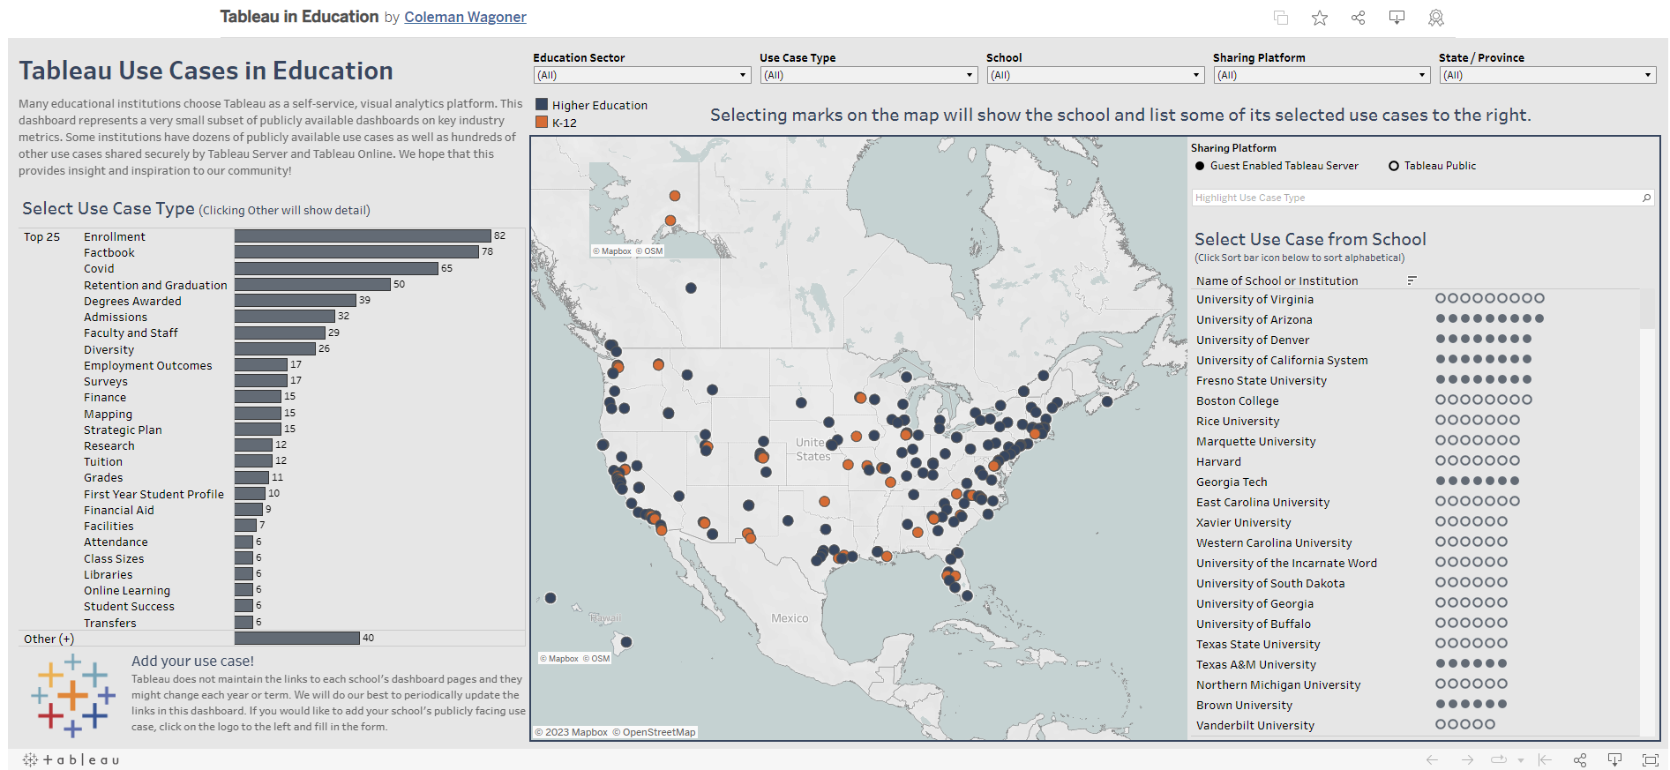
public.tableau.com/views/TableauinEducation/TableauUseCasesinEducation

Slide 27
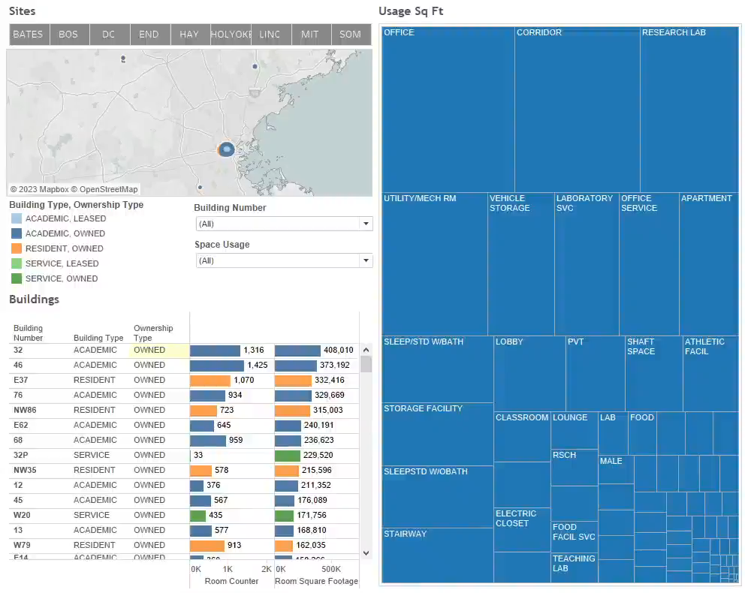
Tableau
Explore, Analyze and Build
Tableau Desktop + Tableau Server
Build charts, tables, and dashboards
Add filters, parameters, sets, dynamic tooltips, and other interactivity

Slide 28
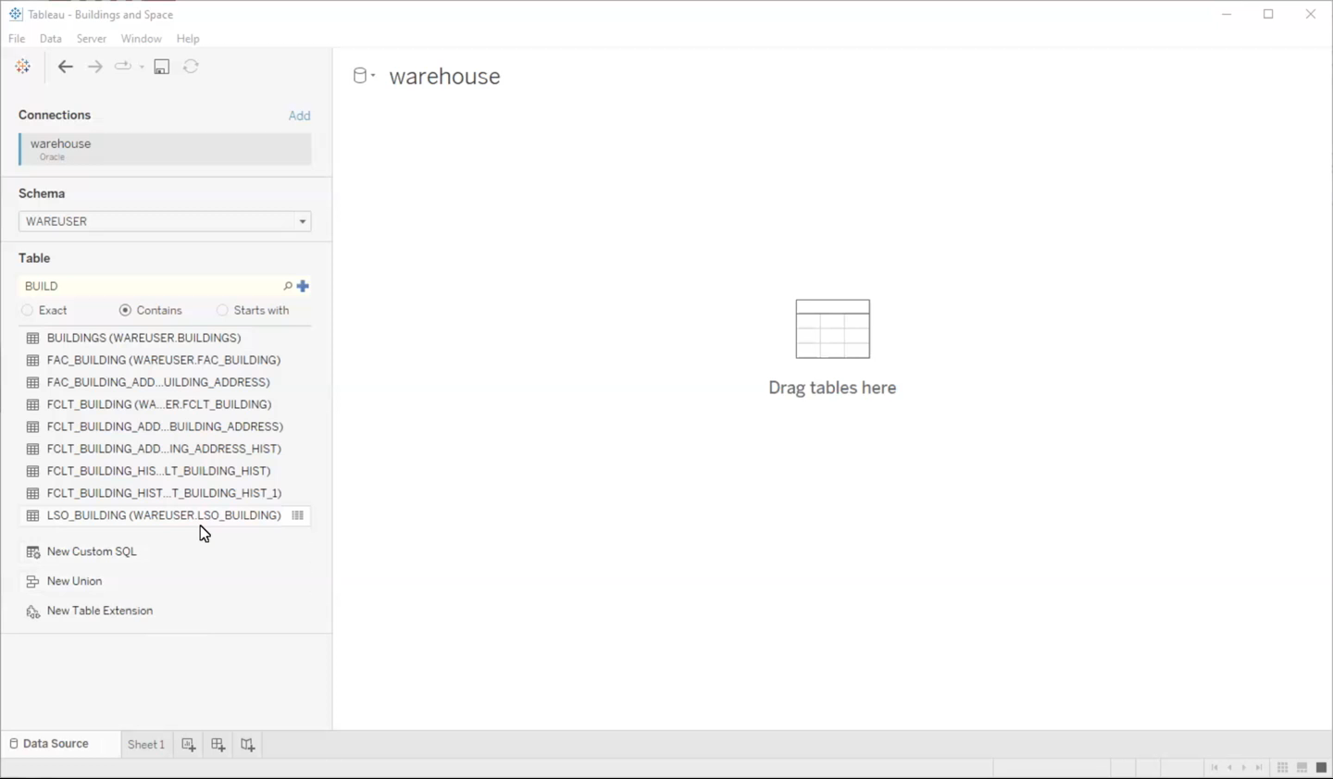
Tableau
Combine, Shape, and Clean Data
Tableau Desktop
Join or union data
Combine DW data with other sources (Excel/CSV/text files, spatial data, other databases, etc.)
Create calculations to aggregate, group, and more
Publish data sources to Tableau Server for others to use in building dashboards

Slide 29
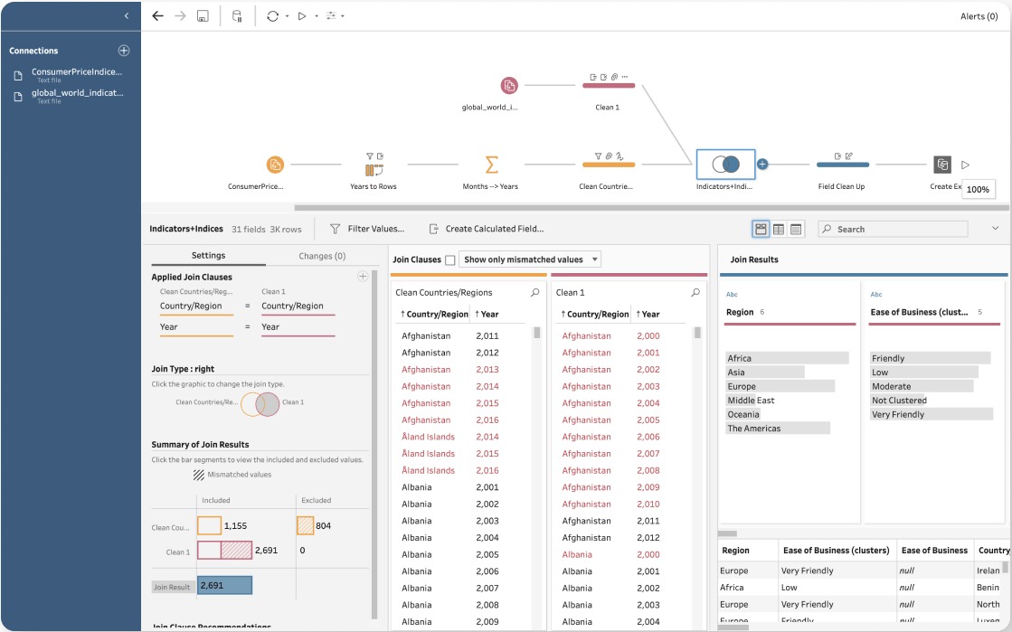
Tableau
Combine, Shape, and Clean Data
Tableau Prep Builder
Good for one-time data clean-up project
Get the JSON behind the flow
.tfl -> .zip
Extract
You will need to re-run the flow to refresh your data
Can’t schedule on Server
Can schedule locally

Slide 30
Tableau Community
@ MIT
MIT Tableau User Group (MIT TUG)
tinyurl.com/MITTUGHome
MIT Tableau Slack
mit-tableau.slack.com
Tableau User Groups usergroups.tableau.com
Massachusetts Higher Education Tableau User Group (MUG)
tinyurl.com/subscribeMUG
Higher Education Tableau User Group (HETUG)
tinyurl.com/subscribeHETUG
Higher Education Tableau Slack
higher-ed-tableau.slack.com
Join with .edu email: tinyurl.com/JoinHETableauSlack
Boston Tableau User Group
tinyurl.com/BostonTUG
#DataFam, Tableau Public, Academic Programs, and so much more
tableau.com/community
Community Projects to upskill
tableau.com/community/community-projects
Tableau Academic Programs
tableau.com/academic
Students
Faculty/Teachers
Data for Kids

Slide 31
Other Applications
Any application that can connect to a database can be used to connect to the Data Warehouse
Excel
SQL*Developer
Quickbase / FileMaker

Slide 32
What’s up with BrioQuery (Brio)?
    Brio
    Reporting
    Is
    Obsolete

Slide 33

What’s up with BrioQuery (Brio)?
If you’re not using it today, don’t start
Brio is no longer supported by the company (Oracle).
It will break. Once it breaks, we can’t unbreak your heart Brio.
Want to migrate a Brio to a supported tool?
Email reporting-help@mit.edu

Slide 34
Questions?

