Slide 1
MIT Tableau User Group
(MIT TUG)
April 8, 2025
Join the conversation on Slack
mit-tableau.slack.com
Yes, we are recording the session
The recording will be sent out and posted on Slack

Slide 2
Press Record
Turn on captions
Post in Zoom Chat:
https://mit-tableau.slack.com
Notes:
https://mit-tableau.slack.com
https://mit-itpartners.slack.com

Slide 3
MIT Tableau User Group
(MIT TUG)
April 8, 2025
Join the conversation on Slack
mit-tableau.slack.com
Yes, we are recording the session
The recording will be sent out and posted on Slack

Slide 4
Agenda
What is the MIT TUG
What’s new in Tableau?
Tableau Conference 2025
RAFFLE!

Slide 5
What is the MIT TUG?
A community of Tableau users, and those who want to use or are thinking about using Tableau, across MIT
Open to anyone
Any MIT department
All skills levels: none to novice to Jedi
Those who use Tableau only, and those who use Tableau with other data tools
Users of any Tableau product (Desktop, Prep, Server, Online, DataDev)

Slide 6
How It Works
Virtual (sometimes hybrid) meetings
Community-informed topics
Presentations (informal or formal) specific to Tableau at MIT
Opportunities to meet other Tableau users at MIT
MIT Tableau Slack: mit-tableau.slack.com
Join the email list: mailman.mit.edu/mailman/listinfo/mit_tableau_user_group
Notes:
https://mit-tableau.slack.com
https://mailman.mit.edu/mailman/listinfo/mit_tableau_user_group

Slide 7
Participate How You Like
Be active
present, share, ask and/or answer questions
Lurk
watch, listen, learn
Anything in between
If you want to present and/or have a topic you want to see, contact the leads
#ask-mit-tug-leads on Slack
mit-tableau-user-group-admin@mit.edu
Notes:
Questions for MIT TUG Leads:
#ask-mit-tug-leads or mit-tableau-user-group-admin@mit.edu

Slide 8
Tableau Upgrade to v2022.3
We’re moving from v2022.3 to v2023.3
Tableau Desktop: stay in line with MIT Tableau Server to prevent compatibility issues
Tableau Prep Builder: newer versions are usually okay

Slide 9
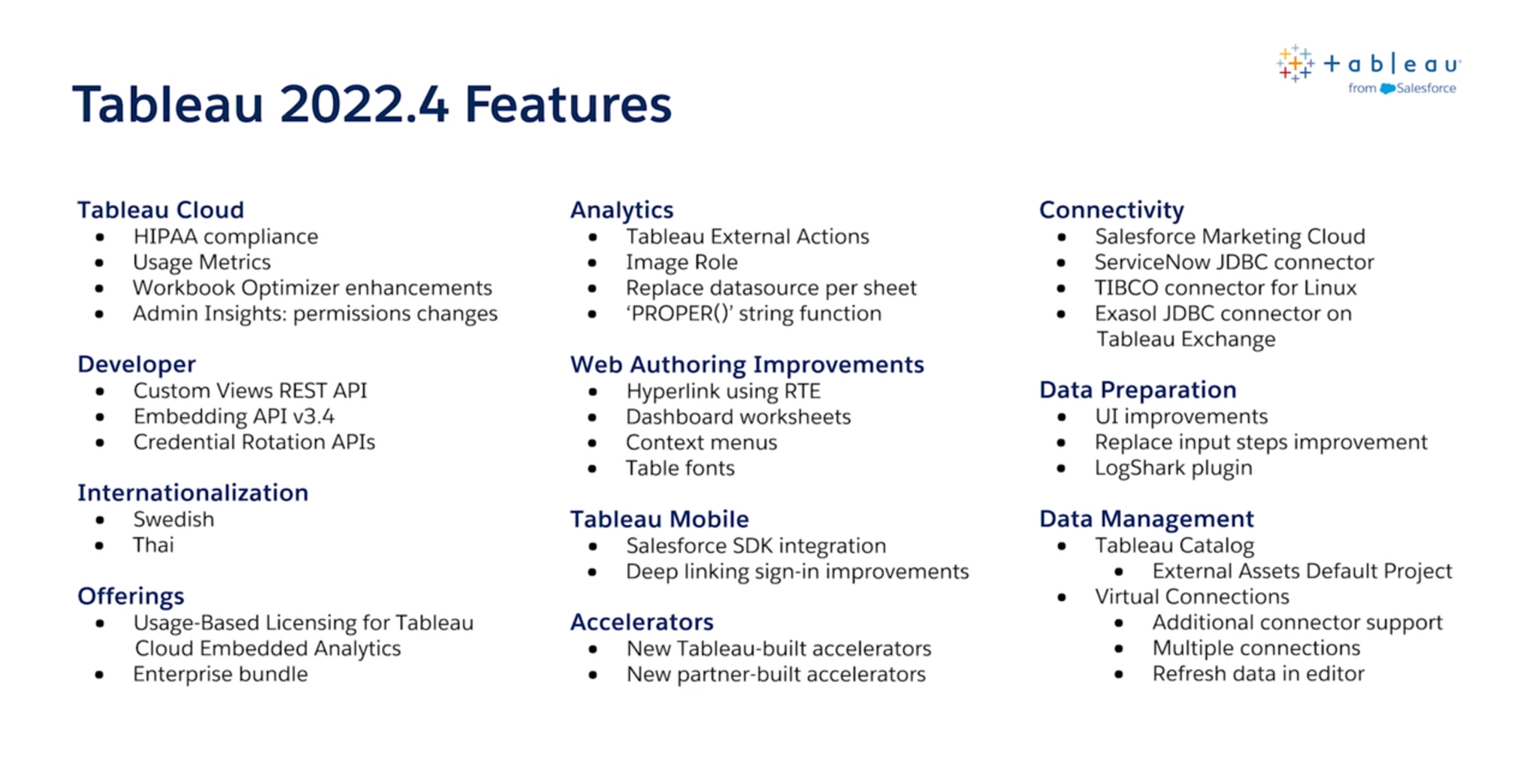
tableau.com/2022-4-features
Notes:
Post in chat:
https://tableau.com/2022-4-features
So what are some of those coming attractions that won’t make it to theaters near us until a second or third run?
Here’s a list of the highlights. We’re going to look at some of these in detail.

Slide 10
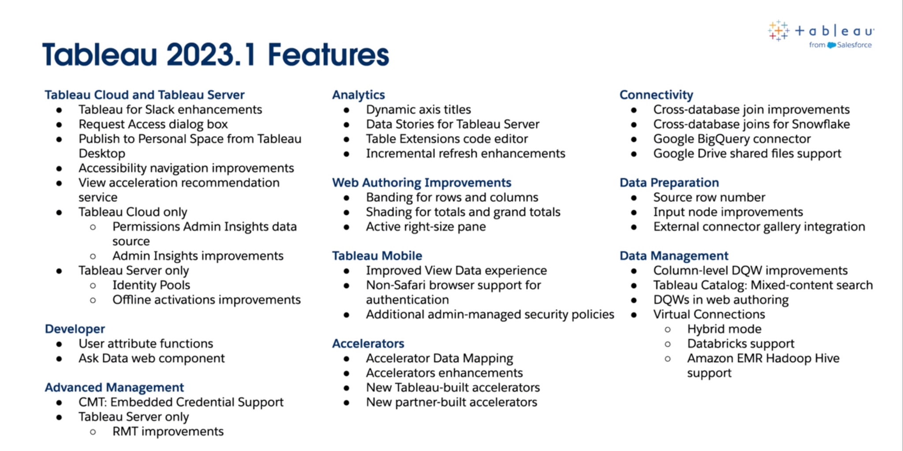
tableau.com/2023-1-features
Notes:
Post in chat:
https://tableau.com/2023-1-features

Slide 11
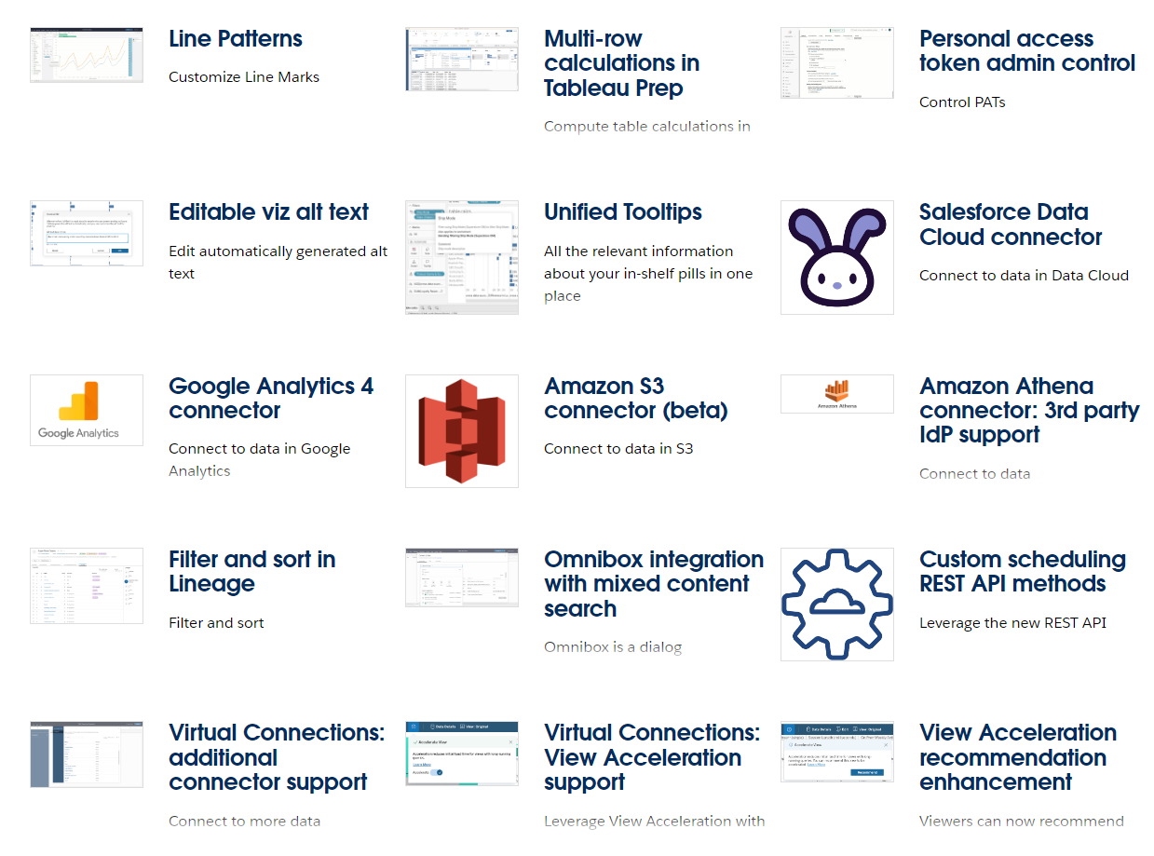
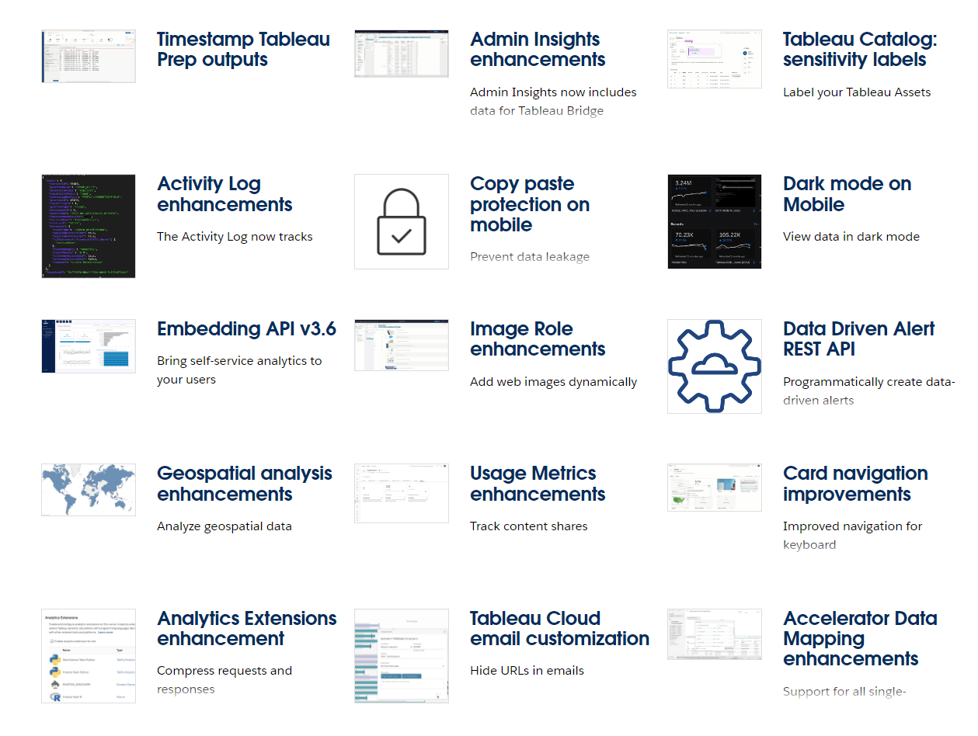
tableau.com/2023-2-features
Notes:
Post in chat:
http://tableau.com/2023-2-features

Slide 12
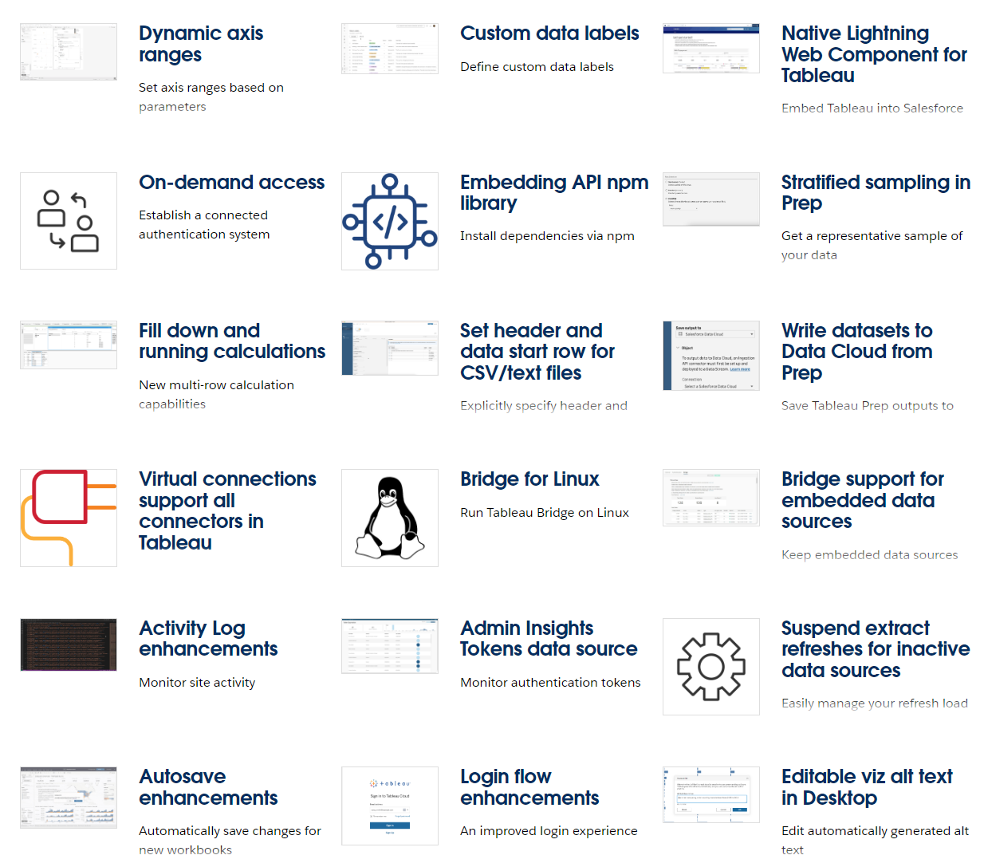
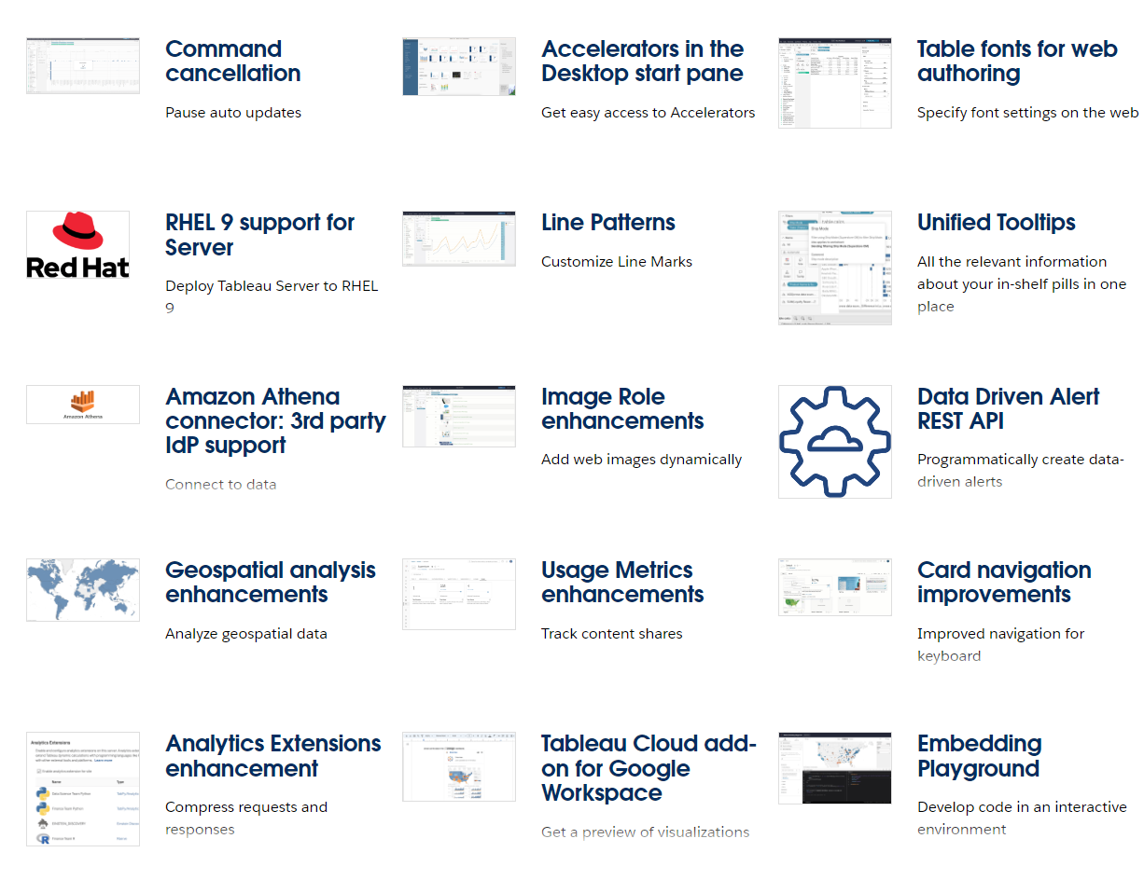
tableau.com/2023-3-features
Notes:
Post in chat:
https://tableau.com/2023-3-features

Slide 13
New Desktop Features

Slide 14
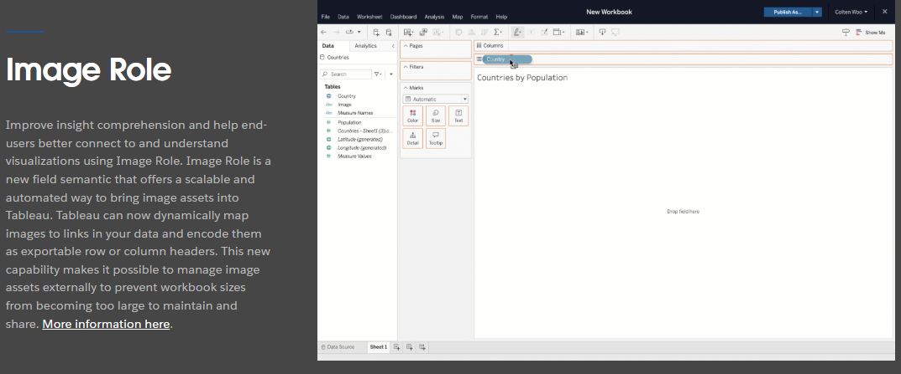
Image Role
tableau.com/2022-4-features#item-95198
Notes:
Image Role
https://tableau.com/2022-4-features#item-95198

Slide 15
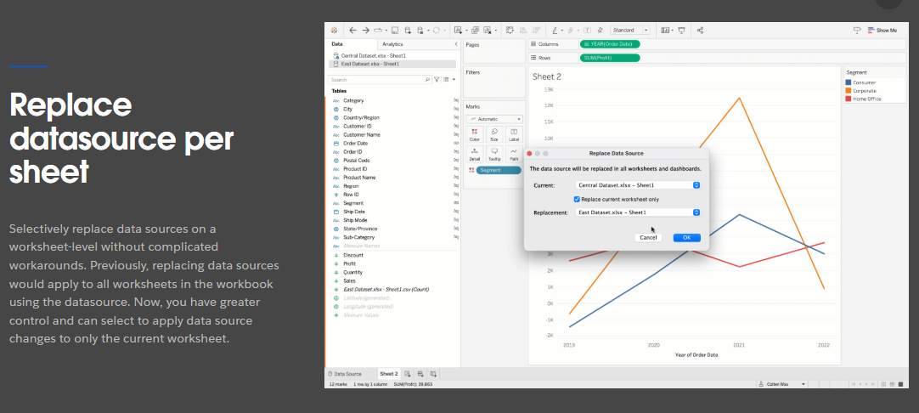
Replace datasource per sheet
tableau.com/2022-4-features#item-95196
Notes:
Replace datasource per sheet
https://tableau.com/2022-4-features#item-95196

Slide 16
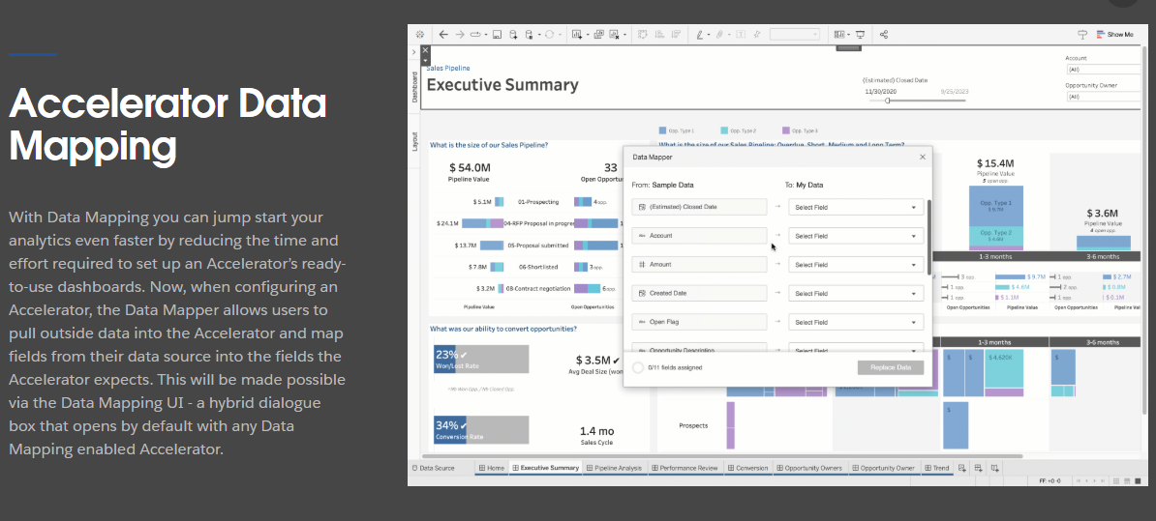
Accelerator Data Mapping
tableau.com/2023-1-features#item-96423
Notes:
Accelerator Data Mapping
https://www.tableau.com/2023-1-features#item-96423

Slide 17
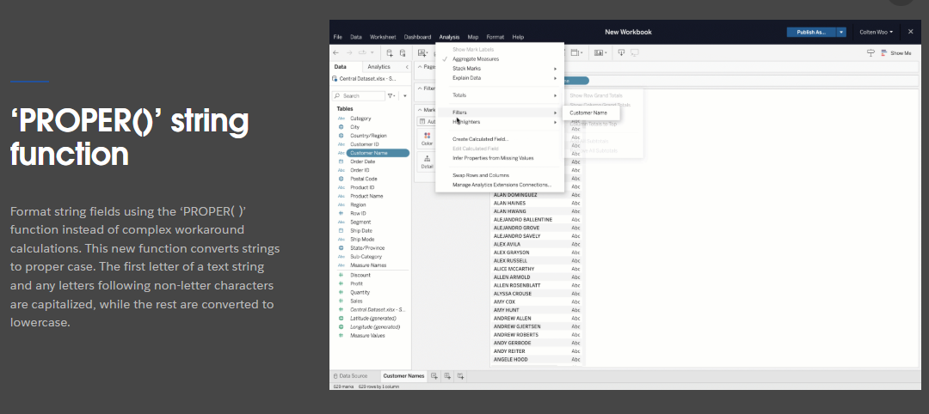
'PROPER()' string function
tableau.com/2022-4-features#item-95193
Notes:
'PROPER()' string function
https://tableau.com/2022-4-features#item-95193

Slide 18
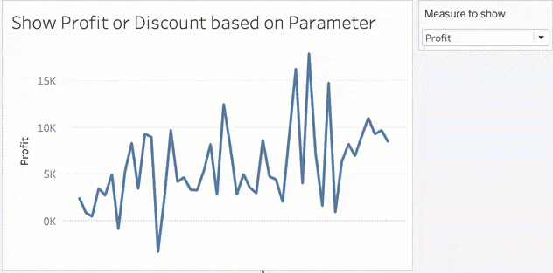
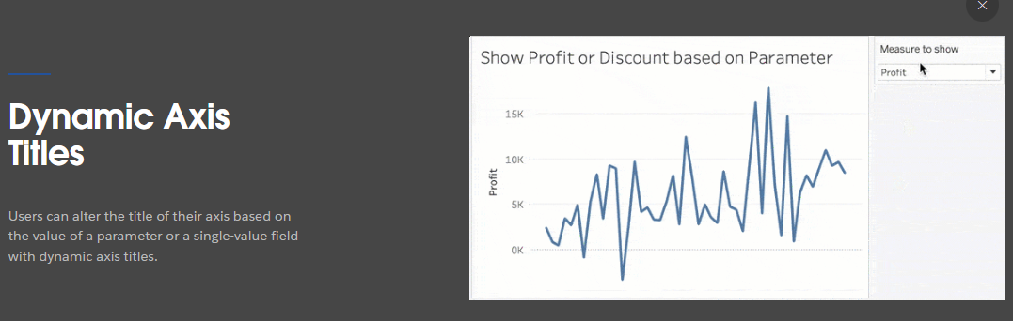
Dynamic Axis Titles
tableau.com/2023-1-features#item-96424
Notes:
Dynamic Axis Titles
https://tableau.com/2023-1-features#item-96424

Slide 19
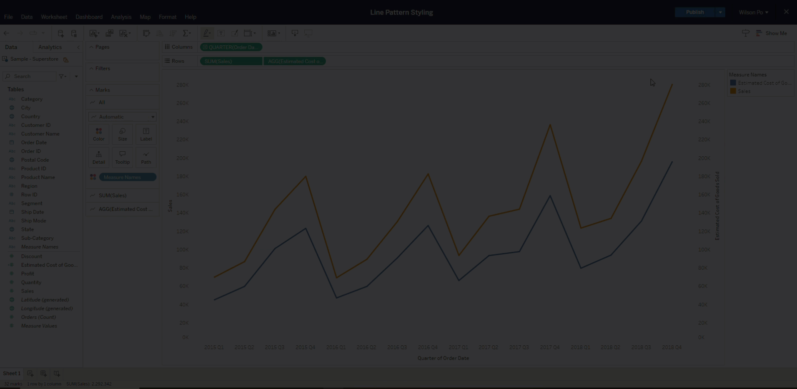
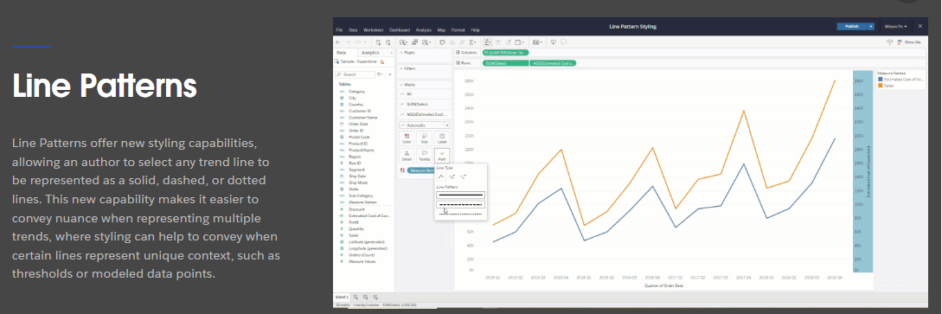
Line Patterns
tableau.com/2023-2-features#item-97291
Notes:
Line Patterns
https://tableau.com/2023-2-features#item-97291

Slide 20
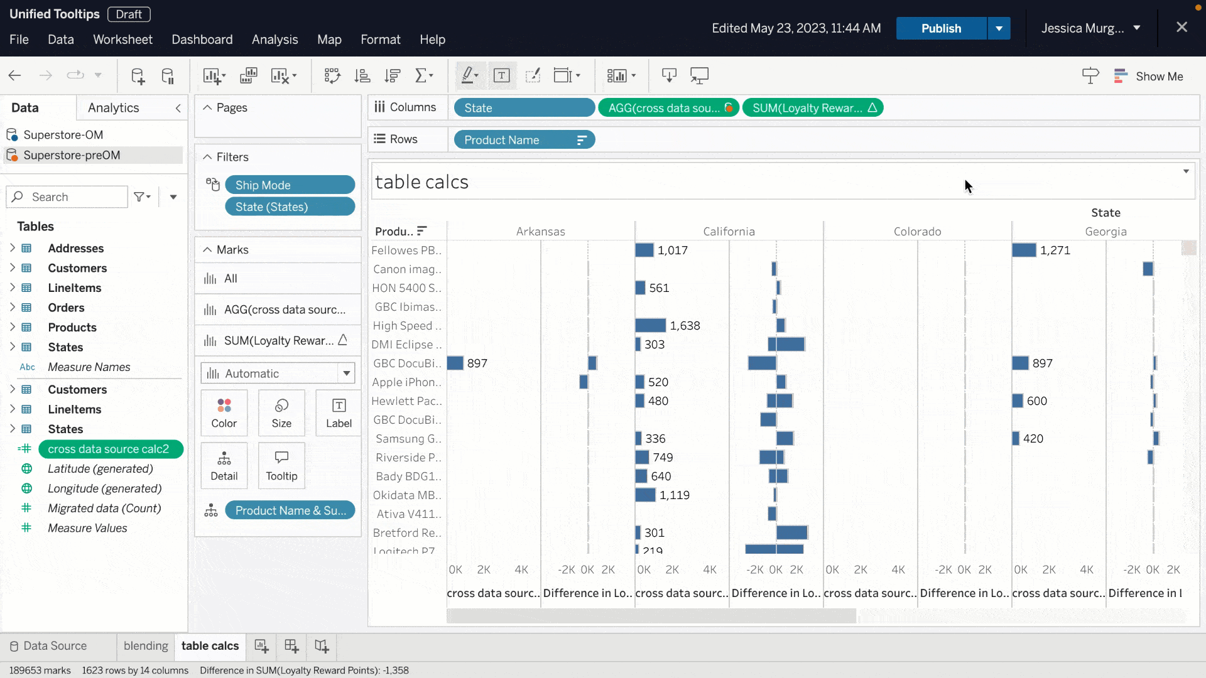
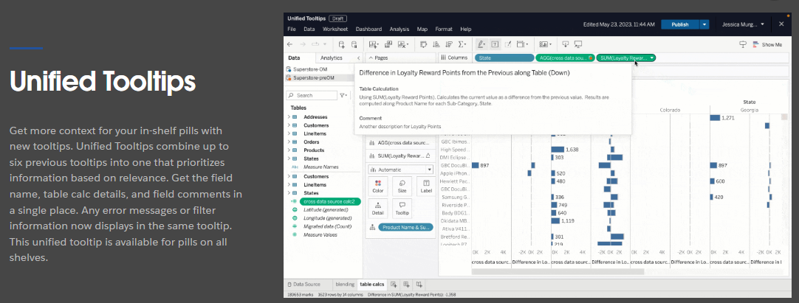
Unified Tooltips
tableau.com/2023-2-features#item-97435
Notes:
Unified Tooltips
https://tableau.com/2023-2-features#item-97435

Slide 21
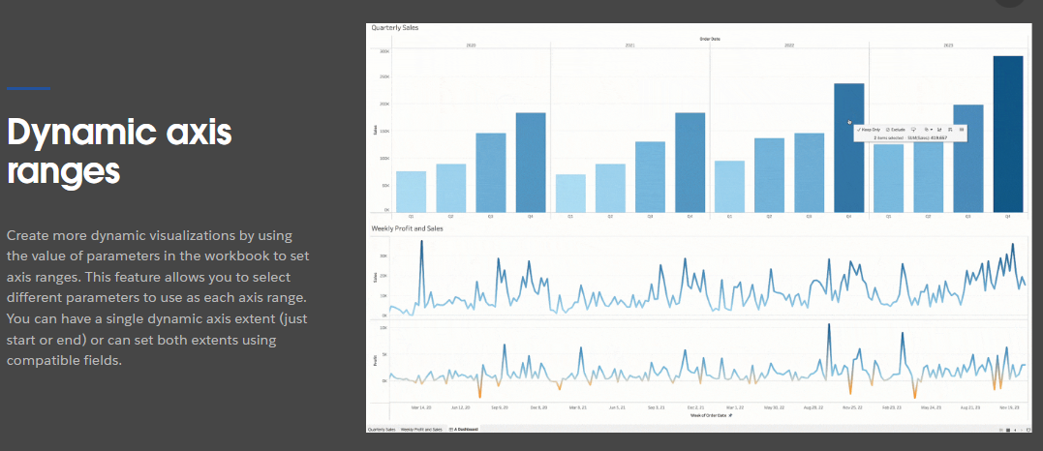
Dynamic axis ranges
tableau.com/2023-3-features#item-98042
Notes:
Dynamic axis ranges
https://tableau.com/2023-3-features#item-98042

Slide 22
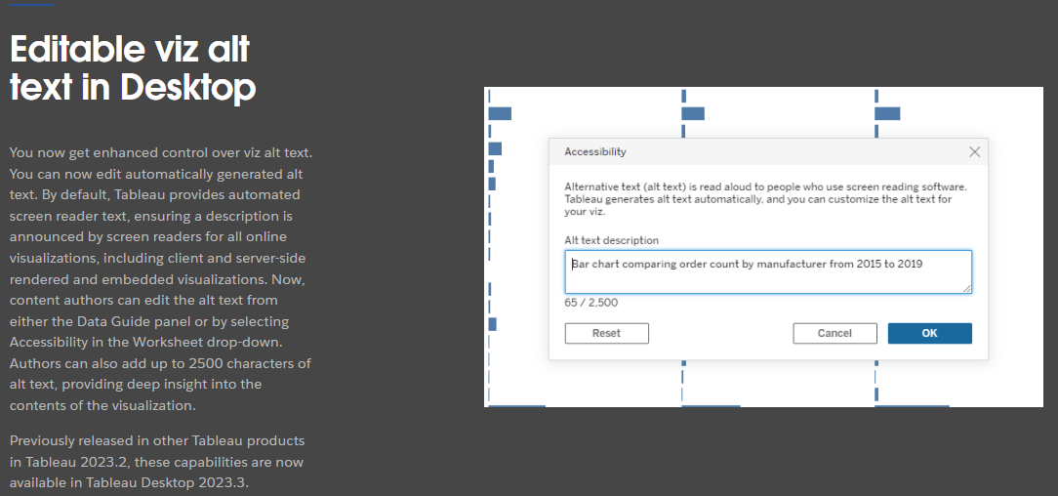
Editable viz alt text
tableau.com/2023-3-features#item-98038
Notes:
Editable viz alt text
https://www.tableau.com/2023-3-features#item-98038

Slide 23
Tableau Server

Slide 24
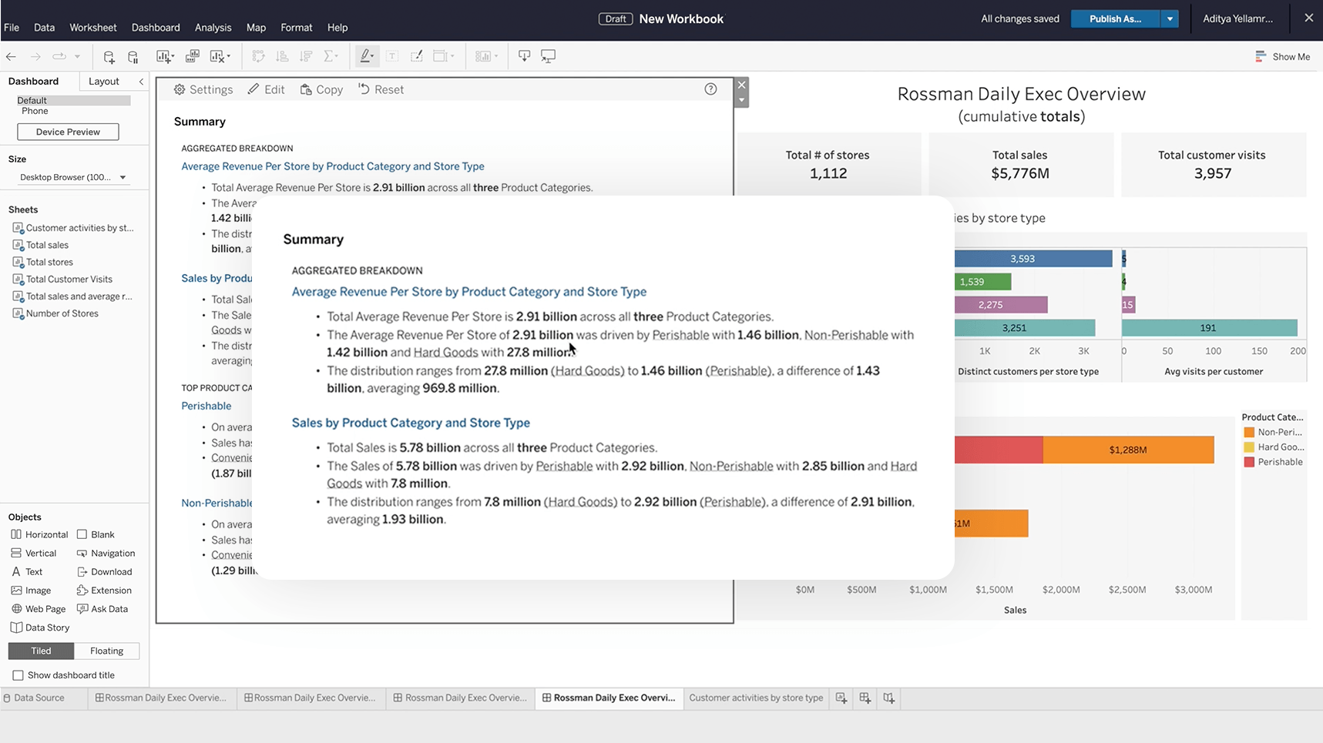
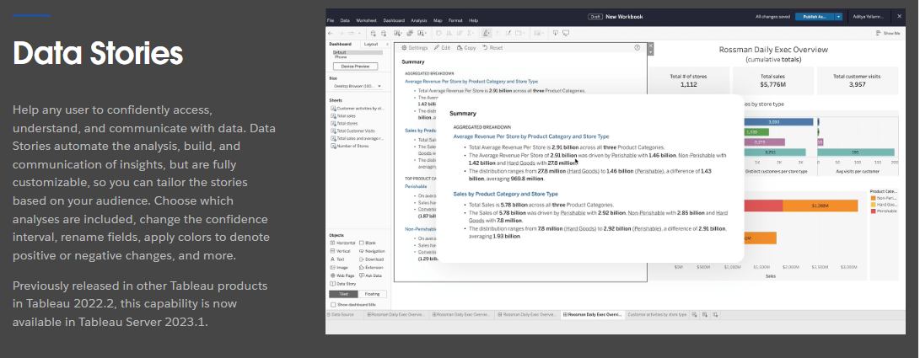
Data Stories
CAVEAT: Data Stories is being retired in 2025.1
tableau.com/2023-1-features#item-96409
Notes:
Data Stories
https://www.tableau.com/2023-1-features#item-96409

Slide 25
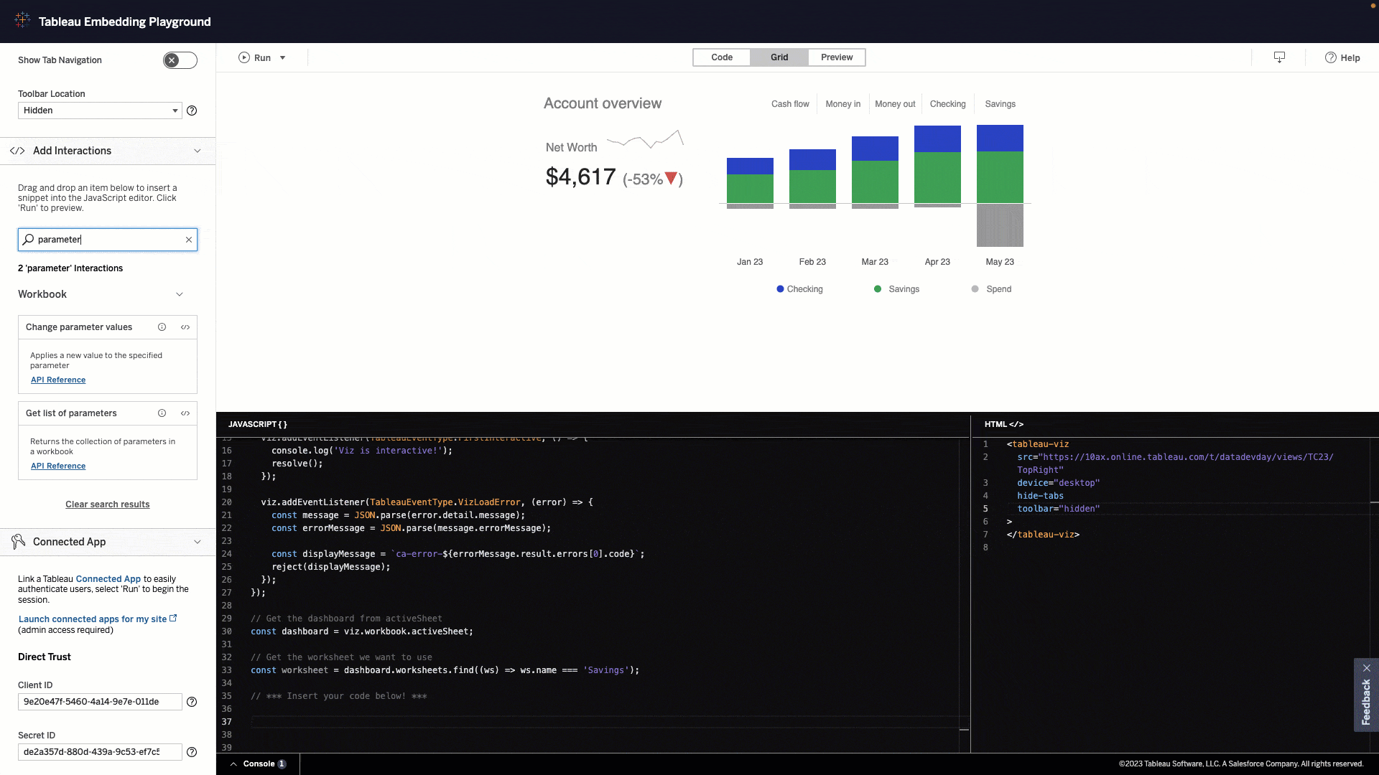
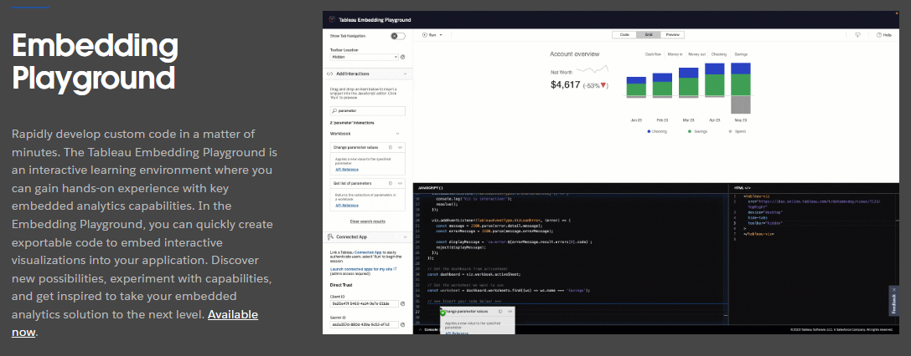
Embedding Playground
tableau.com/2023-3-features#item-98039
Notes:
Embedding Playground
https://www.tableau.com/2023-3-features#item-98039

Slide 26
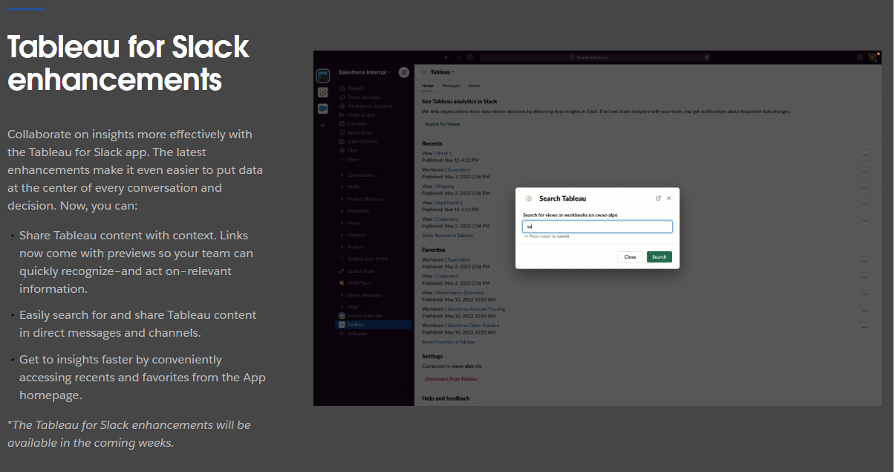
Tableau for Slack enhancements
tableau.com/2023-1-features#item-96399
Notes:
Tableau for Slack enhancements
https://www.tableau.com/2023-1-features#item-96399

Slide 27
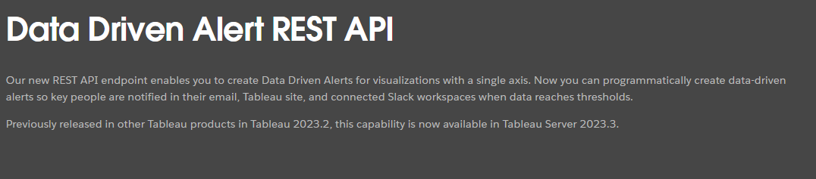
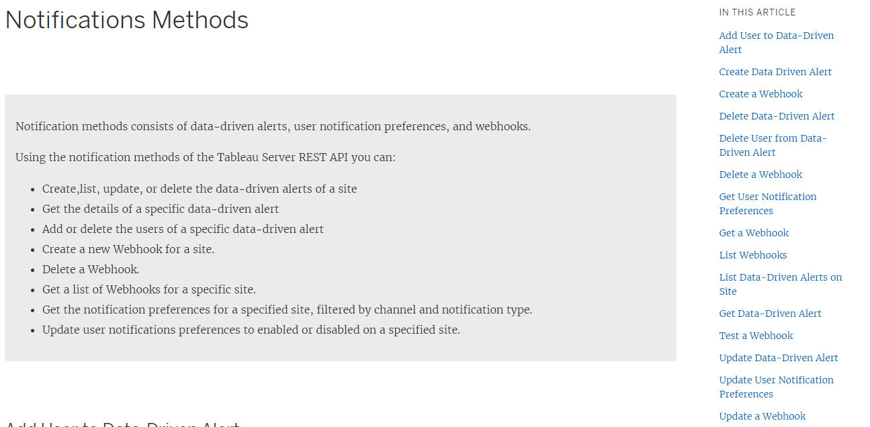
Data Driven Alert REST API
tableau.com/2023-3-features#item-100878
Notes:
Data Driven Alert REST API
https://tableau.com/2023-3-features#item-100878

Slide 28
Tableau Prep Builder

Slide 29
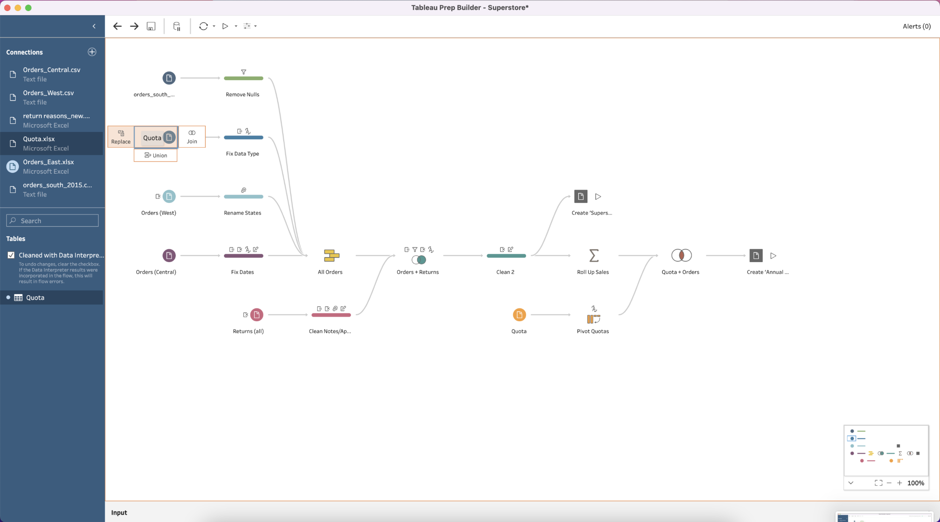
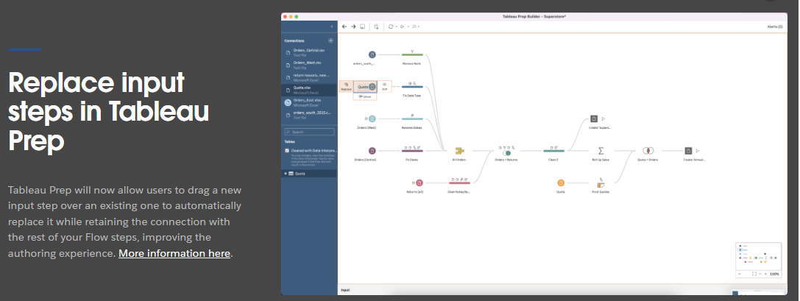
Replace input steps
tableau.com/2022-4-features#item-95181
Notes:
Replace input steps
https://www.tableau.com/2022-4-features#item-95181

Slide 30
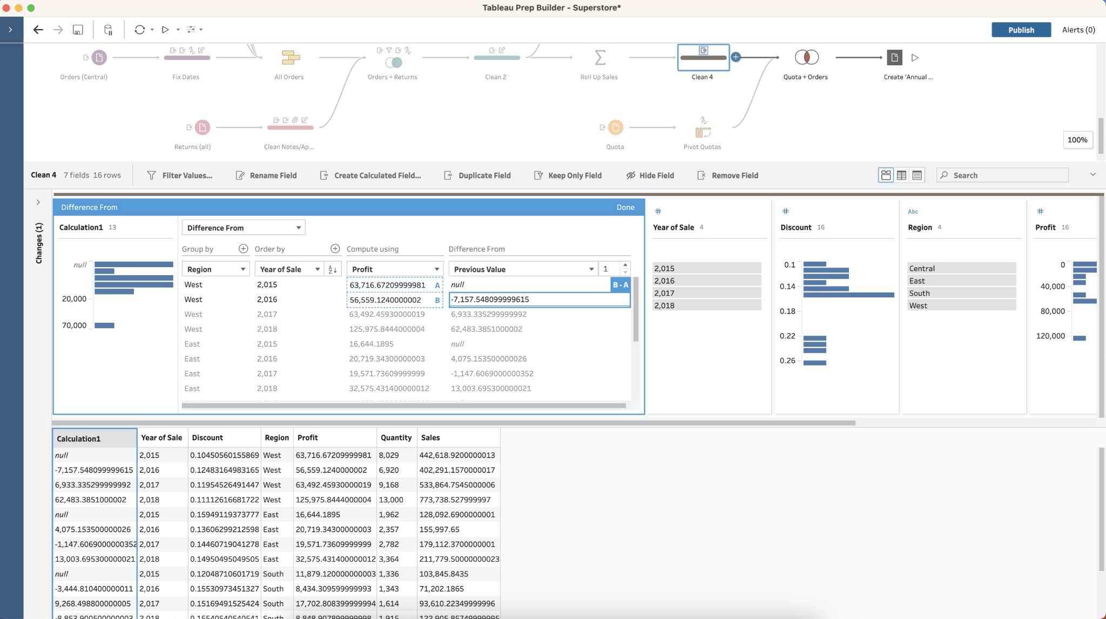
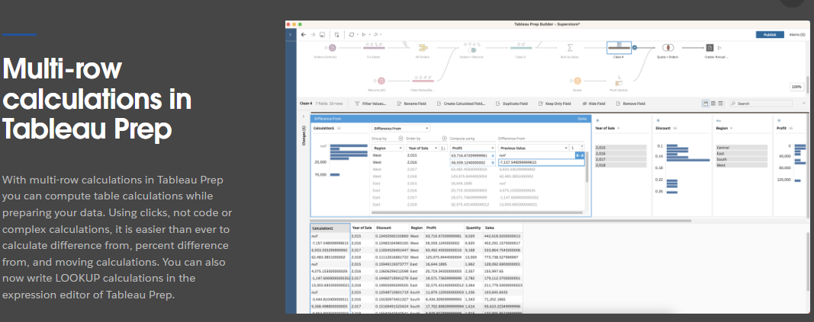
Multi-row calculations
tableau.com/2023-2-features#item-97158
Notes:
Multi-row calculations
https://www.tableau.com/2023-2-features#item-97158

Slide 31
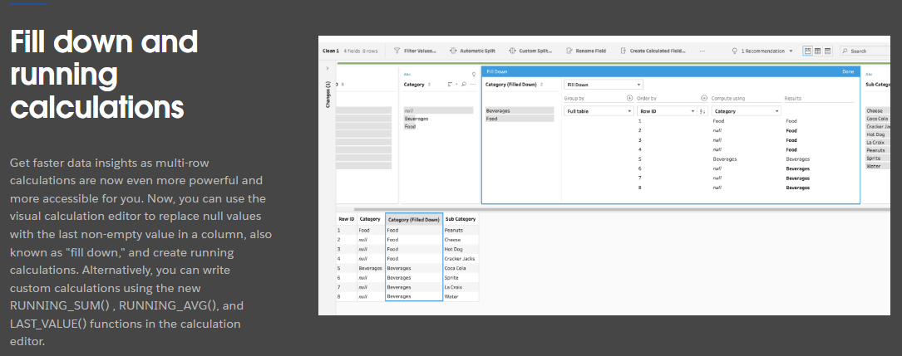
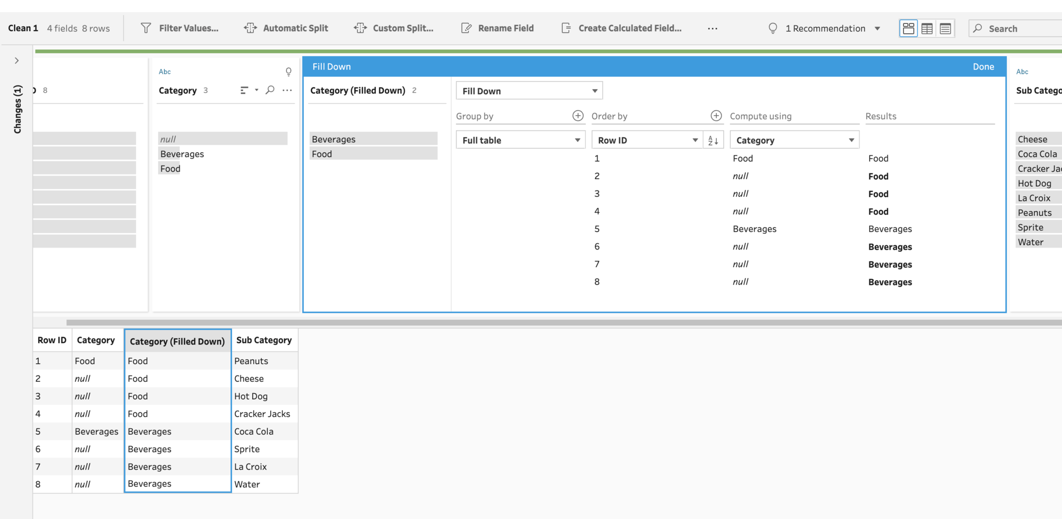
Fill down and running calculations
tableau.com/2023-3-features#item-98046
Notes:
Fill down and running calculations
https://www.tableau.com/2023-3-features#item-98046

Slide 32
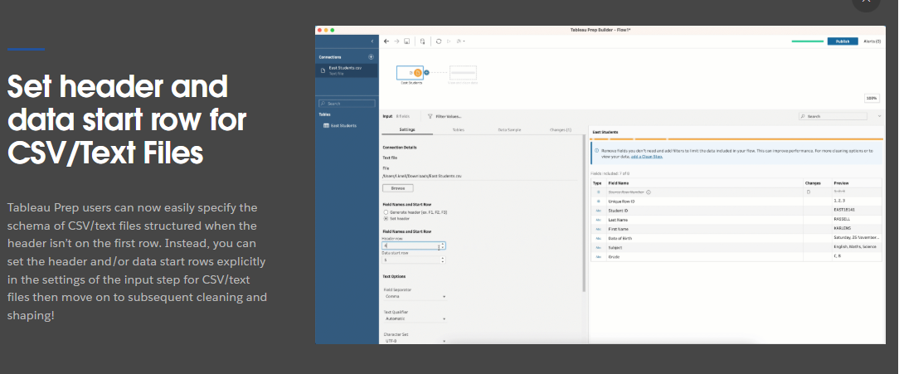
Set header and data start row for CSV/Text Files
tableau.com/2023-3-features#item-98047
Notes:
Set header and data start row for CSV/Text Files
https://www.tableau.com/2023-3-features#item-98047

Slide 33
What are you most excited about?
Talk about it or post it in the chat!
Notes:
So that was it for the highlights (so many) for our upcoming upgrade.
What are you most excited about? Post it in the chat!

Slide 34
Tableau Upgrades v2023.4 and beyond
Tableau is changing its release cadence
  3x/year: Desktop, Prep Builder, and Cloud
  1 or 2x/year: Server in every other release
  tableau.com/blog/tableau-updates-product-release-cadence
MIT will likely continue to upgrade every 12-18 months
  Timing depends on IS&T priorities and community interest
  What’s available? Check out tableau.com/products/all-features
  Want something? Say something reporting-help@mit.edu
Notes:
Updates to release cadence: https://www.tableau.com/blog/tableau-updates-product-release-cadence
New features/all versions: https://www.tableau.com/products/all-features
Want something? Say something: reporting-help@mit.edu
Before we leave the topic of the upgrade, we want to talk about what’s NOT in the upgrade. We’re upgrading to v2022.3, but v2023.3 is coming out soon. As we mentioned before, MIT will always be at least a major version behind. That’s nothing new.
What’s changing in the future (and again), though, is Tableau’s release timing. They’re switching from updating from 4 releases a year to 3. This is in part to stay in line with Salesforce’s release cycle since Salesforce is the parent company of Tableau (and Slack, and Mulesoft, and probably a few others applications we use here at MIT).
Last time they changed release cadence, they started only updating Server twice a year. Now they’re going to move to server upgrades every other release. That’s because most organizations with Server only upgrade once a year. Those server upgrades are going to be once or twice a year. That means our upgrades at MIT may be less frequent or to less recent versions.
IS&T will likely continue to upgrade annually, depending on their priorities and what MIT’s Tableau community needs. One key factor is that community need. There’s lots of cool features in the newest version of Tableau that we won’t be getting until next summer, or even later, if IS&T doesn’t know we’d like the features.
To take a line from the MBTA, want something? Say something. If there are features that you see in new releases, let IS&T know by contacting reporting-help@mit.edu. Let them know what the feature is, what version it’s in, and how it’ll help you do your job better. That’s the best way for us as a community to advocate for more frequent Tableau Server (and therefore Desktop) upgrades.

Slide 35
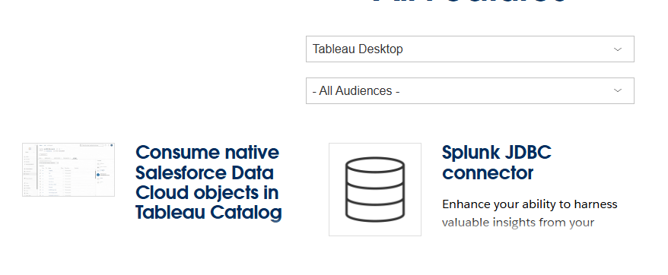
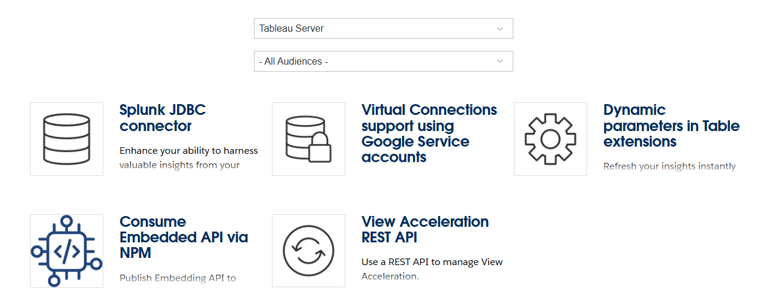
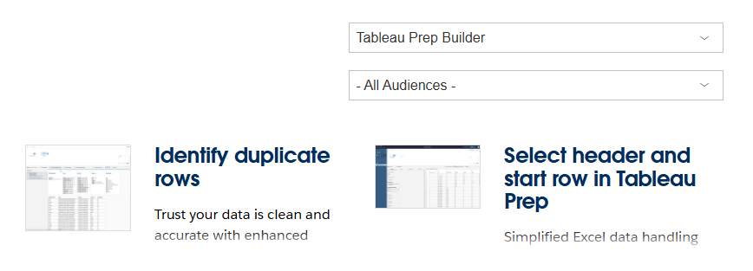
tableau.com/2024-1-features
Notes:
Post in chat:
https://www.tableau.com/products/coming-soon

Slide 36
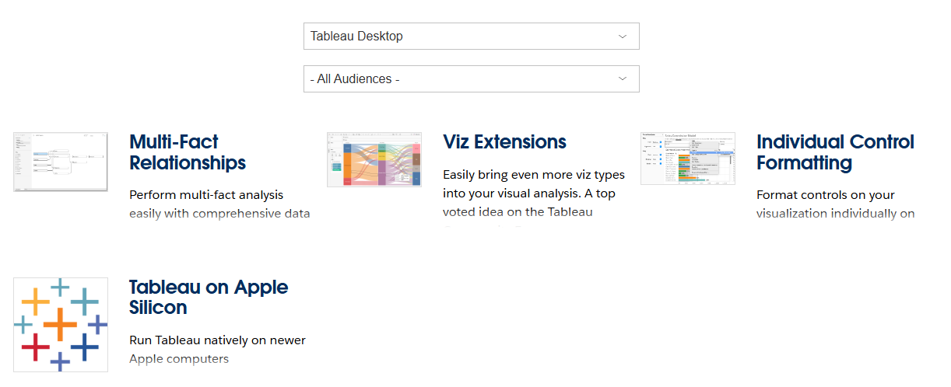
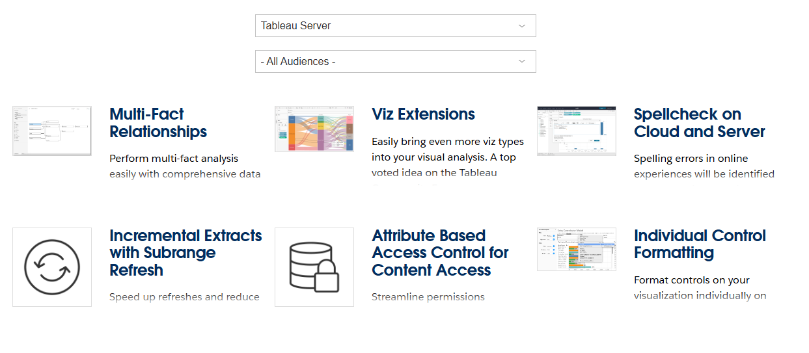
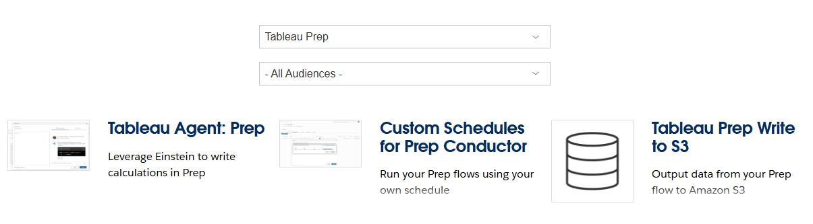
tableau.com/2024-2-features
Notes:
Post in chat:
https://www.tableau.com/products/coming-soon

Slide 37
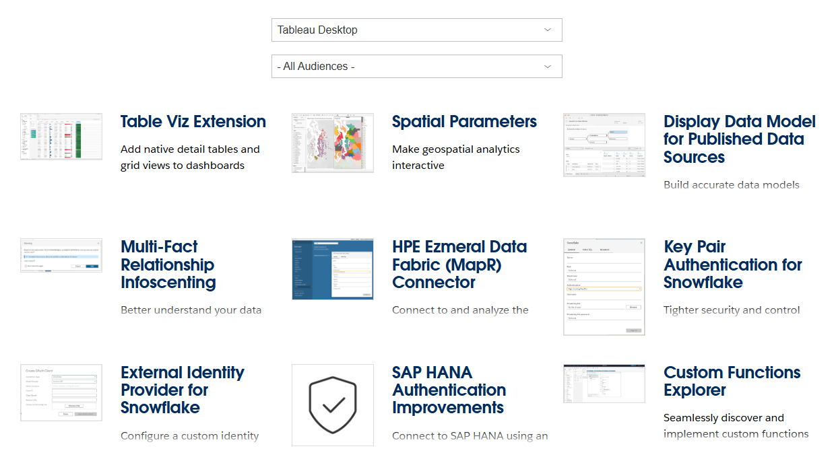
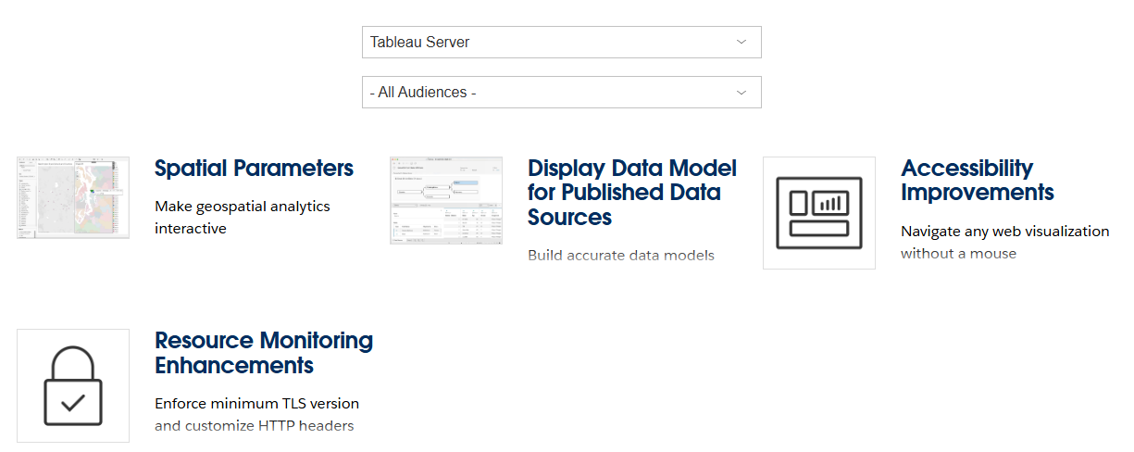
tableau.com/2024-3-features
Notes:
Post in chat:
https://www.tableau.com/products/coming-soon

Slide 38
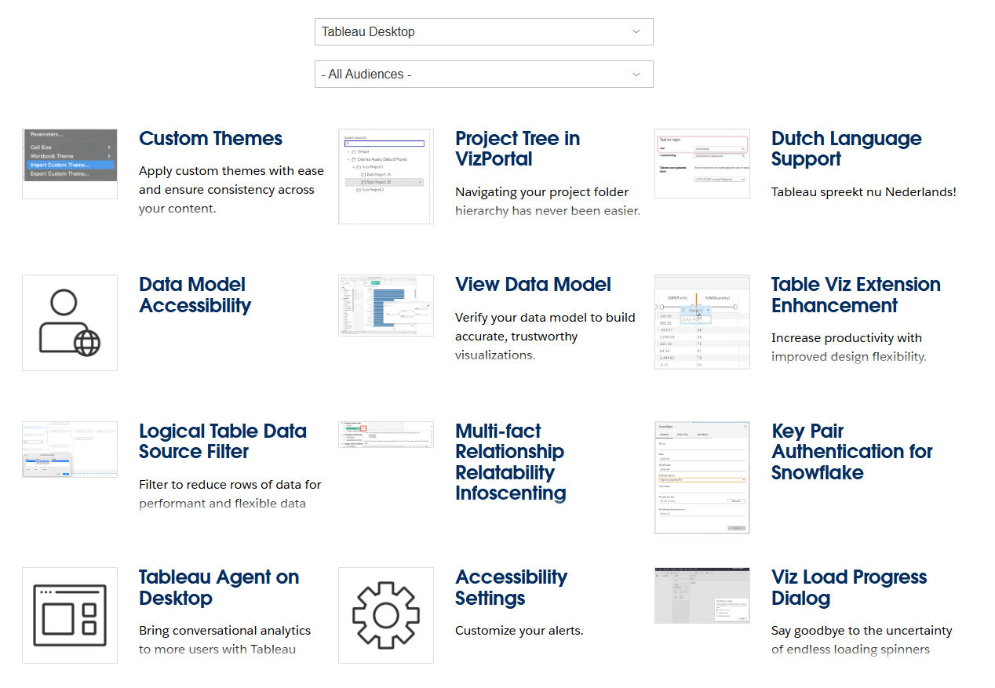
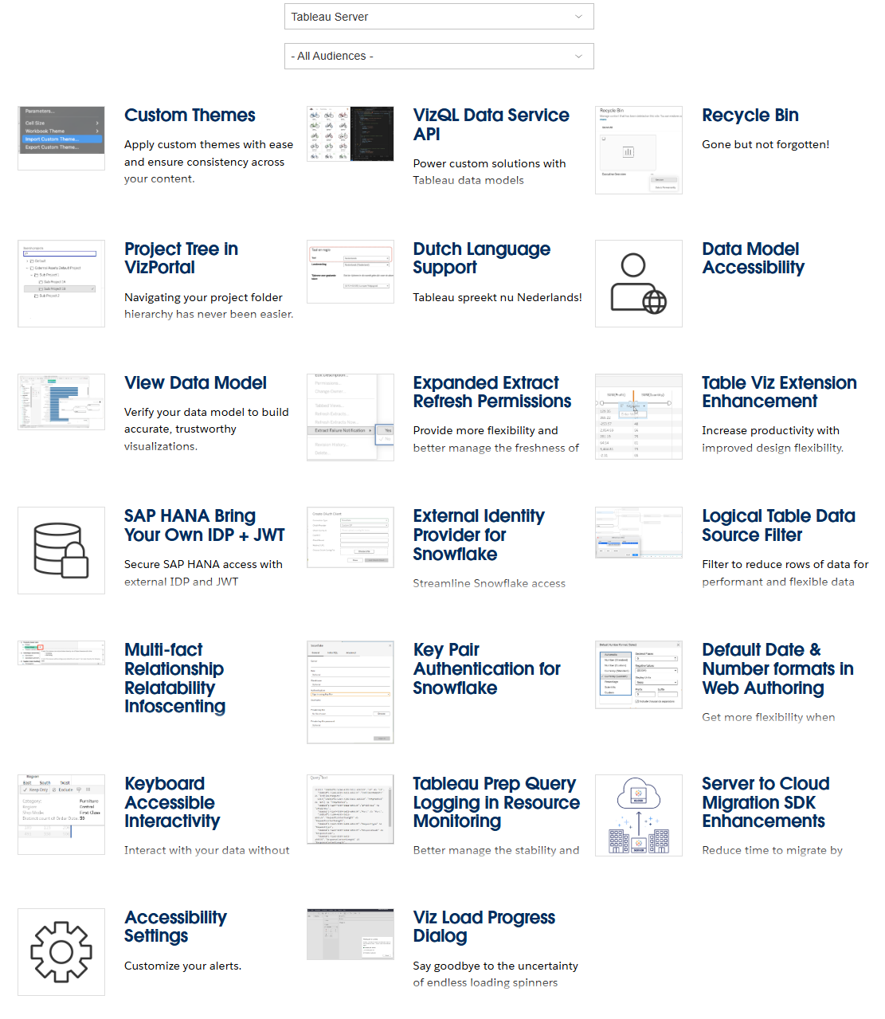
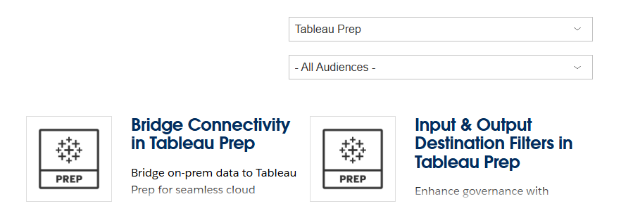
tableau.com/product/new-features
Notes:
Post in chat:
https://www.tableau.com/products/coming-soon

Slide 39
What’s next?
2023.3 is here, but what about 2024.1 and beyond?
  Multi-fact Relationships
  Custom Themes
  Viz Extensions to create Sankeys and other charts with a couple clicks
  VizQL Data Service API to get data out of Tableau
  Auto-save!
  So many accessibility improvements!
  What’s available?
  Check out tableau.com/products/all-features
Want something? Say something.
reporting-help@mit.edu
Notes:
Updates to release cadence: https://www.tableau.com/blog/tableau-updates-product-release-cadence
New features in all releases: https://www.tableau.com/products/all-features
Want something? Say something: reporting-help@mit.edu
Before we leave the topic of the upgrade, we want to talk about what’s NOT in the upgrade. We’re upgrading to v2023.3, but v2025.1 is already out. As we mentioned before, MIT will always be at least a major version behind. That’s nothing new.
Tableau does 3 releases a year, but Server only gets upgraded every other release. Since we’re always at least a major version behind, that means our upgrade cycles at MIT may be infrequent. (Our last upgrade was about year behind; this one is closer to 18 months.)
IS&T’s upgrade cycles depend on internal priorities and on what MIT’s Tableau community needs. One key factor is that community need. There’s lots of cool features in the newest version of Tableau that we won’t be getting until the end of next year if IS&T doesn’t know we’d like those features..
To take a line from the MBTA, want something? Say something. If there are features that you see in new releases, let IS&T know by contacting reporting-help@mit.edu. Let them know what the feature is, what version it’s in, and how it’ll help you do your job better. That’s the best way for us as a community to advocate for more frequent Tableau Server (and therefore Desktop) upgrades.

Slide 40
What’s next?
Education Meetup at Tableau Conference
reg.salesforce.com/flow/plus/tc25/sessioncatalog/page/catalog/session/1742409714347001sjgk
HETUG (Higher Education TUG) meetings scheduled through Dec. 2025
usergroups.tableau.com/higher-education-tableau-user-group
AppState’s Analytics Day!
Notes:
Education Meetup at Tableau Conference: https://reg.salesforce.com/flow/plus/tc25/sessioncatalog/page/catalog/session/1742409714347001sjgk
HETUG (Higher Education TUG) meetings scheduled through Dec. 2025: https://usergroups.tableau.com/higher-education-tableau-user-group
AppState’s Analytics Day!

Slide 41
Want to present?
Want to see something?
MIT TUG Leads
#ask-mit-tug-leads
mit-tableau-user-group-admin@mit.edu
Notes:
MIT TUG Leads
#ask-mit-tug-leads: https://mit-tableau.slack.com/archives/C02DTTZ9UHE
mit-tableau-user-group-admin@mit.edu

Slide 42

RAFFLE
Notes:
Thanks to our old Tableau Account Executive, Denise Youngberg, for putting together this swag bag for us!
So here are the rules:
you have to be an MIT employee, student, or temp/contractor (not sure if we'll get any randos)
mit tug leads aren't eligible
you have to here when we draw to get a prize
If we pick your name and you’re not still in the meeting, we’ll draw again until we get someone who IS in the meeting

Slide 43
Stick around to chat

