Slide 1
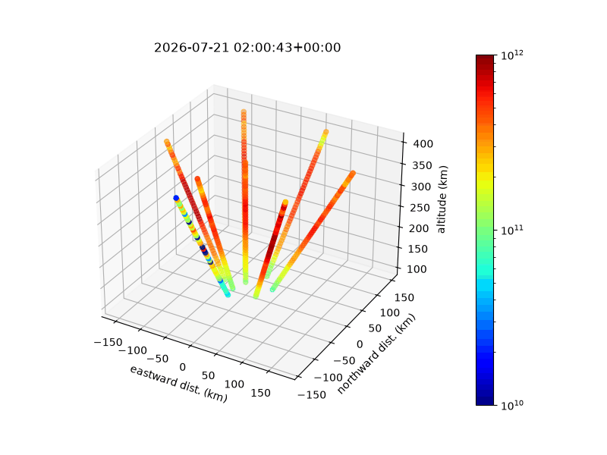




I’m not afraid to be different!
Digging Through
the Ionospheric
Trough
electron density, m⁻³
An Ill-Fated Investigation
Adedayo Akande · Samuel Freeman
Sreelekshmi Radhakrishnan Girijakumary
Lin Le · Augustus Richter
ISR Summer School 2026 · Boston, MA
Notes:
Adedayo

Slide 2
01
Background
Defining a trough and why summer troughs are unusual
The potential explanation and how ISR can help
Notes:
Lin

Slide 3
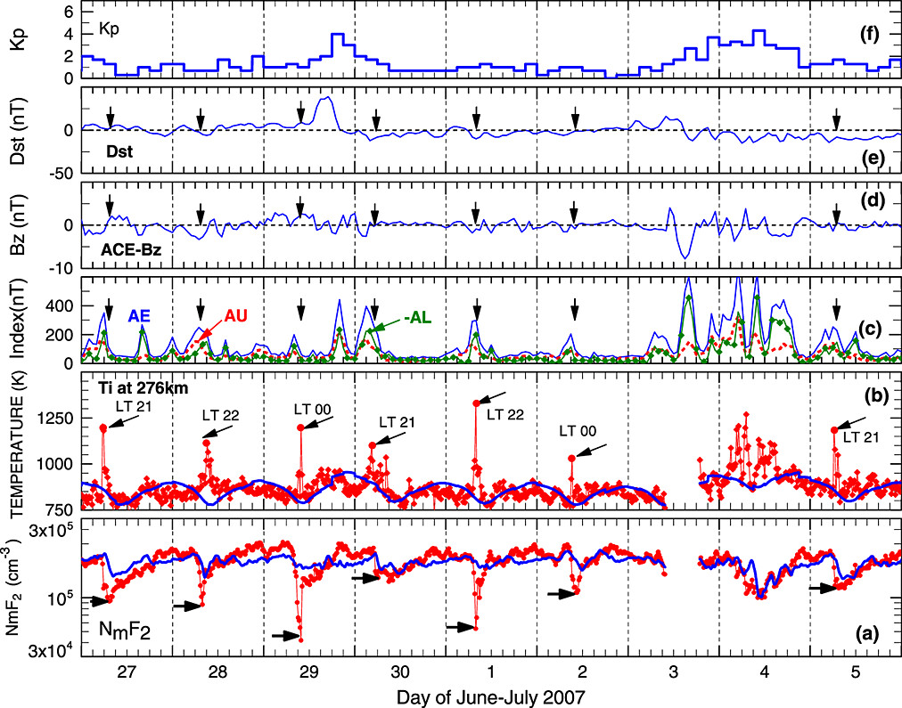
The mid-latitude ionospheric trough
Trough: a deep, narrow depletion in F-region electron density
Typically sits between the mid-latitude ionosphere and the auroral oval
  Near 60–70° magnetic latitude
Sharpest gradient on its poleward wall
Importance: it refracts HF and degrades GNSS positioning; its occurrence in the summer also raises physics questions
Richards et al, 2014, JGR Space Physics
Notes:
Lin
Magnetic quite
Narrow depletion in F region
400 degree TI spike
depletion not caused by sunset

Slide 4
The mid-latitude ionospheric trough
Latitude — sub-auroral, typically 60–70° magnetic, just equatorward of the auroral oval; can also be found poleward of auroral oval (“high-latitude troughs”)
Local time - most often premidnight through the night sector
Season - classically winter, when production has switched off and plasma can decay more quickly
Activity - favoured during quiet-to-moderate conditions, sharpened by enhanced auroral electrojet (“small” storms)
Notes:
Lin
PFISR lat 65

Slide 5
The summer puzzle
At Poker Flat in midsummer the Sun never sets far enough to stop production — so what carves a trough?
Solar zenith angle never exceeds ~93° at Poker Flat in summer
  The ionosphere is essentially always lit, so ordinary night-time recombination cannot dig a trough
Yet Richards et al. (2014) observed sudden, deep summer depletions anyway.
The paper poses a transport explanation for the sudden drop in electron density
Notes:
Adedayo

Slide 6
The hypothesis we set out to test
Richards, Nicolls, St.-Maurice, Goodwin & Ruohoniemi (2014), JGR Space Physics
1
2
3
4
Aged plasma
Convection expands
Dragged in
Radar sees it
Low-density plasma corotates in darkness after sunset, decaying for several hours at lower latitude.
A weak substorm intensifies and expands the convection pattern (an AE surge).
Low-density plasma is carried poleward and westward into the PFISR field of view.
A sudden density drop, plus a 100–400 K ion-temperature spike from frictional heating.
Their events sit near 21 MLT, at 65° magnetic, during weak activity
Notes:
Gus

Slide 7
02
Science goals
The question we asked
The specific evidence we set out to gather
Notes:
Sree

Slide 8
Our objectives
Can we independently reproduce the Richards et al. result — F-region troughs with ion-temperature spikes — and show they are convection-driven, not a precipitation artifact?
Validate a published result with our own observation, rather than take it on trust.
Determine whether plasma convection or particle precipitation is responsible for the observations.
Interpret the observations using frictional-heating theory (Thayer & Semeter, 2004).
Notes:
Sree

Slide 9
Our objectives
Search for an F-region density depletion across our beam spread in magnetic latitude
Test for a coincident ion-temperature spike as the signature of frictional heating
Resolve the bulk plasma flow with vector velocities from our multi-beam layout
Check the E region independently — precipitation would light it up; convection would not
Validate the heating quantitatively against Thayer & Semeter (2004) eq A.15
Notes:
Sam

Slide 10
03
Observation
Experiment design
Observation conditions
Notes:
Lin
: I will walk you through our experiment design, including the specific radar parameters and beam configurations, and describe the observational conditions under which we collected this data.

Slide 11
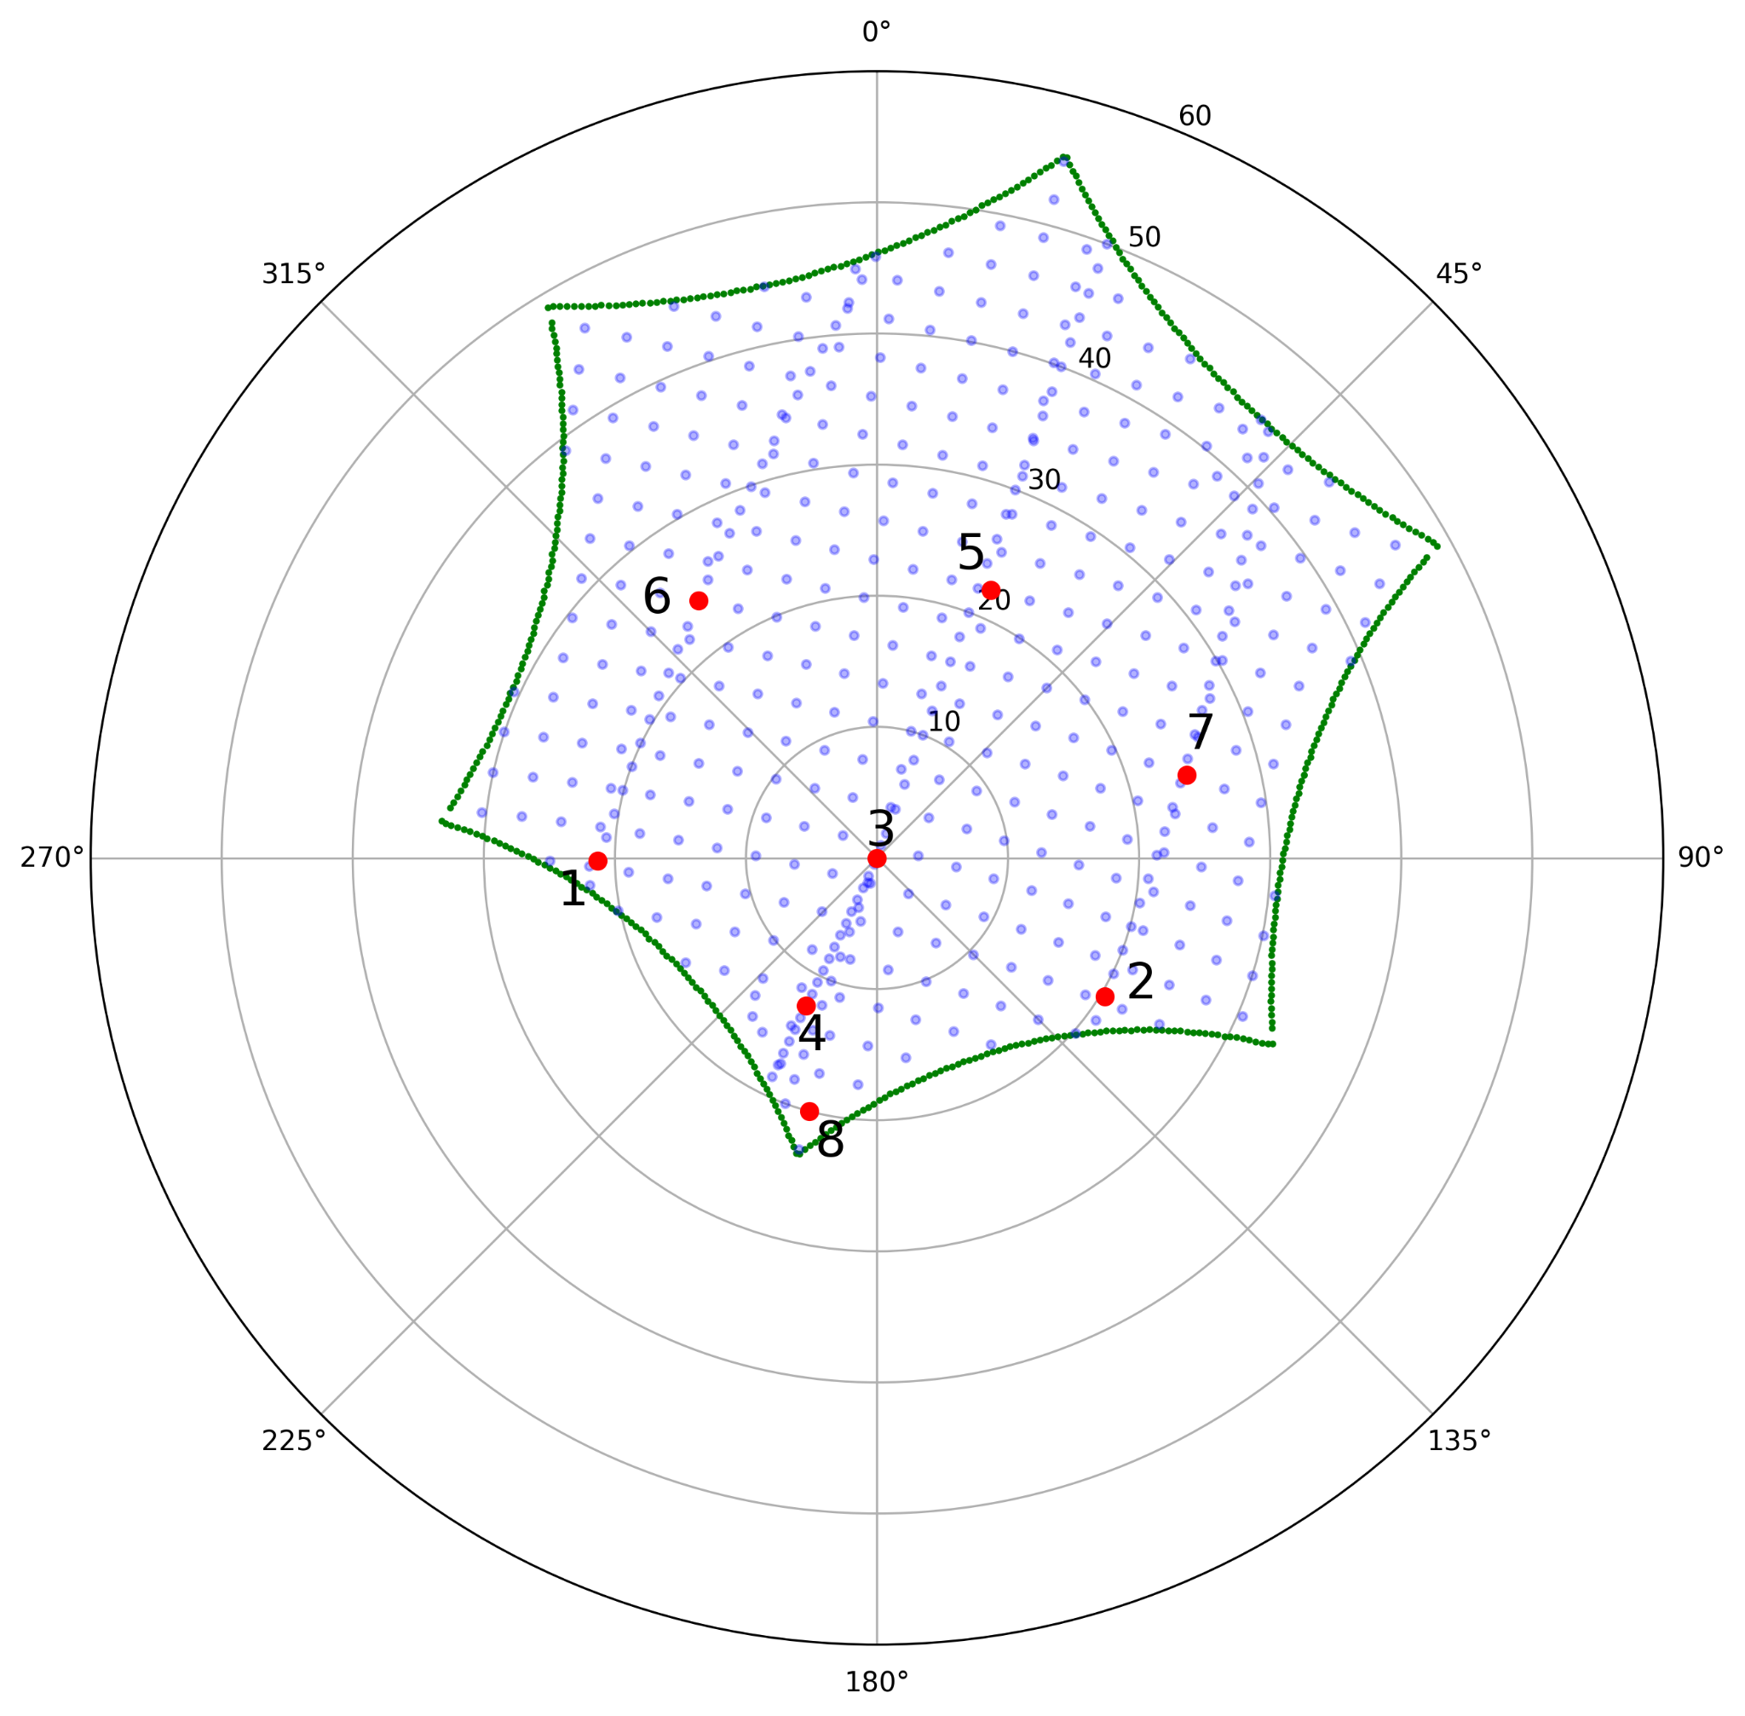
PFISR parameters
The selected beams were chosen to provide broad directional coverage across the PFISR field of view. Six beams forming a hexagonal shape are picked, which cover the entire azimuth angle.
Two additional beams pointing perpendicularly up and parallel to the B field are also selected.
Notes:
Lin

Slide 12
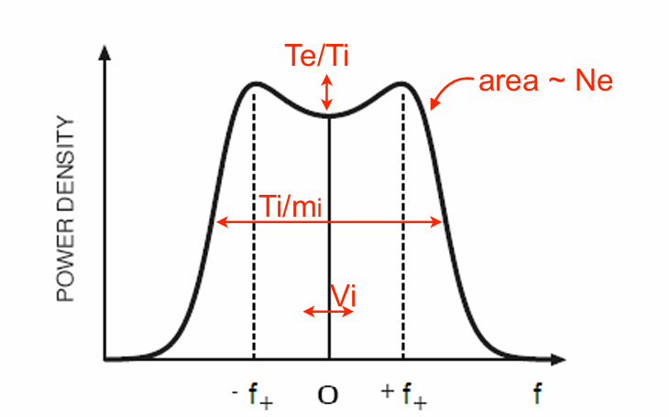
What an incoherent scatter radar measures
Received power → electron density
Spectral width → ion temperature
Spectral shape → electron/ion temperature ratio
Doppler shift → line-of-sight ion velocity
Semeter, J. (2026), ISR Summer School
Notes:
Adedayo

Slide 13
Trade space for mode design
Temporal resolution = integration period
Longer integration → less noise and smaller errors, but coarser time resolution
Shorter integration → finer time resolution, but relatively larger errors
Spatial resolution = beam positions
More beams → finer spatial sampling, but each is revisited less often
Fewer beams → better statistics per beam, but coarser spatial coverage
Signal-to-noise ratio
Denser, sunlit plasma gives higher SNR, allowing shorter integration — we focused on 5 min, giving 24 samples
Notes:
Adedayo

Slide 14
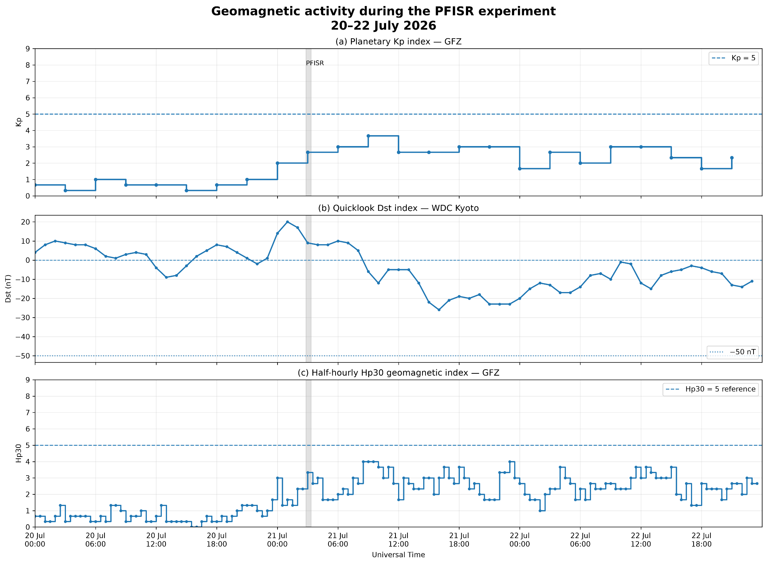
Geomagnetic Indices
We selected our time to occur during weak geomagnetic conditions
Our Kp ≤ 3 → same condition as Richards
Dst changed by ≈30 nT in 12 hours leading up to our time, a bit more than Richards’ 25 nT
Notes:
Adedayo

Slide 15

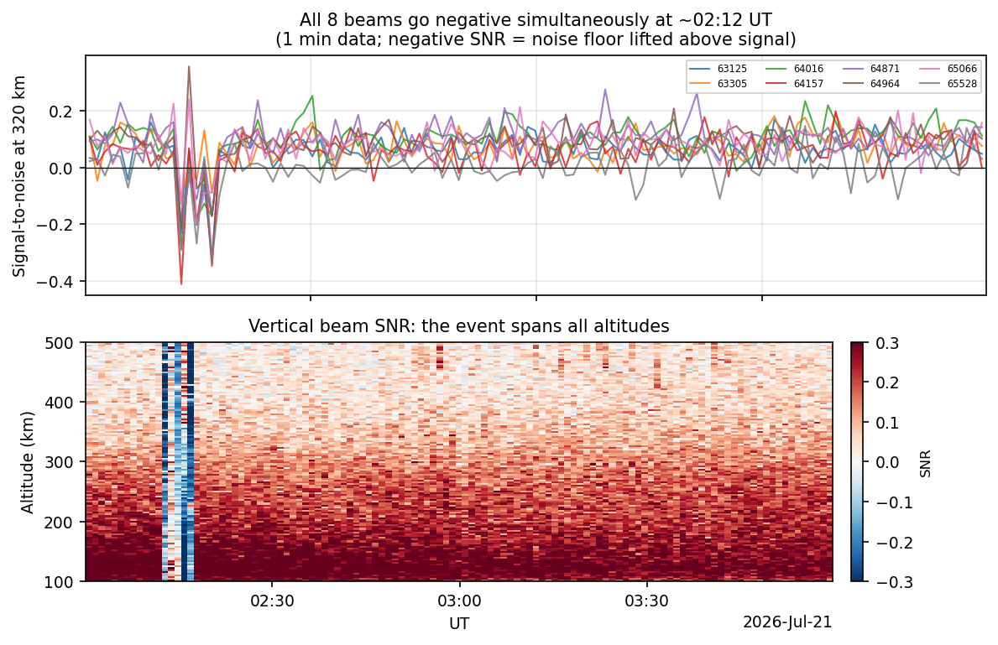
A source of interference
At 2:12-2:16 UT, SNR goes negative across all beams and all range gates
This engendered non-physical changes to plasma parameters
Most likely from RF interference
Notes:
Gus

Slide 16
04
Results
What we found (and what we didn’t)
What we can infer from what we found
Notes:
Sree

Slide 17
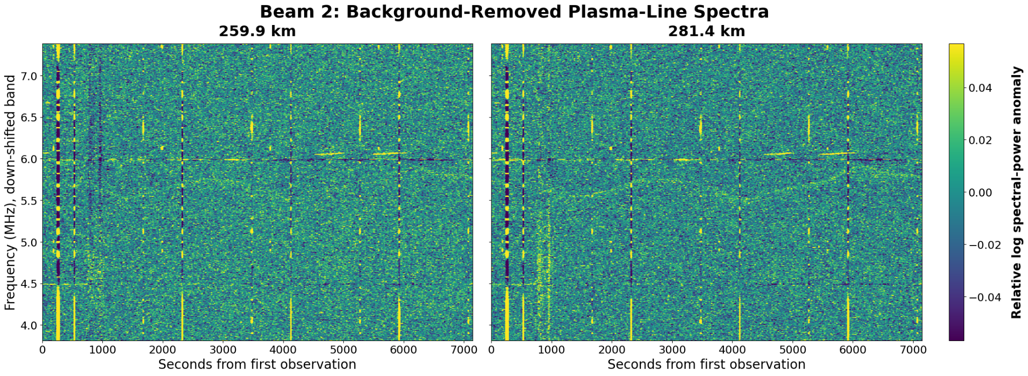
Plasma Line
Notes:
Sree

Slide 18
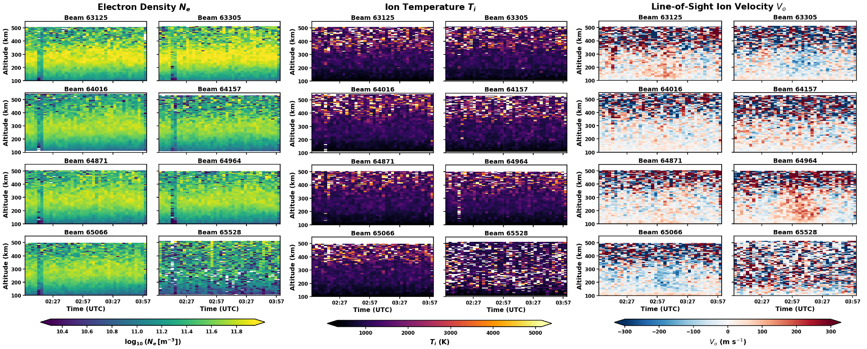
First look at our observations
Question: Was there evidence of an F-region trough during our observation period?
No clear depletion in electron density or pronounced ion temperature spike
Disturbance at ~2:12 UTC is from the interference
Notes:
Sree

Slide 19
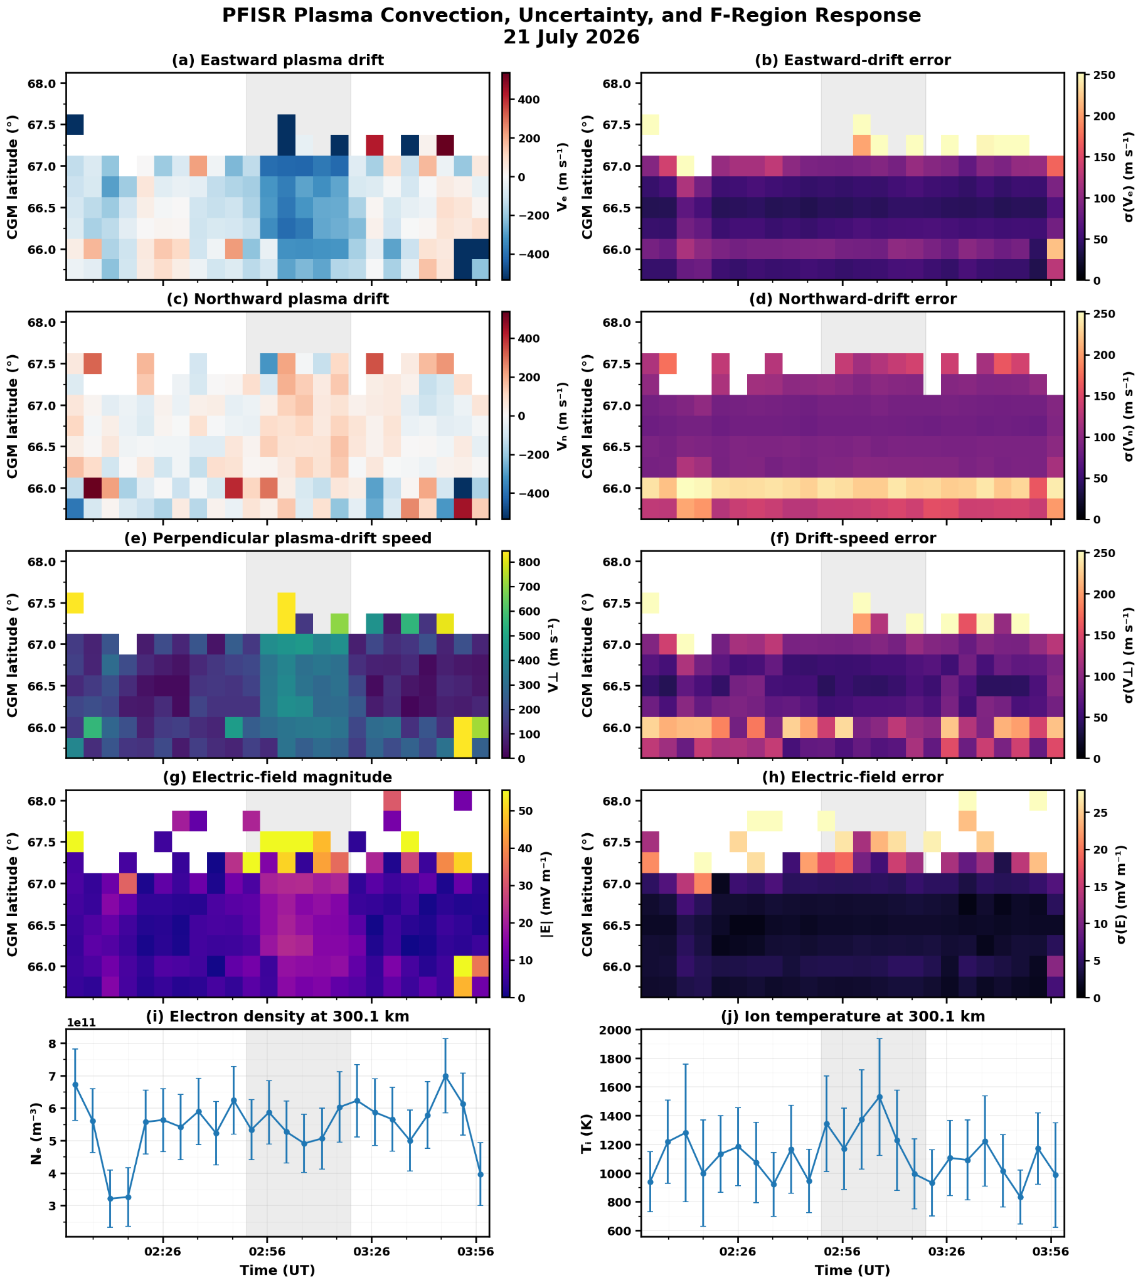
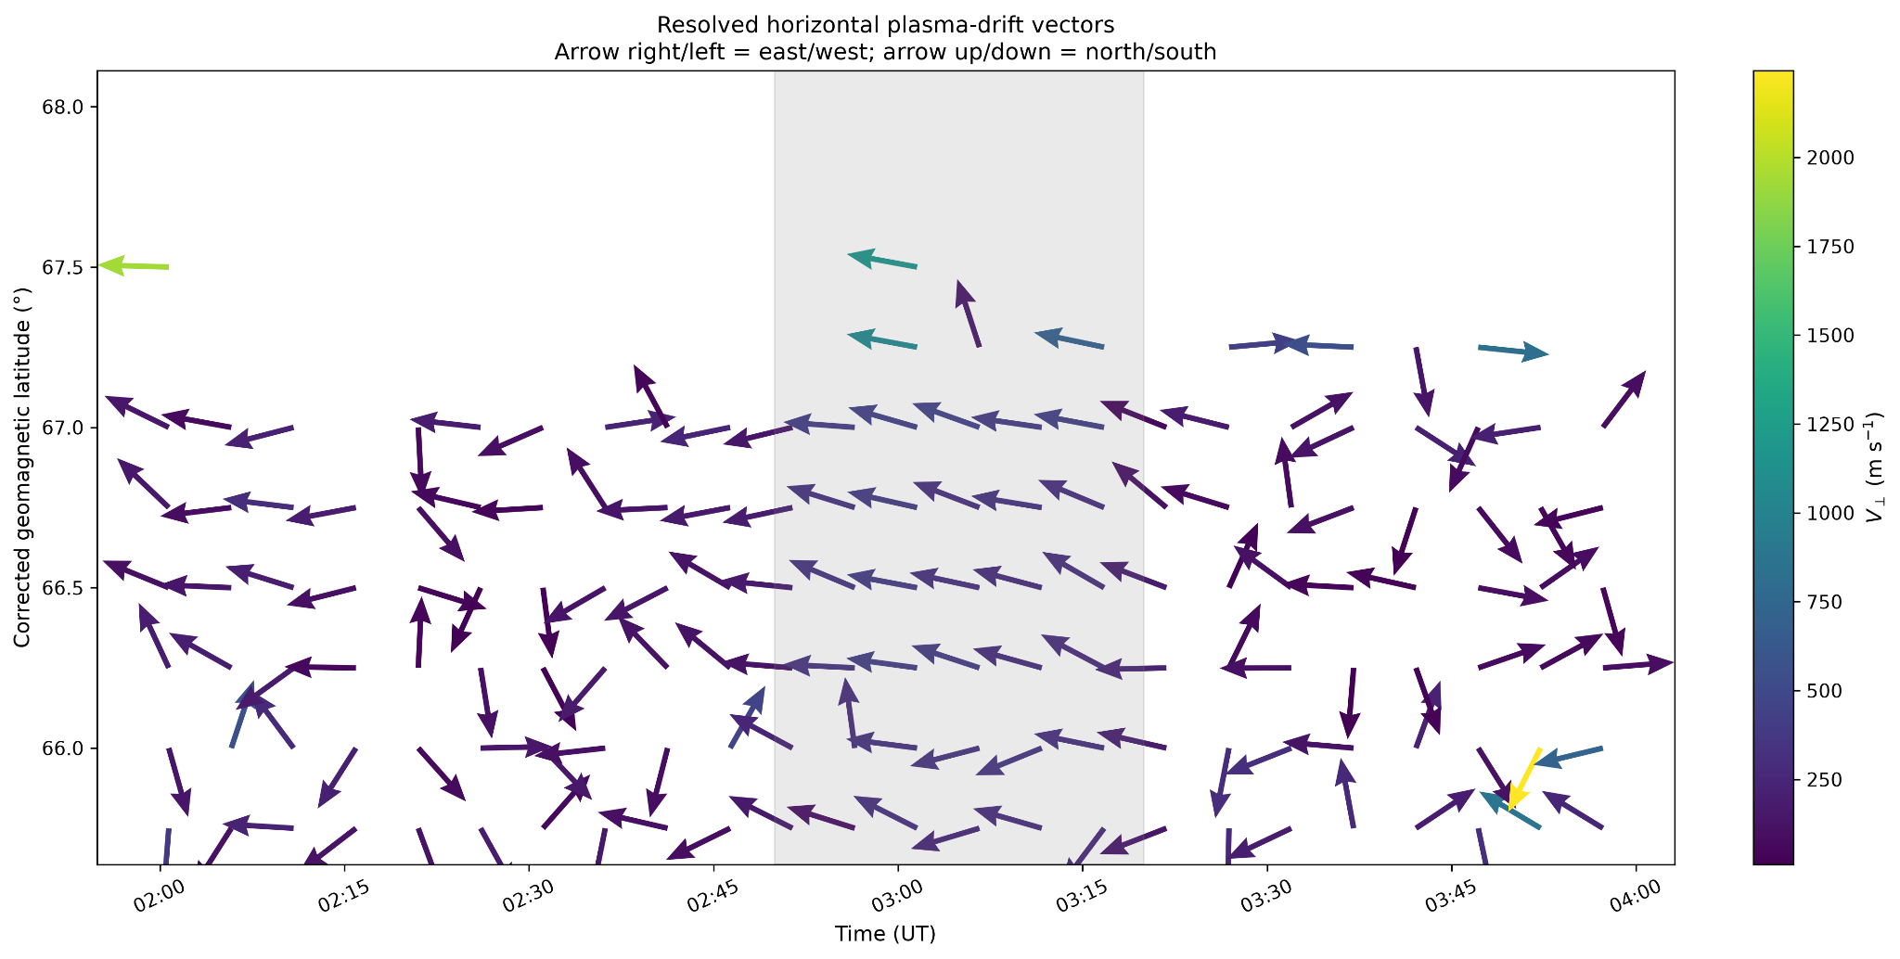
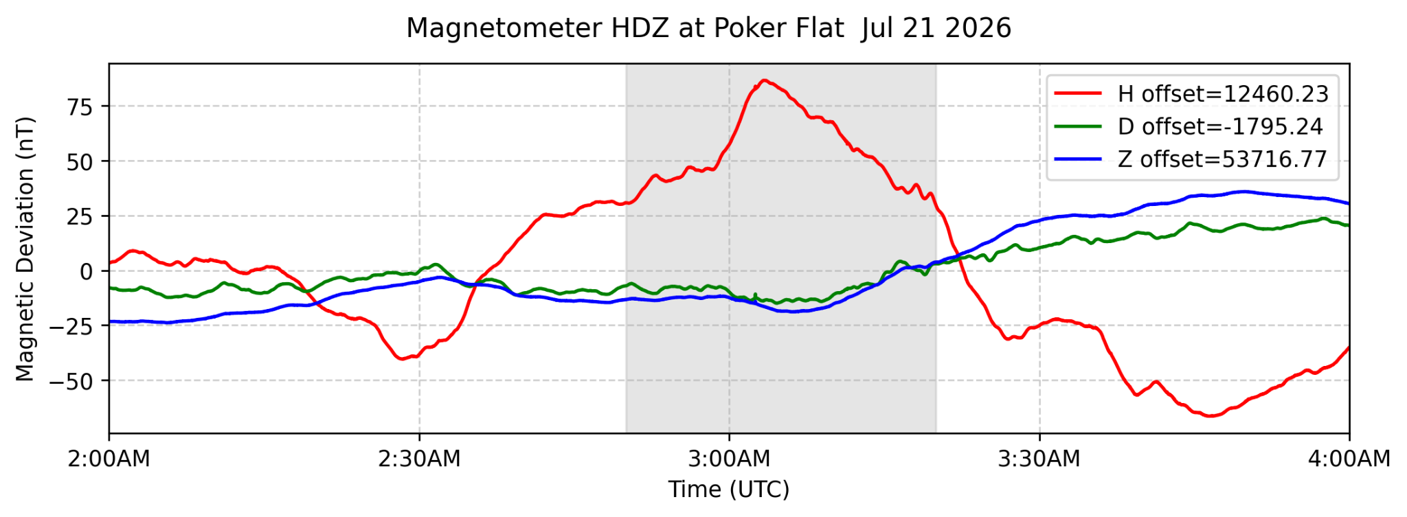
Was plasma convection enhanced even though a trough was not obvious?
Despite stronger plasma convection, no significant density depletion or ion heating is observed.
Notes:
Sree
Moderate enhancement in plasma drift.
Slight increase in electric field.
Brief Ti enhancement
Electron density showed no sustained depletion.

Slide 20
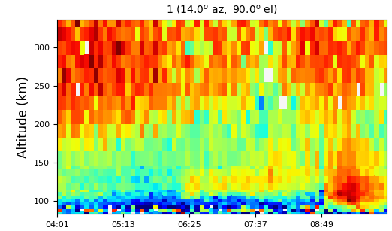
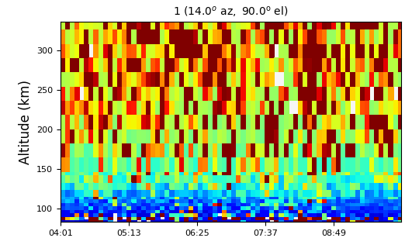
Inspecting later observations
Can we detect signatures of an ionospheric trough (F region drop, ion temperature spike, increased vector velocity) in the time periods closer to magnetic midnight (from 4 UT to 8 UT)?
electron density, 5 min AC
aurora!
ion temperature, 5 min AC
Notes:
Sam

Slide 21
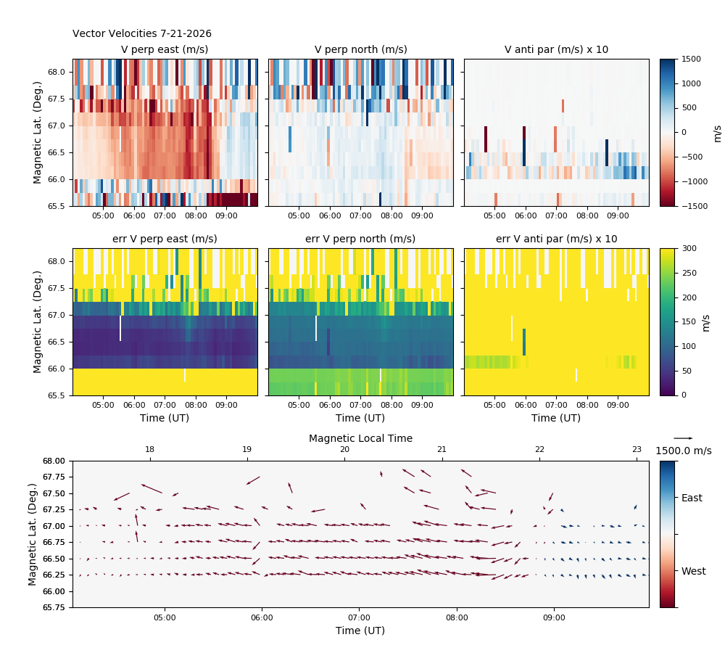
Inspecting later observations
Can we detect signatures of an ionospheric trough (F region drop, ion temperature spike, increased vector velocity) in the time periods closer to magnetic midnight (from 4 UT to 8 UT)?
Electron density decreases after sunset, sharp decrease associated with trough not visible
Ion temperatures remain relatively constant
Vector velocity increases, but does not affect ion temperature
…no
Notes:
Sam

Slide 22
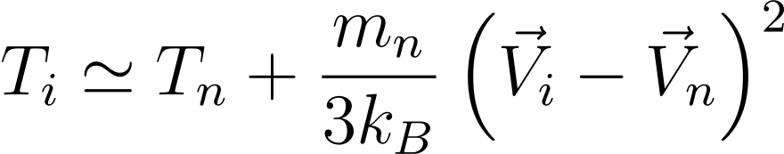






Frictional heating - the equation
Thayer & Semeter (2004), JASTP — The convergence of magnetospheric energy flux in the polar atmosphere
Variable | What we plug in
Neutral temperature | From NRLMSIS 2.1 model; assume 10% uncertainty
Ion temperature | Fitted 5 min long pulse
Boltzmann’s constant | In joules per kelvin
Neutral mass | Assumed atomic oxygen O (16 amu)
Bulk ion drift | Long pulse 5 min vvel
Bulk neutral drift | Assumed to be zero; overestimates heating
When a convection E-field drives ions through a slower neutral gas, the ions are frictionally heated
  Explains the T_{i} spikes Richards et al. tie to troughs
Relevant collision in F-region: O⁺ + O → O⁺ + O
We compare results to equation at 320 km (F-region)
Notes: bad beam and interference data are removed
Notes:
Gus

Slide 23
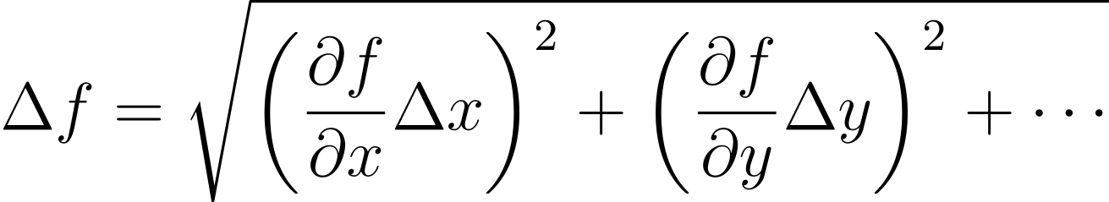
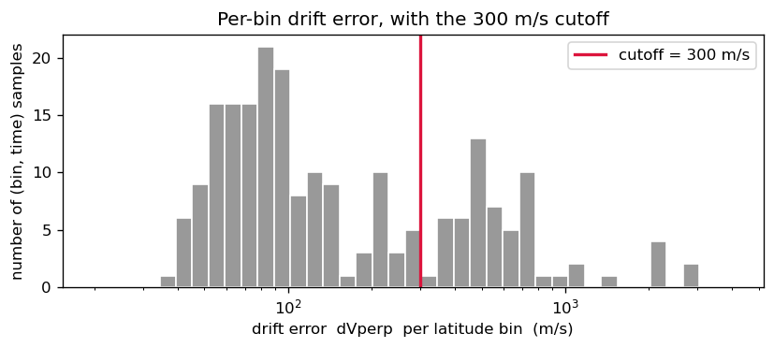
Frictional heating - data analysis
All uncertainties are calculated using the general law of propagation
Ion drift is |V⊥|, which combines V_{⊥,N} and V_{⊥,E}
The ion drift magnetic latitude bins with high error are removed; the surviving bins at each time point are inverse variance-weighted
  Assumes drift is uniform over 2.3॰ span
T_{i} is inverse variance-weights 7 usable beams
We then predict T_{i} using Thayer and compare
Lastly, we summarize ion drift for over 2 hours using inverse variance weighting
Simplified Form of Propagation of Uncertainty
Notes:
Gus

Slide 24
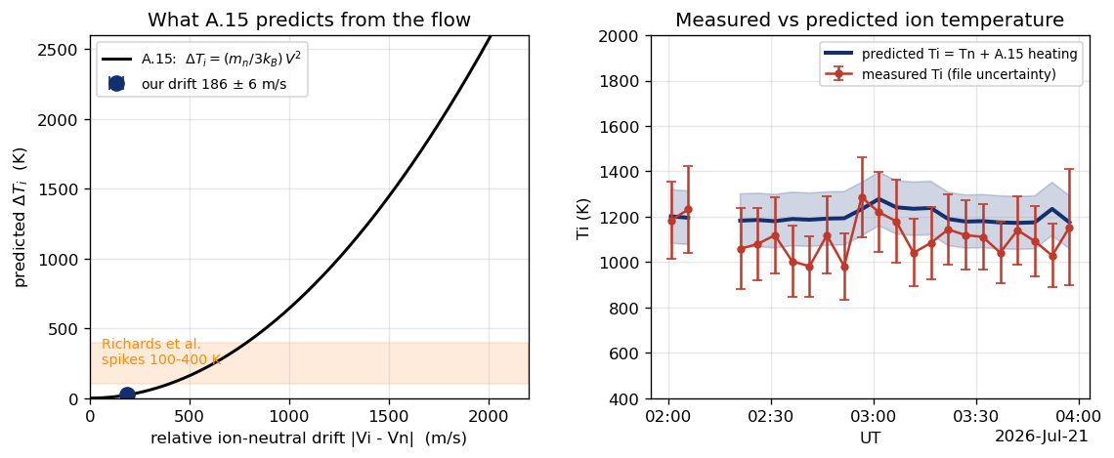
Frictional heating - How we compared
The comparison
Average drift is 186 ± 6 m/s, gives predicted heating of 22 ± 1 K
Need 500-750 m/s drift to get Richards’ 100-400 K spike
Predicted and measured T_{i} are within uncertainty
Weak drift gives low heating → what Thayer predicts
Note: 5 min points are linearly interpolated
Notes:
Gus

Slide 25
05
Conclusions
What we can claim (and what we can’t)
What we would change
Notes:
Adedayo

Slide 26
Specific objectives - were they met?
F-region density depletion - was not present during the observation period
A coincident ion-temperature spike - was not present during the observation period
Bulk plasma flow - vector velocities showed very minimal flow
Check the E region independently - AC data showed no anomalous electron density from precipitation
Validate the heating - heating and velocity agree with Thayer and Semeter (2004) - both are minimal
Notes:
Adedayo

Slide 27
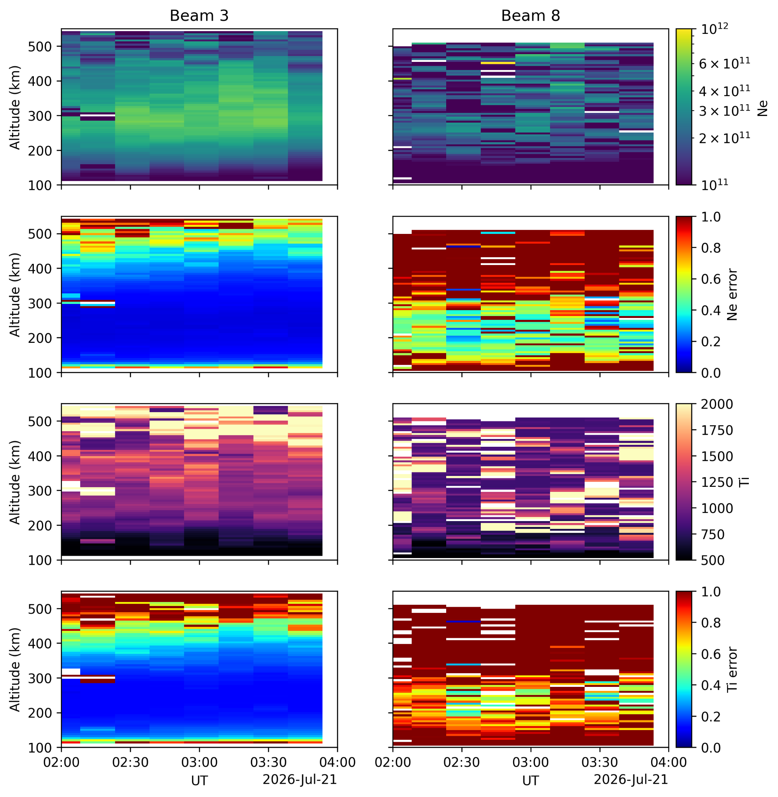
Troublesome Beam 8
Beam 8 [id: 65528] has data that doesn’t align with any reasonable fit. All Beam 8 data was discarded in analysis.
  Even a 15 minute integration time doesn’t provide meaningful data
Notes:
Lin

Slide 28
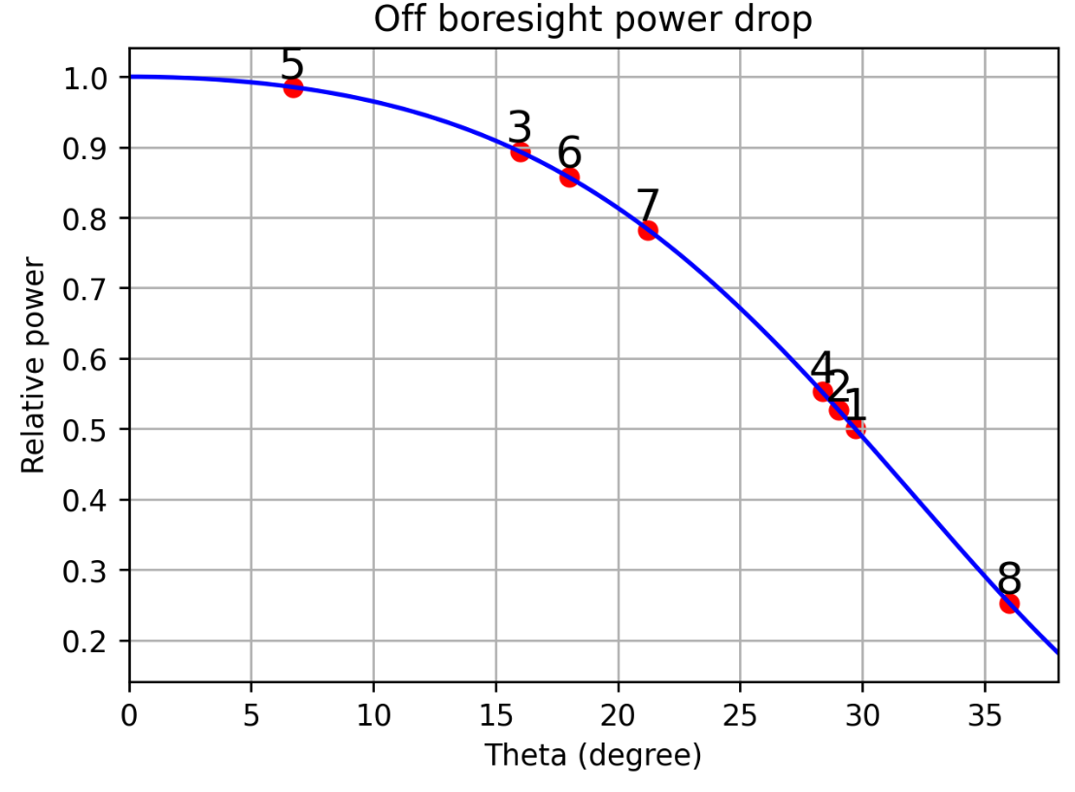
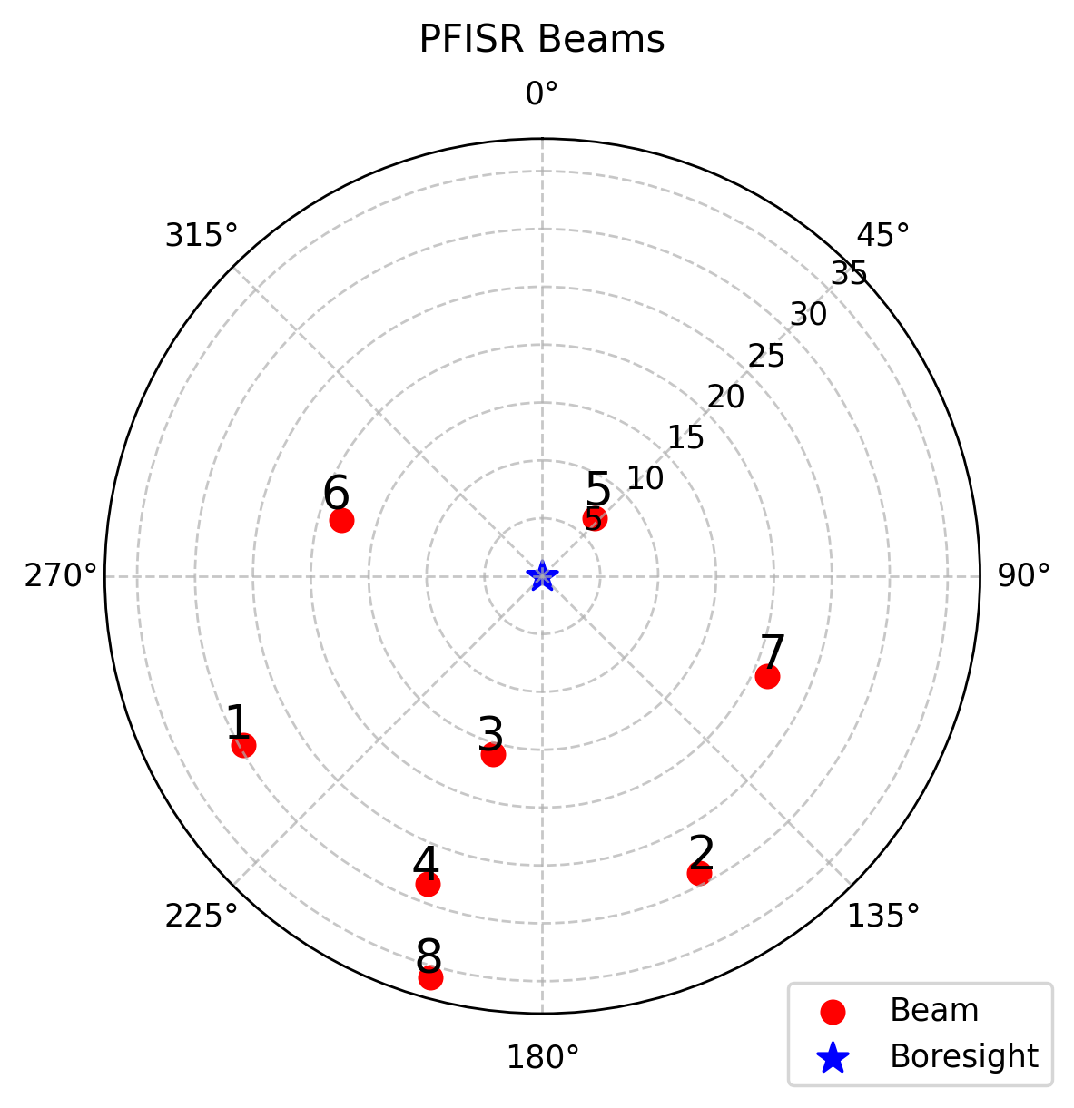
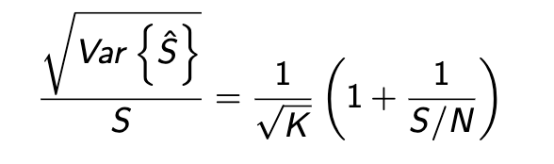
Troublesome Beam 8
bore sight direction
Beam at grating limit has only ¼ of the power of the bore sight beam.
Error estimation
(Assume boresight S/N=0.25)
  Beam 4: S/N=⅛, 2x error (Up-B)
  Beam 8: S/N=1/16, 3x error
30 degree is the maximum steering angle (don’t go beyond Up-B beam)
beam direction
Up-B beam
θ
λ/2
ground plane
Notes:
Lin
We want to identify the cause of the issue with Beam 8
The effect of ground plane

Slide 29
Potential improvements
If offered the chance to try again, we would seek to improve…
Problem
Reason
Solution
Reason
No trough observed
small observation period
increase observation period
better chance to see trough activity over long period of time
PFISR location suboptimal
Too close to auroral oval
use Millstone Hill
sub-auroral region more likely to observe ionospheric trough
Beam 8 misbehavior
problems with equipment
use different beams, if possible
better aggregate electron density data, vector velocities
Different trough types
expand to high-latitude, post-midnight troughs
use PFISR, look to even higher latitudes
observing different trough types gives insight into similarities and differences
Notes:
Sam

Slide 30
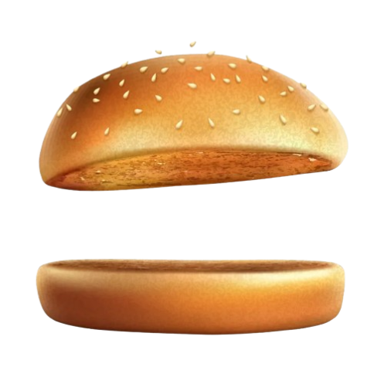
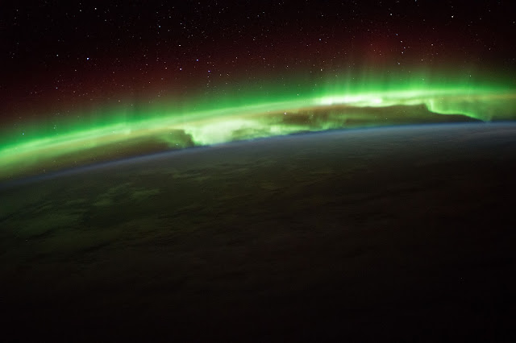
The takeaway
Don’t bank your experiment on seeing a phenomenon that isn’t guaranteed to happen in the two-hour window you have to do the experiment!
Questions?

Slide 31
References
Bhatt, A., SRI International (2026), Data from the CEDAR Madrigal database, Available from https://w3id.org/cedar?experiment_list=experiments0/2026/pfa/21jul26b&file_list=pfa20260721.002_ac_fit_01min.001.h5; https://w3id.org/cedar?experiment_list=experiments0/2026/pfa/21jul26b&file_list=pfa20260721.002_ac_fit_05min.001.h5; https://w3id.org/cedar?experiment_list=experiments0/2026/pfa/21jul26b&file_list=pfa20260721.002_lp_fit_01min.001.h5; https://w3id.org/cedar?experiment_list=experiments0/2026/pfa/21jul26b&file_list=pfa20260721.002_lp_fit_03min.001.h5; https://w3id.org/cedar?experiment_list=experiments0/2026/pfa/21jul26b&file_list=pfa20260721.002_lp_fit_05min.001.h5; https://w3id.org/cedar?experiment_list=experiments0/2026/pfa/21jul26b&file_list=pfa20260721.002_lp_vvels_05min.001.h5; https://w3id.org/cedar?experiment_list=experiments0/2026/pfa/21jul26c&file_list=pfa20260721.003_ac_fit_05min.001.h5
GFZ Hemholz Center for Geosciences (2026), Data: Kp index, https://kp.gfz.de/en/data
GFZ Hemholz Center for Geosciences (2026), Data: Kp index, https://kp.gfz.de/en/hp30-hp60/data
Imajo, S. (2026), Real-time (Quicklook) Dst Index Monthly Plot and Table, WDC/Kyoto, https://wdc.kugi.kyoto-u.ac.jp/dst_realtime/202607/index.html
Karpachev, A. (2022) Advanced separation and classification of ionospheric troughs in midnight conditions, Sci Rep., 12, https://doi.org/10.1038/s41598-022-17591-4
NASA/ESA (2016), ISS orbit of the earth, https://earthspacecircle.blogspot.com/2016/09/aurora-seen-from-international-space.html
Richards, P. G., M. J. Nicolls, J.-P. St.-Maurice, L. Goodwin, and J. M. Ruohoniemi (2014), Investigation of sudden electron density depletions observed in the dusk sector by the Poker Flat, Alaska incoherent scatter radar in summer, J. Geophys. Res. Space Physics, 119, pages 10,608–10,620. https://doi.org/10.1002/2014JA020541
Semeter, J. (2026), Radar Signal Processing: Principles of Pulse-Doppler Radar [slide presentation], 2026 ISR Summer School, Boston, MA, https://wikis.mit.edu/confluence/display/ASGScience/2026+ISR+School?preview=/351513383/351513372/PulseDopplerRadar_Semeter_July2025.pdf
Thayer, J. P., Semeter, J. (2004), The convergence of magnetospheric energy flux in the polar atmosphere, Journal of Atmospheric and Solar-Terrestrial Physics, 66, pages 807-824, https://doi.org/10.1016/j.jastp.2004.01.035
Voiculescu, M., T. Nygrén, A. T. Aikio, H. Vanhamäki, and V. Pierrard (2016), Postmidnight ionospheric troughs in summer at high latitudes, J. Geophys. Res. Space Physics, 121, 12,171–12,185, https://doi.org/10.1002/2016JA023360

