Slide 1
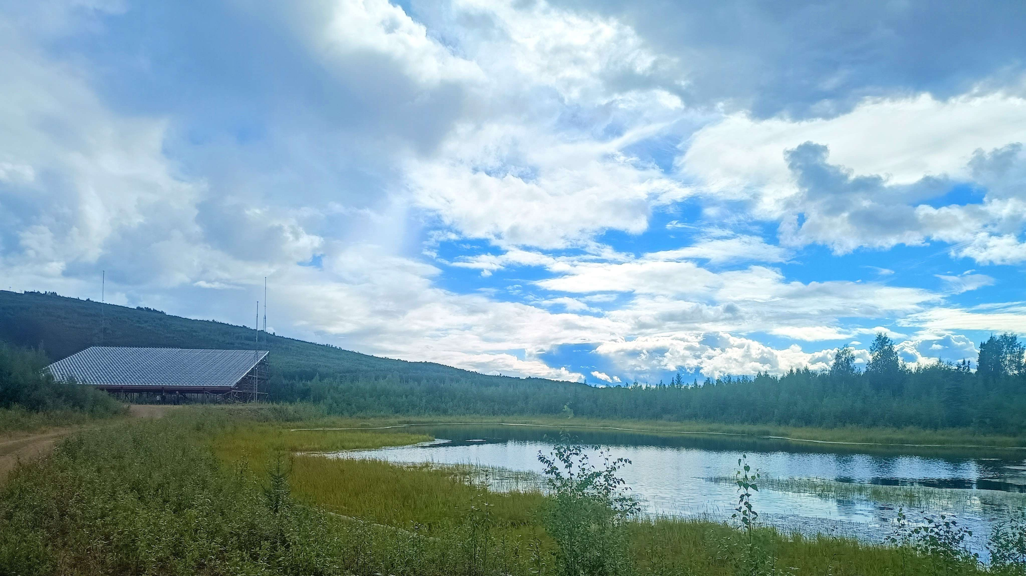
Group 4 super cool best science presentation you’ve ever seen in your life
Huzzah!

Slide 2

Science Motivation
Solar radiation excites the dayside ionosphere, plasma recombines at night.
Solar terminator line separates day and night side ionosphere, recombination can be observed as decreasing electron density at night, and increases again in the morning.
Objective: Observe electron density gradient across terminator by ‘sweeping’ PFISR beam at low solar elevation angles

Slide 3
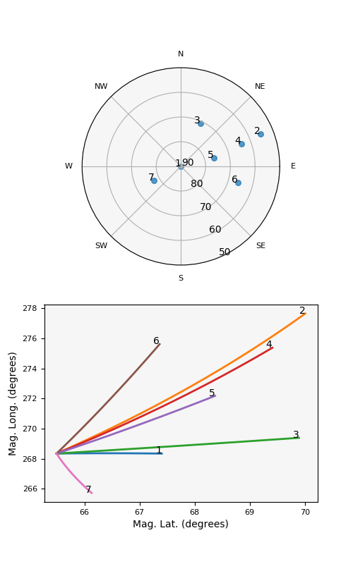
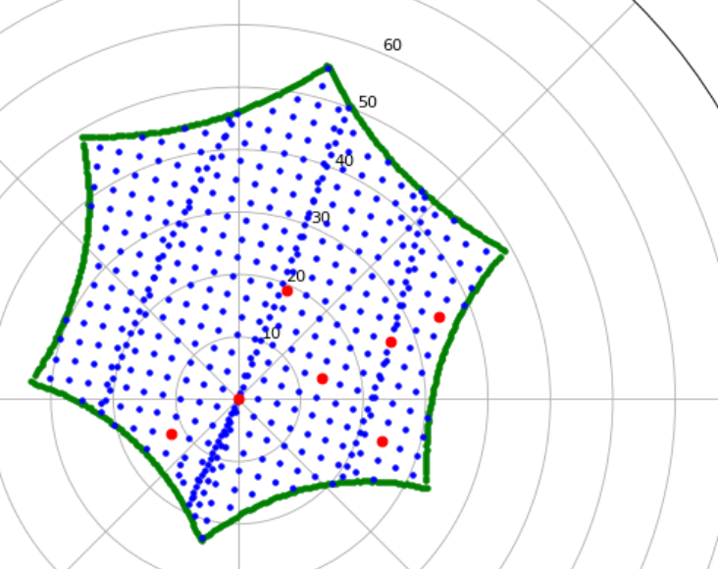
Experiment Design
7-9 am, July 22nd
7 PFISR beam positions
  Sweeping 5 elevations in line with the sun
  Lowest is ~55 deg
  2 extra for position diversity
Long pulse + Alternating Code
  Target the E-F region
  Expecting largest variation in E region
7:00 am
3
2
4
1
5
7
6
9:00 am

Slide 4
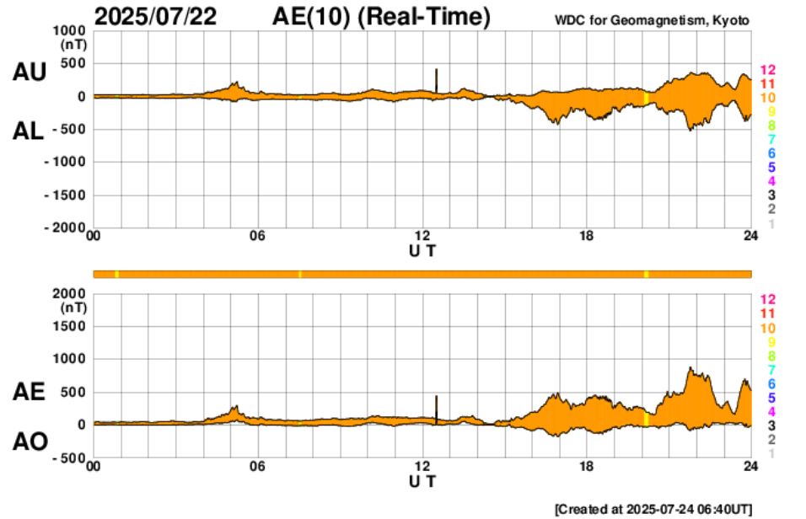
It’s just so quiet…

Slide 5
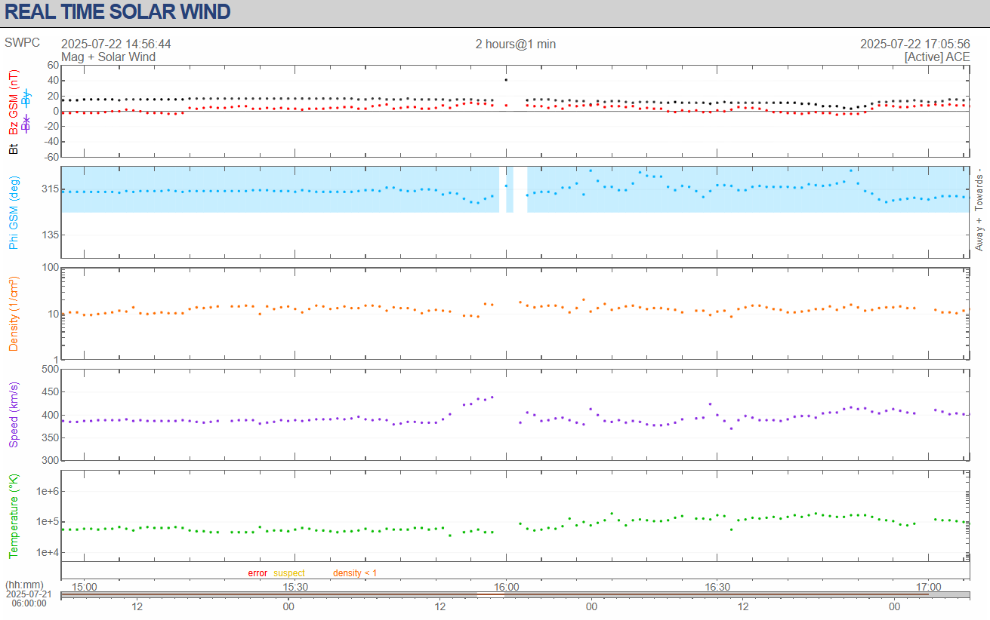
No significant solar activity in radar…

Slide 6
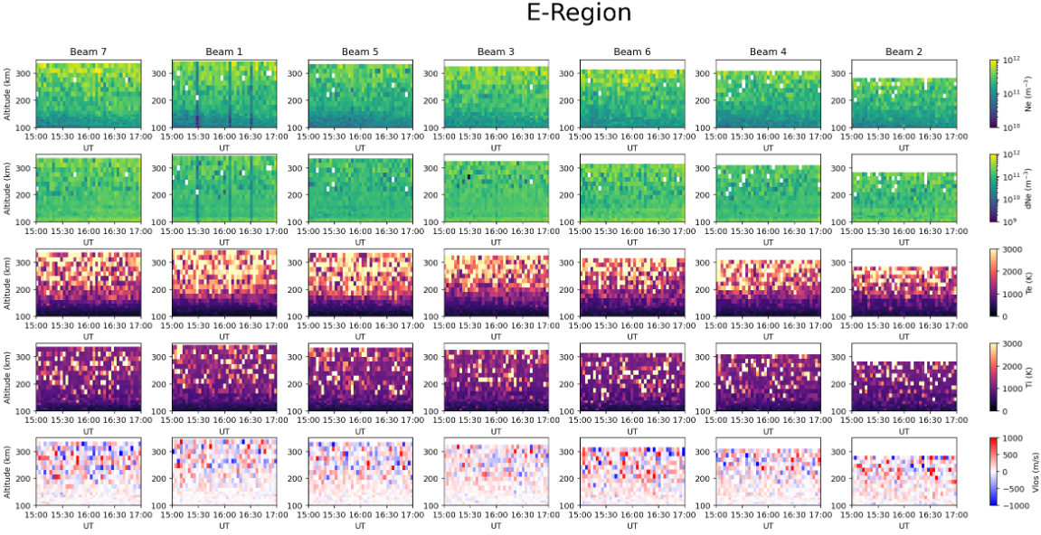
Data Modes Used - 3-min Fitted Long Pulse
7:00 am
3
2
4
1
5
7
6
9:00 am

Slide 7
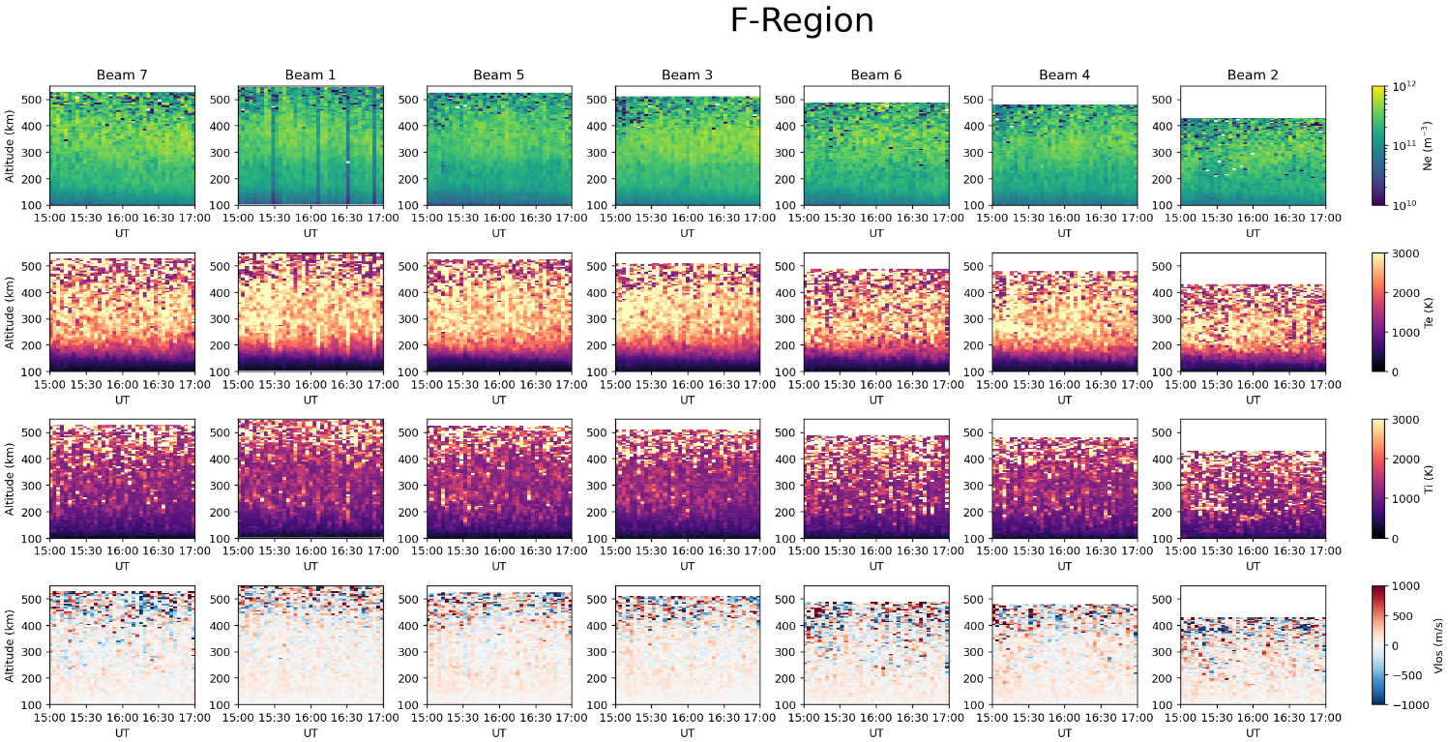
Data Modes Used - 3-min Fitted Long Pulse
7:00 am
3
2
4
1
5
7
6
9:00 am

Slide 8
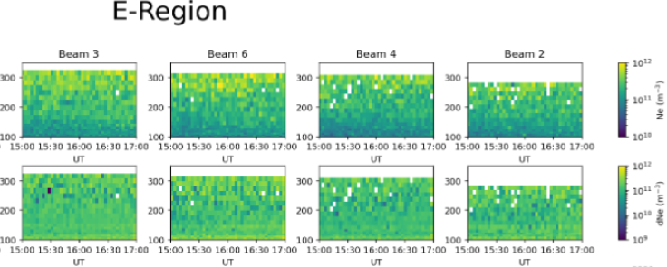
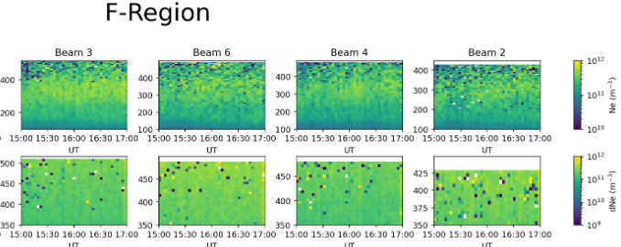
Choice of Data Mode
Alternating Mode
Alternating Mode Data in our experiment window:
  Line of sight velocity plots are good
  Limited range covered by beams
  Electron density Data is too noisy in E-region
Long Pulse mode is doing a better job in capturing both E and F region in our window.
Long Pulse Mode

Slide 9
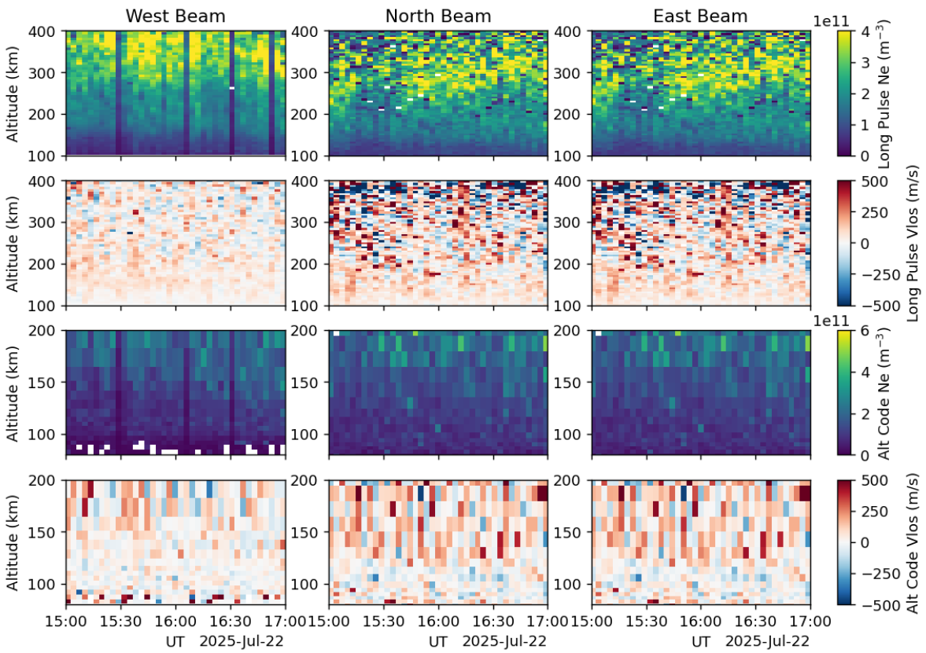
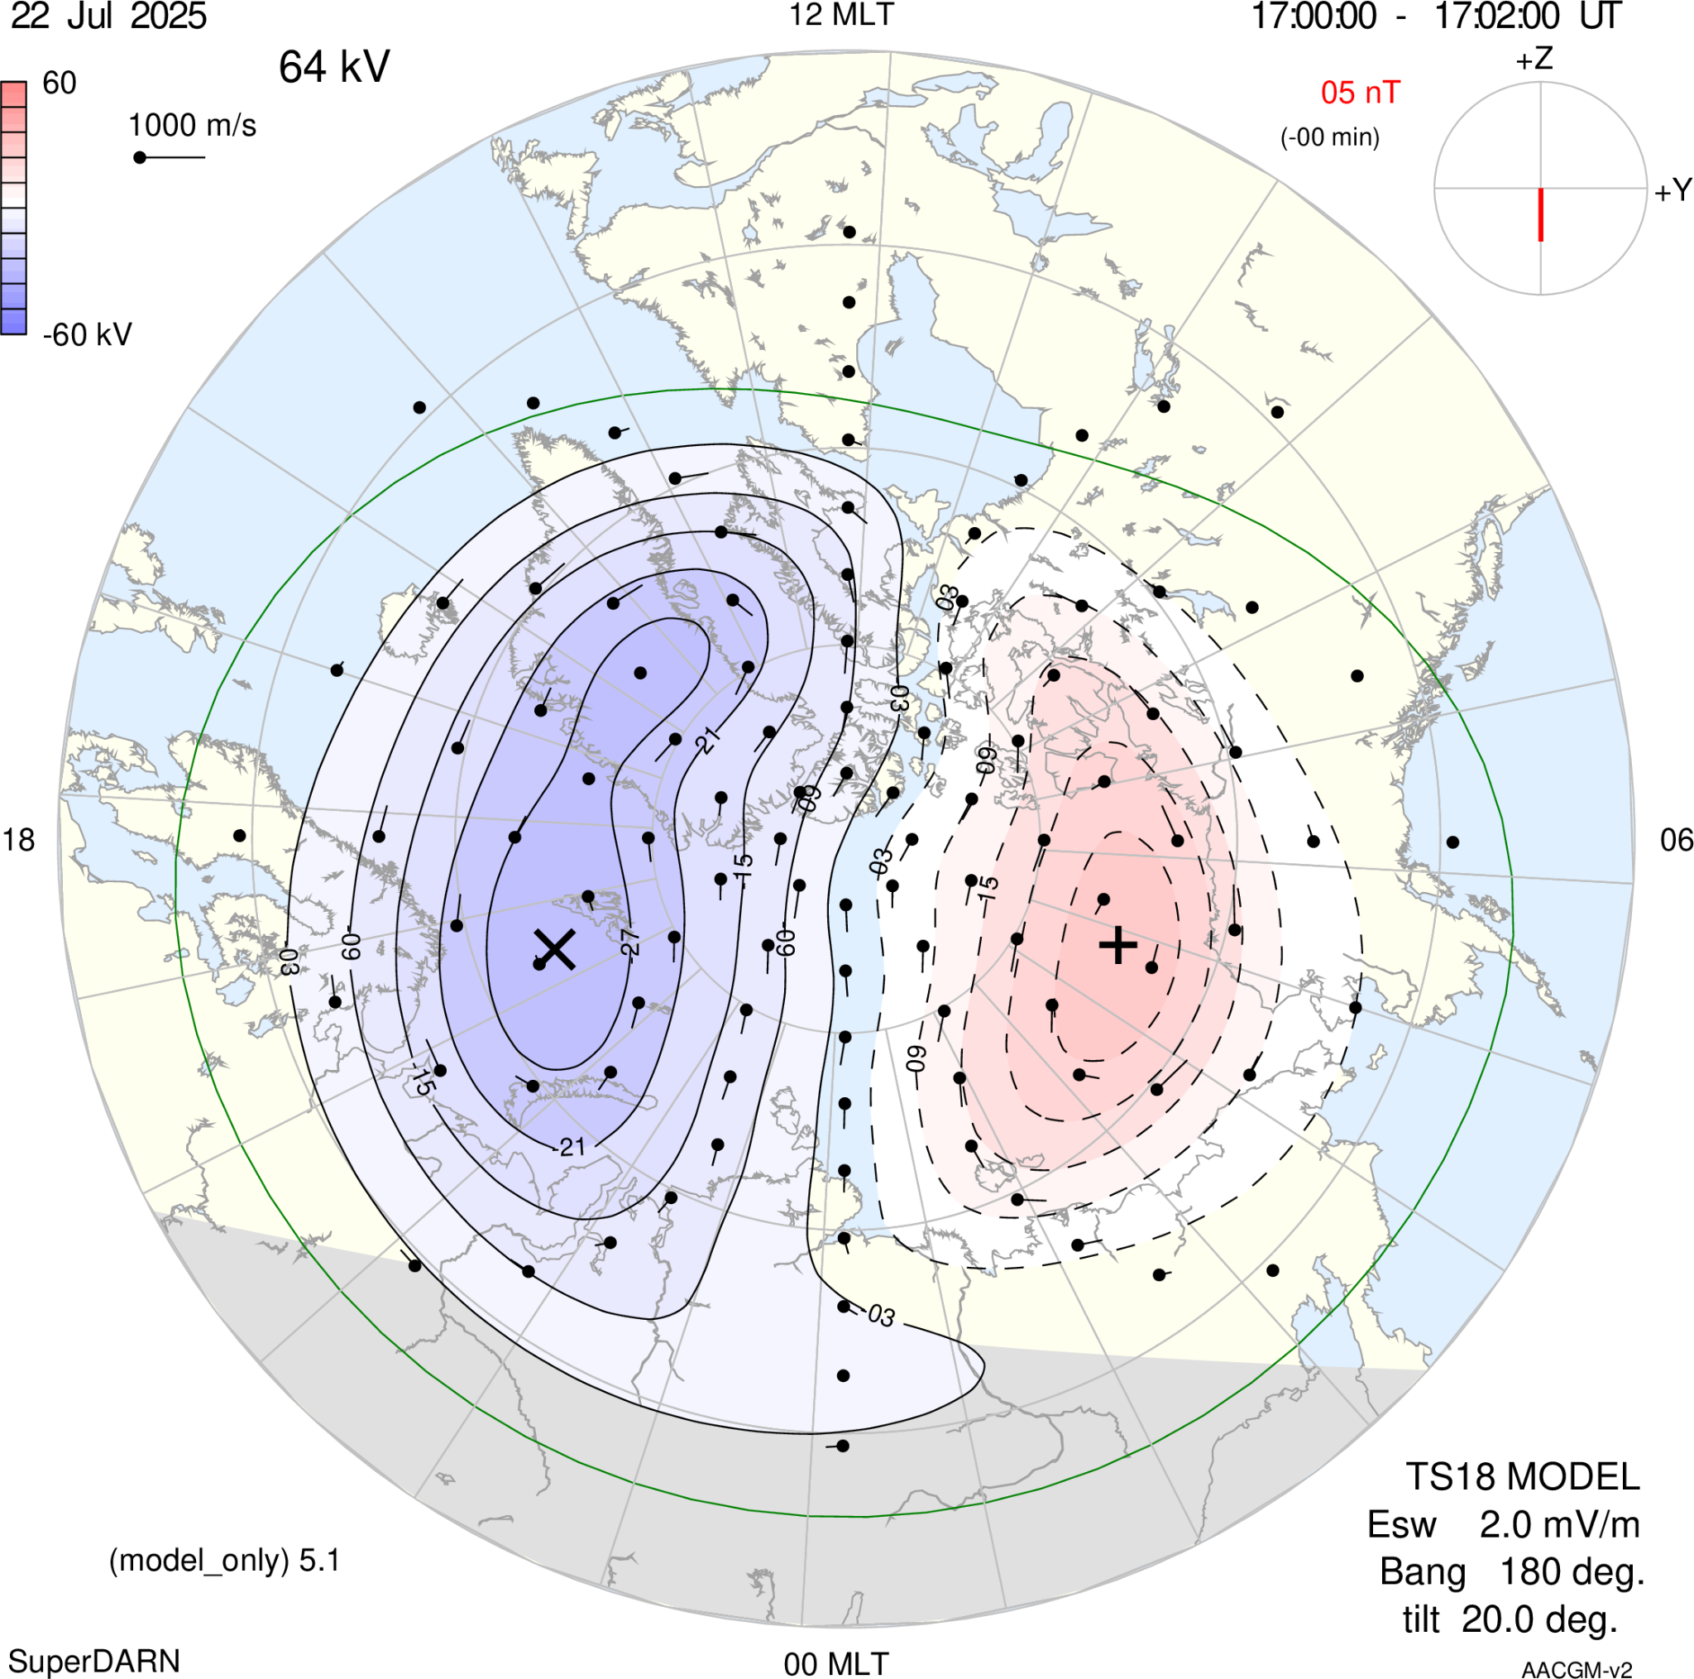
E-Region Velocities
[https://kauai.ccmc.gsfc.nasa.gov/instantrun/superdarn/]

Slide 10

Fan Plots of Slant Electron Density

Slide 11
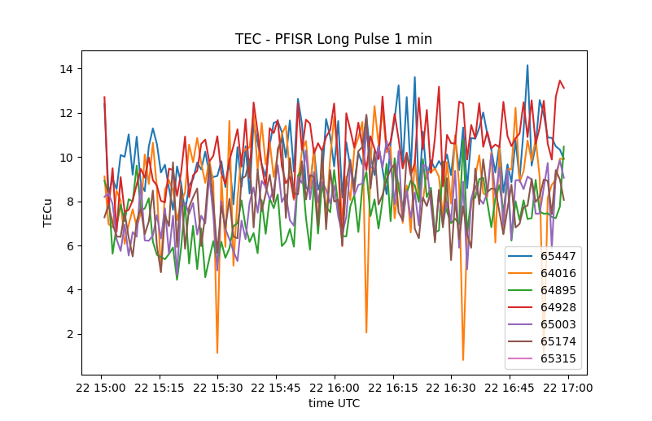
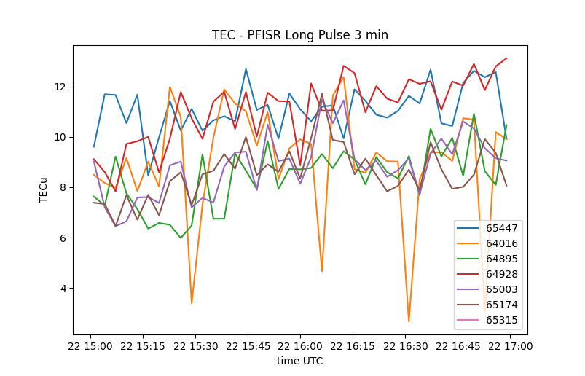
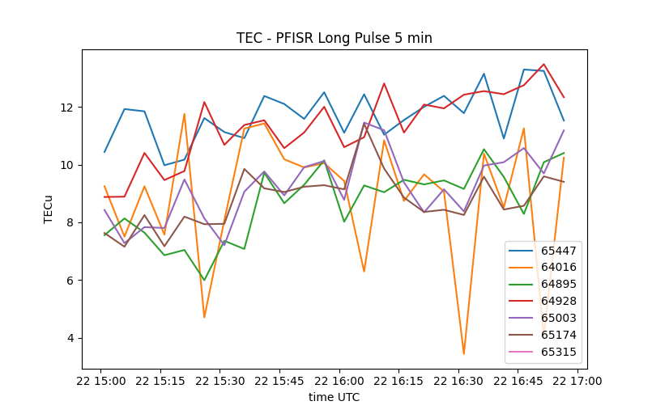
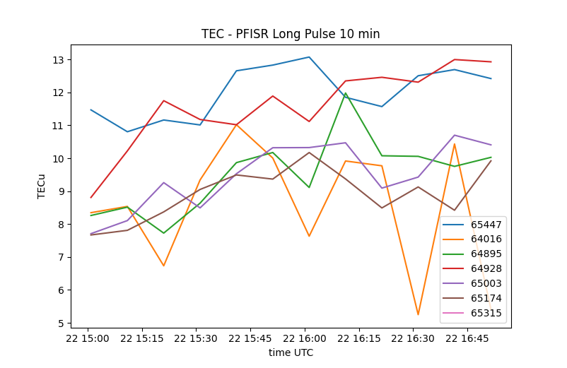
Slant TEC Data from PFISR

Slide 12
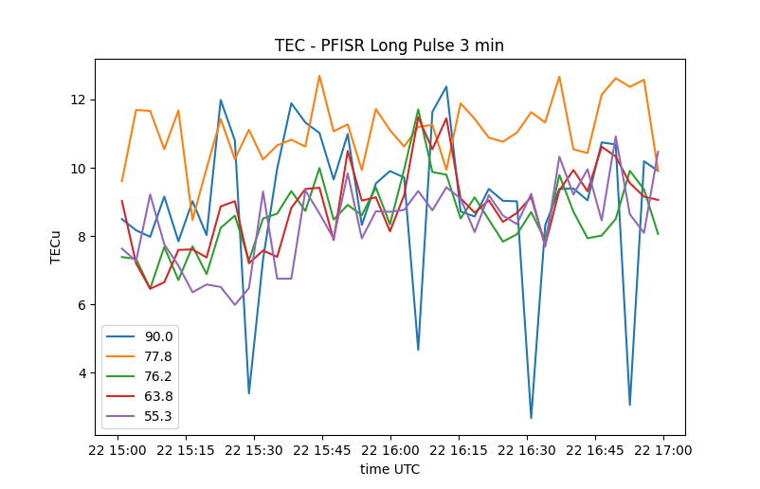
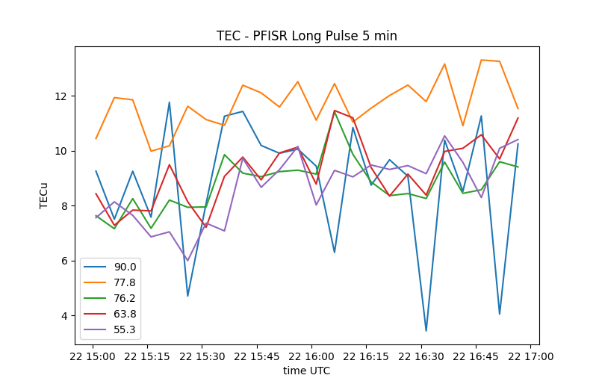
Final Choices for TEC Data

Slide 13
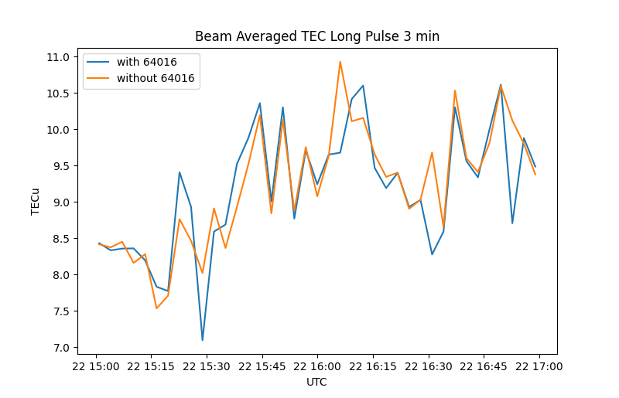
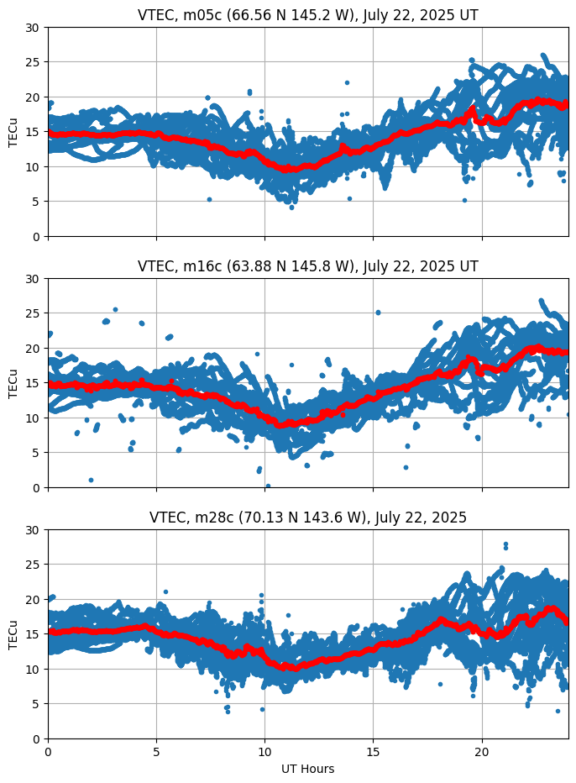
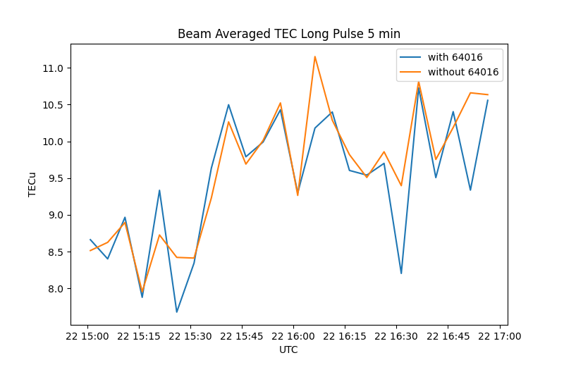
Radar-GNSS TEC Comparison
GNSS
PFISR

Slide 14
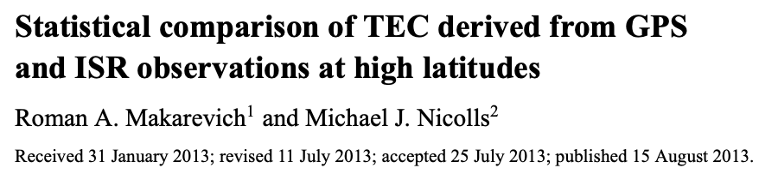
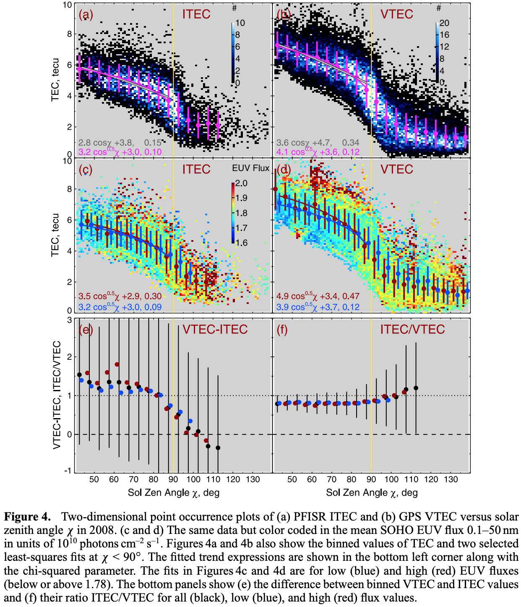
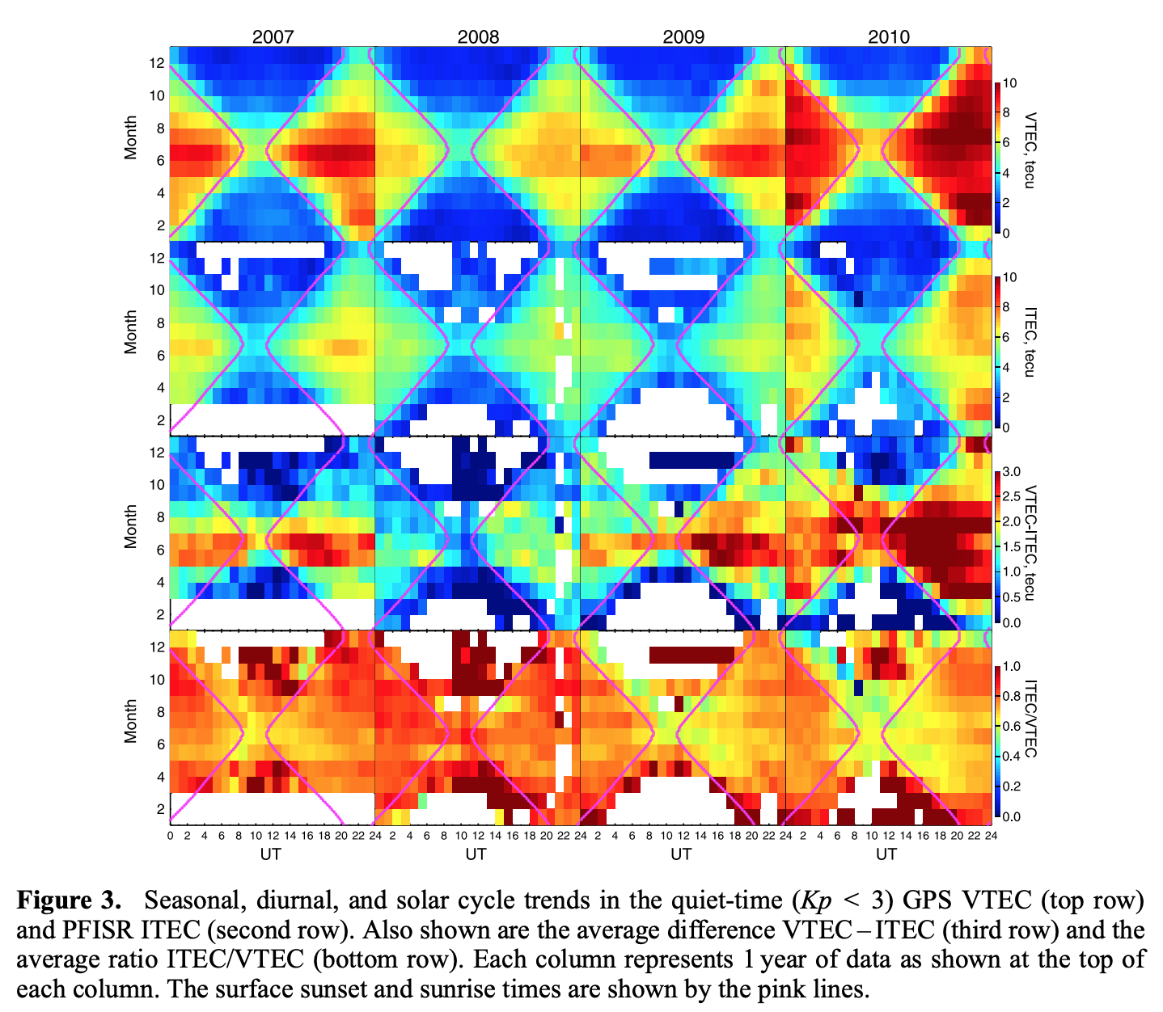
Notes:
also note that gnss are always to the south where the ionosphere is more dense, so that may also do that

Slide 15
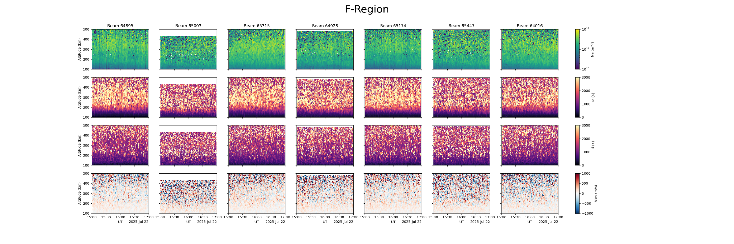
Trends in the F-Region

Slide 16
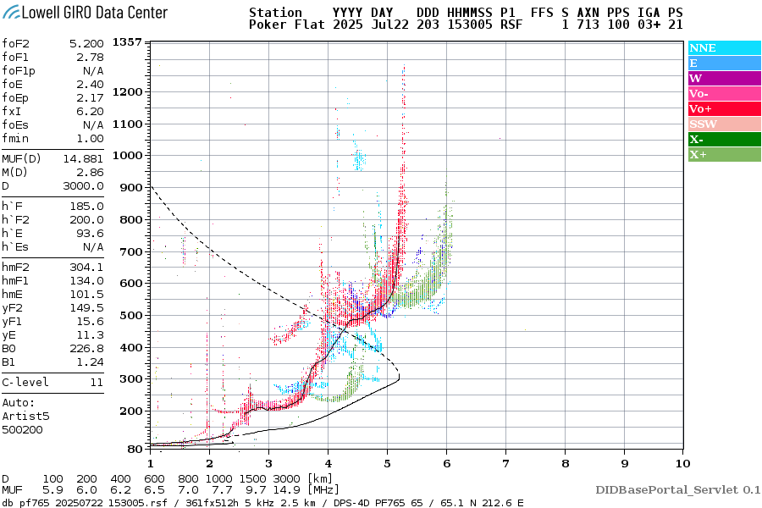

Slide 17
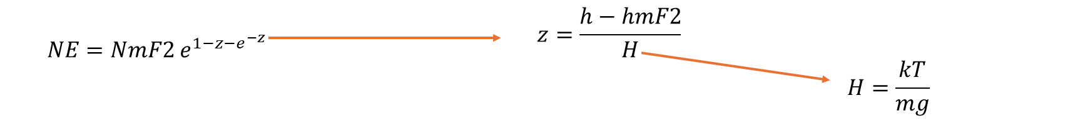

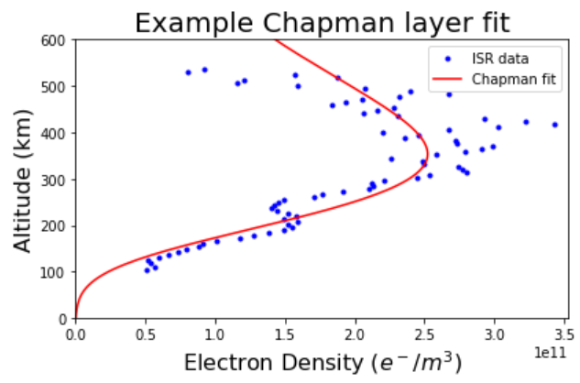
foF2 Calculation
Derivation in Hunsucker & Hargreaves :)

Slide 18
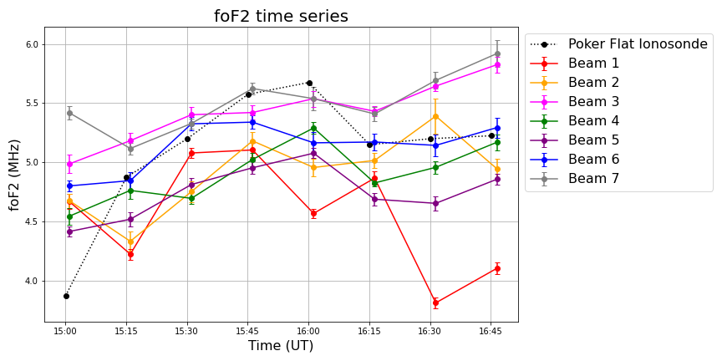
(90°)
(55.26°)
(70.77°)
(63.82°)
(76.23°)
(66.00°)
(77.77°)

Slide 19
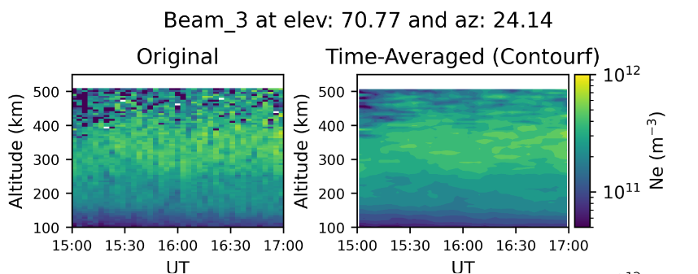
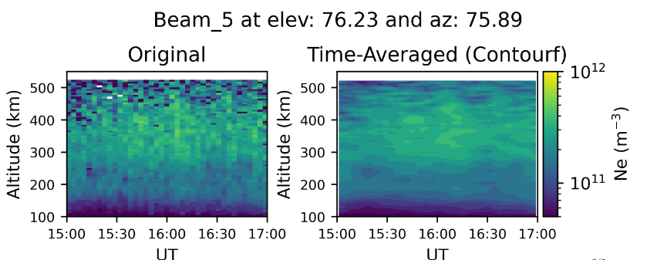
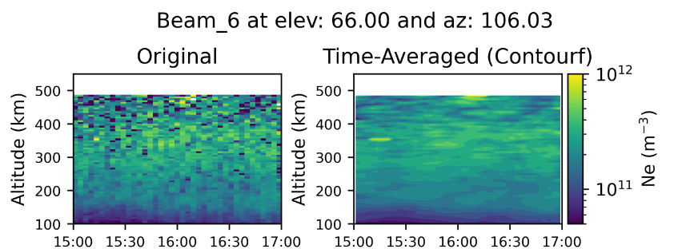
Directional Ne Comparison
7:00 am
3
4
2
1
5
7
6
9:00 am
Highest density in beam_3 which is pointing at most sunlit region (Expected)
Compelling arguments:
  It’s Alaska so difference shouldn’t be so much
  Beam_3 has highest sensitivity which could lead to above

Slide 20
Spotting TIDs in Fan Plots

Slide 21
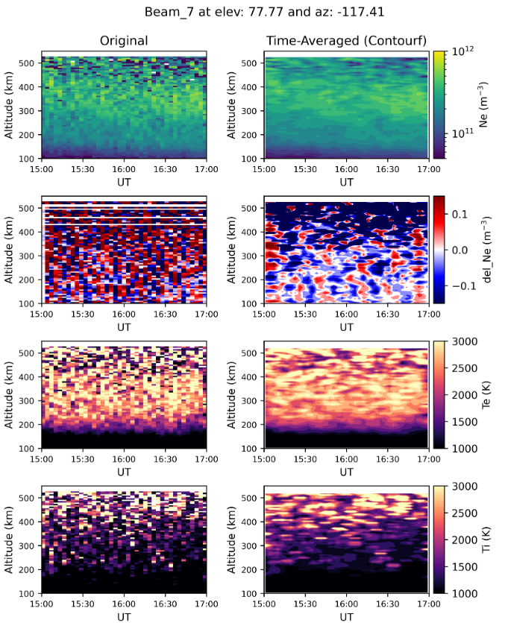
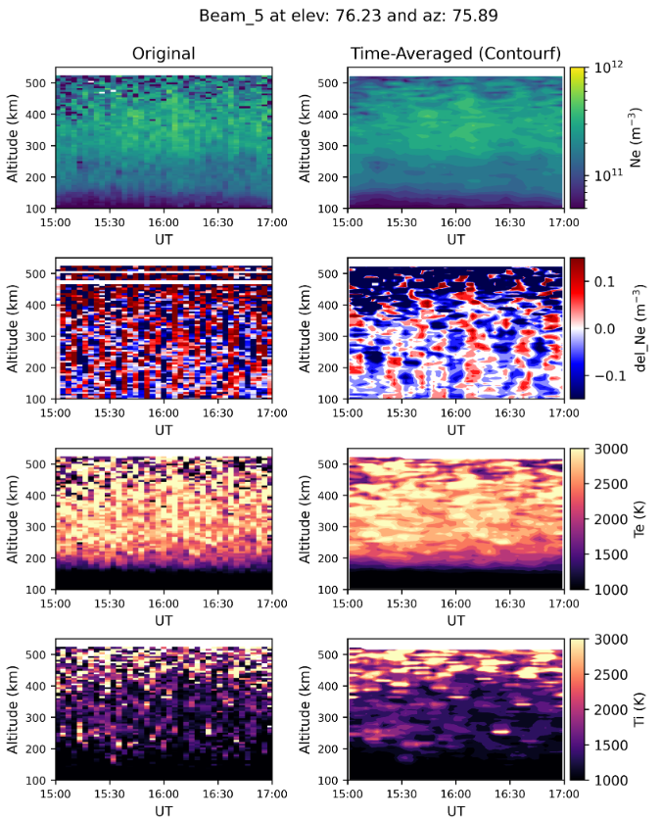

Slide 22
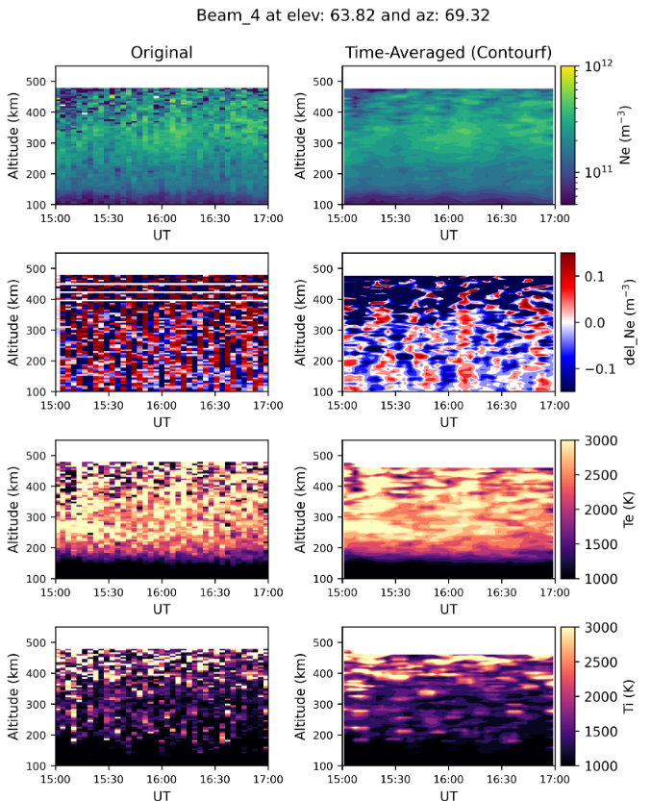
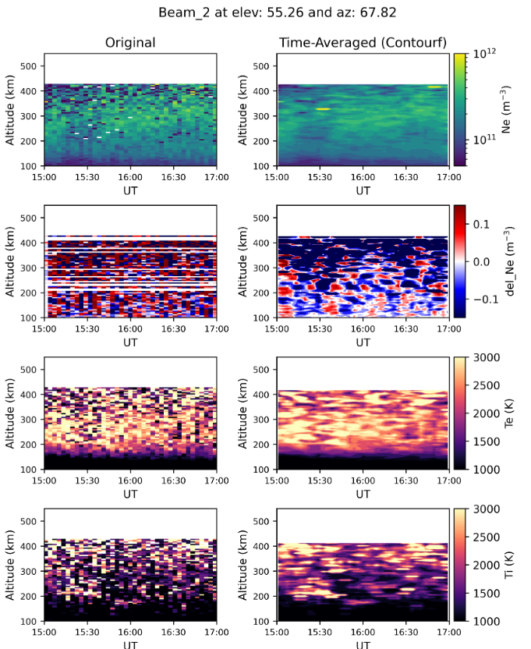

Slide 23
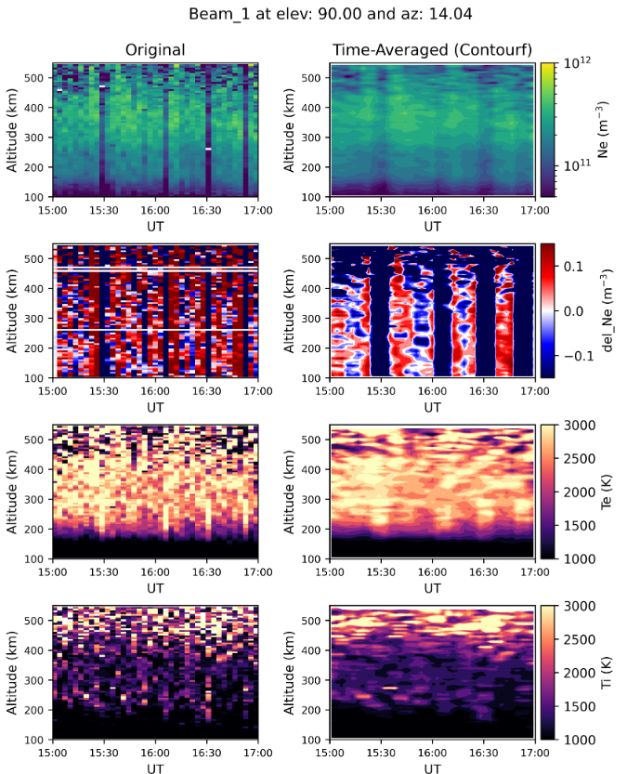
Too high error regions so we are ignoring its detailed analysis on smoothened plots
Wave-like nature is slightly present in original data
  Crests and troughs are hard to distinguish

Slide 24
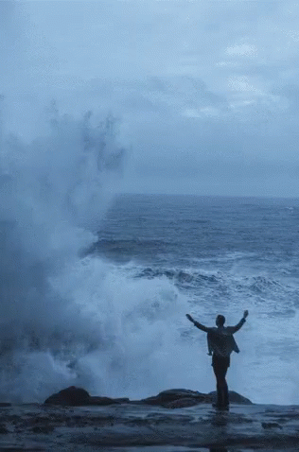
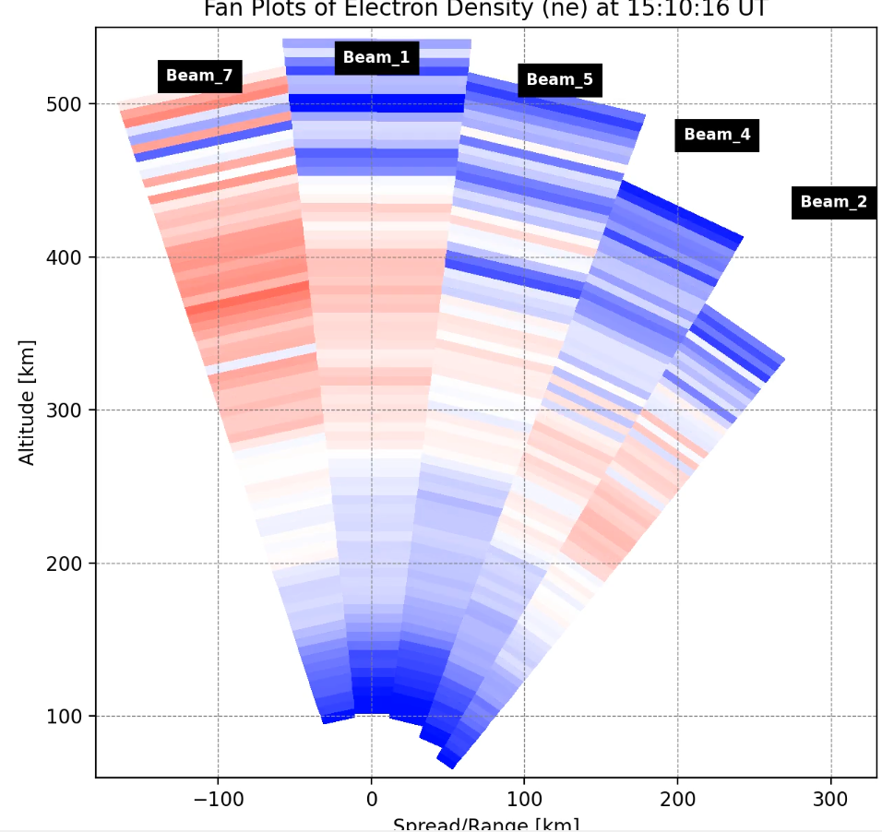
Data shows waves that are Medium-scale TID:
[Tsugawa et al 2007]

Slide 25
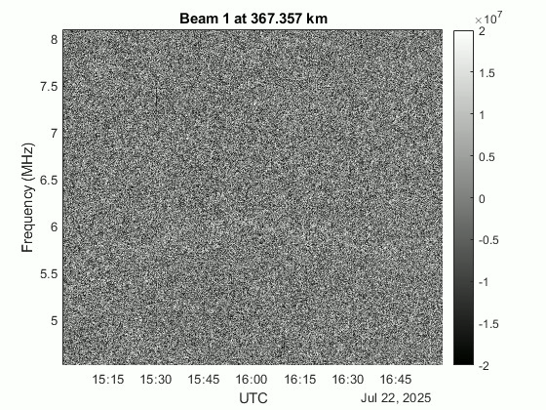
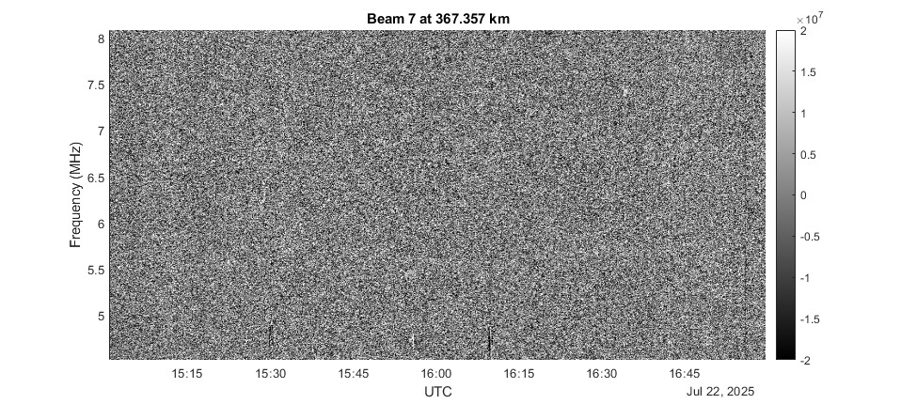
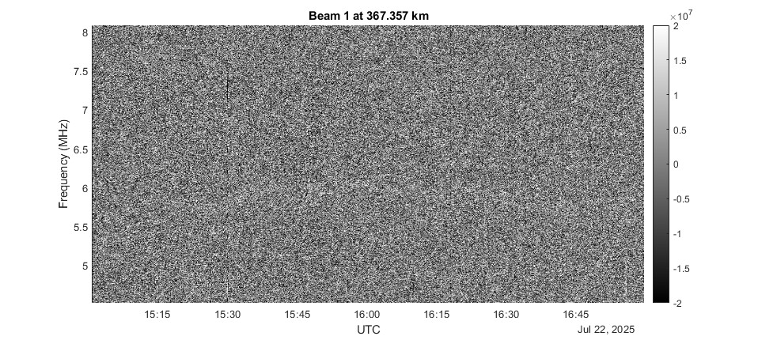
Plasma Frequency?

Slide 26
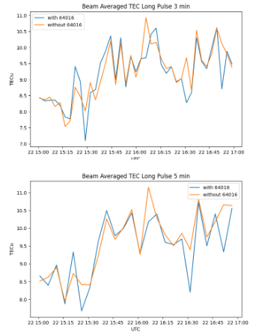
Conclusions 1
TEC determined by PFISR was lower than TEC determined from GNSS
  PFISR doesn’t reach entire region with electron density
  Southward facing receiver look directions may be through regions of higher electron density, i.e. mid latitudes
  Perpetual sun makes bias determination difficult
  Results here are consistent with a previous statistical study with PFISR
foF2s derived from individual ISR beams show a generally positive trend and agree with the ionosonde data but we do see the bias effect of hard targets even at 15 minute resolution
(90°)
(55.26°)
(70.77°)
(63.82°)
(76.23°)
(66.00°)
(77.77°)

Slide 27
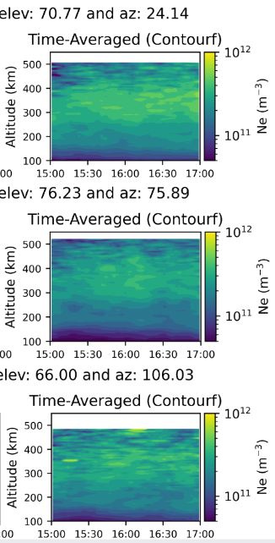
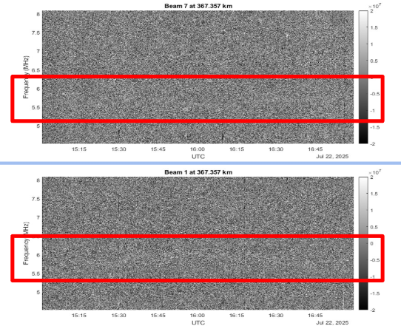
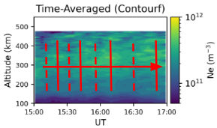
continued…
7:00 am
Slant Electron density in beams yields:
  Highest ionization in F-peak observed by beam_3
  MSTID (~15-30 min) spotted approx parallel to beam 4
  Plasma lines identified but not feasible for further analysis
3
4
2
1
5
7
6
9:00 am

Slide 28
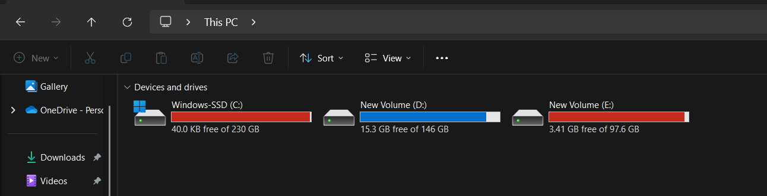
And a new ACHIEVEMENT UNLOCKED….

Slide 29





Group 4
Cameron Westerlund, University of Alaska Fairbanks
Sankalita Sengupta, Virginia Tech
Emma-Claire Gurney, University of Birmingham
Rick Marcusen, University of Colorado Boulder
Prasoon Vishwakarma, University of Texas Dallas

Slide 30
Thank you!
To the organizers, the guest lecturers, NSF, and everyone else who made the summer school possible!

Slide 31
Backup Slides

Slide 32
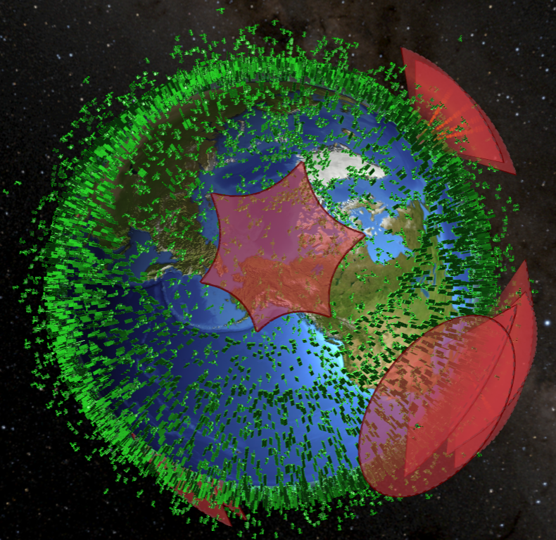

[https://platform.leolabs.space/visualization]

Slide 33
Electron measurement variations with elevation
Internal trends (increase with time) or elevation-to-elevation trends (slower or faster?)

Slide 34
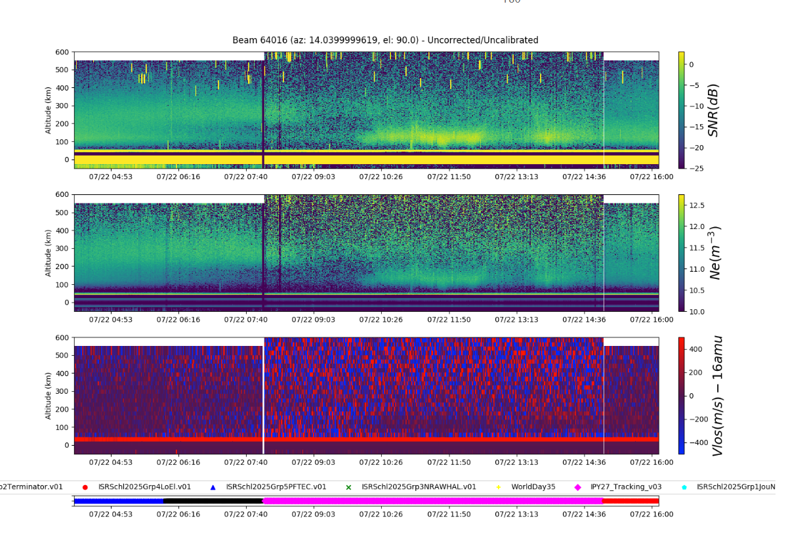

Slide 35
Discussion
May be worth in the context/introduction section having a small literature review discussing other people’s observations of the quiet-time ionosphere
Plot of electron density at a fixed altitude (like if can find the foE or foF2) and varying elevation angle so you see how it changes??

Slide 36
(preemptive) what went wrong/what do better
We can talk about the satellites showing up in the data here, they were visible in the up-B(?) beam (beam 1) up to 5 minute resolution so not insignificant
If we work out how to remove them that’s cool and would make for an interesting slide but if not still worth mentioning i think

Slide 37
Context, other studies/instruments/historical data
PFISR previous studies, 1 year before?
https://data.amisr.com/madrigal/showExperiment?experiment_list=30002751
Millstone hill?
http://millstonehill.haystack.mit.edu/showExperiment?experiment_list=10006480
Context? It is geomagnetically quiet so maybe worth having some pretty NOAA plots

Slide 38
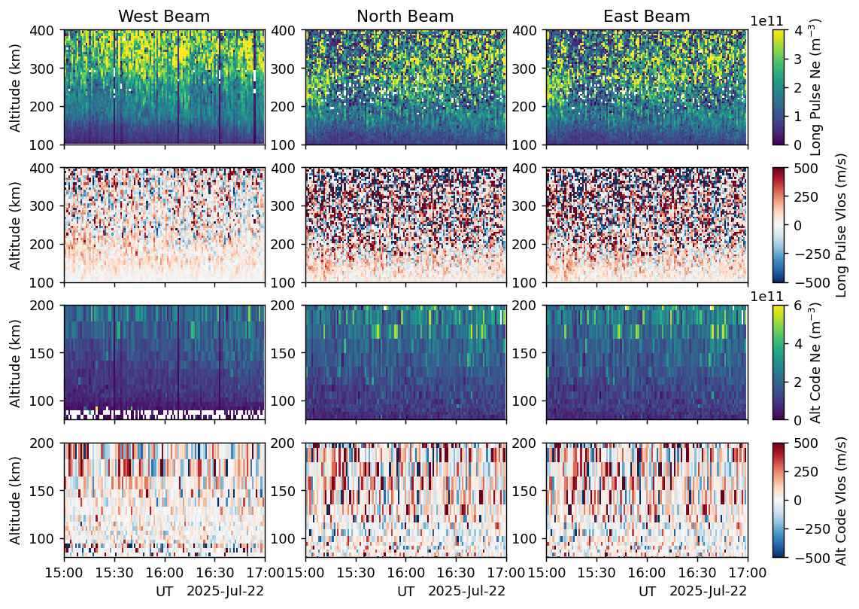
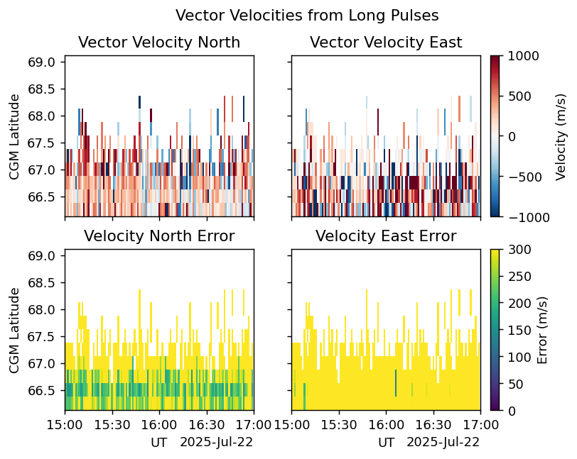

Slide 39


