Slide 1
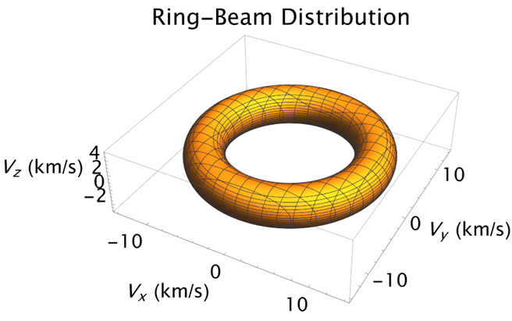
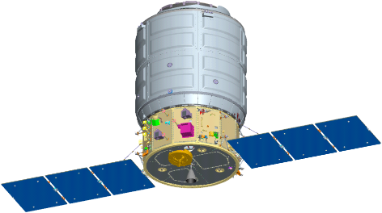
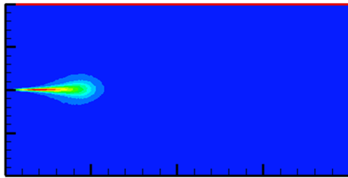
Incoherent Scatter from Non Thermal Ion Velocity Distributions in the Ionosphere with Applications to Rapid Radiation Belt Remediation
Paul A. Bernhardt
Geophysical Institute, University of Alaska, Fairbanks, AK
Arecibo ISR, 27 July 1999
Thermal
Ring
Cygnus Rocket Burn
Pickup Ion Velocity Distribution
Measured ISR Spectra

Slide 2
Incoherent Scatter from Non Thermal Velocity Distributions
Sources of Non Thermal Velocity Distributions
  Hypersonic Flow Between Ions and Neutrals in the Ionosphere
    Auroral Ion Acceleration Convection by Large Electric Fields
    High Speed Injection of Neutral Exhaust from Orbiting Rocket Motors
  Neutral and Ion Velocity Distributions
    Neutrals Move in One Direction with Fixed Temperature
    Ion Move Along Magnetic Field B with Gyro Motion Around B
    Ion Ring Velocity Distribution for Perpendicular Speed > Thermal Speed
  Incoherent Scatter Properties
    Thermal Ion Spectrum Becomes Distorted
    ISR Spectrum Yields Perpendicular and Parallel Ion Motion Relative to B
  Application to Using the Ion Ring Distribution to Amplify Whistlers

Slide 3
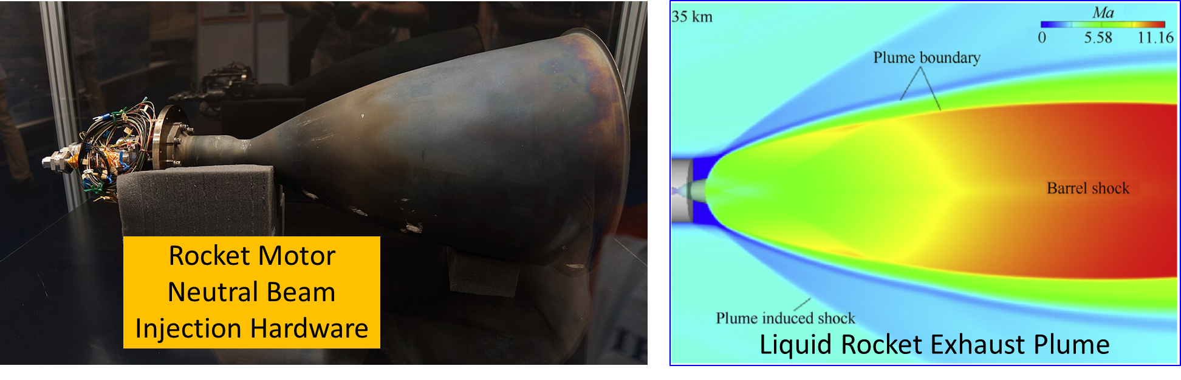
Rocket Exhaust Driven Amplification of VLF Waves in Space
BT-4 Main Engine on the Cygnus Automated Cargo Spacecraft
Fuel and Oxidizer Exhaust Charge Exchange to Produce Molecular Ions

Slide 4
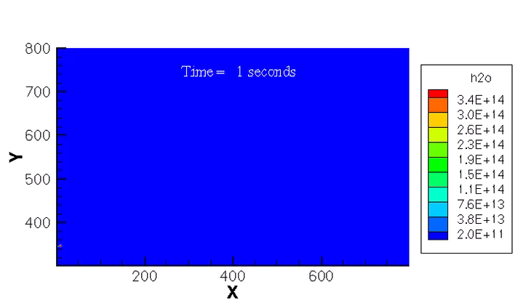
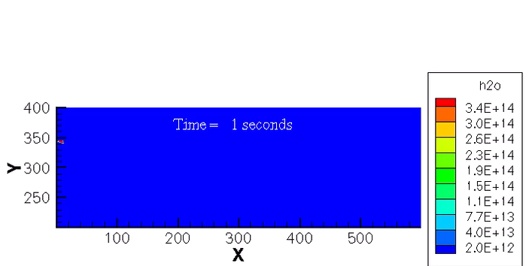
DSMC Modeling of F-Region Rocket Burns
C.R. Kaplan and P.A. Bernhardt, JOURNAL OF SPACECRAFT AND ROCKETS, Vol. 47, No. 4, July–August 2010
OMS Engine Pointed Up
Introduce Exhaust Molecules at Rocket Nozzle
Move Molecules By Amount
Δt C_{Avg}
Allow Molecules to Exit Top, Bottom, and Sides
Sort Molecules into Cells and Subcells
Compute Collisions Between Molecules
OMS Engine Pointed Down
Compute Averages over Molecules in Each Cell

Slide 5
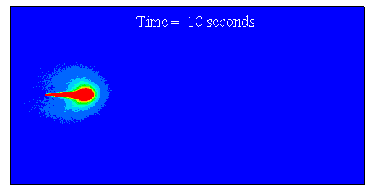
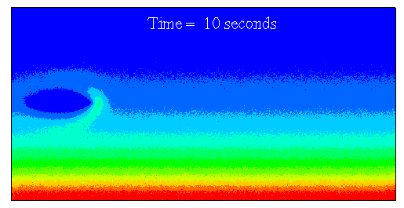
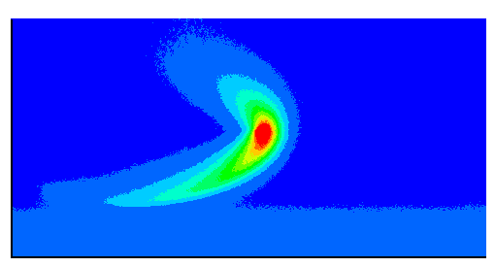
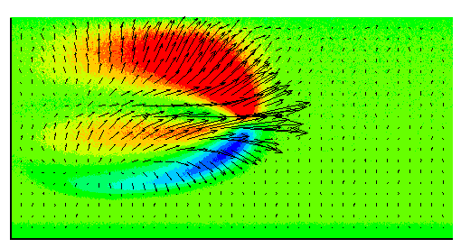
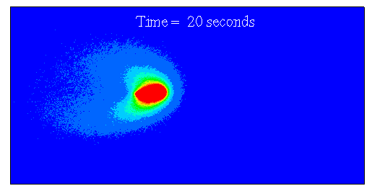
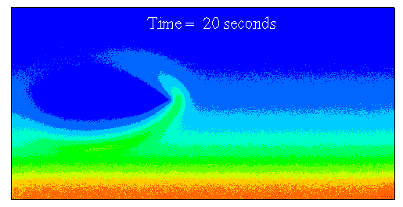
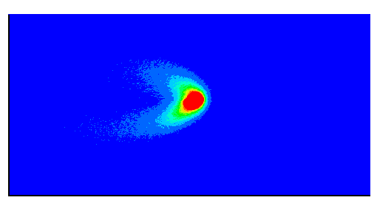
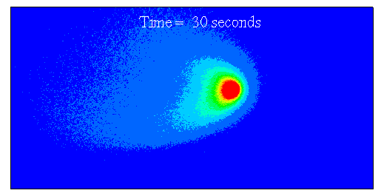
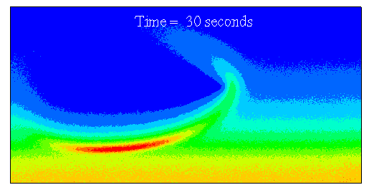
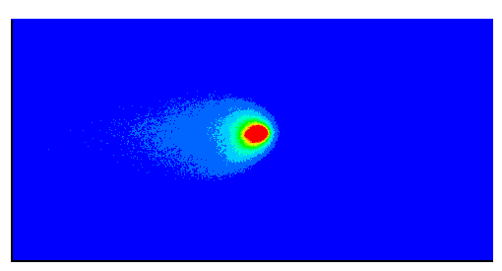


DSMC Modeling of Neutral Flow for F-Region Rocket Burns
C.R. Kaplan and P.A. Bernhardt, JOURNAL OF SPACECRAFT AND ROCKETS, Vol. 47, No. 4, July–August 2010
Time = 10 Seconds
Time = 10 Seconds
Pressure
(N/m²)
Time = 20 Seconds
Time = 20 Seconds
y-velocity
(m/s)
400
H₂ (m-³)
Time = 30 Seconds
Time = 30 Seconds
Vertical distance (km)
400
CO₂ (m-³)
200
Vertical distance (km)
0
Horizontal distance (km)
400
200
0
Horizontal distance (km)
400

Slide 6
Neutral Exhaust Interactions and Radar Detection in the Ionosphere
Magnetic Field Line
Ionospheric Thermal Ions
High-Speed Pickup Ions
Supersonic Neutral Flows and Ion-Neutral Charge Exchange
Electrostatic Waves
Lower Hybrid
Ion Cyclotron
Ion Acoustic
Electron Cyclotron
Rocket Engine
Neutral Exhaust
Incident Radar Beam
Reflected Radar Beam
In Situ Wave and Particle Sensors

Slide 7
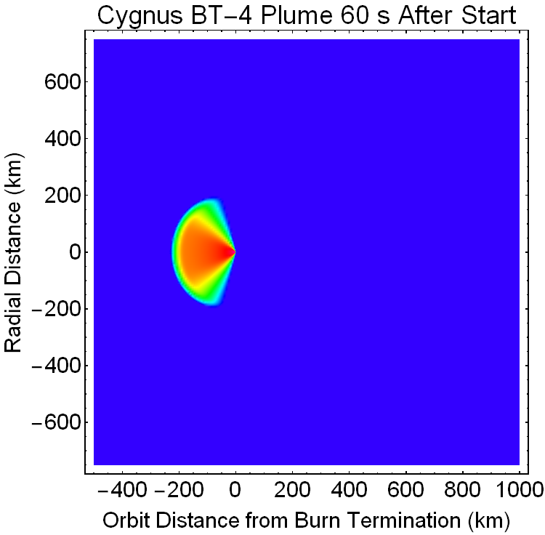
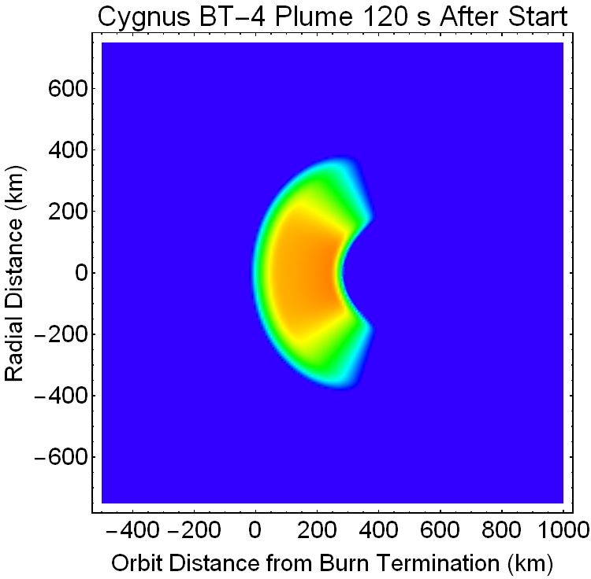
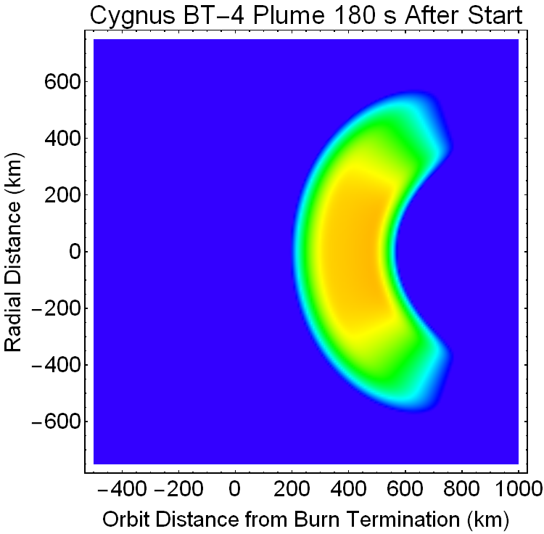

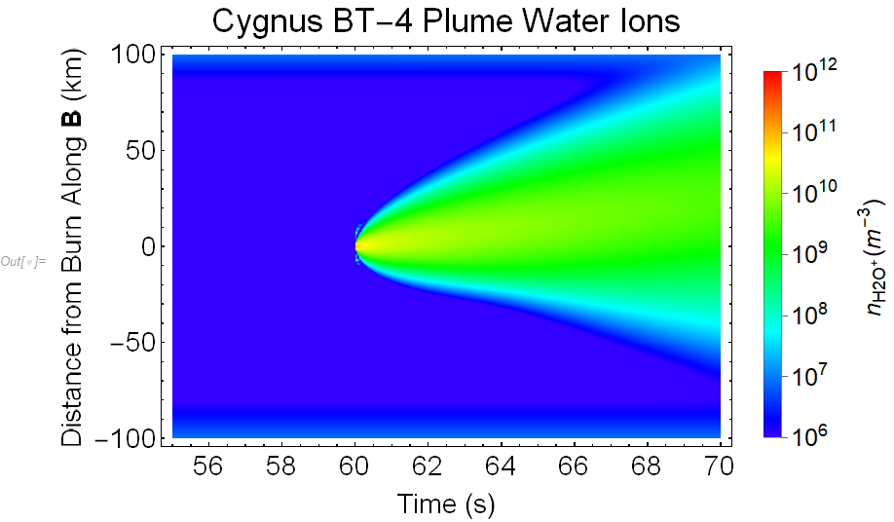
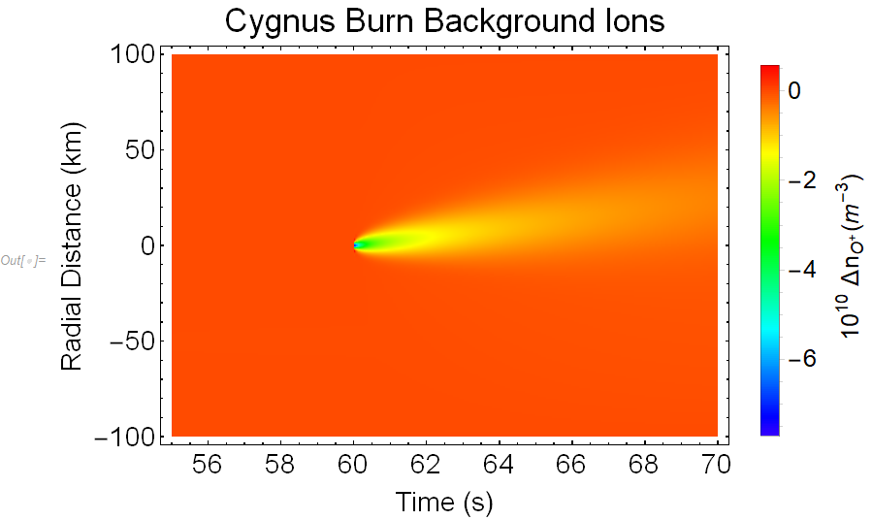
Plasma Density from Cygnus BT-4 Motor for 60 s Posigrade Burn
Neutral Jet Driving Ion Plasma Chemistry and Transport Equations
10¹²
10¹⁰
10⁸
10⁶
10⁴
10²
10⁰
Orbit
Neutral Density (m⁻³)
Exhaust Vapor
Exhaust Vapor
Exhaust Vapor
Charge Exchange Chemistry and Diffusive Transport
Disturbed Region
Pickup Ions at 0 km
Thermal Ions at 0 km

Slide 8
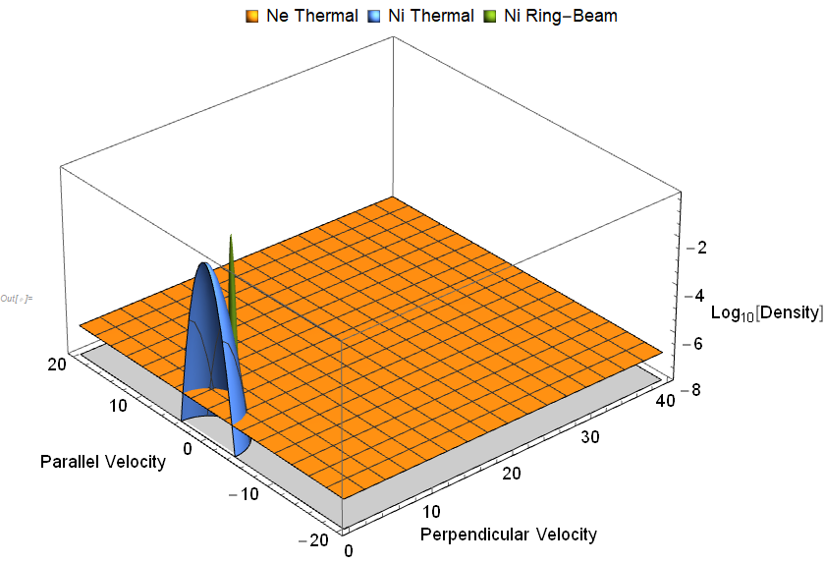
Distributions with Ion-Ring and Thermal Electron Plasma
Plasma Velocity Distributions
  Ambient Electrons,
  Background Ions,
  Cold Ring-Beam Ions,
  Warm Ring-Beam Ions,

Slide 9
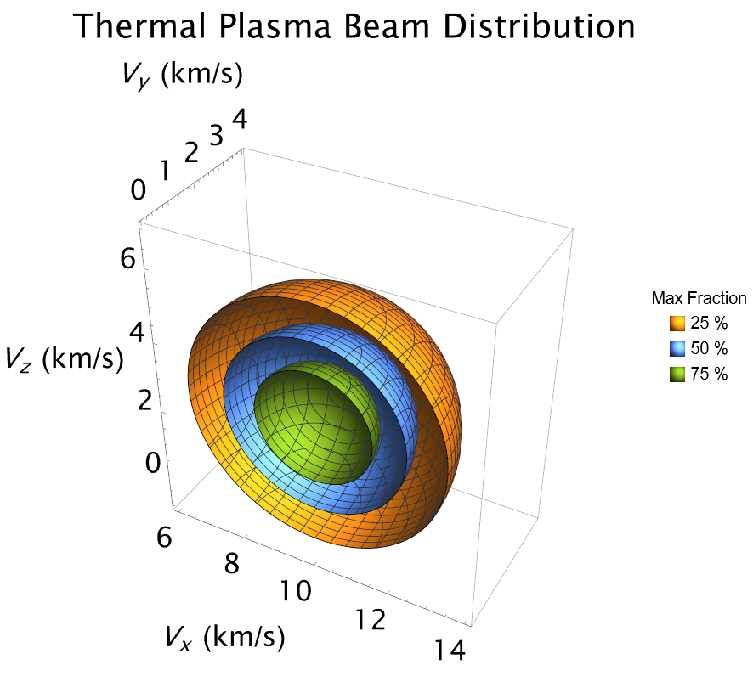
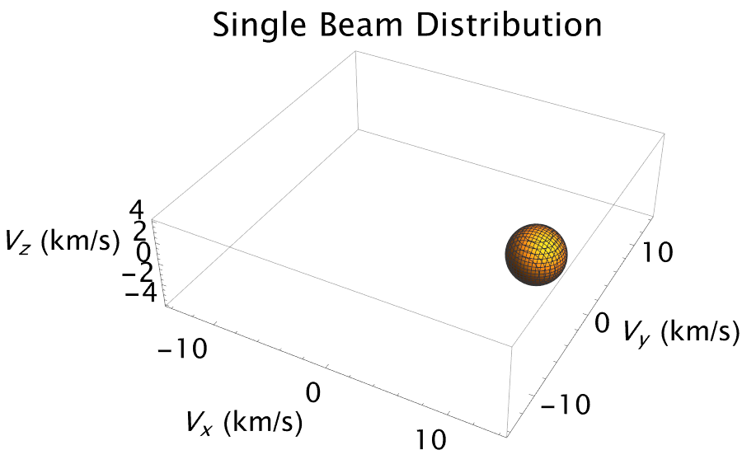
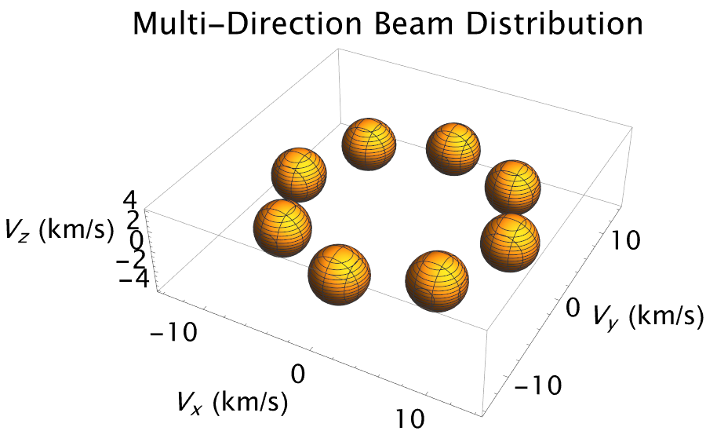

Incoherent Scatter Detection of Ring-Beam Distributions
Formation of Ring Velocity Distribution
  Neutral Beam of Exhaust from Chemical Thruster
  Charge Exchange of High Speed Neutrals with Atomic Ion Plasma
  Lorentz Force on Pickup Ions Cause Spiral Motion Around Magnetic Field Lines into Ring-Beam
  Ring-Beam a sum of Thermal Distributions

Slide 10
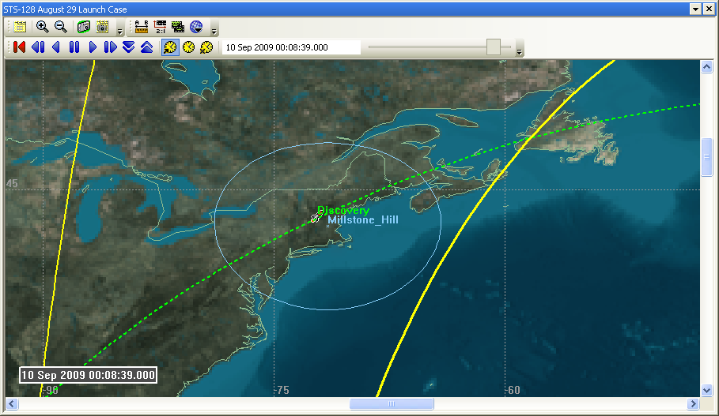
SIMPLEX: Millstone Hill pass in twilight
10 September 2009, 00:08:38 GMT Burn
Burn Time = 10 Seconds

Slide 11
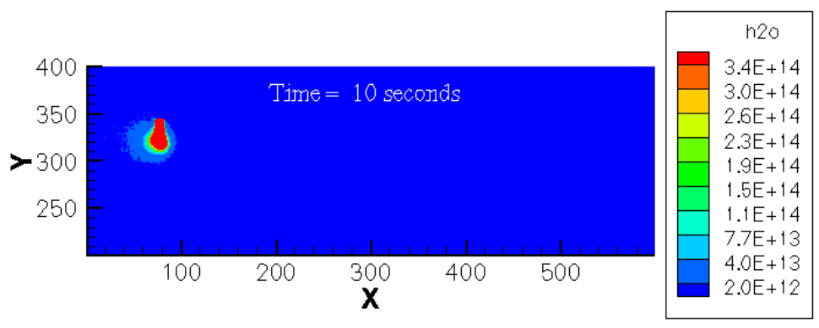
Cloud at End of 10 Second Burn
Radar Pointed at Lat: 44.32, Long: -69.86, Altitude: 275.00
Radar Beam

Slide 12
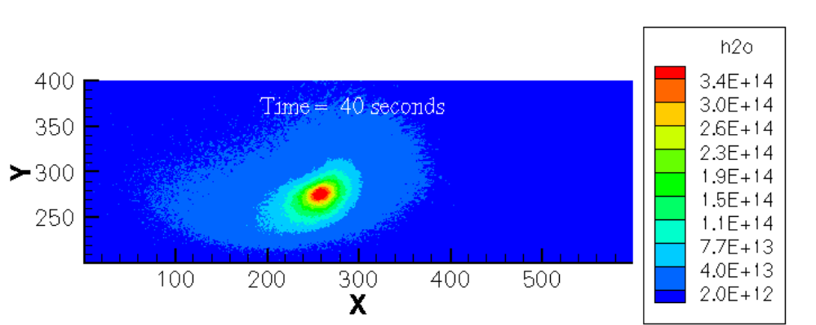
Cloud at End of 30 Second Burn
Radar Pointed at Lat: 44.32, Long: -69.86, Altitude: 275.00
Radar Beam

Slide 13
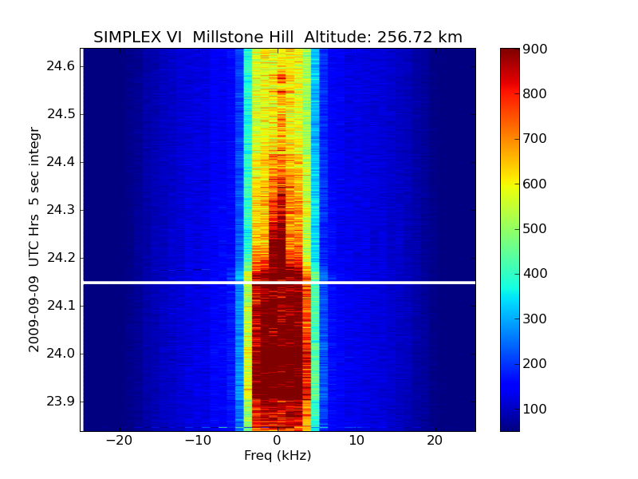
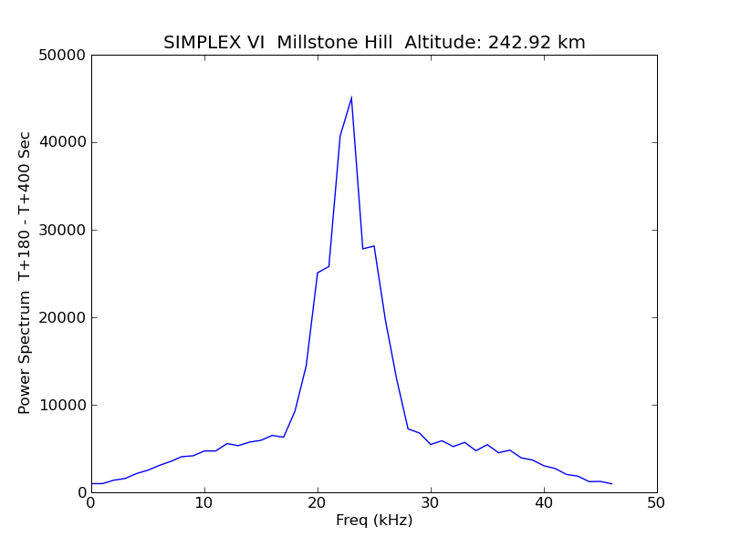
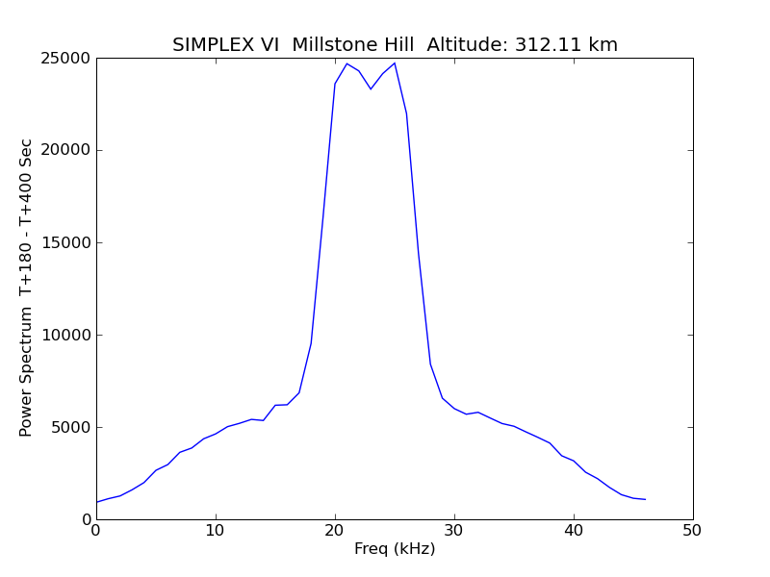
STS 128 OMS 10 Seconds Burn 10 September 2009 08:38 GMT
Ion Line Spectra at 256.72 km Altitude
Ring Beam Ion Line Spectrum
243 km Altitude
Ring Beam Ion Line Spectrum
-20 -10 0 10 20
Burn Stop
Thermal Ion Line Spectrum
312 km Altitude
Burn Start
Thermal Ion Line Spectrum
-20 -10 0 10 20
Frequency Offset
from 440 MHz (kHz)

Slide 14
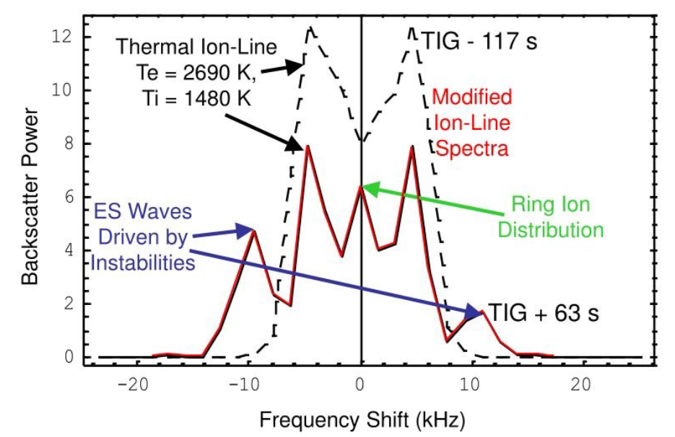
Incoherent Scatter Measurements from F-Region Rocket Burns
Arecibo SIMPLEX II Experiment
27 July 1999, Altitude 287.3 km
OMS Burn Ignition TIG = 05:58:59 UT
Termination at T₀ = 05:49:11 UT
Millstone Hill Radar Ion-Line
SIMIPLEX IV Spectrum
18 April 2002, TIG = 17:26:19 UT
10 Second Burn at 420 km Altitude

Slide 15
Generation of Non Thermal Ion Velocity Distributions
18 April 2002, Millstone Hill Radar Ion-Line Spectrum (kHz)
Burn
Time (Minutes:Seconds) after 17 UT
Non Thermal Ion Velocity Distributions Detected with In Situ Electric Fields and Radar Scatter
  St. Maurice, J.-P., and R. W. Schunk, Ion velocity distributions in the high-latitude ionosphere Rev. Geophys.1, 7, 99-134, 1979.
  D. Hubert, E. Kinzelin, The Three‐Dimensional Raman's distribution as a non‐Maxwellian model and the ionospheric ion outflows into the magnetosphere revisited, JGR: Space Physics, 96, 11633, 1991.
  P. A. Bernhardt, et al., Enhanced radar backscatter from space shuttle exhaust in the ionosphere, JGR, 100, 23,811, 1995.
  P. A. Bernhardt, et al., Incoherent scatter from space shuttle and rocket engine plumes in the ionosphere, JGR, 103, 2239 1998.
  Bernhardt, P. A., and M. P. Sulzer (2004), Incoherent scatter measurements of ring-ion beam distributions produced by space shuttle exhaust injections into the ionosphere, JGR, 109.
  P. A. Bernhardt et al., "Ground and Space-Based Measurement of Rocket Engine Burns in the Ionosphere,“, IEEE Tr. Plasma Sci., 401, 367, 2012.

Slide 16
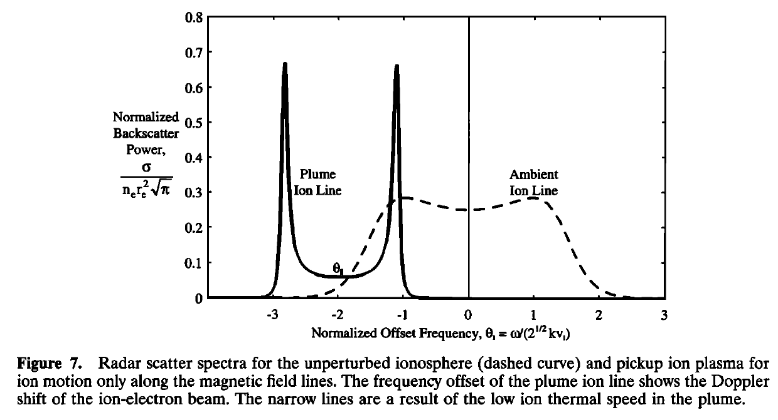
Incoherent Scatter from Ion Beam Distributions: Field Aligned Beam

Slide 17
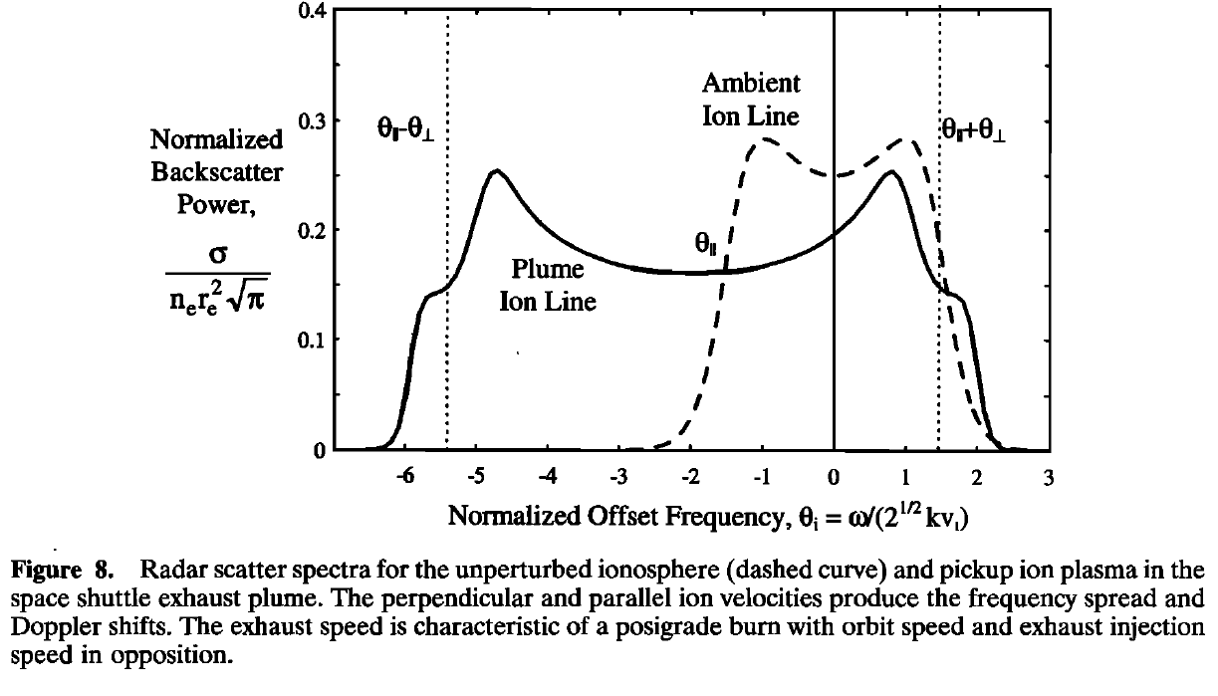
Incoherent Scatter from Ion Beam Distributions: Oblique Injection

Slide 18
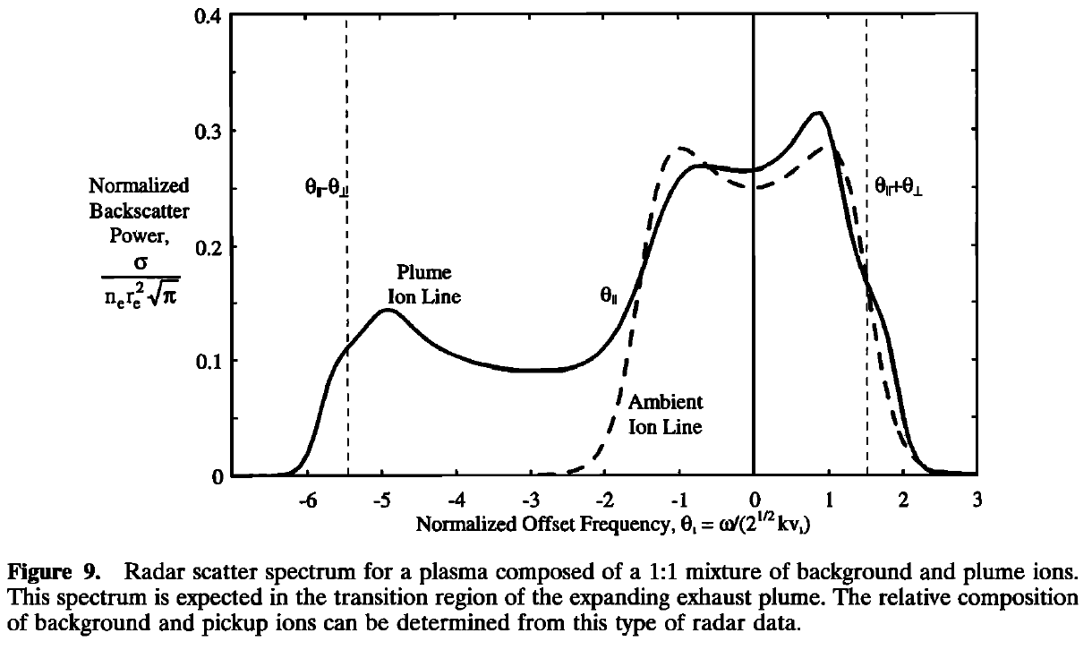
Incoherent Scatter from Ion Beam Distributions: Thermal and Plume

Slide 19
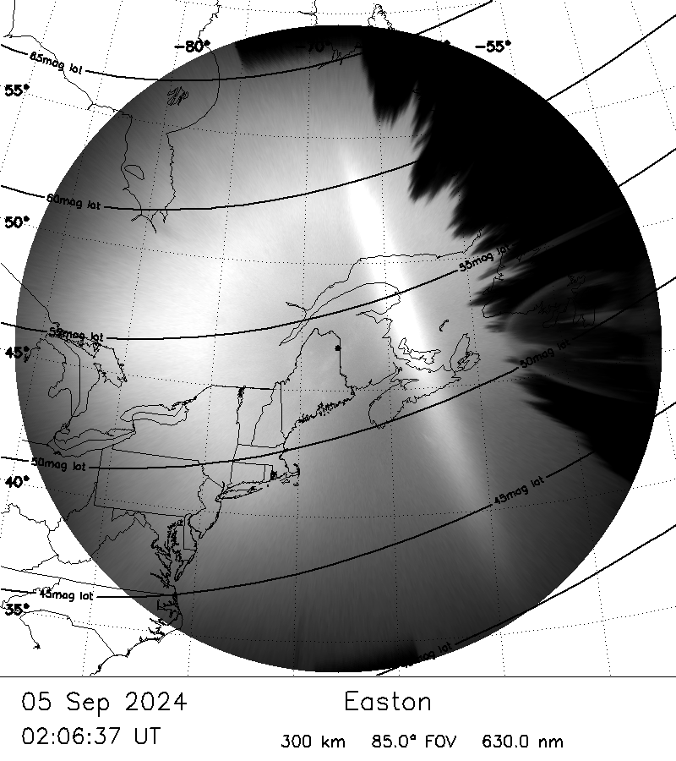
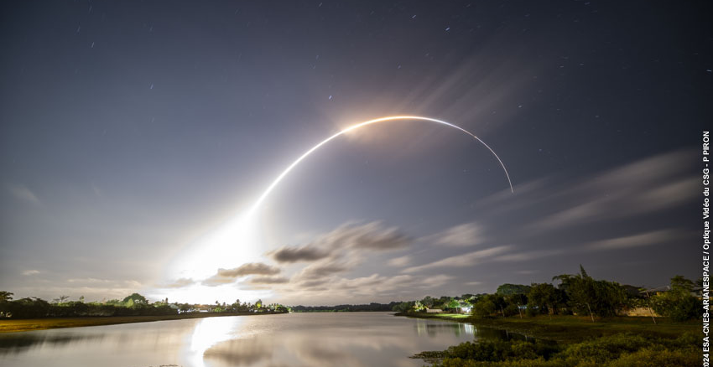
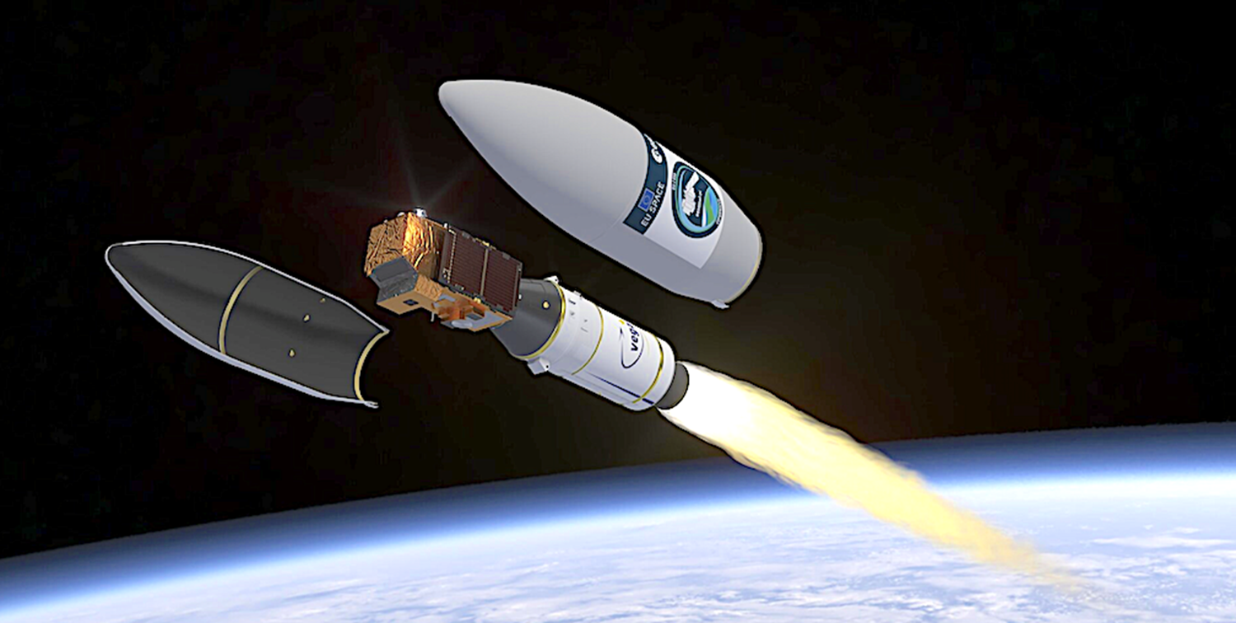
Current Rocket Burns of Opportunity Near ISR Radars
Vega Launch of SENTINEL-2 at 5 Sept 2024 01:50 GMT
150 Rayleigh Enhancement at 630 nm
450 km Altitude
42.6N
71.5W
AVUM Burn Location
49 N, 64 W
380 km Altitude
Attitude Vernier Upper Module (AVUM) Burn
Millstone Hill ISR
NAA VLF Transmitter
44.64°N 67.28°W
240 km Altitude
60 W
65 W
75 W
70 W
BU All-Sky Imager at Easton Maine

Slide 20
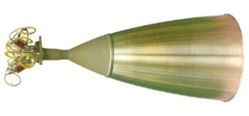
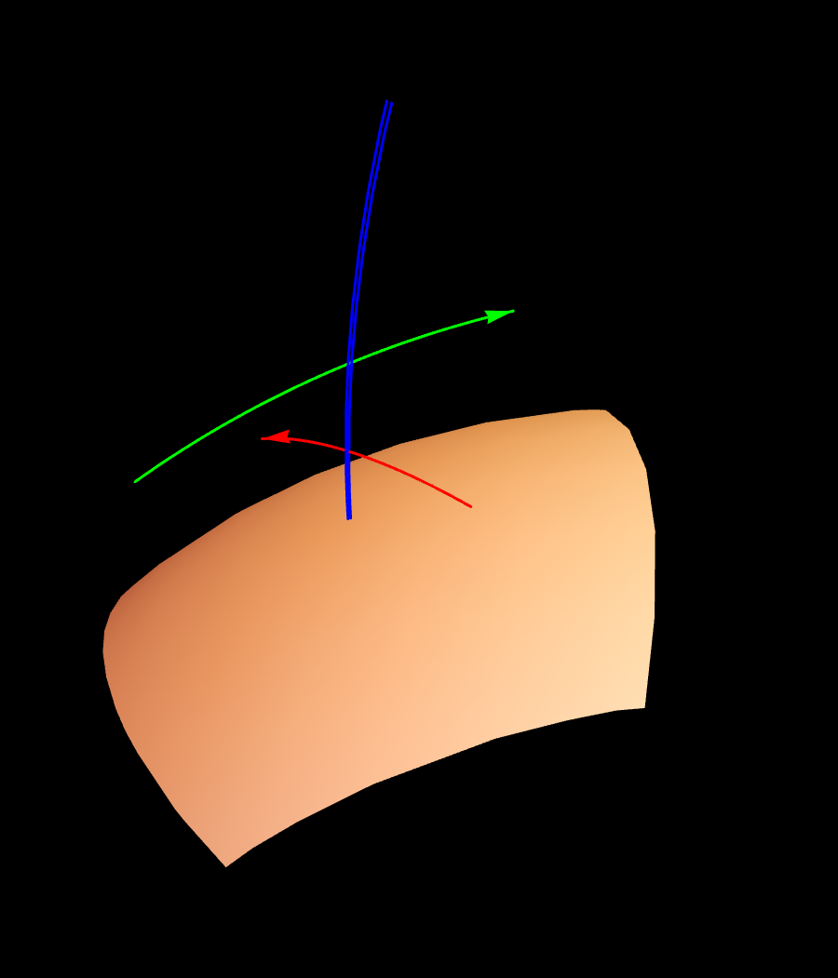
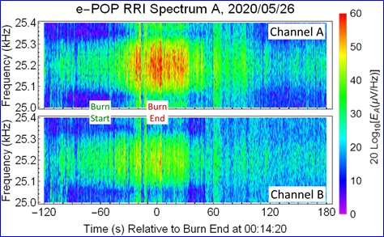
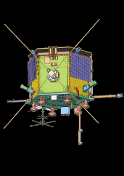
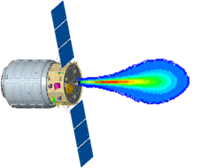
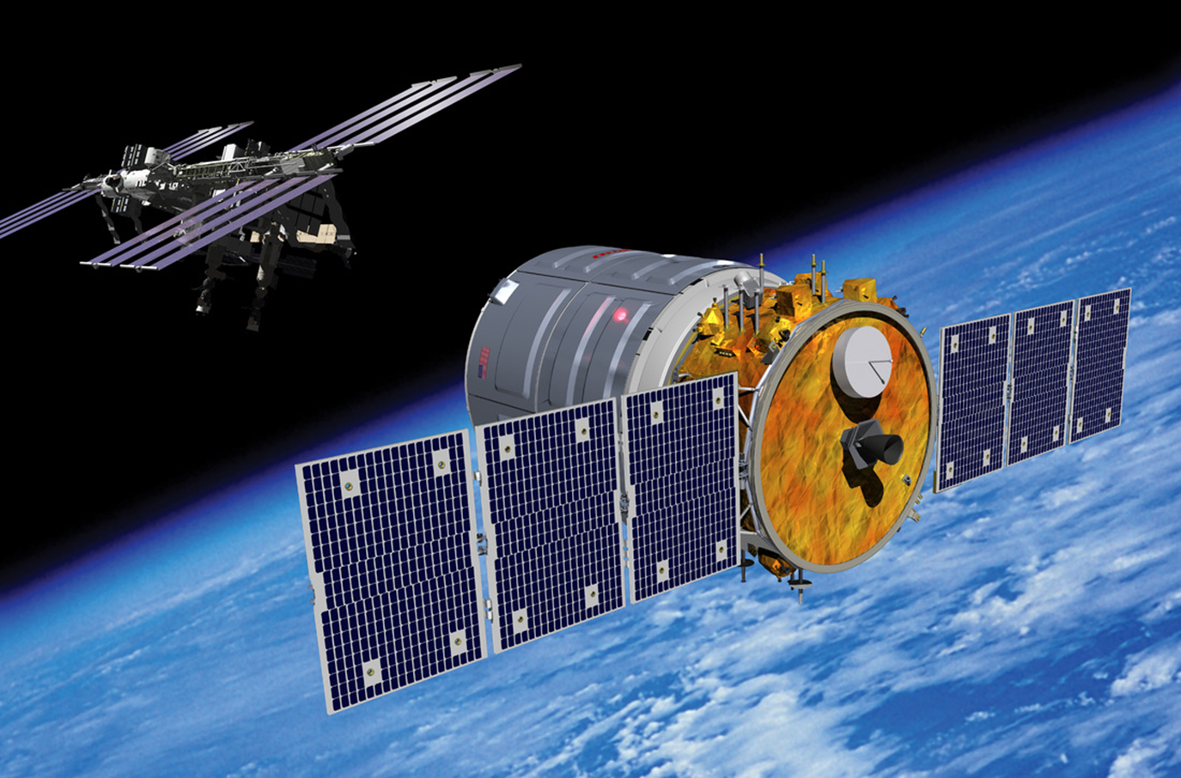
Demonstration of Concept Whistler Wave Amplification
Magnetic Field Lines
SWARM-E
e-POP/RRI
BT-4 Motor on Cygnus space craft
147 g/s, 3.18 km/s
Original Signal
Amplified Signal
Original Signal
Cygnus Engine Wake Burn
Cygnus Satellite Undocked from ISS
●
Ground VLF Source
Experiment setup and results published:
P.A. Bernhardt, (2021) Strong Amplification of ELF/VLF Signals in Space Using Neutral Gas Injections from a Satellite Rocket Engine Radio Science https://doi.org/10.1029/2020RS007207
Earth’s Surface
Rocket Exhaust Driven Amplification WAKE Burn (4 km/s) Test Concept
Note Optimal Alignment of Observation Spacecraft, Rocket Burn, and VLF transmitter

Slide 21
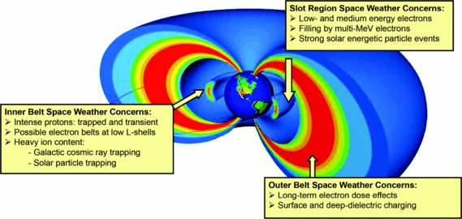
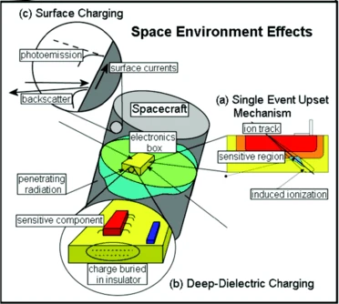
Active Problem: Natural and Artificially Generated Radiation Belts
Solution Uses Whistler Cyclotron Resonance Scattering of Harmful Energetic Electrons
Precipitating Electrons
Radiation Problem Remediation
Rocket Exhaust Driven Amplifier
5
Whistler Mode Ray Propagation
Lightning or Man-Made VLF Source
Gyroresonance Pitch-Angle Scattering

Slide 22
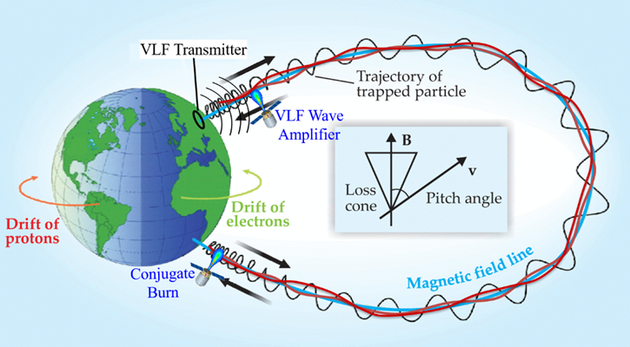
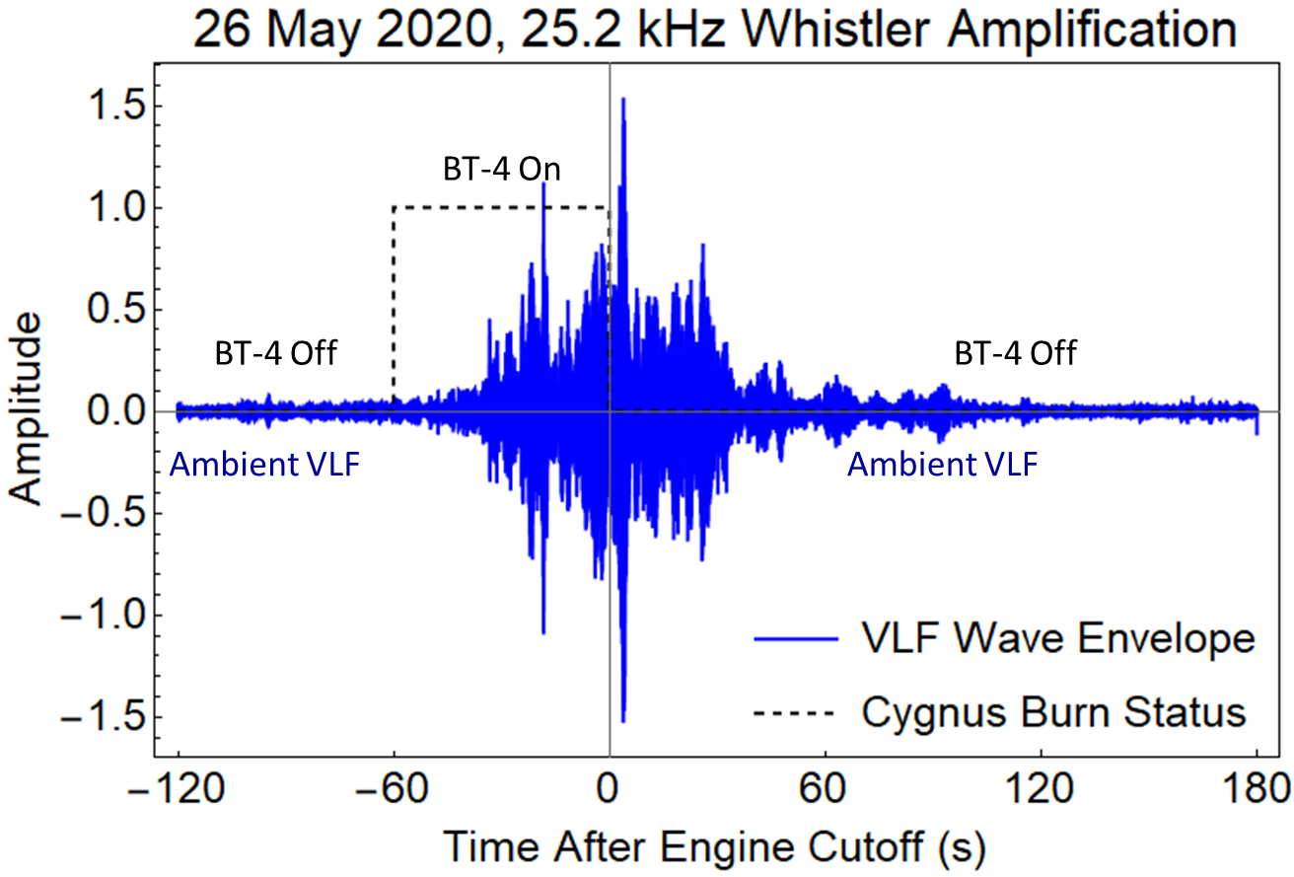
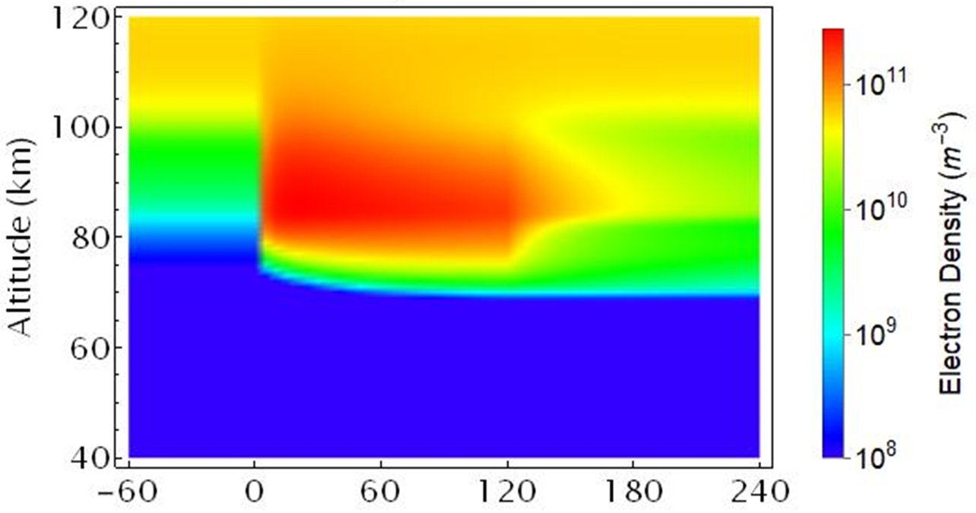
Why Do We Care? Simulations of Rocket Burn Amplifier Experiment
Provide Intense Whistler Waves That Remove Radiation Belt Electrons
Ion Ring Distributions Amplify Whistler Signals
Whistler Cyclotron Resonance Removes Energetic Pericles
Precipitation Detected with Enhanced D-Region
D-Region Enhancements from REDA
Reduction from 50 dB REDA
(c)
Time After Start of Precipitation Event (s)

Slide 23
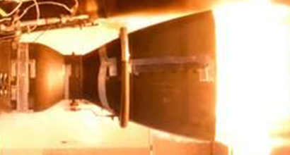

Diagnostics of Ionospheric Activation by Injections of Rocket Exhaust Include
Incoherent and Coherent Scatter Radar, Ground Optics, and Space Sensors
Incoherent Scatter Radar
Weak Coupling
Moderate
Strong Coupling
Ambient
O⁺ Ions
Non Thermal
Ion Distribution
Rocket Fuel
MMH
Oxidizer
NTO
Rocket Motor Combustion Nozzle
Charge Exchange with Atomic Ions
Lorentz Force
F = q_{i} v_{i} x B
Lower Hybrid
Ion Ring Instability
Exhaust
H₂O, CO₂
Ion Beam
H₂O⁺, O₂⁺
Ion Ring
Beam
Density
Structure
Backscatter Radar
Low Temperature
High Speed Gases
ꝉ
Gyrating Molecular Ions H₂O⁺ and O₂⁺
Electrostatic Lower Hybrid Waves, ω_{LH}
H₂O + O⁺ H₂0⁺ + O
CO₂ + O⁺ O₂⁺ + CO
ꝉ
Falcon9 Merlin 1-D Test
Molecular Ions
LH Pump Fields
Dissociative Recombination
Whistler Generators
Ground Transmitters
Traveling Wave Parametric Amplifier
Ambient
Electrons
Weak Whistlers
Intense
Signal
Satellite Receiver
ꝉ
H₂O⁺ + e⁻ H0* + O
O₂⁺ + e⁻ O* + O*
Chemical Releases
Modulated Electrojet
Amplified Whistlers and EMIC Waves
ꝉ
Artificial
Airglow
Ducted Whistlers
Camera
Energetic Particle Cyclotron Resonance
Trapped Particles
Aurora
X-Rays
Camera SQUID
630 nm Emission from Falcon 9 Deorbit Burn
Radiation Belt Particle Precipitation

Slide 24
Incoherent Scatter Supports Artificial Whistler Amplifiers in Space for Devices Designed to Reduce Harmful Radiation Belt Particles
Ground and Space Based Exciters of Whistler Waves
  Small Amplitudes (< 10 pT) are Geo-Ineffective for RBR
  Stronger Amplitudes Needed to Scatter of Trapped Particles
Solution: Ionospheric Amplification of Whistler Waves
  Powered by Existing High Power Rocket Exhaust in the Ionosphere
  Ion Ring Beams Diagnostics are ISR Radars and Ground Optics
  Whistler Parametric Traveling Wave Amplifier
    Spatial Growth Through Activated Plasma
    30 dB up to 50 dB Measured Gain
Intense (1000 pT) Whistlers Provide RBR in Minutes not Days

Slide 25
Incoherent Scatter Diagnostics of High Speed Ion Beams
Sources of Non Thermal Velocity Distributions
  Hypersonic Flow Between Ions and Neutrals in the Ionosphere
    Auroral Ion Acceleration Convection by Large Electric Fields
    High Speed Injection of Neutral Exhaust from Orbiting Rocket Motors
  Neutral and Ion Velocity Distributions
    Neutrals Move in One Direction with Fixed Temperature
    Ion Move Along Magnetic Field B with Gyro Motion Around B
    Ion Ring Velocity Distribution for Perpendicular Speed > Thermal Speed
  Incoherent Scatter Properties
    Thermal Ion Spectrum Becomes Distorted
    ISR Spectrum Yields Perpendicular and Parallel Ion Motion Relative to B
  Application to Using the Ion Ring Distribution to Amplify Whistlers

