Slide 1
GAC Review Meeting
Tuesday, January 17, 2023

Slide 2
OUTLINE
Review the current admissions cycle
Special cases/questions about the process
Preparations for sector meetings
Notes:
Video watch first 34 mins….

Slide 3
ADMISSION PROCESS: Round 0
(1)
(2)
(3)
(GPS/GACC): select completed applications that are ready for review (e.g. letters, transcripts etc.).
  Assign primary sector (A/C/S)
  Add Round 0 tag
(GPS/GACC): if URM/F/FG assign D&I primary sector reviewer – review focus is diversity and inclusion
(GPS/GAAC): assign GAC reviewer based on field of interest
(GAAC/GPC): Triage. Guideline:
  score <=2 reject and write short review (add Probable Reject tag)
  Score >2 pass (replace Round 0 by Round 1 tag)
Applicants
1st Triage (GPS/GACC)
URM or F
no
assign +1 faculty
in related Field of Study
Reject
yes
D&I Review
(D&I)
(4)
additional check
ROUND 0
fail
2nd Triage
(GACC/GPC)
pass
assign 1 faculty
in related field(s) of study (SH/GACC)
(5)
(6)
avg score > 2.5
(GACC/GPC)
additional check
no
yes
GAC
ROUND 0 completed by Jan. 3
Admissible
4 (5) reviews
(7)
GPS: Graduate Program Staff (Shuster)
GACC: GAC Chair (Peraire)
GPC: GC Chair (How)
SH: Sector Heads (deWeck, Darmofal, Spakovszky)
assign +2 faculty
in related field of study (SH)
SECTOR MEETINGS FEBRUARY 6-10
SECTORS

Slide 4
ADMISSION PROCESS: Round 1
(1)
(2)
(3)
Applicants
URM or F
no
assign 1 faculty
in related Field of Study
(SH/GACC): assign 1 round 1 reviewer within sector or outside based on the field of interest.
(GPS/GACC): monitor scores and if low scores appear evaluate viability:
  if not viable add a Probable Reject tag and de-assign non-completed reviews)
  If viable, add an Admissible tag
1st Triage (GPS/GACC)
Reject
yes
D&I Review
(D&I)
(4)
additional check
fail
2nd Triage
(GACC/GPC)
pass
ROUND 1
assign +1 faculty
in related field(s) of study (SH/GACC)
(5)
(6)
avg score > 2.5
(GACC/GPC)
additional check
no
yes
GAC
ROUND 1 completed by Jan. 13
Admissible
4 (5) reviews
(7)
GPS: Graduate Program Staff (Crisley, Shuster))
GACC: GAC Chair (Peraire)
GPC: GC Chair (How)
SH: Sector Heads (deWeck, Darmofal, Spakovszky)
assign +2 faculty
in related field of study (SH)
SECTOR MEETINGS FEBRUARY 6-10
SECTORS

Slide 5
ADMISSION PROCESS: Round 2
(1)
(2)
(3)
Applicants
URM or F
no
assign +1 faculty
in related Field of Study
(SH) seek additional reviews in preparation for sector meetings – folders become available for all faculty to enter reviews. All reviews are open to all faculty in the department.
1st Triage (GPS/GACC)
Reject
yes
D&I Review
(D&I)
(4)
fail
2nd Triage
(GACC/GPC)
additional check
pass
ROUND 1
assign 1 faculty
in related field(s) of study (SH/GACC)
(5)
(6)
avg score > 2.5
(GACC/GPC)
additional check
no
yes
GAC
ROUND 2 completed by Feb. 6
Admissible
3 (4) reviews
(7)
GPS: Graduate Program Staff (Crisley, Shuster))
GACC: GAC Chair (Peraire)
GPC: GC Chair (How)
SH: Sector Heads (deWeck, Darmofal, Spakovszky)
assign +1/2 faculty
in related field of study (SH)
SECTOR MEETINGS FEBRUARY 6-10
SECTORS

Slide 6
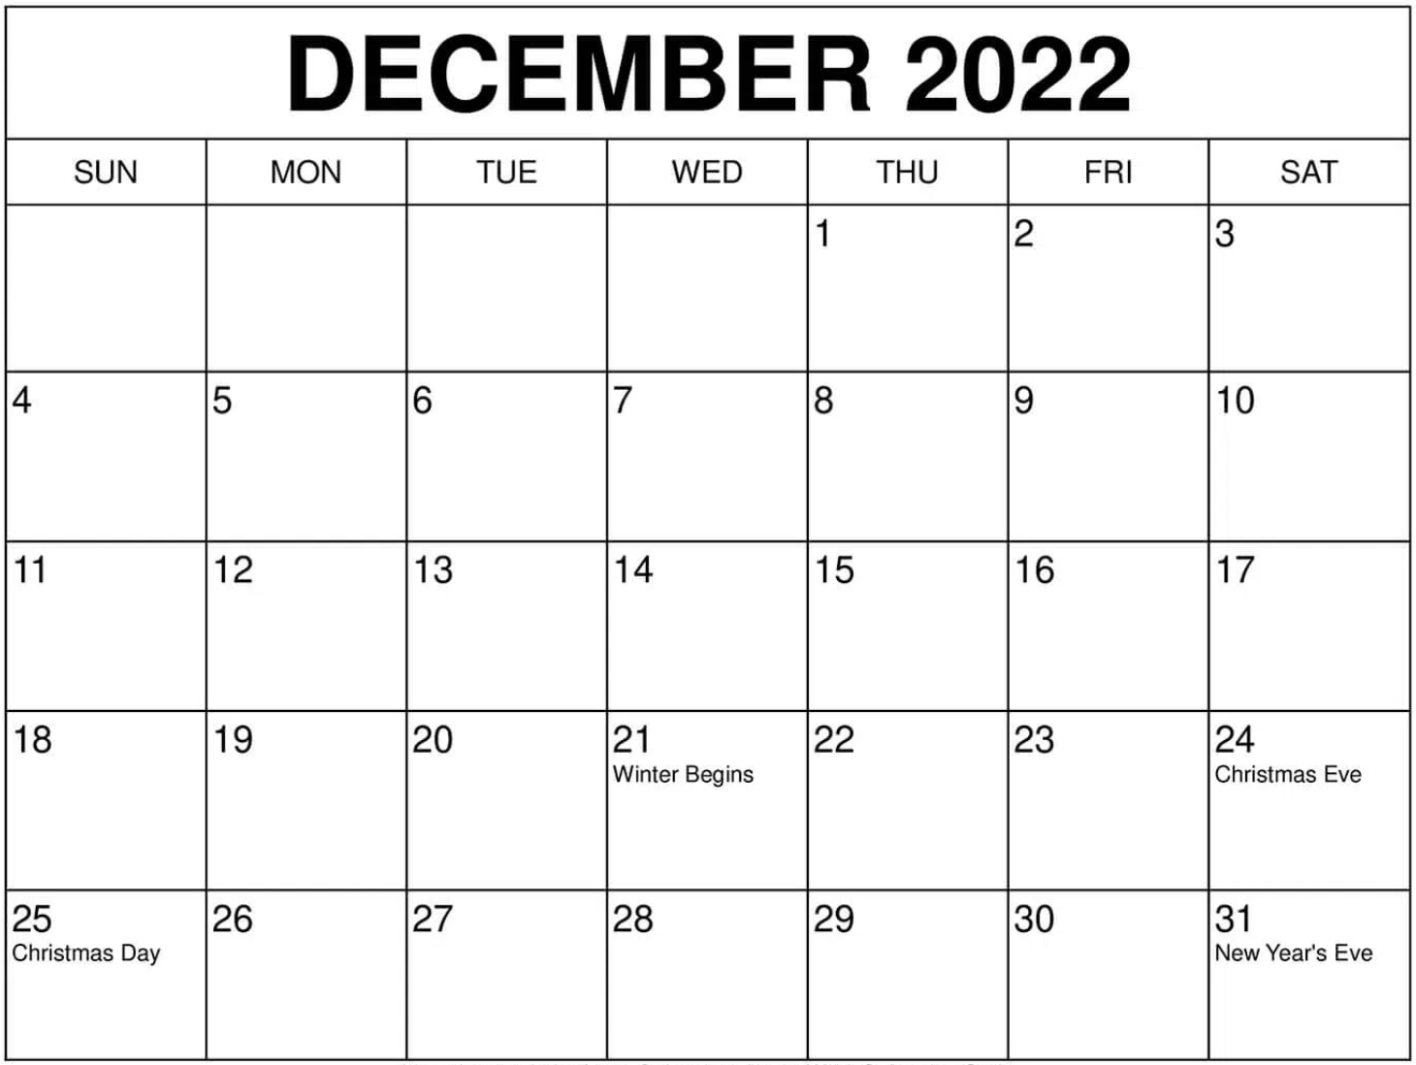
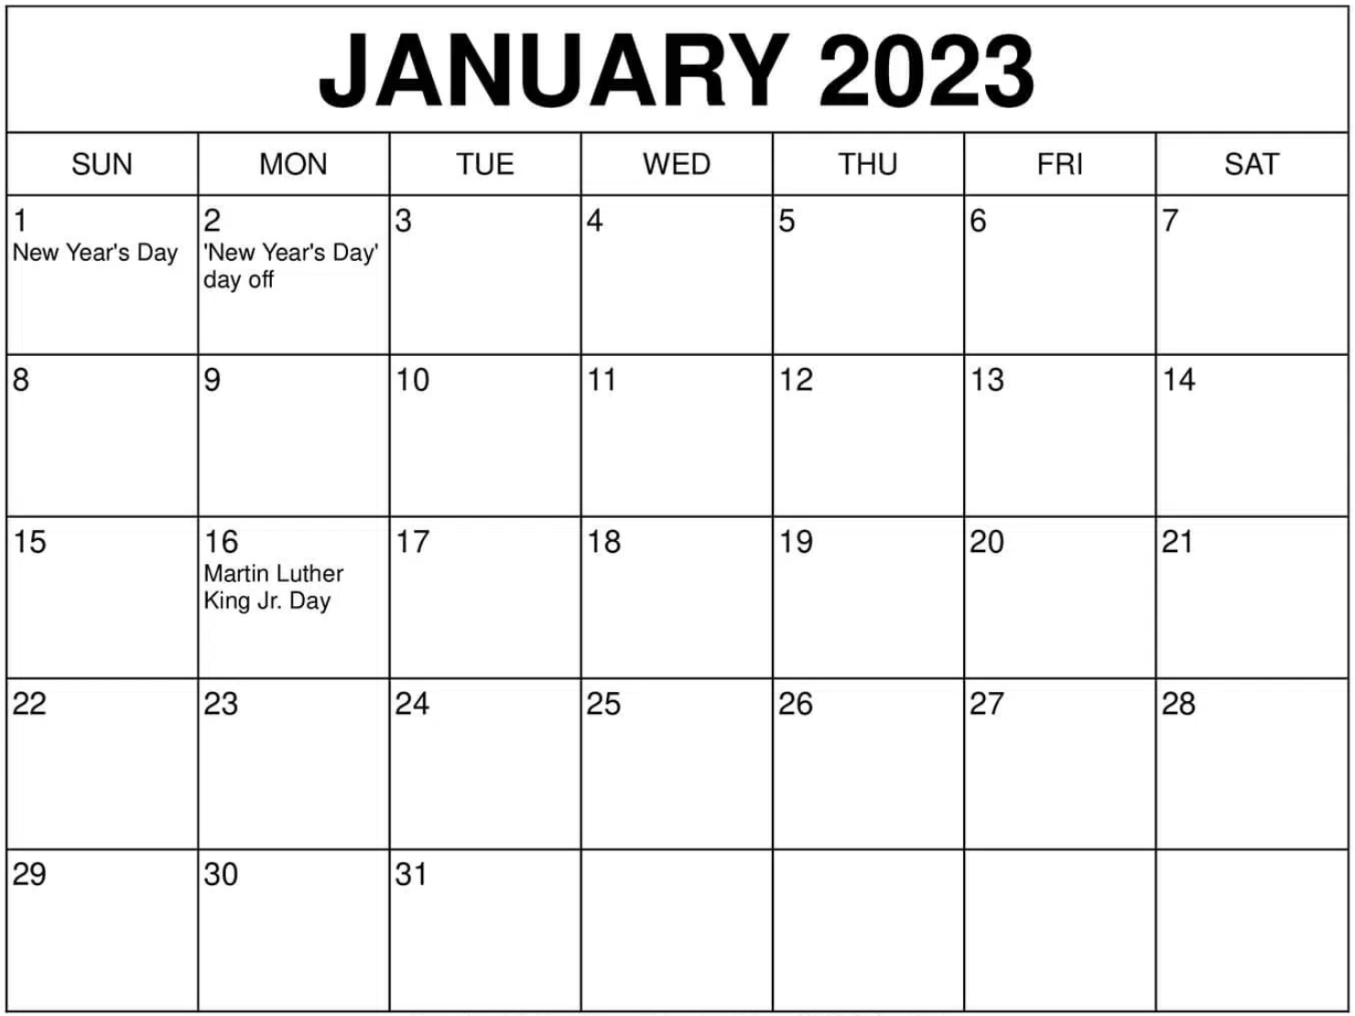
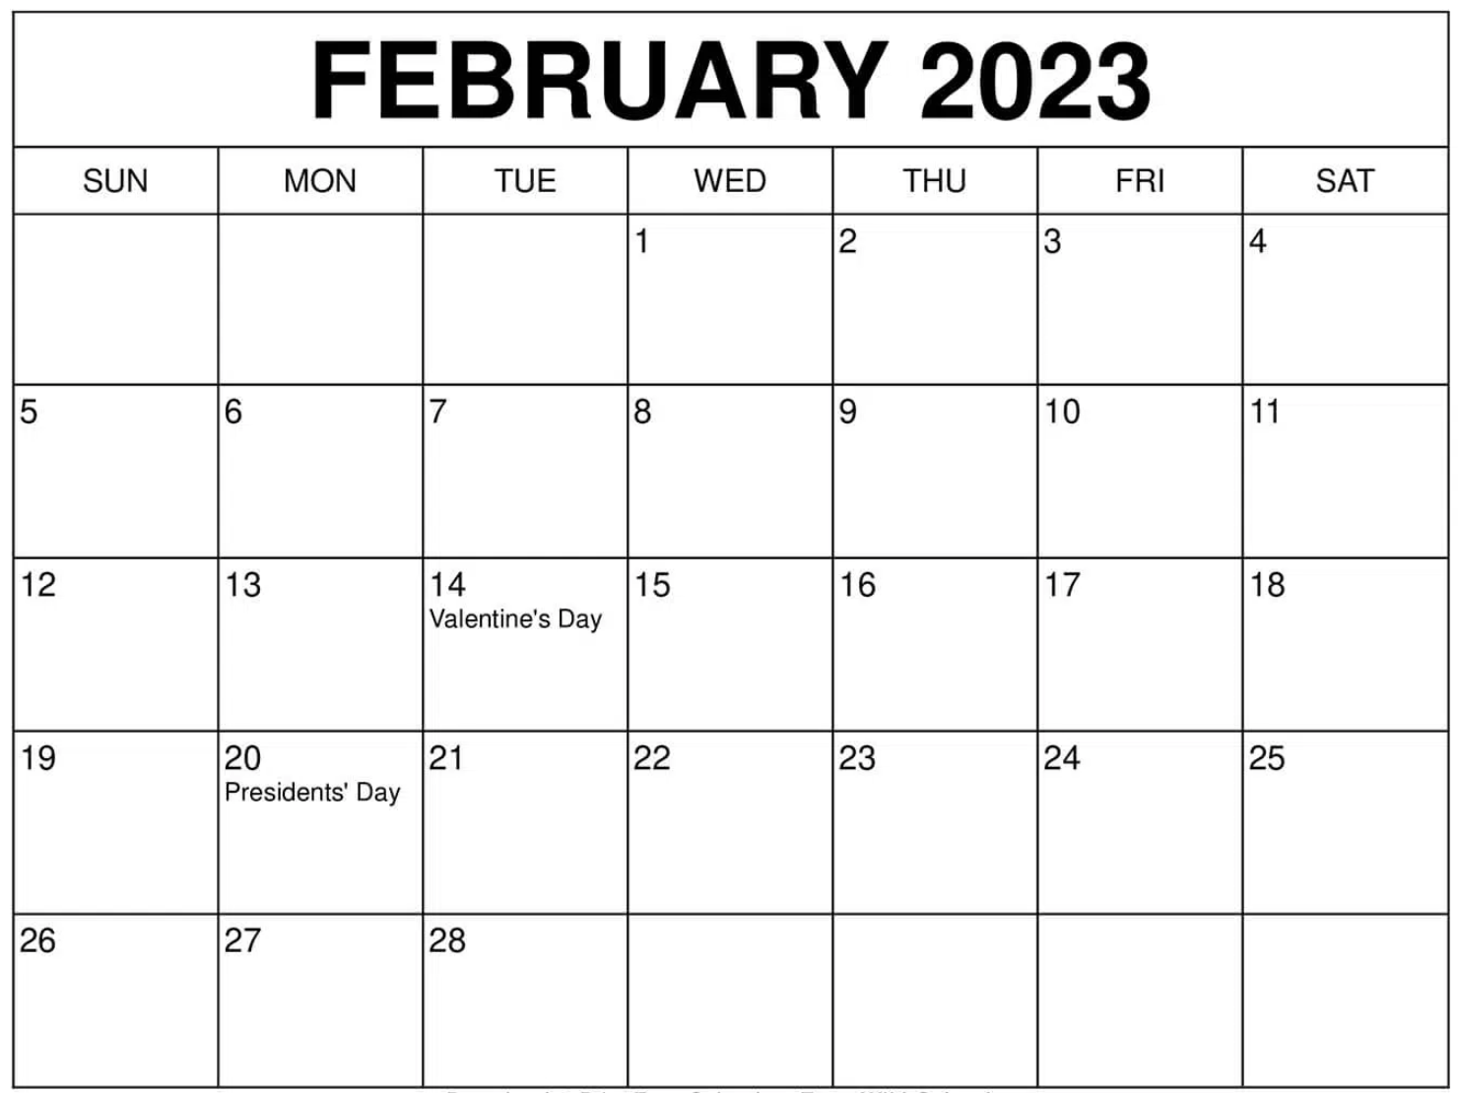
TIMELINE & STATUS
C
A
S
Meeting
Meeting
Meeting
1082: total applications
Today:
275: Probable Reject
229: round_0
192: round_1
339: round_2
Notes:
Difference: 33 missing letters, Early Appilicants and Early_LGO

Slide 7
TO DO
Round 0 (229)
Round 1 (192)
Round 2 (339)
Complete GAC missing reviews < 40
Perform a check on ~200 applications that received 1 or 2 from first reader
Complete GAC missing reviews
Monitor completed reviews and advance/reject
Verify sector
Assign folders to AA faculty
Follow up and monitor completed reviews and advance/reject
Notes:
33 missingletters

Slide 8
ROUND 0
Identify complete applications: 3 letters, transcripts (and English Test)
Assign primary sector (A,C, or S)
Perform screening review by 1 GAC member
If W/URM/FG additional review by sector DEI GAC member
If average score > 2.5

Slide 9
2022-2023 GAC Membership
Katya Arquilla, S
Steven Barrett, A
Kerri Cahoy, S, (DE&I Space)
Zack Cordero, S
Faith Crisley, (GPA)
David Darmofal, C, (SH Computing)
Oli de Weck, S, (SH Systems, after 1/16/23)
Chuchu Fan, C
Carmen Guerra, A
Ed Greitzer, A
Wesley Harris, A, (DE&I Air)
Daniel Hastings, S
Jon How, C, (GPC)
Nancy Leveson, S
Richard Linares, S
Eytan Modiano, C, (DE&I Computing)
Jaime Peraire, C, Chair (GACC)
Lonnie Petersen, S
Beata Shuster, (GPA)
Zoltán Spakovszky, A, (SH Air)
Qiqi Wang, C
Moe Win, C

Slide 10

The Process/Timeline 2021-2022
Round 0
2 reads/applicant
3 reads if URM or F
Completed 1/14/2022
Round 1
2 additional reads
Completed 2/2/2022
528
48%
432
40%
Sector Meetings
2/7-11 /2022
1067
97%
89
8%
1101
Admitted Students
39 Waitlisted
Initial Pool
Deadline 12/15/2022
Completed Applications
Notes:
folder:all
reviewer:>0
Tag:admissible
Rating:>3
Tag:mit_admit

Slide 11
Can we make the process more efficient?
Too much time is going into multiple full reads of non-viable candidates – we need to shift that investment to viable and diverse candidates
  One low score makes it impossible to get through anyway
This year there are short-form answers to targeted questions
  Reviewers can extract information without wading through lengthy personal statements
  Applicants are asked for specifically what is needed rather than having to know what to say (harder for some, e.g. first generation/low income)

Slide 12
Proposed changes
Round 0
Change first round to 1 full read for viability + 1 rejection check
2 full reads for all W/URM (and possibly FG/LI)
Guidance that a viable candidate unlikely if GPA < X/4.0 in a relevant area from a good school, suggest X = 3.6 (for MIT GPA < 4.7/5.0)
  HQ has declined requests to admit students with low GPA
Round 1
No change

Slide 13
ADMISSION PROCESS: Round 2
(1)
(2)
(3)
Applicants
URM or F
no
assign +1 faculty
in related Field of Study
(SH) seek additional reviews from faculty at-large in preparation for sector meetings – folders become available for all faculty to enter reviews
1st Triage (GPS/GACC)
Reject
yes
D&I Review
(D&I)
(4)
additional check
fail
2nd Triage
(GACC/GPC)
pass
assign 1 faculty
in related field(s) of study (GACC)
(5)
(6)
avg score > 2.5
(GACC/GPC)
additional check
no
yes
GAC
ROUND 2 completed by end of Jan.
Admissible
ROUND 2
(7)
GPS: Graduate Program Staff (Shuster))
GACC: GAC Chair (Peraire)
GPC: GC Chair (How)
SH: Sector Heads (deWeck, Darmofal, Spakovszky)
4 (5) reviews
assign +2 faculty
in related field of study (SH)
SECTOR MEETINGS FEBRUARY 6-10
SECTORS

Slide 14
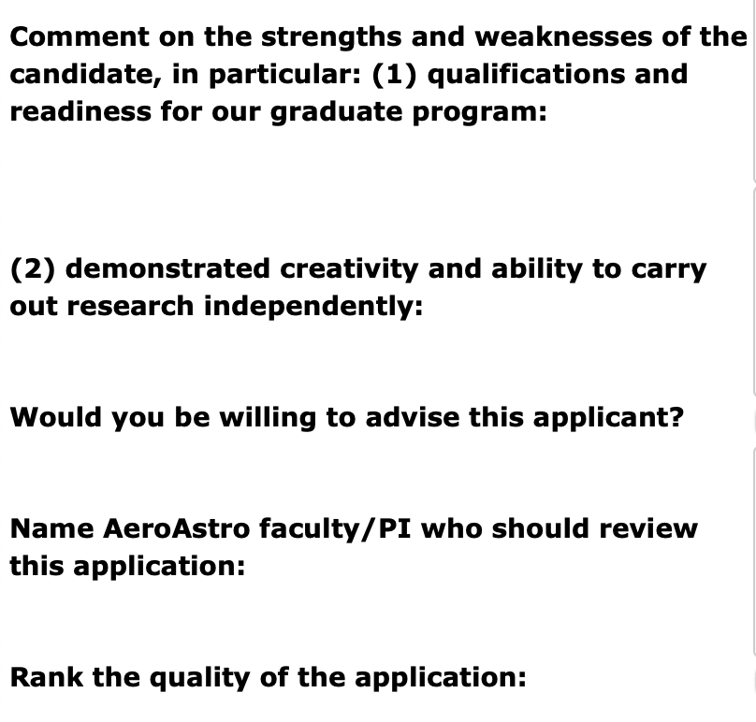
Review Form
Note: Viable candidate unlikely if GPA <X/4.0 in a relevant area from a good school, suggest X = 3.6 (for MIT GPA <4.7/5.0)
  HQ has declined requests to admit students with low GPA
A yes answer to this question is understood as an expression of interest (not commitment)
(e.g. it is OK to say NO if application is not in your area of expertise and still give a score of 4)
Help identify secondary sector if relevant and additional reviewers
1 Reject
2 Probably admissible
3 Admissible
3.5 Admit
4 Definite admit

Slide 15
SCORING GUIDELINES
Better
Letters | Address qualifications, ambition, accomplishments and independence | No | Vague | Good | Excellent
Statement of Objectives | Content | Vague, Lacks depth, Meaning is unclear | Some objectives/Lacks specificity | Clear objectives but lacking depth/details | Clear objectives/ Concise in depth
 | Alignment with department's research | None | Minimal alignment | Good alignment | Strong/Strategic alignment
 | Clarity | Poorly written/ difficult to understand | Lack of precision and unclear statements | Easily read and understood | Well written and engaging
Academic Preparation | Curriculum | Not relevant or insufficient | Relevant with possibly some gaps | Adequate preparation | Exceptionally well prepared both in terms of quantity and quality
 | Transcripts considering school and grades | Insufficient for our graduate program | Concerns about successfully completing graduate courses | Adequate grades and program | Stellar grades and program
Experience | Research/Professional/Internships | None | Some experience but nothing exceptional | Comparable to one of our average/strong UG students | Demonstrated creativity, maturity and independence. Possibly with publications/leadership experience
Values | Alignment with department's values: Community, Succeeding Together, Excellence and Ethics | No evidence | Some relevant activities | Involvement in some community building activities | Demonstrated evidence of leadership/ strong community-building and outreach
Comments on different components of application are helpful to ensure uniformity

Slide 16
TAKE AWAY POINTS
Do your reviews gradually and on time
  it is a problem if all reviews arrive the day of the deadline
Complete your round 0 reviews before doing round 1 reviews
  remember that for round 0, you are the only one looking at that folder
Provide information in your reviews
  Should another sector be involved ?
  Who should read the application?
Only GAC reviews are considered during round 0/1
  After an application is deemed Admissible (end of round 1), it is open for all faculty to enter reviews (faculty can also look through other applicants and bring them up at sector meetings if they wish)
If you can not do your reviews on time, we need to know now !

Slide 17
RESOURCES
Website:
https://gradapply.mit.edu/aeroastro/review/
Wiki Page:
https://wikis.mit.edu/confluence/display/AAGAC/Home
Unconscious Bias Video: https://www.youtube.com/watch?v=nLjFTHTgEVU

Slide 18
Questions?

Slide 19
OTHER ISSUES
  Deadline for letter writers (23 Dec vs. 8 Jan) (not made public)
  Student asking for deadline extension due to illness
  Wiki needs to be updated
  Next year MIT wants us to change to Slate

Slide 20
FIELDS OF STUDY MAPPED TO SECTORS
Air Sector
Aerospace, Energy, and the Environment
Air-Breathing Propulsion
Aircraft Systems Engineering
Air Transportation Systems
Space Sector
Engineering Systems
Humans in Aerospace
Materials and Structures
Space Propulsion and Plasmas
Space Systems
Computing Sector
Aerospace Computational Engineering
Autonomous Systems
Communications and Networks
Controls

Slide 21
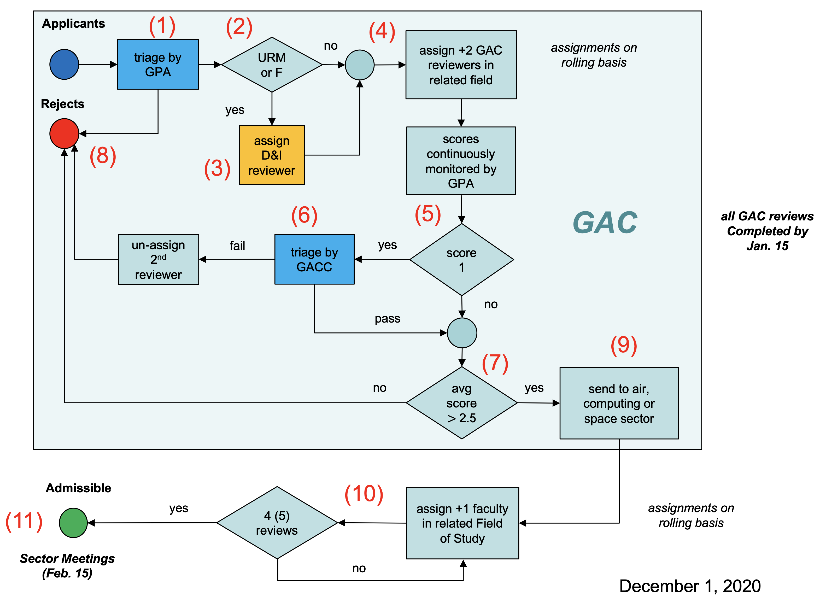
ADMISSION PROCESS
All GAC Reviews completed by Jan. 14 – GAC Meeting follows shortly after to to review decissions
Applicants assigned to DE&I reviewers will no be triaged until DE&I review is complete
Sector Meetings Feb. 6-10

Slide 22
ADMISSION PROCESS: Round 0 and Round 1
Applicants
1st triage
assign 2 faculty
in related field(s) of study
send to sectors
AIR
[process runs parallel in sectors]
Review Form
COMPUTING
SPACE
Rejects
URM or F
yes
DIO review
[bypass TO at 3rd review]
fail
TO 2nd triage
yes
score 1
assign +1 faculty
in related Field of Study
send to other sector
pass
3 (4) reviews
no
Review Scores
1 – Reject
2 – Probably admissible
3 – Admissible
3.5 – Admit
4 – Definite admit
no
avg score > 1.5
SECTOR MEETINGS
Admissible

Slide 23
ADMISSION PROCESS: Rounds 0 and 1
(1)
(2)
(3)
Applicants
1st Triage (GPS/GACC)
URM or F
no
assign +1 faculty
in related Field of Study
Reject
yes
D&I Review
(D&I)
Assignments are made on a rolling basis
ROUND 0 reviews completed by Jan. 3
ROUND 1 completed by Jan. 13
GAC Meeting follows shortly after to to review decissions
(4)
additional check
ROUND 0
fail
2nd Triage
(GACC/GPC)
pass
ROUND 1
assign 2 faculty
in related field(s) of study (SH/GACC)
(5)
(6)
avg score > 2.5
(GACC/GPC)
additional check
no
yes
GAC
Admissible
4 (5) reviews
assign +1 faculty
in related field of study (SH)
(7)
SECTOR MEETINGS FEBRUARY 6-10
send to sectors
SECTORS

Slide 24
ADMISSION PROCESS
ROUND 0
ROUND 1
(GPS/GACC): select completed applications that are ready for review (e.g. letters, transcripts etc.).
  Assign primary sector (add tag A/C/S)
  Add Round 0 tag
(GPS/GACC): if URM/F (possibly FG/LI) assign D&I primary sector reviewer – review focus is diversity and inclusion
(GPS/GAAC): assign faculty round 0 reviewer based on field of interest
(GAAC/GPC): Triage. Guideline:
  score <=2 reject and write short review (add Probable Reject tag)
  Score >2 pass (replace Round 0 by Round 1 tag)
(SH): assign 2 round 1 reviewers within sector or outside based on filed of interest. If necessary add a secondary sector (i.e. add tag A/C/S)
(GPS/GACC): monitor scores and if low scores appear evaluate viability:
  if not viable add Probable Reject tag and de-assign non-completed reviews)
  If viable add Admissible tag
(SH) seek additional reviews in preparation for sector meetings – folders become available for all faculty to enter reviews
GPS: Graduate Program Staff (Crisley, Shuster))
GACC: GAC Chair (Peraire)
GPC: GC Chair (How)
SH: Sector Heads (deWeck, Darmofal, Spakovszky)

Slide 25
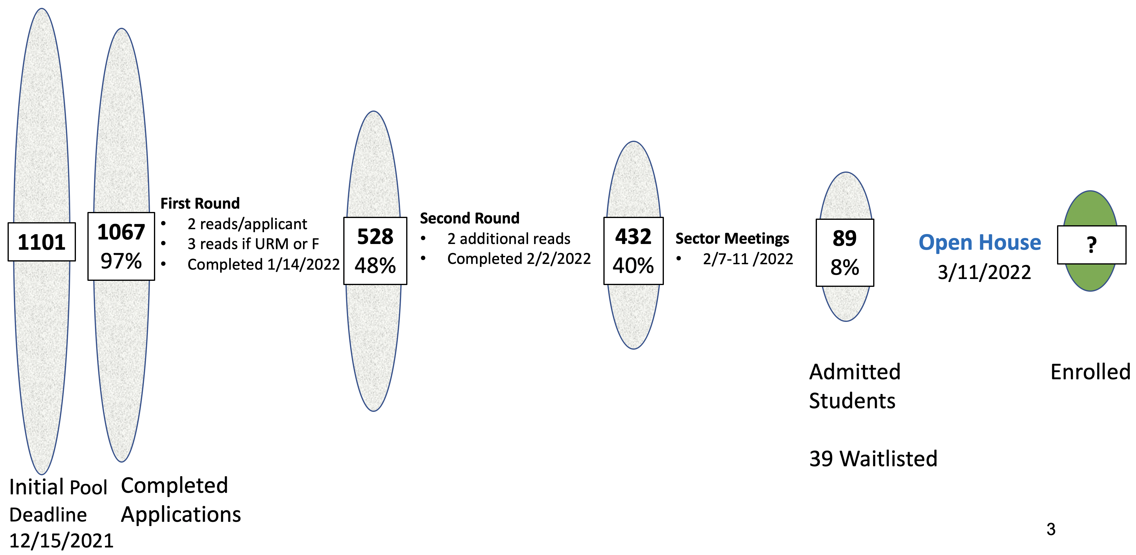
Can we make the process more efficient?
~2000 of ~3000 reads are invested into candidates that do not make the second round
One low score makes it impossible to get through anyway
21-22 Admission Process

Slide 26
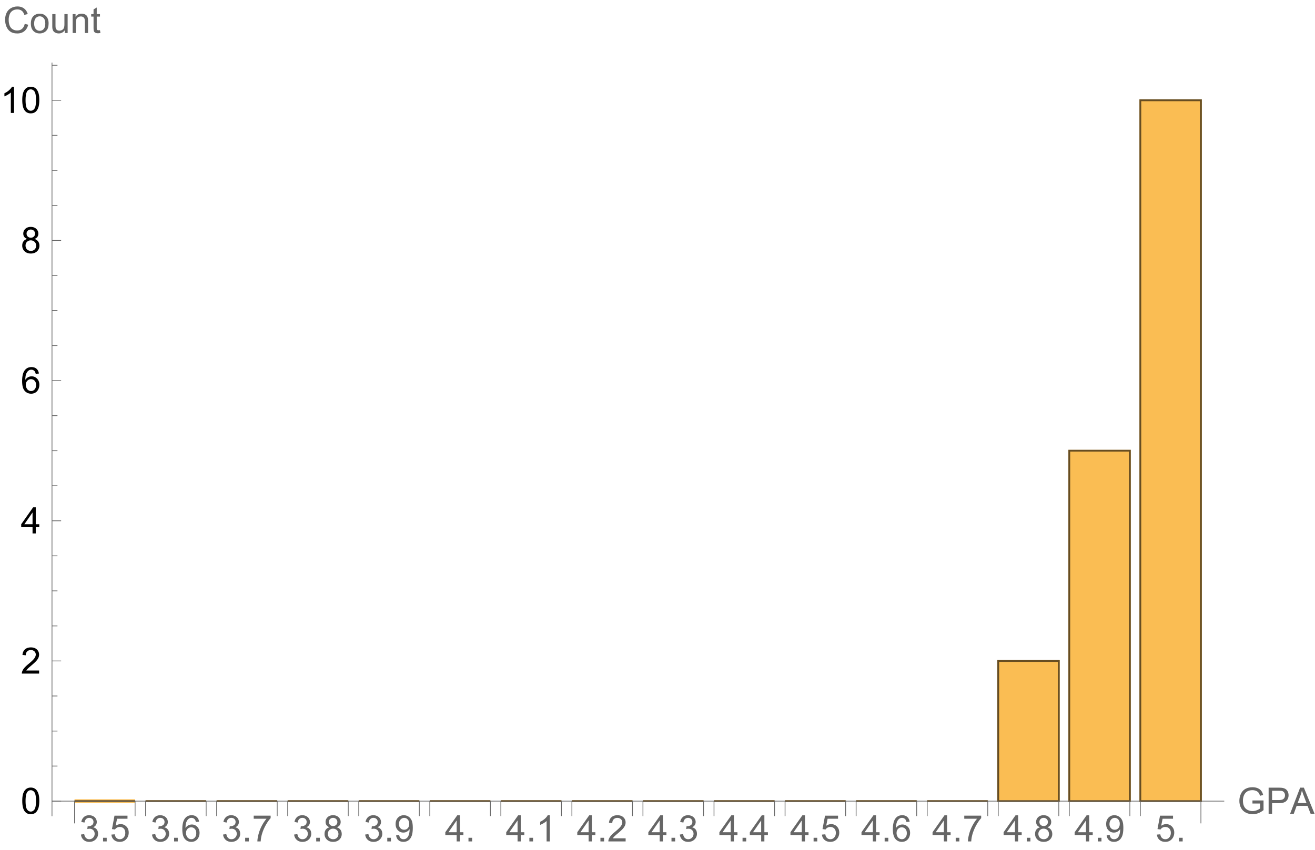
GPAs of MIT undergraduates who were admitted to our grad program in 2022

Slide 27
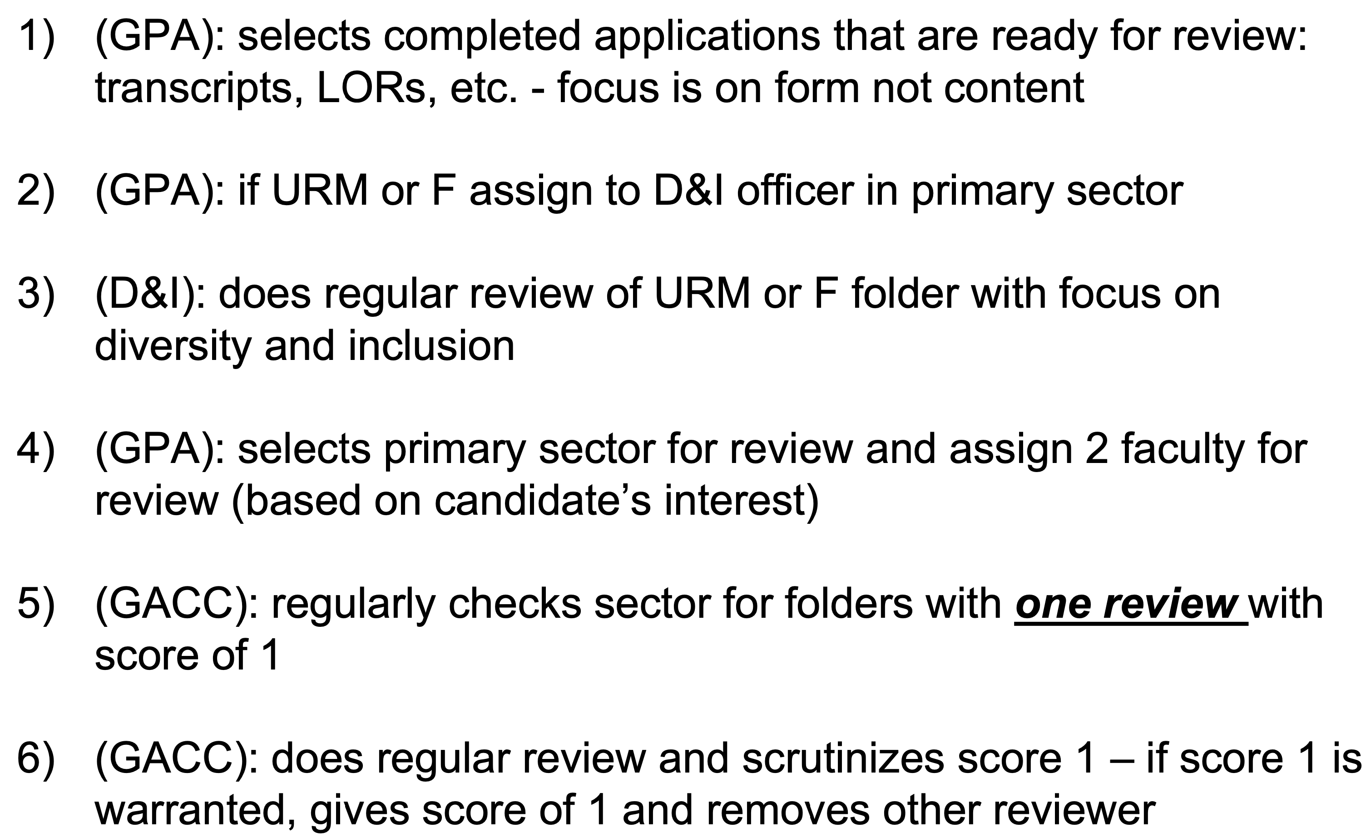
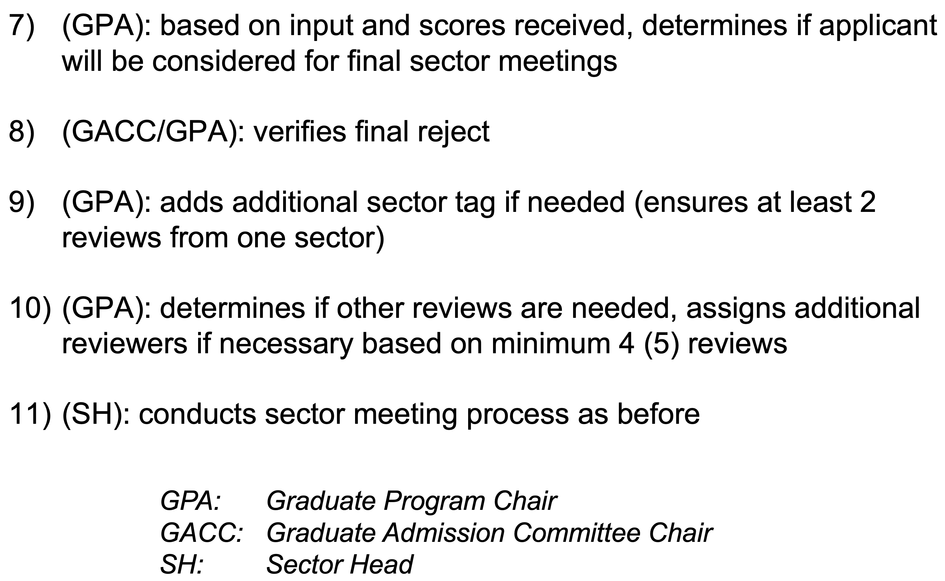
ADMISSION PROCESS

Slide 28
Applicants
Total
Int’l
W
URM
Growth in applicants from 737 to 1101 – a 49% increase
Over this period W applicants increased by 52%, URM 84% (from 52 to 96), and internationals by 40% – strongest growth in URM applicants (low base)

Slide 29
ADMISSION PROCESS: First and Second Rounds
Applicants
1st triage
assign 2 faculty
in related field(s) of study
send to sectors
AIR
[process runs parallel in sectors]
COMPUTING
SPACE
Rejects
URM or F
yes
DIO review
[bypass TO at 3rd review]
fail
TO 2nd triage
yes
score 1
assign +1 faculty
in related Field of Study
send to other sector
pass
3 (4) reviews
no
no
avg score > 3.0
SECTOR MEETINGS
Admissible

