Slide 1
GRADUATE ADMISSIONS
Kick off meeting
B. Marois and J. Peraire
November 8, 2021

Slide 2
OUTLINE
Review GAC Membership and Organization
Review Timeline/Process
Questions?

Slide 3
2021-2022 GAC Membership
Jon How, Computing
Nancy Leveson, Space
Richard Linares, Space
Paulo Lozano, Space, DI&I
Beth Marois, Graduate Administrator
Eytan Modiano, Computing
Jaime Peraire, Chair, Computing
Nick Roy, Computing, DI&I
Moe Win, Computing
Steven Barrett, ADH, Air
Luca Carlone, Computing
Zack Cordero, Space
Oli de Weck, Space
Chuchu Fan, Computing
Ed Greitzer, Air
John Hansman, Air
Wesley Harris, Air, DI&I
Daniel Hastings, Space

Slide 4

The Process/Timeline 2020-2021
First Round
2377 GAC reads
2 reads/applicant
3 reads if URM or F
Completed 1/14/2021
?
Second Round
709 Additional reads
2 additional reads
Completed 2/2/2021
68
6%
441
41%
272
25%
Sector Meetings
2/8-12 /2021
1057
98%
101
9%
Open House
1085
3/12/2021
Enrolled
Admitted Students
35 Waitlisted
Initial Pool
Deadline 12/15/2021
Completed Applications
Notes:
folder:all
reviewer:>0
Tag:admissible
Rating:>3
Tag:mit_admit

Slide 5
ADMISSION PROCESS: First and Second Rounds
Applicants
1st triage
assign 2 faculty
in related field(s) of study
send to sectors
AIR
[process runs parallel in sectors]
COMPUTING
SPACE
Rejects
URM or F
yes
DIO review
[bypass TO at 3rd review]
fail
TO 2nd triage
yes
score 1
assign +1 faculty
in related Field of Study
send to other sector
pass
3 (4) reviews
no
no
avg score > 3.0
SECTOR MEETINGS
Admissible

Slide 6
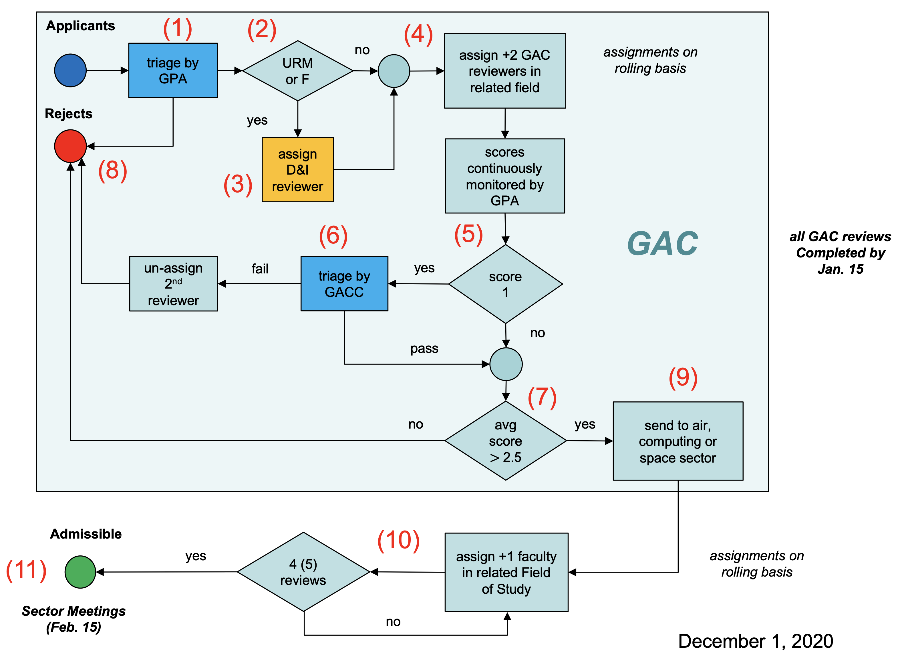
ADMISSION PROCESS
All GAC Reviews completed by Jan. 14 – GAC Meeting follows shortly after to to review decissions
Applicants assigned to DE&I reviewers will no be triaged until DE&I review is complete
Sector Meetings Feb. 3-11

Slide 7
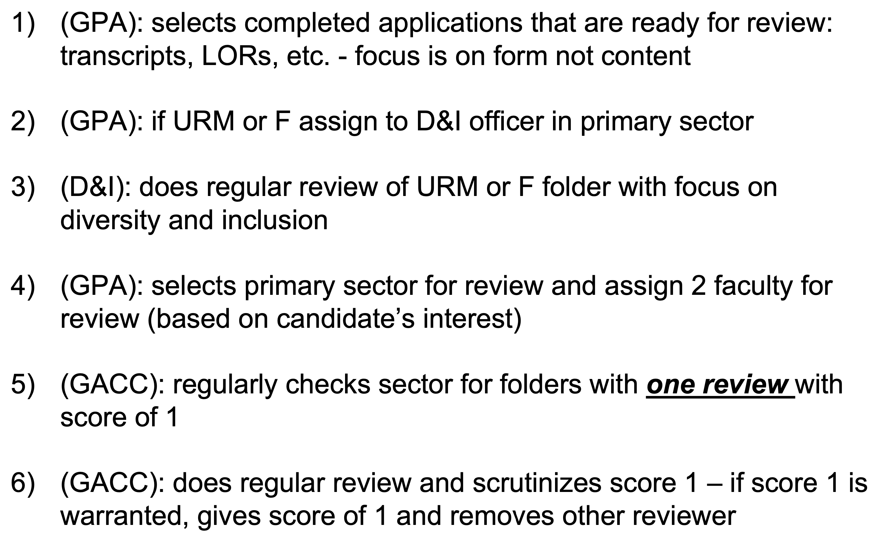
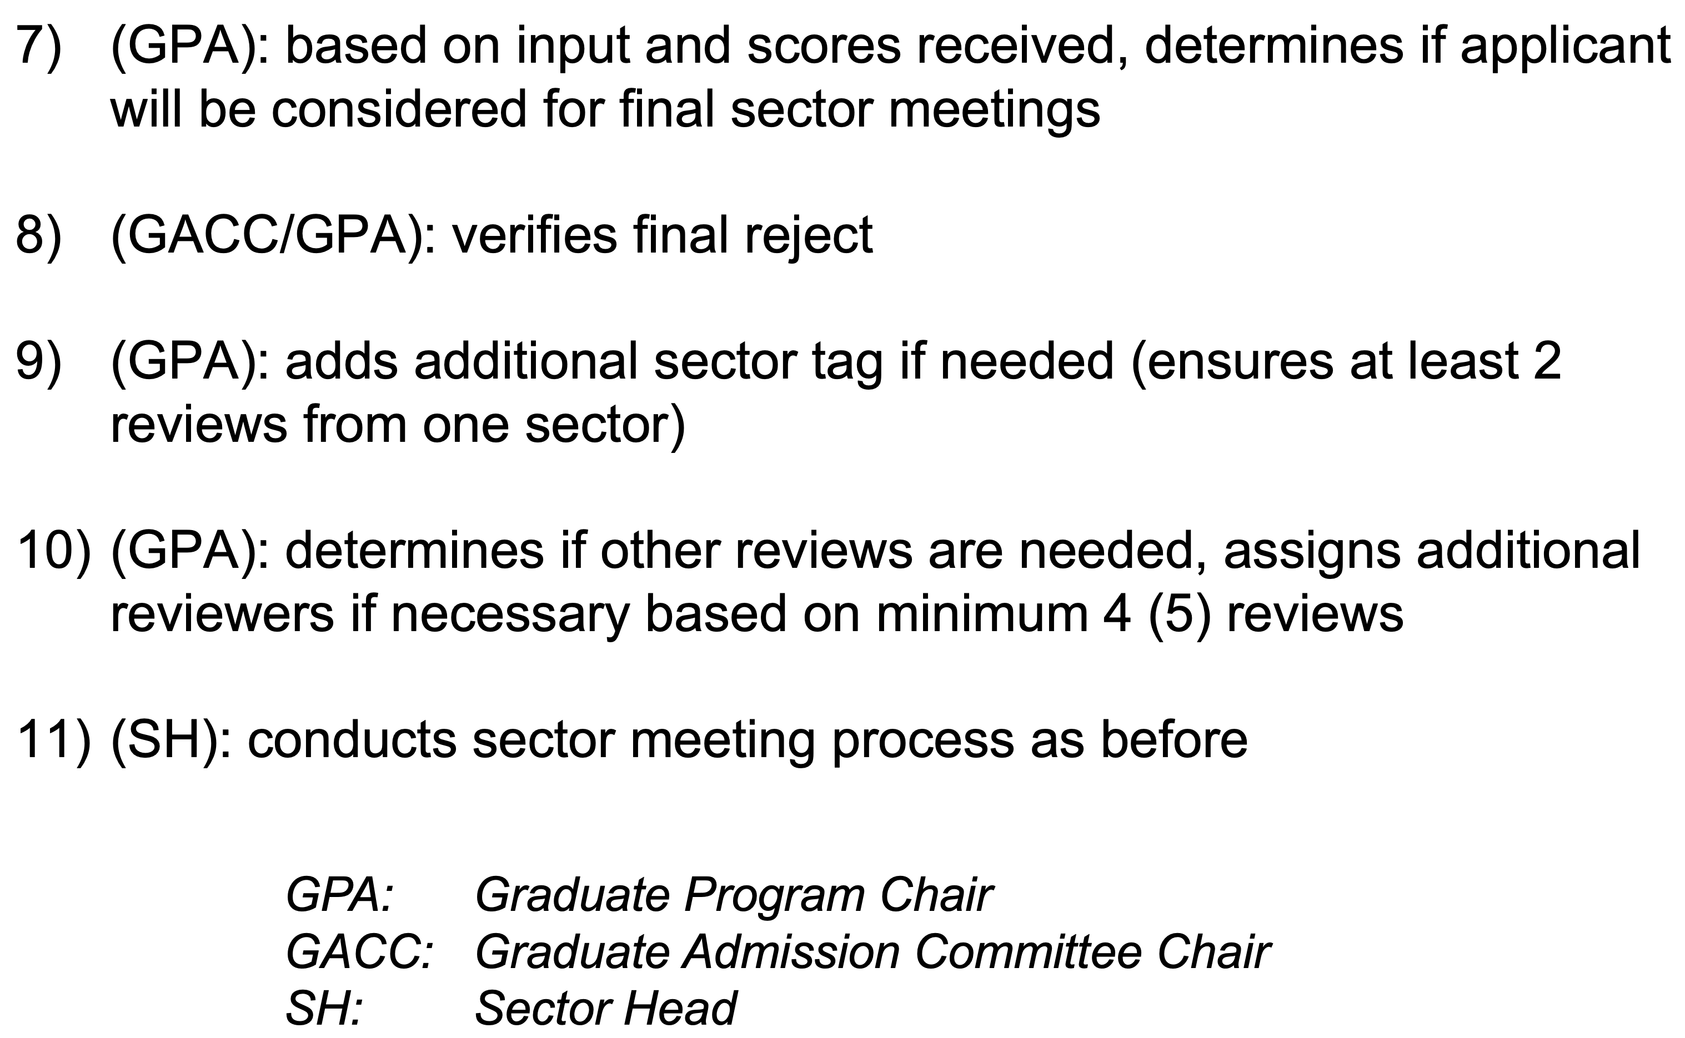
ADMISSION PROCESS

Slide 8
FIELDS OF STUDY MAPPED TO SECTORS
Air Sector
Aerospace, Energy, and the Environment
Air-Breathing Propulsion
Aircraft Systems Engineering
Air Transportation Systems
Space Sector
Engineering Systems
Humans in Aerospace
Materials and Structures
Space Propulsion and Plasmas
Space Systems
Computing Sector
Aerospace Computational Engineering
Autonomous Systems
Communications and Networks
Controls

Slide 9
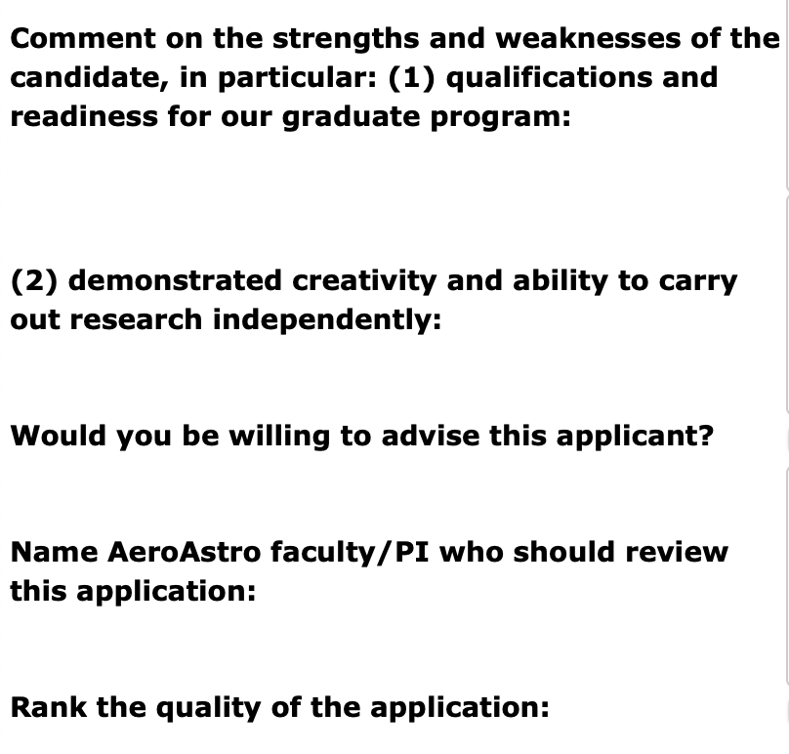
Review Form
Review Scores
1 Reject
2 Probably admissible
3 Admissible
3.5 Admit
4 Definite admit
A yes answer to this question is understood as an expression of interest (not commitment)
(e.g. it is OK to say NO if application is not in your area of expertise and still give a score of 4)

Slide 10
(STRONGLY ENCOURAGED) Scoring Guidelines
Comments on different components of application are helpful to ensure uniformity
Better
Letters | Address qualifications, ambition, accomplishments and independence | No | Vague | Good | Excellent
Statement of Objectives | Content | Vague, Lacks depth, Meaning is unclear | Some objectives/Lacks specificity | Clear objectives but lacking depth/details | Clear objectives/ Concise in depth
 | Alignment with department's research | None | Minimal alignment | Good alignment | Strong/Strategic alignment
 | Clarity | Poorly written/ difficult to understand | Lack of precision and unclear statements | Easily read and understood | Well written and engaging
Academic Preparation | Curriculum | Not relevant or insufficient | Relevant with possibly some gaps | Adequate preparation | Exceptionally well prepared both in terms of quantity and quality
 | Transcripts considering school and grades | Insufficient for our graduate program | Concerns about successfully completing graduate courses | Adequate grades and program | Stellar grades and program
Experience | Research/Professional/Internships | None | Some experience but nothing exceptional | Comparable to one of our average/strong UG students | Demonstrated creativity, maturity and independence. Possibly with publications/leadership experience
Values | Alignment with department's values: Community, Succeeding Together, Excellence and Ethics | No evidence | Some relevant activities | Involvement in some community building activities | Demonstrated evidence of leadership/ strong community-building and outreach

Slide 11
Questions?

Slide 12
 | Applicants | Admitted (Selectivity) | Accepted (Yield)
2018 | 737 | 110 (15%) | 72 (65%)
2019 | 740 | 93 (13%) | 57 (61%)
2020 | 797 | 108 (14%) | 76 (70%)
2021 | 1085 | 101* (9%) | 68 (67%)
Selectivity: relative to total applicants
Yield: relative to admitted

Slide 13
 | Applicants |  | Admitted |  | Accepted
 | TOTAL | FEMALE | TOTAL | FEMALE | TOTAL | FEMALE
2018 | 737 | 150 (20%) | 110 | 37 (34%) | 72 | 23 (32%)
2019 | 740 | 141 (19%) | 93 | 30 (32%) | 57 | 17 (30%)
2020 | 797 | 139 (17%) | 108 | 39 (36%) | 76 | 27 (36%)
2021 | 1085 | 192 (18%) | 101 | 34 (35%) | 68 | 24 (35%)
Notes:
36% increase in number of applciants

Slide 14
 | Applicants |  |  | Admitted |  |  | Accepted
 | TOTAL | INT. | URM* | TOTAL | INT. | URM* | TOTAL | INT. | URM*
2018 | 737 | 326 (44%) | 52 (13%) | 110 | 28 (25%) | 12 (17%) | 72 | 17 (24%) | 9 (16%)
2019 | 740 | 337 (46%) | 56 (14%) | 93 | 23 (25%) | 9 (13%) | 57 | 15 (26%) | 6 (14%)
2020 | 797 | 340 (43%) | 77 (17%) | 108 | 26 (24%) | 20 (24%) | 76 | 21 (28%) | 12 (22%)
2021 | 1085 | 482 (44%) | 87 (14%) | 101 | 18* (19%) | 16* (21%) | 68 | 14 (21%) | 7 (13%)
URM precentages are relative to domestic students

Slide 15
 | Applicants |  |  | Admitted |  |  | Accepted
 | TOTAL | INT. | URM | TOTAL | INT. | URM | TOTAL | INT. | URM
2018 | 737 | 326 (44%) | 52 (7%) | 110 | 28 (25%) | 12 (11%) | 72 | 17 (24%) | 9 (13%)
2019 | 740 | 337 (46%) | 56 (8%) | 93 | 23 (25%) | 9 (10%) | 57 | 15 (26%) | 6 (11%)
2020 | 797 | 340 (43%) | 77 (10%) | 108 | 26 (24%) | 20 (19%) | 76 | 21 (28%) | 12 (16%)
2021 | 1085 | 482 (44%) | 87 (8%) | 101 | 18* (19%) | 16* (17%) | 68 | 14 (21%) | 7 (10%)

Slide 16
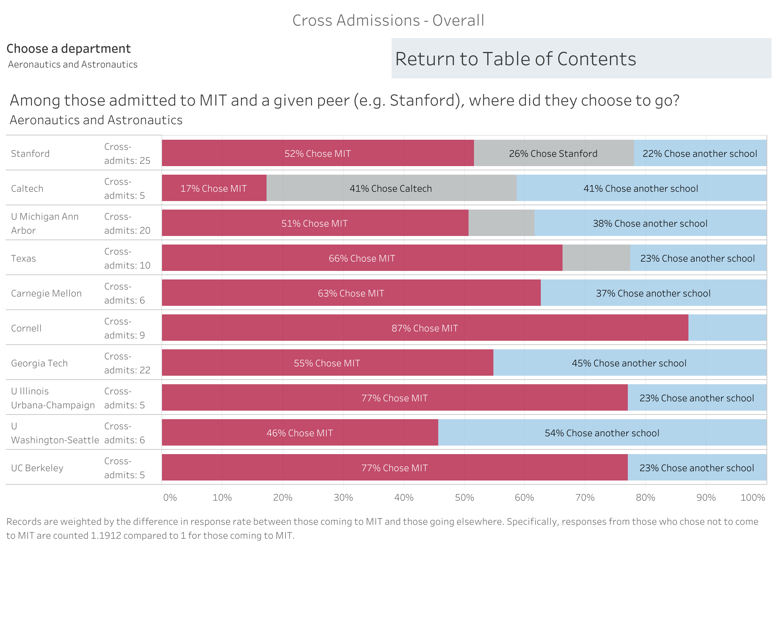
2020 GRADUATE STUDENTS SURVEY

Slide 17
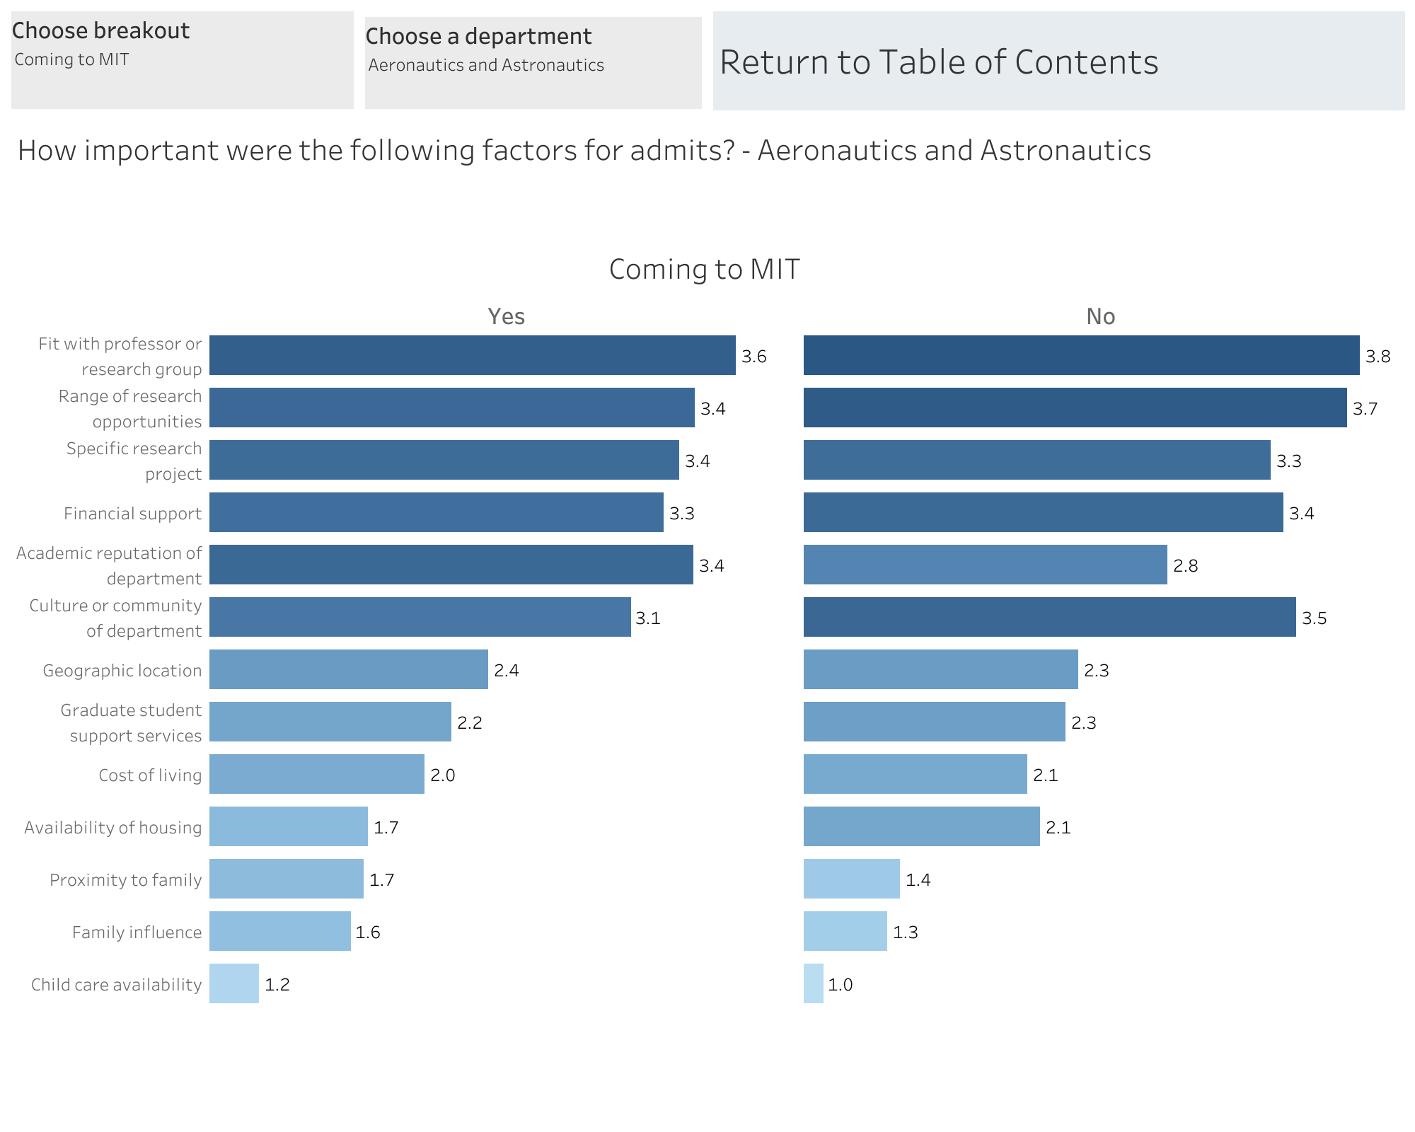
2020 GRADUATE STUDENTS SURVEY

Slide 18
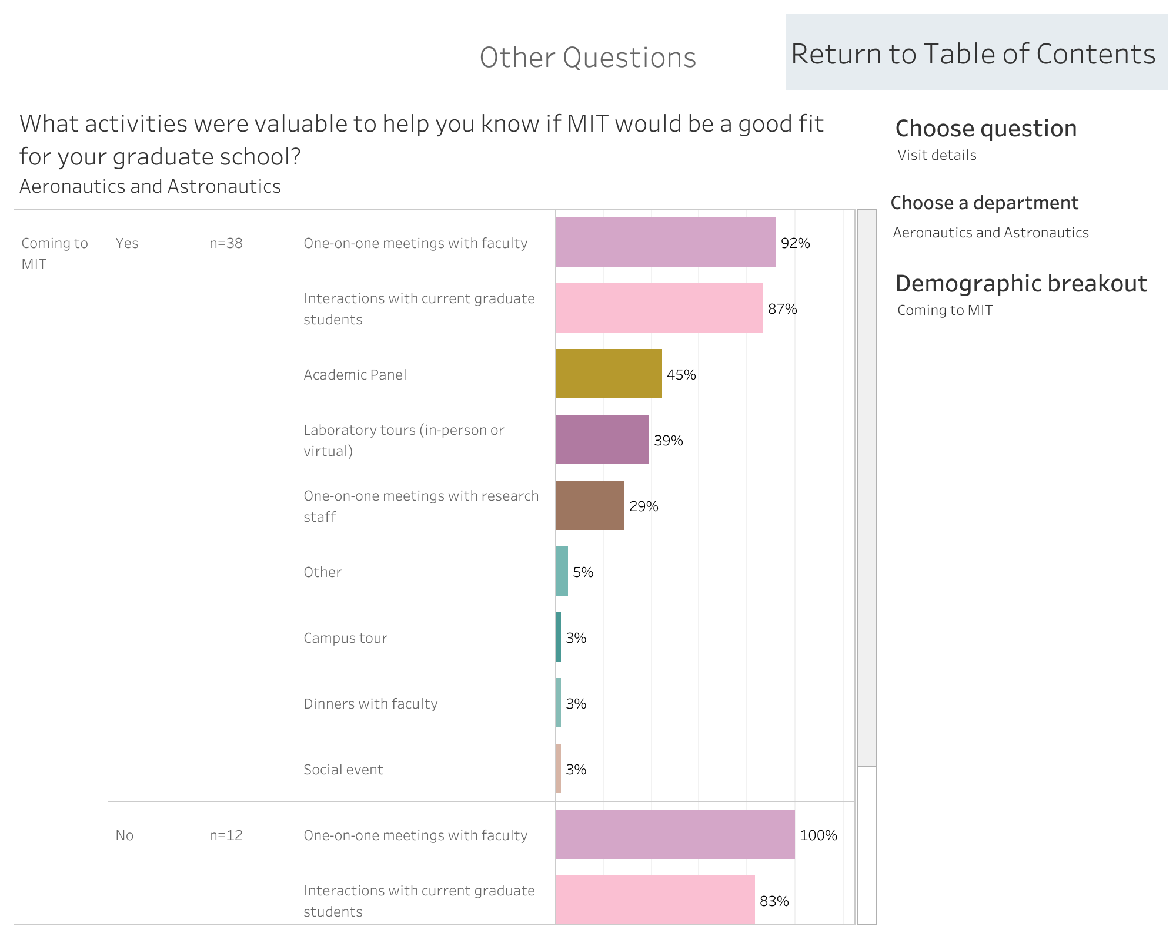
2020 GRADUATE STUDENTS SURVEY

Slide 19
2020 GRADUATE STUDENTS SURVEY - SUMMARY
Stanford and Caltech are our top ranked competitors
Things that matter
  Fit with professor or research group
  Range of research opportunities
  Specific research project
  Financial support
  Academic Reputation of the Department
  Culture or community of the Department – gender difference (males prefer us more than females)
Key influencers in making a decision (positive or negative)
  One on one meetings with faculty
  Interactions with current graduate students

