Slide 1



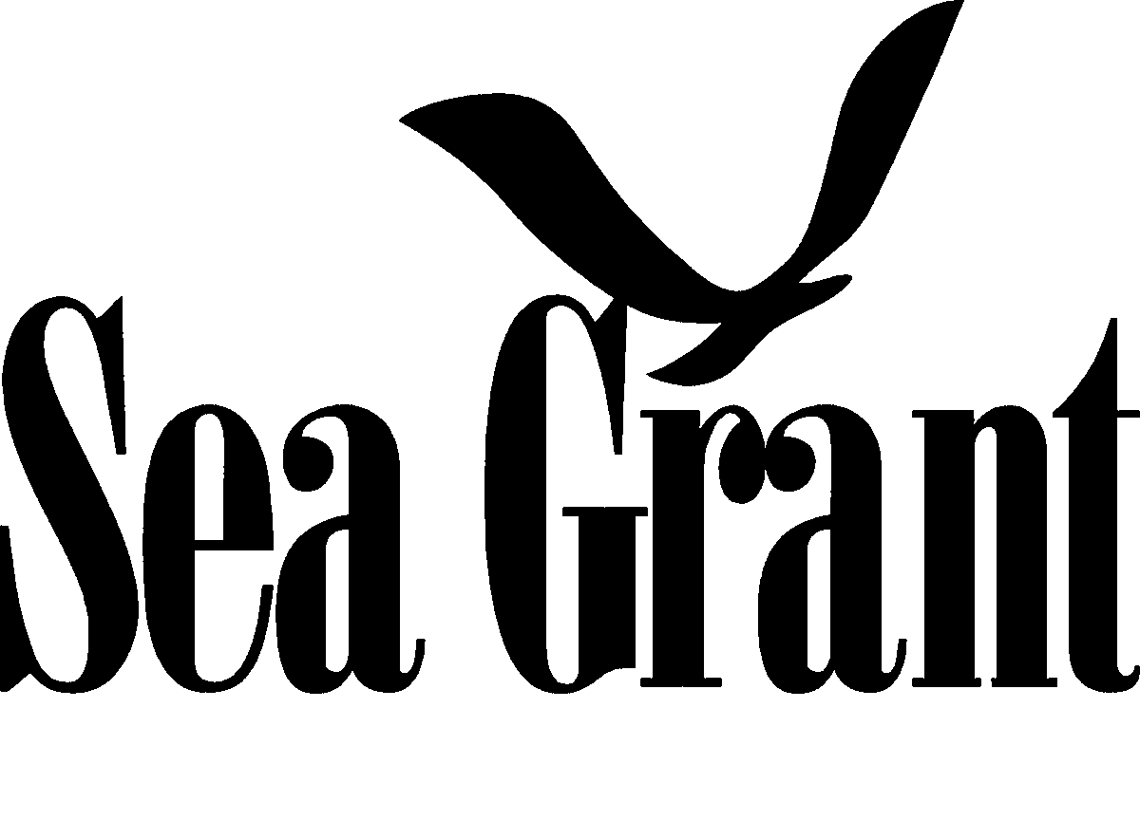
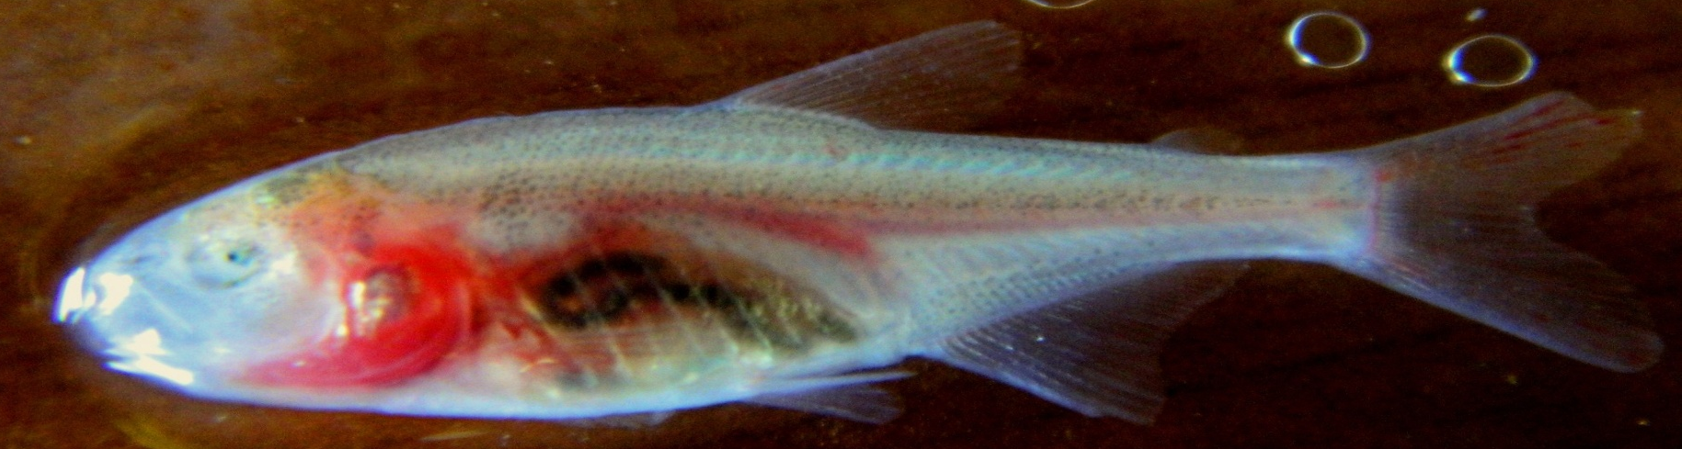
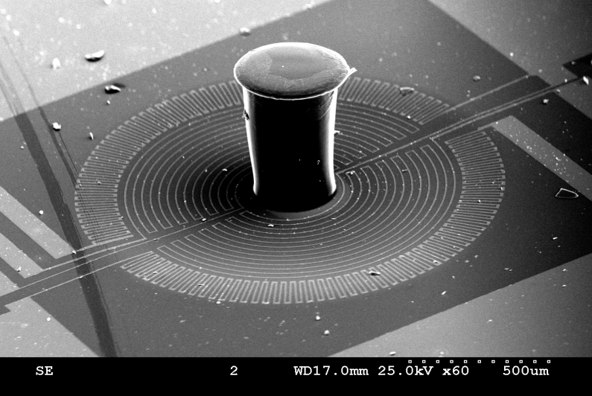
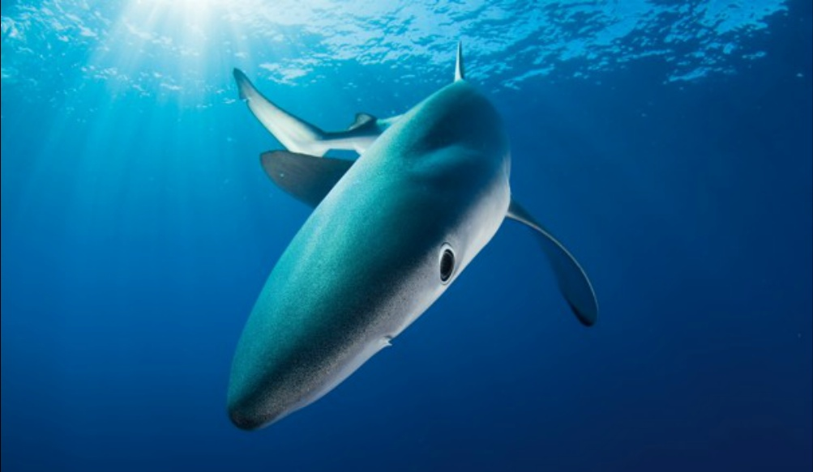
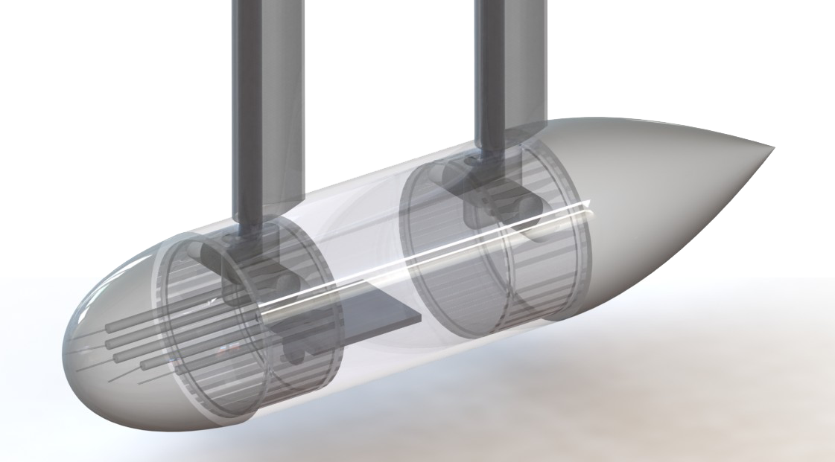
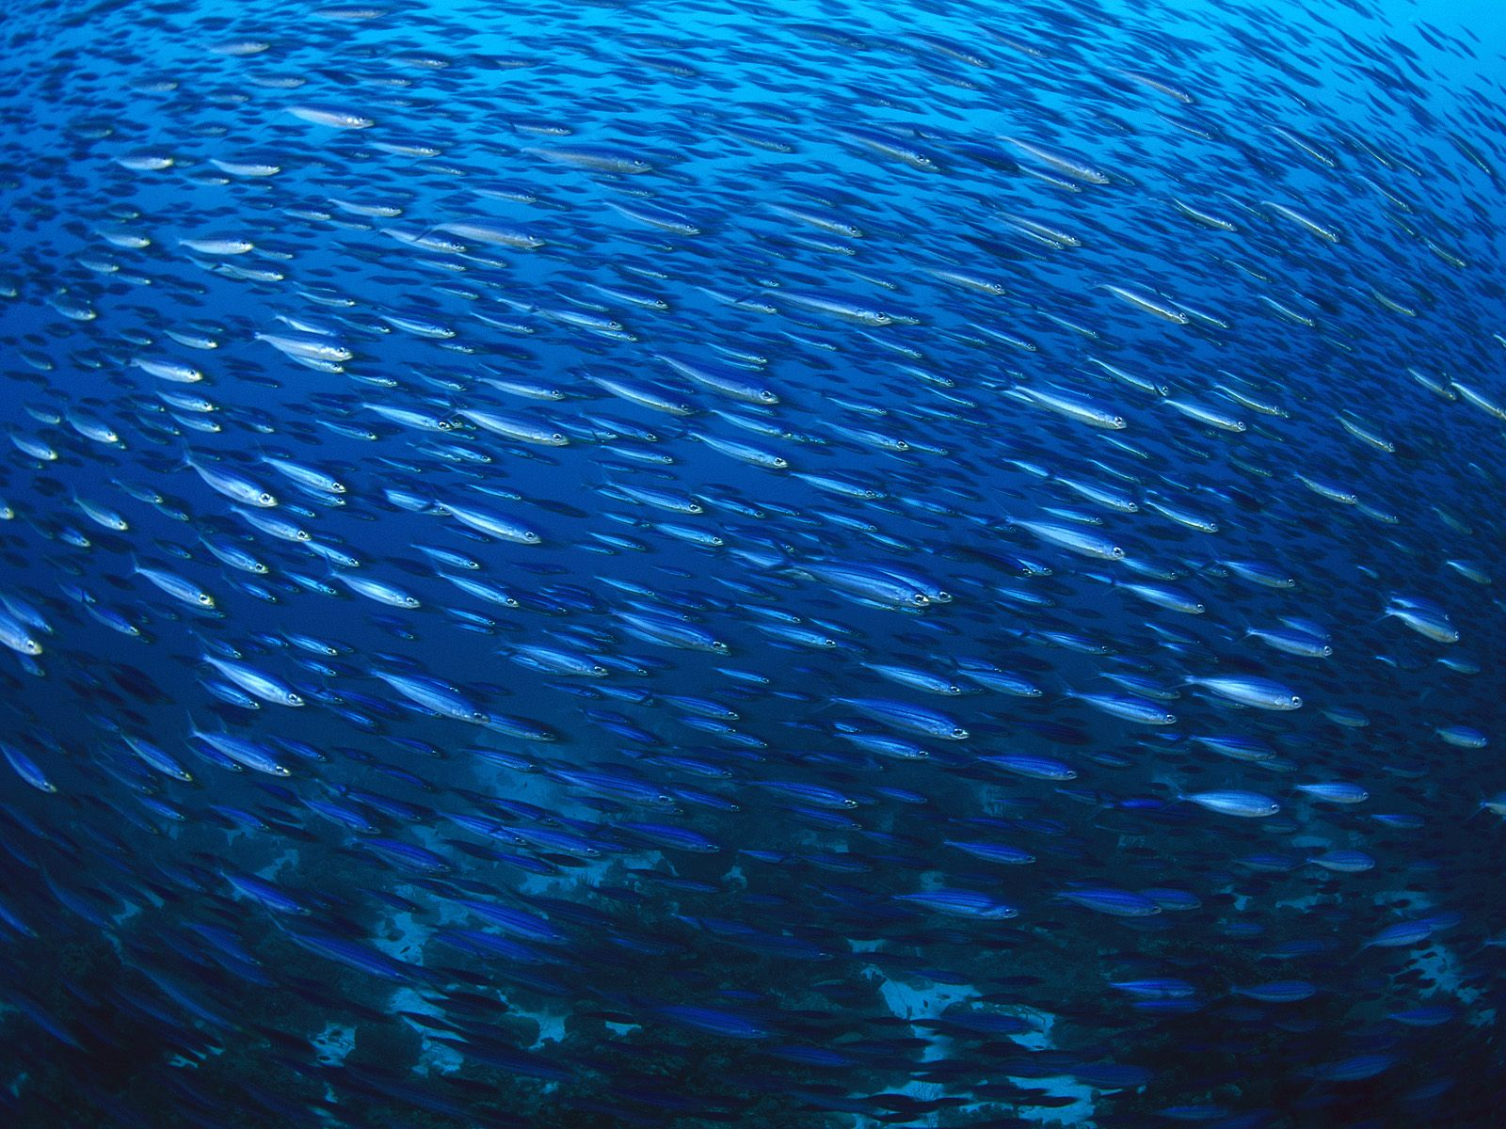
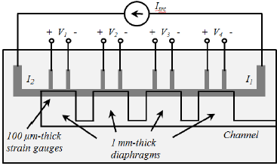
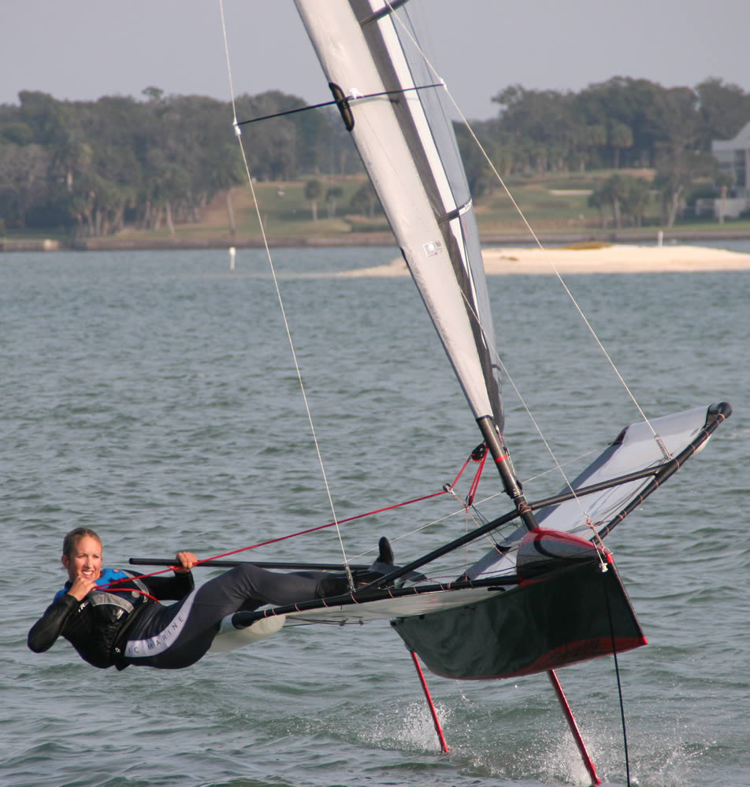
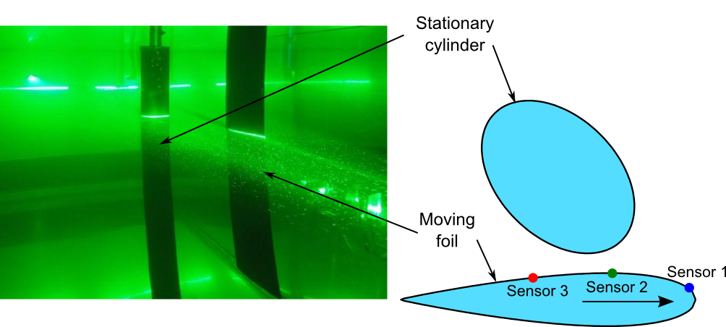
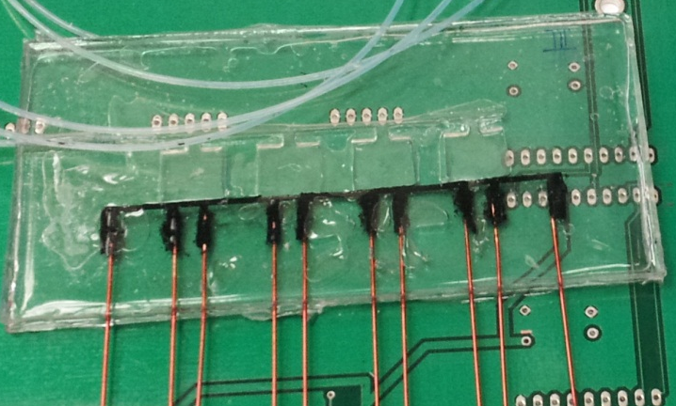
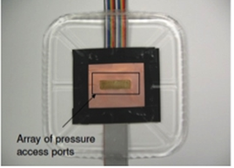
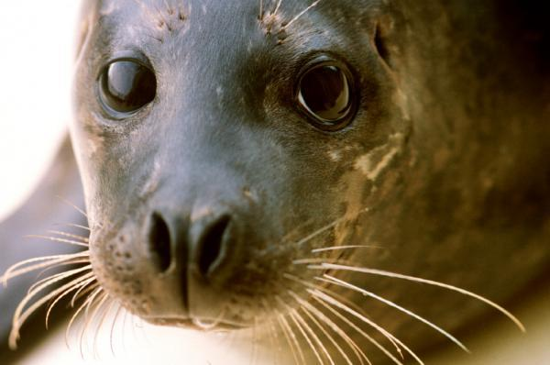
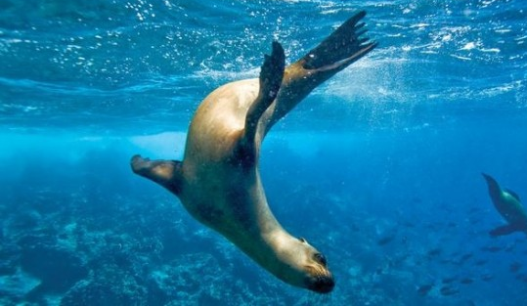
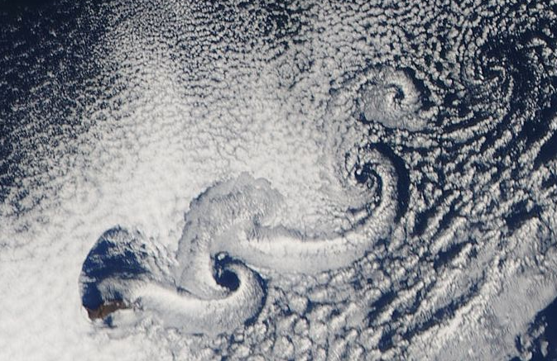
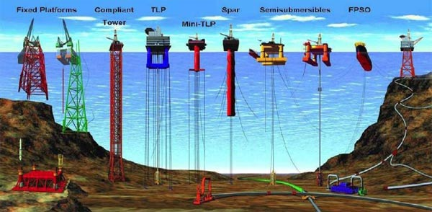
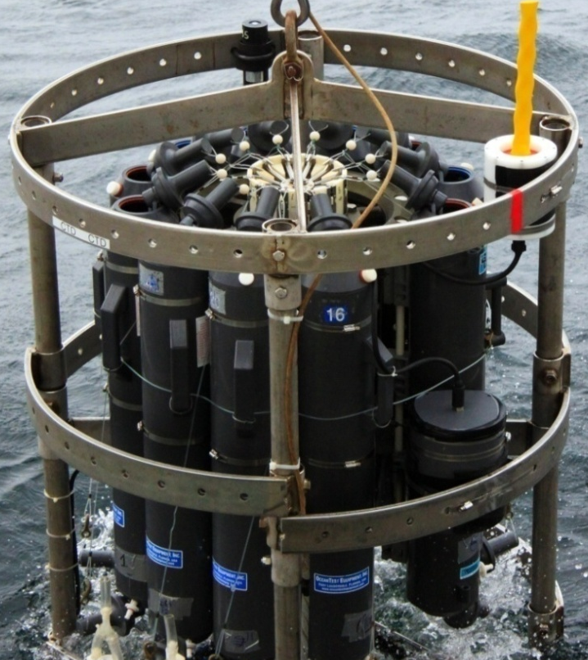
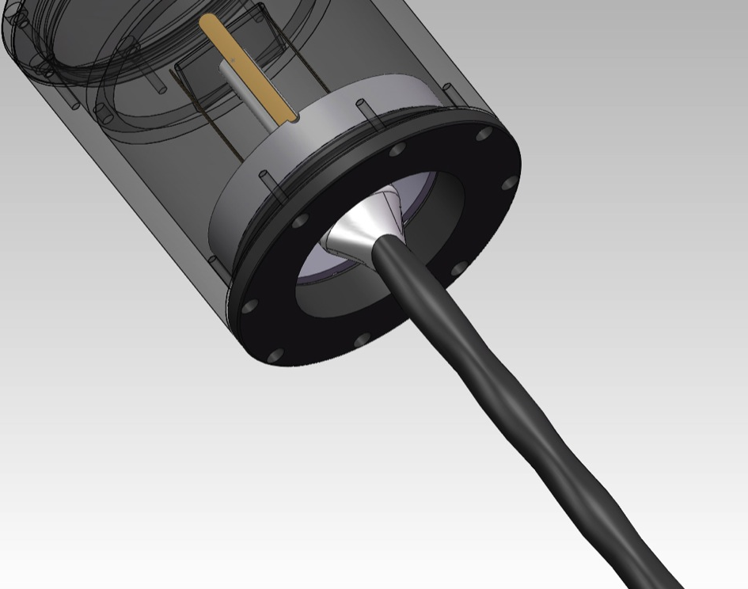
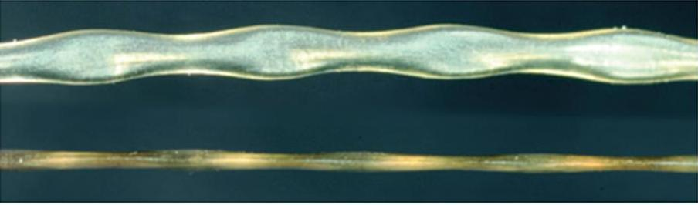
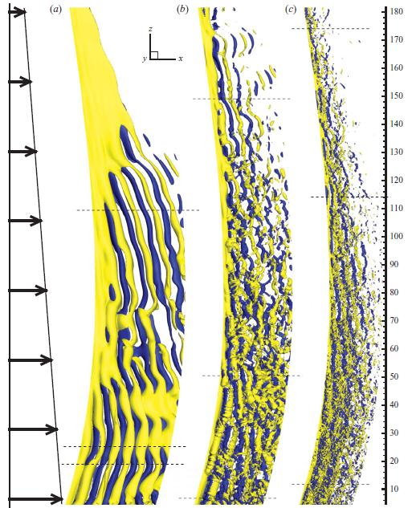
Ocean Engineering at MIT:
Hydrodynamics and Biomimetics
Lateral Line Sensing and Active Control
Fish in the wild are equipped with a unique sensory organ known as the lateral line, which allows them to detect vortical flows, identify and avoid obstacles, and maintain orientation within a school or ambient flow field. Current underwater vehicles are very limited by the lack of small, lightweight and fast sensing systems, and we aim to take inspiration from fish to develop an artificial lateral line system and relevant control algorithms.
A photograph of blind cave fish - Astyanax mexicanus fasciatus. Due to survival in dark deep caves, this fish developed an atrophied eye and pale pink skin.
SEM image of a SU-8 pillar on a Si membrane. A circuit is patterned on a diaphragm using metal strain gauges.
PIV image of fish passing a vortex
Artificial Lateral Line Sensor
The blind cave fish swims adeptly by solely relying on lateral-line neuromasts to generate hydrodynamic images of its surroundings. Such sensors could guide an AUV to navigate in a dark, unsteady and cluttered environment where sonar and vision-based systems fail. In an effort to improve the environmental awareness of maritime devices, our group is developing MEMS pressure sensor arrays based on flexible polydimethylsiloxane (PDMS), liquid crystal polymer (LCP) and LCP/PDMS substrates. These arrays have been tested on kayaks, and will be mounted on underwater vehicles in the future.
http://www.washingtonpost.com/national/health-science
Super-Maneuverability
Marine animals are experts in efficient and graceful underwater acrobatics. They maneuver effectively by both actively and passively controlling the flow around their bodies. Taking cues from the experts in the field, we seek to develop technologies for super-maneuverability of ocean vehicles through generating large transient forces, and controlling and minimizing flow separation.
Flexible LCP array
Sailing-bladerider.com
www.best-free-wallpaper.com
ScienceDaily.com
Seal Whiskers as Sensors
Harbor seals can detect the wake of a fish up to 30 seconds after it has passed. Biological experiments show that they are able to do this using their whiskers, even when auditory and visual cues have been blocked. A major challenge for AUVs is being able to intelligently assess their surroundings, and so we look to the harbor seal for inspiration. A whisker-inspired sensor would enable underwater robots to “feel” the flow.
Front of PCB sensor array
Vortex shedding near Guadelupe Island
http://www.creative-journeys.com
Various off-shore structures in use today
Vortex Induced Vibrations
VIV is a phenomenon experienced by bluff bodies in a flow. The shedding of asymmetric vortices from the bluff body results in oscillating hydrodynamic forces which act on the body and lead to vibration. The vibrations cause severe fatigue damage to structures and thereby reduce the operation life of the structures. As such, we are studying VIV of long flexible cylindrical structures and the development of VIV suppression methods.
Left: A first prototype sensor. This instrument was tested on the R/V Wecoma during the NSF Chief Scientist Training Cruise. Above: enlarged image of the harbor seal whisker geometry.

