Slide 1
Climate Change 102: U.S. and International Climate Policy Options
Wesnesday Jan 19, 2:00-4:00pm, E51-149
Jennifer Morris, Megan Lickley, Arthur Gueneau, Claudia Octavio, Tanvir Madan, and Cuicui Chen

Slide 2
U.S. and International Policy Review
Developed Countries
  United States
  Canada
  European Union
Developing Countries
  Mexico
  India
  China

Slide 3
United States

Slide 4
Climate and Energy Facts

Slide 5
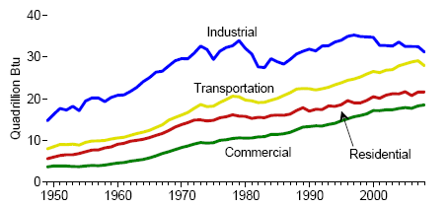
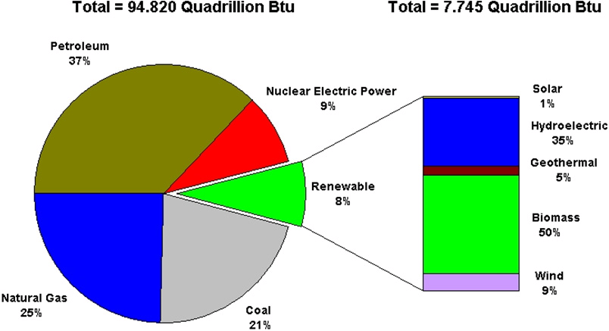
U.S. Energy Consumption by Sector
Energy
U.S. Energy Consumption by Fuel (2009)
Source: Energy Information Administration

Slide 6
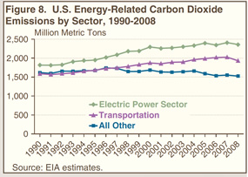
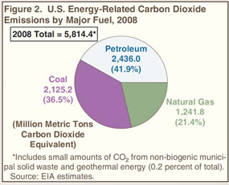
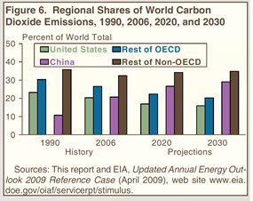
Emissions
41%
33%
26%

Slide 7
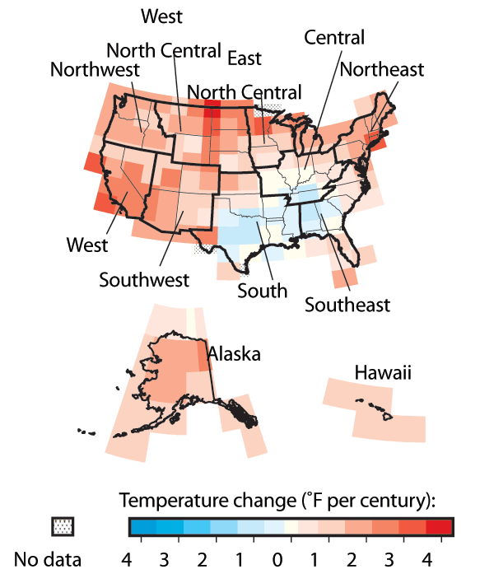
Temperature Change
Annual Mean Temperature Anomalies 1901-2005
Red shades indicate warming over the period and blue shades indicate cooling over the period.
Data courtesy NOAA's National Climatic Data Center.

Slide 8
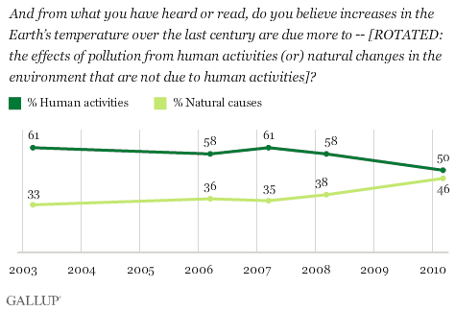
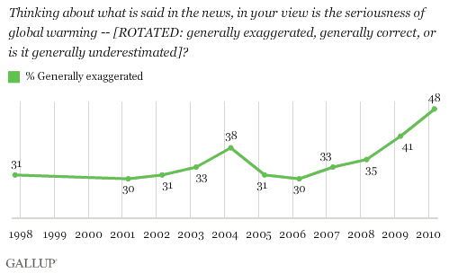
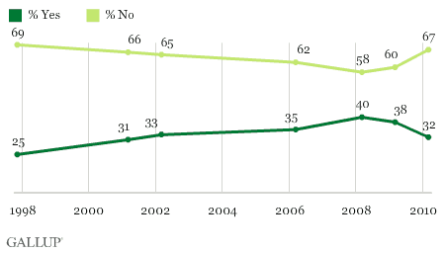
Are increases in Earth’s temperature due more to human activities or natural causes?
Public Perception
Percentage of people who think the seriousness of global warming is generally exaggerated
Do you think global warming will pose a serious threat to your or your way of life in your lifetime?

Slide 9
Domestic Climate Policies

Slide 10
Cap-and-Trade
Waxman-Markey 2009 (H.R.2454)
  Passed House of Representatives June 2009
Kerry-Lieberman 2010 (senate draft)
  Bill died in Senate
    Create Jobs vs. Hurt Business and Consumers
  In Bills:
    Reduce emissions to 83% below 2005 levels by 2050
    Renewable Electricity Standard (not in K-L, but in separate proposals)
    Energy Efficiency and Standards
    Advanced Technology Support
      Carbon Capture and Storage
      Nuclear (K-L only)
      Electric Vehicles
      Smart Grid
    Revenue goes to: electricity and natural gas consumers, low-income households, energy-intensive industries, lump sum rebates to households, deficit reduction, etc.

Slide 11
Allowance Allocation: Congressional Bills
2008 level
50% below 1990
80% below 1990

Slide 12
CO2-e Price and Welfare Change under Cap-and-Trade
287 bmt = hold emissions at 2008 levels
203 bmt = reduce emissions by 50% below 1990 level by 2050
167 bmt = reduce emissions by 80% below 1990 levels by 2050

Slide 13
Renewable or Clean Energy Standard
Require that a certain percentage of total electricity come from renewables or clean technologies
American Clean Energy Leadership Act (ACELA) (S.1462)
  Sponsored by Senator Bingaman
  Passed out of the Senate Energy and Natural Resources Committee
  Provisions related to increased energy production, energy efficiency, renewable energy standards, technology research and development, energy market stabilization, and transmission network improvements, among others
Practical Energy and Climate Plan Act (S.3464)
  Sponsored by Senator Graham
  Diversified Energy Standard (DES): includes qualifying CCS and nuclear and leaves room for any technology that reduces emissions by 80% relative to conventional sources

Slide 14
EPA Regulation
Massachusetts v. EPA, April 2007
  Concerning mobile sources of GHGs
  Supreme Court found that GHGs are air pollutants covered by the Clean Air Act. EPA had to determine if dangerous, and if dangerous must regulate
Endangerment Finding, Dec. 2009
  6 GHGs threaten the public health and welfare of current and future generations
  → EPA required to regulate GHGs from mobile and stationary sources
Regulations moving forward
  Raise corporate average fuel economy to 35.5 miles per gallon by 2016.
  Monitoring and reporting of emissions by entities emitting at least 25,000 tons per year
  Permitting for large stationary sources (emit at least 25,000 tons per year)
    Must obtain construction and operating permits that demonstrate the use of best available control technologies (BACT) and energy efficiency measures to minimize GHG emissions
    Applies to the approximately 14,000 large businesses that emit 70-85% of national GHGs
Legal and Administrative Nightmare!
  Thousands of entities to monitor
  Lawsuits, lawsuits everywhere!
  What is BACT? (ex. for coal power plant: IGCC? co-firing? CCS?
Incentive to pass legislation in Congress instead???

Slide 15
Existing Alternative Energy Incentives
Production Tax Credits (PTC)
Option to take ITC in lieu of PTC
Option to take cash grant in lieu of ITC (ends in 2011)
  Tax bill: 1 year extension of cash in lieu of ITC, and ethanol excise tax exemption and tariff, and PTC for biodiesel
Resource Type | In-Service Deadline | Credit Amount
Wind | December 31, 2012 | 2.2¢/kWh
Closed-Loop Biomass | December 31, 2013 | 2.2¢/kWh
Open-Loop Biomass | December 31, 2013 | 1.1¢/kWh
Geothermal Energy | December 31, 2013 | 2.2¢/kWh
Landfill Gas | December 31, 2013 | 1.1¢/kWh
Municipal Solid Waste | December 31, 2013 | 1.1¢/kWh
Qualified Hydroelectric | December 31, 2013 | 1.1¢/kWh
Marine and Hydrokinetic (150 kW or larger) | December 31, 2013 | 1.1¢/kWh
Nuclear (up to 6,000 MW of new nuclear) | December 31, 2021 | 1.8¢/kWh
Investment Tax Credits (ITC)
Resource Type | In-Service Deadline | Credit Amount (share of capital cost)
Solar, fuel cells, small wind (100 kW or less) | December 31, 2016 | 30%
Geothermal, microturbines, CHP | December 31, 2016 | 10%
PTC-eligible geothermal and biomass | December 31, 2013 | 30%
Wind of all sizes | December 31, 2012 | 30%

Slide 16
Existing Alternative Energy Incentives
Modified Accelerated Cost-Recovery System
  Accelerated depreciation for all ITC-eligible projects in place by December 31, 2010 (tax breaks)
DOE Loan Guarantees (ends Sept. 30, 2011)
  Biomass, hydrogen, solar, wind, hydropower, advanced coal, CCS, electricity delivery and reliability, alternative fuel vehicles, industry energy efficiency, pollution control equipment, and nuclear
Government R&D
  ARPA-E: $400 million from Recovery Act
  Innovation Hubs: Solar, Efficient Building, Nuclear Reactor Modeling and Simulation
  USDA programs for electricity generation, transmission and distribution in rural communities

Slide 17
Current Environment
Failure of major climate/energy legislation
Economic Situation
  Recession
    Jobs
    Deficit (budget pressure)
Political Situation
  Democrats lose House
  Reduced majority in Senate
→ Broader energy/climate legislation unlikely
→ Piecemeal EPA regulations likely

Slide 18
International Negotiations
Demand commitments (and monitoring) by major developing countries, especially China
At Copenhagen agreed to contribute significantly to technology transfer fund for developing countries
Difficulty of getting Congressional approval of any international agreement
Bilateral agreements possible

Slide 19
Canada

Slide 20
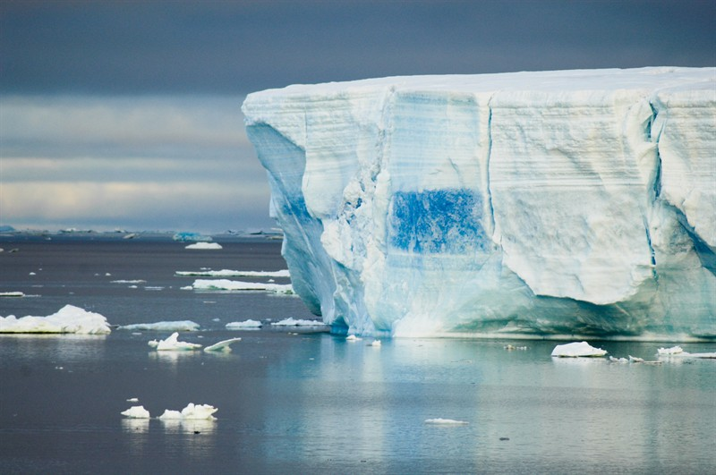
CANADA

Slide 21
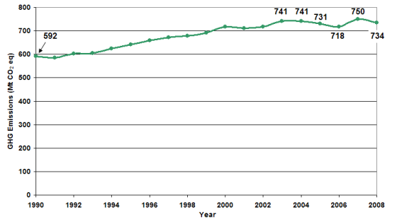
Canada's GHG Emissions 1990-2008

Slide 22
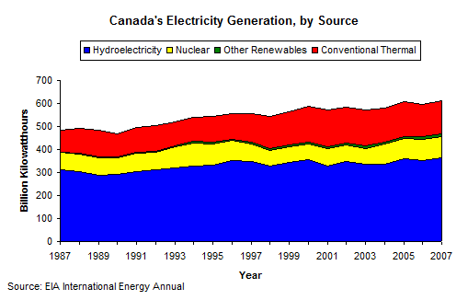
Notes:
canada is the world's largest producer of hydroelectricity

Slide 23
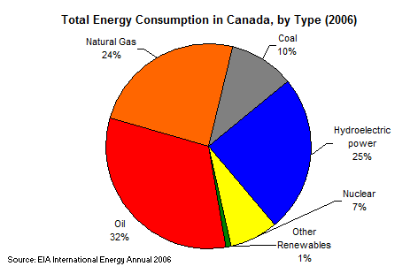
Notes:
coal, we exported 27 Metric Tonnes mostly to Asia, import about half that from the US
natural gas- produces about 7 trillion cubic feet a year, consumes about half that and supplied the US with 85% of its natural gas imports

Slide 25
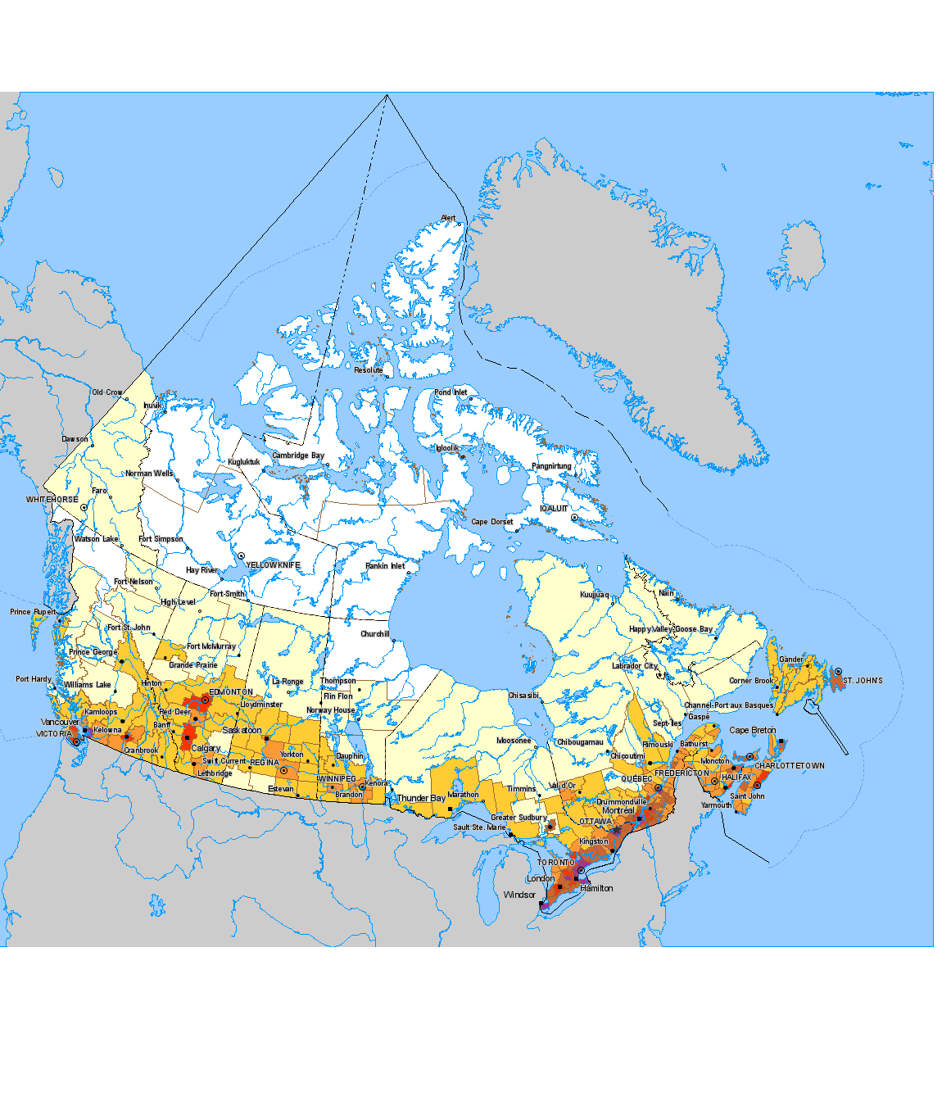
Density Map of Canada

Slide 26
Canadian's Current Climate Policies
Notes:
On Nov. 16, the Senate of Canada voted to defeat Canada's only piece of federal climate change legislation, Bill C-311 - The Climate Change Accountability Act. This legislation passed twice in the House of Commons, the first time in 2008 and the second time in May 2010.

Slide 27
Canada in International Negotiations
Canada is the only country to renounce its commitments under the Kyoto Protocol, calling them "impossible." -David Suzuki Foundation
Copenhagen: embarrassment
"Canada recognizes that climate change is a global challenge requiring a global solution. ... Our government has inscribed in the Copenhagen Accord an economy-wide emissions reduction target for 2020 of 17 percent below 2005 levels, a target which is aligned with the United States target.
On June 23rd, 2010 Canada announced that it is contributing $400 million in new and additional climate change financing for the 2010-2011 fiscal year.
it is important to ensure that our principles, policies, regulations and standards are aligned with those of our largest trader partner- the US." -Environment Canada's Website
Notes:
Kyoto: Canada had agreed on reducing emissions 6% below 1990 levels. We're now 26% above

Slide 28
Government of Canada's Economic Action Plan
Investing $795 million over five years in clean energy technologies R&D. This includes:
    large-scale carbon capture and storage demonstration projects which have already begun totalling $466 million
    smaller-scale demonstration projects of renewable and alternative energy technologies

Slide 29
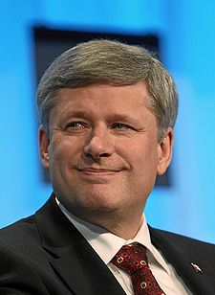

Peter Kent's Green Agenda: Clean up oil sands' dirty reputation

Slide 30
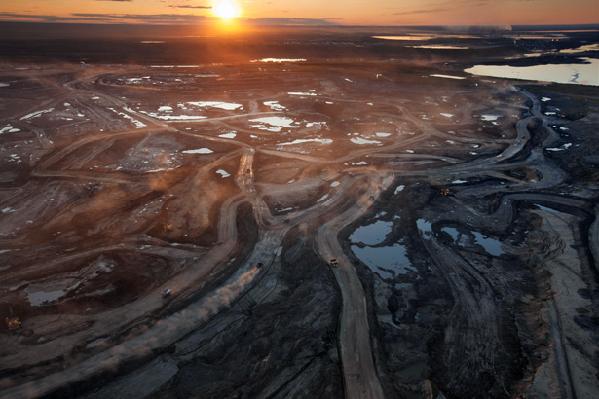
Notes:
pipeline
provincial divide

Slide 31
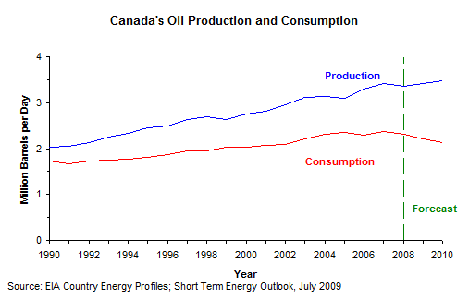
Notes:
Canada sends 99 percent of its crude oil exports to the US

Slide 32
Talking to Canadians
Most talked about
  climate change
  state of the global economy
  environmental problems
  extreme poverty and hunger
  terrorism
Extremely serious global problem:
72%- extreme poverty
65%- environmental problems
64%- armed conflict
54%- corruption and human-rights abuses
49%- climate change

Slide 33
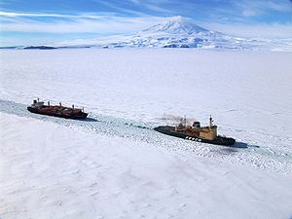
Effects of Climate Change on Canada
Notes:
oil and gas exploration
dispute over land
permafrost
less cold related deaths
polar bears
agriculture
tree survival
cultural aspects dependent on winter
winter tourism

Slide 34
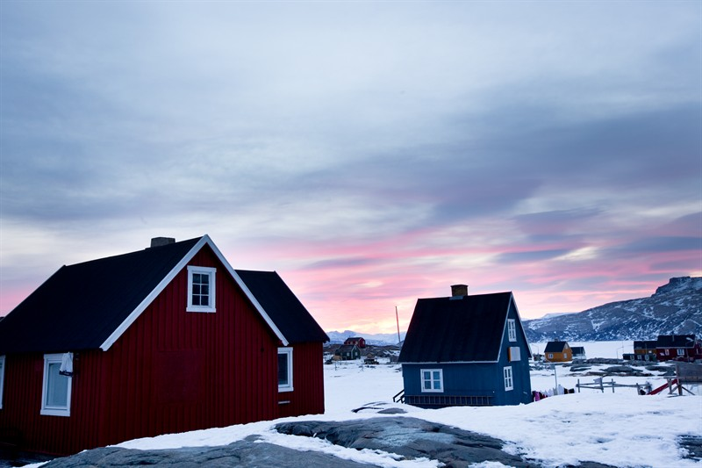

Slide 35
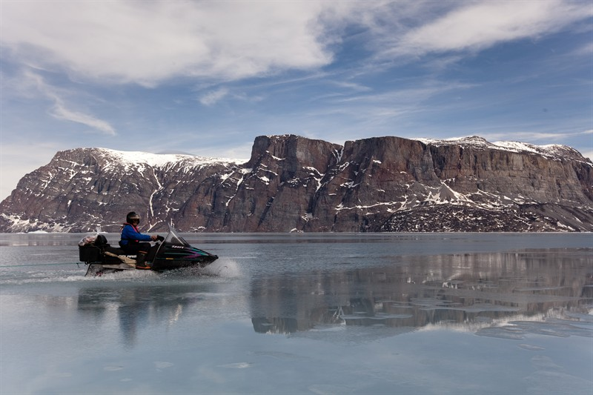
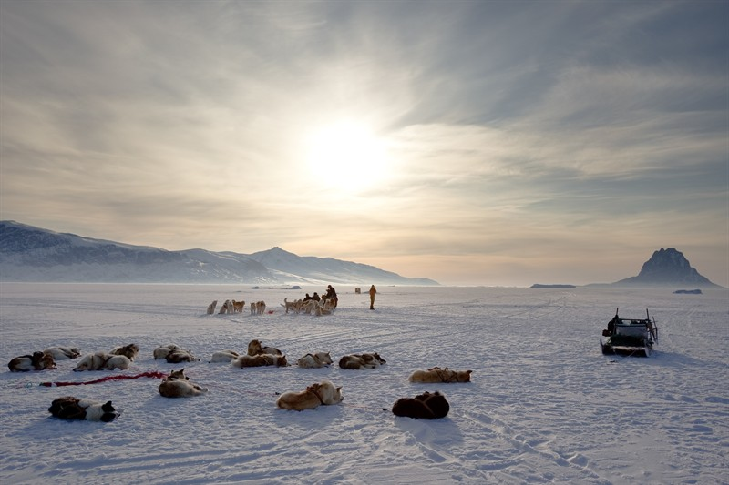

Slide 36
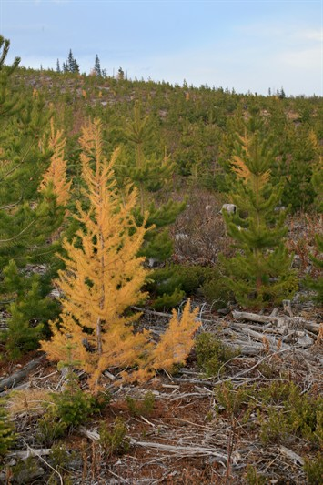

Slide 37
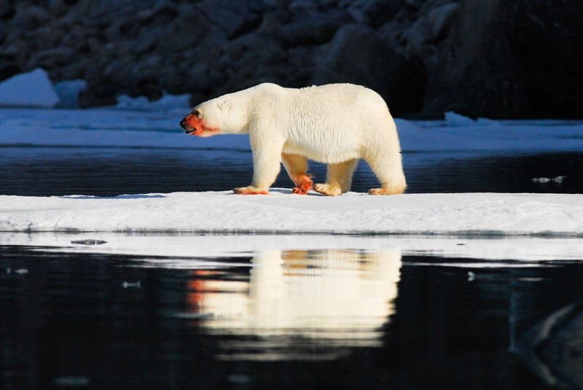

Slide 38
European Union

Slide 39
Climate and Energy facts

Slide 40
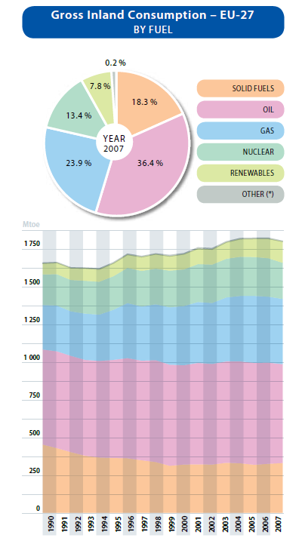
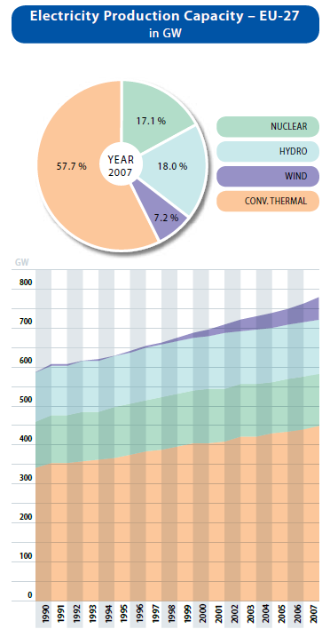
European Energy Portfolio
Source: European Commission

Slide 41
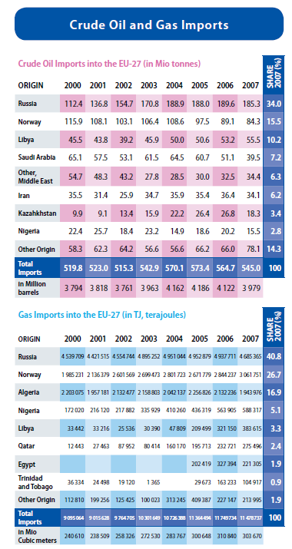
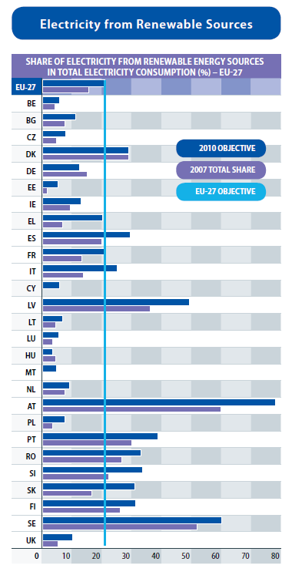
European Energy Portfolio
Source: European Commission

Slide 42
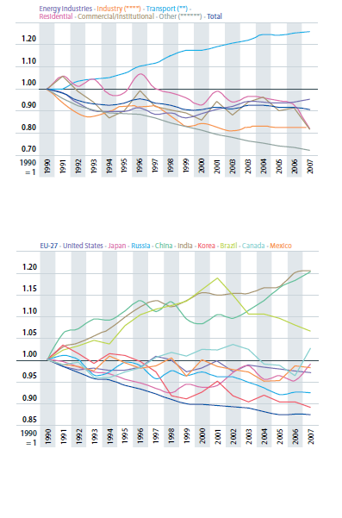
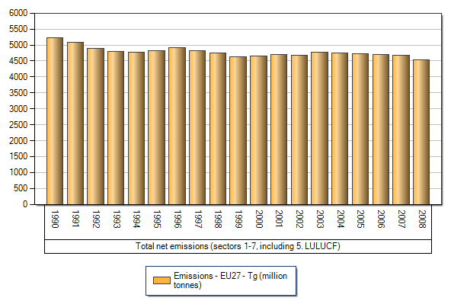
European GHG emissions
Evolution of GHG emissions per sector
Source: EEA
Evolution of carbon intensity of energy in the world
Source: European Commission

Slide 43
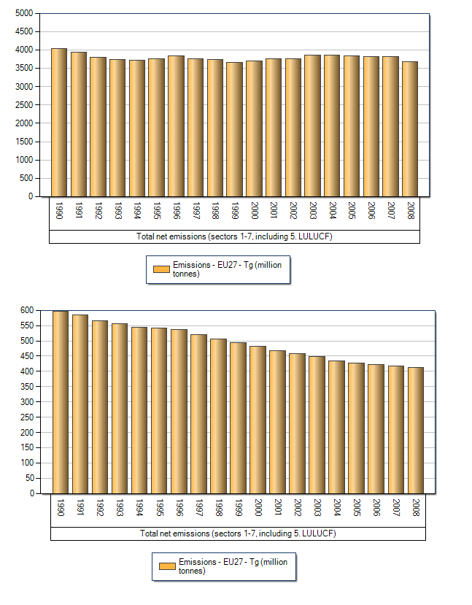
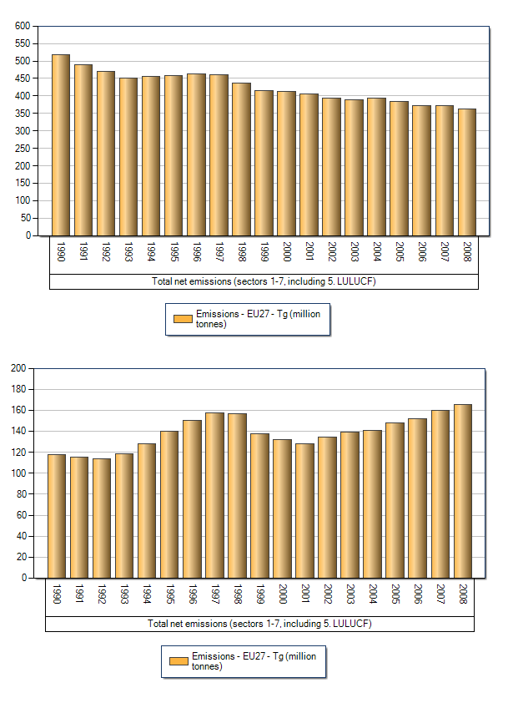
European GHG emissions
CO2
N2O
CH4
Fluorinated
gases
Source: EEA

Slide 44
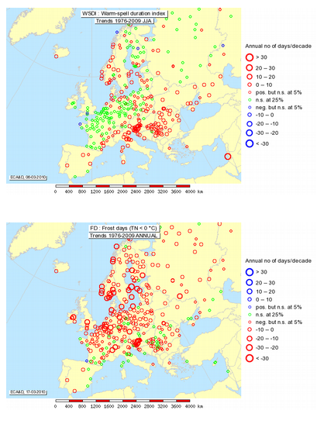
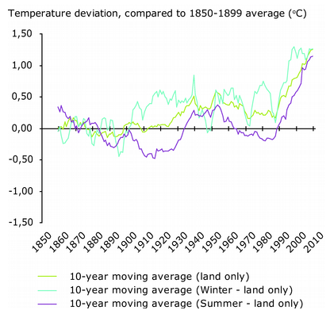
European Climate Evolution
Source: EEA

Slide 45
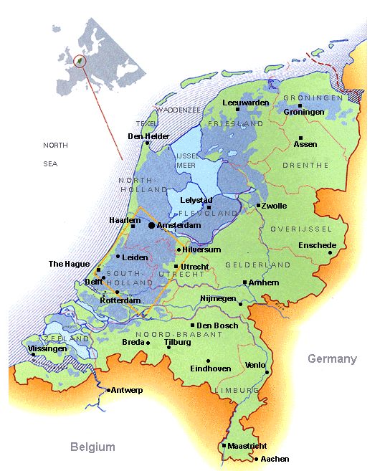
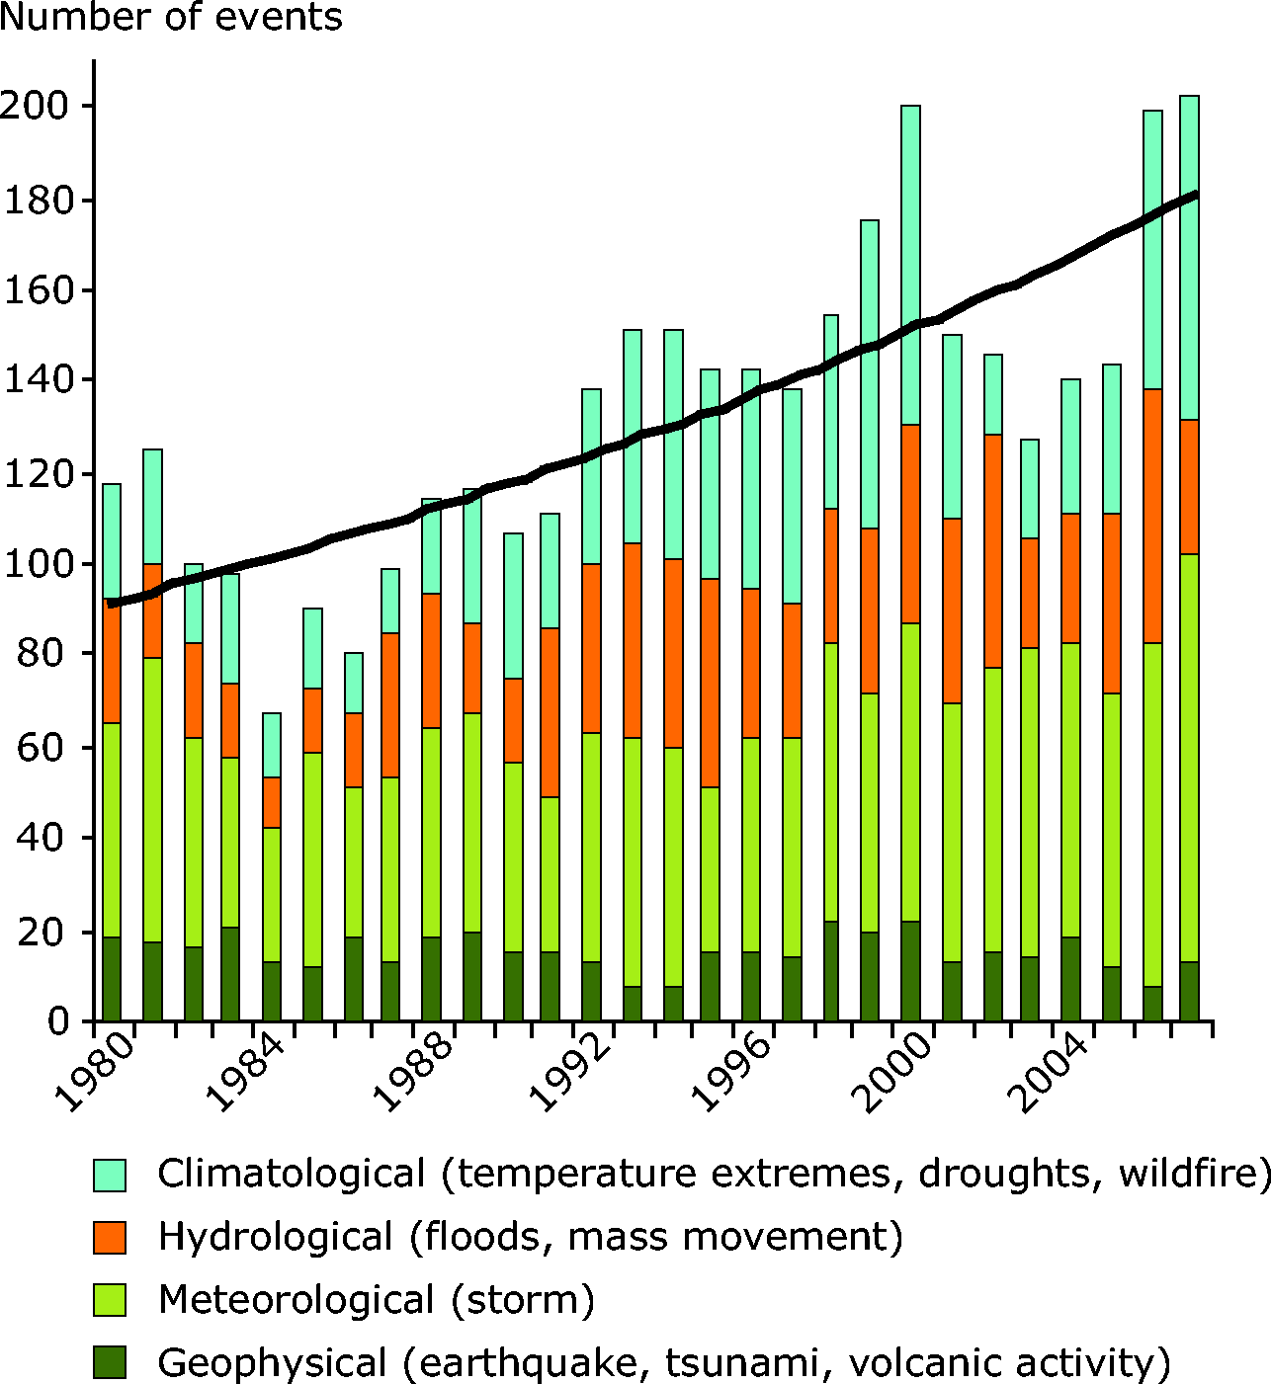
Climate Disasters
Source: Munich Re

Slide 46
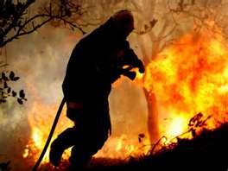
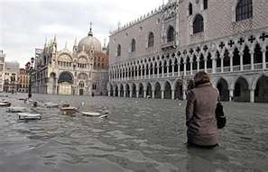
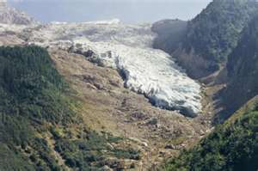
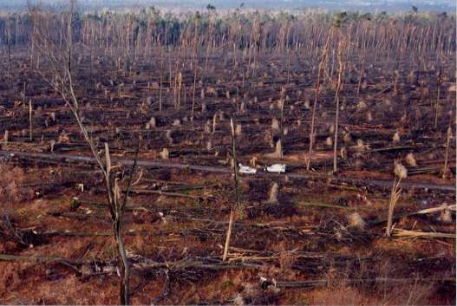
Climate disasters (2)

Slide 47
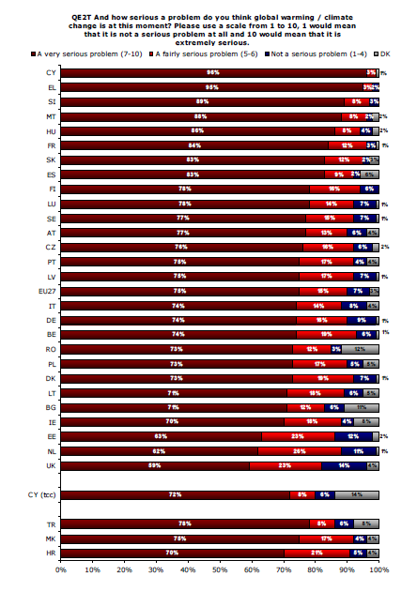
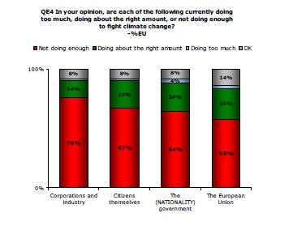
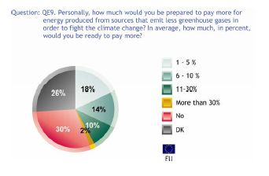
Public Opinion
Source: Eurobarometer 2008

Slide 48
Domestic climate policies

Slide 49
Mitigation Policies
The 20-20-20 targets for 2020:
  Reduce GHG Emissions by 20%
    ETS cap-and-trade + national policies
    Creation of a legislative framework for CCS
  Get 20% of energy from renewable sources
    National goals + fund for clean technologies
  Reduce primary energy use by 20% (energy efficiency)
    EU energy efficiency action plan to come soon

Slide 50
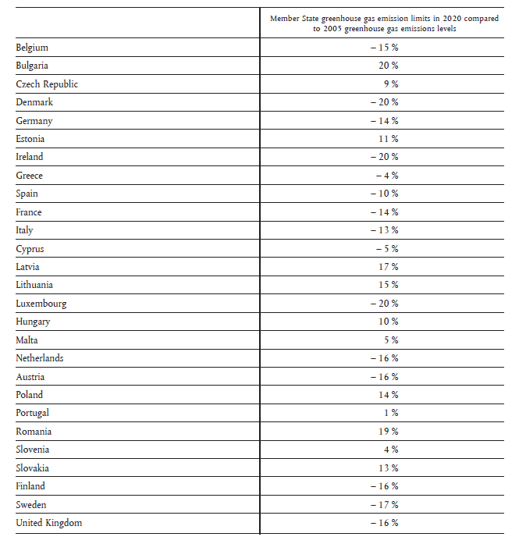
Mitigation Policies: ETS
Cap-and-Trade mechanism
2005, 30 countries, 40% of all GHG emissions (50% in 2012 with airlines)
All industrial sources of GHG
Allocations down by 21% in 2020 => Kyoto target (down 30% if global agreement on climate policy)

Slide 51
Adaptation Policies
White Paper released in 2009
Key sectors:
  Health Impacts
  Agriculture and Forests
  Biodiversity, Ecosystems and Water Resources
  Coastal and Marine Areas
  Infrastructure and Production Sector
  Emergency Services
Every country needs an adaptation plan by 2012

Slide 52
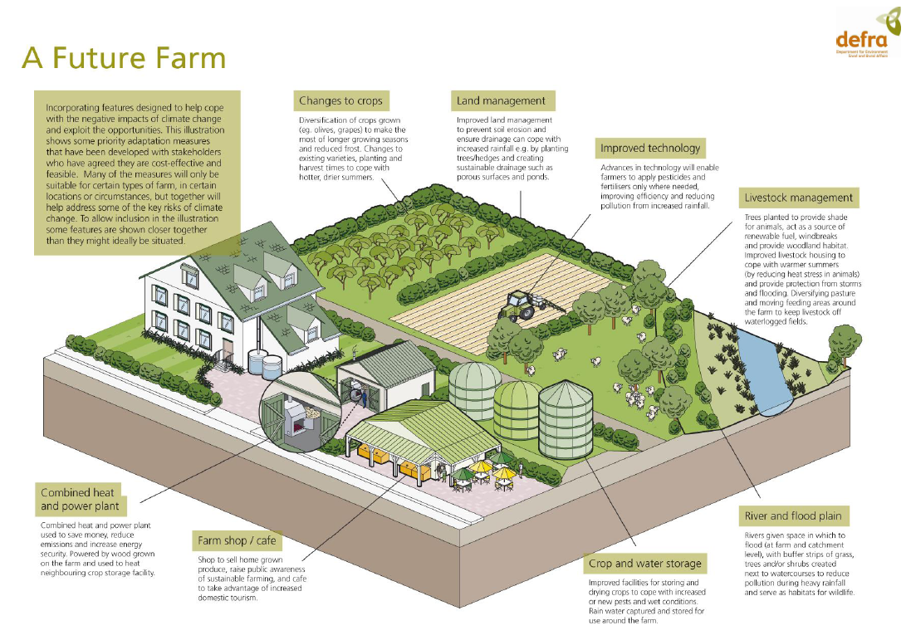
Adaptation Policies (2)
Source: DEFRA (UK Department for Environment Food and Rural Affairs)

Slide 53
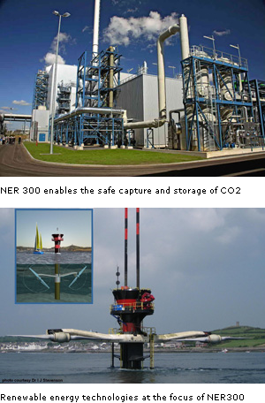
Alternative Energy Technologies
NER 300:
  Fund for demonstration plants
  First call in Nov 2011
  Around 9 billion Euros
  Renewable energy projects
  CCS demonstration plants
Lots of initiatives at the national level (to meet the renewable energy targets)
Source: EU DGCLIMA

Slide 54

Major Actors
General consensus
Effort sharing help Eastern Europe countries to agree
Green parties and ecological movements are very powerful (participated to some governments)
46 European Parliamentary members

Slide 55

Major Barriers
Some industry reluctance
Fear of a clean energy bubble
Economic crisis
Feeling that we’re alone in the world…

Slide 56
International Climate Policies

Slide 57
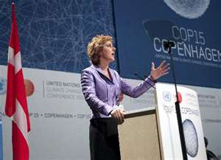
Past Negotiations
Copenhagen:
  Push for a very ambitious accord
  Commitment to 20% and 30% if global deal
  Put on the side of the negotiation
Cancùn:
  Rather passive role
  Internal division on the 30% target

Slide 58
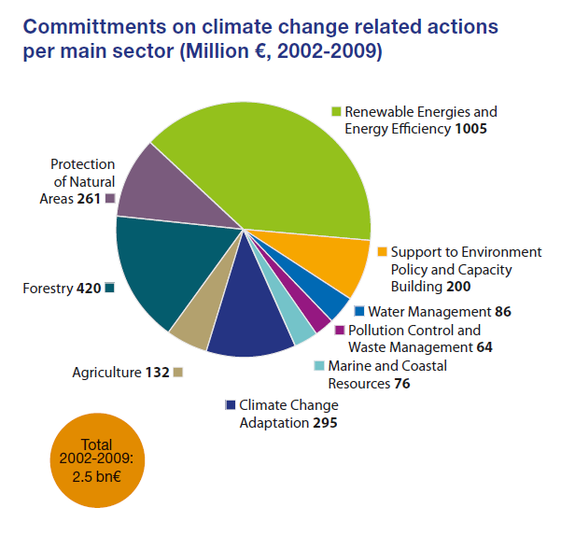
International Cooperation
€ 7.2 billion over the period 2010-2012 for the fast-start fund
Global Climate Change Alliance (existing fund)
Global Energy Efficiency and Renewable Energy Fund €100 million for developing countries
Source: European Commission

Slide 59
Mexico

Slide 60
Energy consumption, 2008
Canada
US
Norway
Australia
Korea
France
Germany
Japan
*South Africa
Spain
UK
Mexico
Italy
*China
*Indonesia
*Brazil
*India
* For 2007
* *PPP dollars
Fuente: OECD

Slide 61
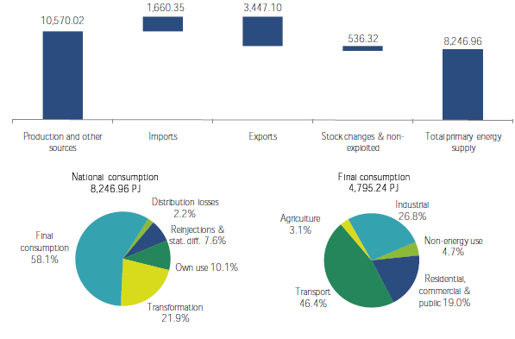
National Energy Balance 2009, PJ

Slide 62
Electricity generation 2010

Slide 63
Energy international trade

Slide 64
GHG emissions inventory
SEMARNAT-INE (2002). National Greenhouse Gas Inventory 1990-2002. Report from Mexico

Slide 65
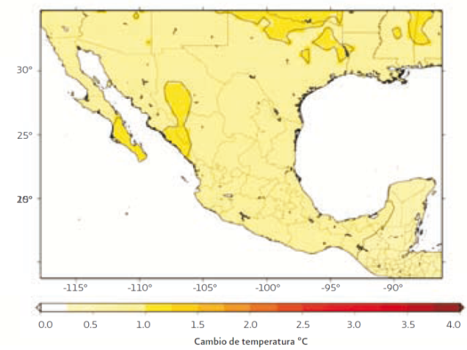
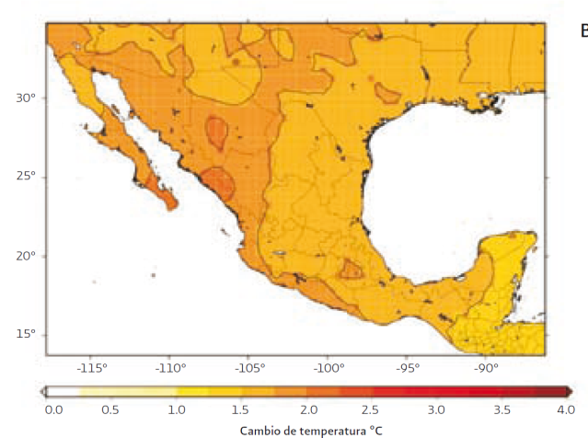




Change in Surface Temperature (°C)
Scenario A2
2020
2050
2080
Change in Precipitation (%)
Scenario A2
2020
2050
2080
Fuente: SEMARNAT “México. Cuarta Comunicación Nacional ante la Convención Marco de las Naciones Unidas“, 2010.

Slide 66

Future Consequences of Climate Change in Mexico
Change in soil aptitude for rain-fed corn
2005
2020
Scenario A2
HADLEY MODELO
Fuente: SEMARNAT “México. Tercera Comunicación Nacional ante la Convención Marco de las Naciones Unidas“, 2006.

Slide 67



Future Consequences of Climate Change
in Mexico. Most vulnerable coastal areas
Estimated impacted area with a potential 1m slr
State
km²
%
Fuente: UNAM, Ciencias de la Atmósfera y SEMARNAT
“México. Cuarta Comunicación Nacional ante la Convención
Marco de las Naciones Unidas“, 2010.
Notes:
ine:
http://cambio_climatico.ine.gob.mx/index.html
Zonas Costeras:
Las zonas costeras vulnerables se localizan principalmente en el Golfo de México y en le Mar Caribe. En las zonas mas vulnerables las costas pueden ser cubiertas hasta una distancia de 40-50 km tierra adentro.
Las zonas que presentan mayor vulnerabilidad son en Tamaulipas la laguna deltaica del río Bravo, en Veracruz la Laguna de Alvarado y el río Papaliapan, en Yucatán, los Petenes, y en Quintana Roo la bahía de Sian Kaán y Chetumal, debido principalmente a que la maypria de las costas del Golfo y Mar Caribe son bajas y se encuentras a menos de un metro sobre el nivel del mar. (Estudios de vulnerabilidad, zonas costeras, ine)
Además se de afectar al sector turismo el cual es muy importante en la economía del país

Slide 68

Special Climate Change Program
Source: SEMARNAT, 2009
Notes:
By 2012 the mitigation goal is 51 MtCO_{2e} (about 8% of total emissions)
Measures grouped in 12 action lines
If sufficient financial and technical support is available, Mexico could reduce up to 30% of its emissions by 2020
By 2050, Mexico could reduce emissions up to 50% with respect to 2000, conditioned to finantial support

Slide 69
Mitigation by sector, 2008-2012
Measures (selected) | CO2e
Reinjection of sour gas in Cantarell | 27.6
Sustainable Forest Management (2.95 ha) | 11.88
REDD incentives | 8.97
Landfill sites with controlled methane combustion or energy generation | 7.56
Environmental services payments program (additional 2.175 million ha) | 6.27
Operational efficiency in PEMEX | 4.96
Energy savings, new household appliances | 4.73
Wildlife conservation management units (additional 2.5 million ha) | 4.19
Increased use of rail for freight transport | 3.9
Cogeneration | 3.77
Renewable energy (self-supply) | 3.65
Wind power | 2.4
Green buildings | 2.1
Efficient wood burning stoves | 1.62

Slide 70

Wind potential in Mexico

Slide 71

State programs, special emphasis on adaptation
Vulnerability assessments
Land use management measures
Natural disasters programs (review of experiences and resources gap)

Slide 72
Main challenges
Financing. In particular of higher upfront costs of measures with high investment costs
Enforcement of policies and programs
Limited institutional capacity in some sectors
Political struggle between agencies
Incomplete legal framework
Limited opportunities for private sector participation (lack of incentives, uncertainty)

Slide 73


TIMELINE
of international action
on climate change
First World Climate Conference
IPCC Intergovernmental Panel on Climate Change
UNFCCC United Nations Framework Convention on Climate Change
COP & CMP. Conferences of the Parties
of the UNFCCC and the Kyoto Protocol
1979
1988
MEXICO signed the UNFCCC
IPCC Events & REPORTS
1992
1992
UNFCCC enters into force
1994
COP 3. KYOTO PROTOCOL
1990
1997
MEXICO The 1st National Communication is presented
1997
MEXICO The 2nd National GHG National Inventory
1995
1998
MEXICO Ratifies the Kyoto Protocol
2000
COP 7. MARRAKESH ACCORDS
2001
MEXICO The 2nd National Communication is presented
2001
2001
2005
Kyoto Protocol enters into force
MEXICO The 3rd National Communication is presented
2006
COP 13 & CMP3. BALI ROADMAP
2007
2007
MEXICO Published the National Strategy on
Climte Change
2007
MEXICO Presents the Special Program on
Climate Change
Sets a 50% reduction goal for 2050
2009
2010
MEXICO hosts COP16 in Cancun
SOURCE: Mario Molina Center from UNFCC reports

Slide 74
Position in COP 16
Developing countries
Mexico supports strengthening of National Appropriate Mitigation Actions (NAMA’s) by developing countries within the sustainable development and poverty eradication context, as well as the adequate financial and technological support.
In accordance with the country position regarding the National Appropriate Mitigation Actions (NAMA’s), these should:
  Be voluntary, non binding and should correspond with each country capabilities
  Reflect aspects of responsibility, capacity, mitigation potentials and national circumstances.
  Have an actions monitoring, reporting and verification (MRV) system that respects countries sovereignty

Slide 75
India

Slide 76

Energy Facts
With high economic growth rates and over 15 percent of the world’s population, India is a significant consumer of energy resources.
In 2009, India was the fourth largest oil consumer in the world, after the United States, China, and Japan.
India is now the 3rd largest consumer of Coal in the world after the US and China.
India is the 5th largest consumer of Electricity – after the US, China, Japan and Russia.
In recent years, India’s energy consumption has been increasing at one of the fastest rates in the world due to population growth and economic development. Despite the overall increase in energy demand, per capita energy consumption in India is still very low compared to other developing countries. (2004 figure)
Today, India has one of the highest potentials for the effective use of renewable energy. India is the world’s fifth largest producer of wind power after Denmark, Germany, Spain, and the USA.
*IEA Data

Slide 77

Climate and Energy Facts

Slide 78


Climate and Energy Facts

Slide 79

Climate and Energy Facts

Slide 80


Climate and Energy Facts
India CO2 emissions – IEA Top 10 emitting countries – IEA,2008

Slide 81
Climate Facts - Observed
There are some observed changes in the climatic parameters in India. Some of these were consolidated by India’s Initial National Communication (NATCOM) to UNFCCC. Some are listed below:
  Surface Temp: A increases of about 0.4 degrees C has been observed in surface air temperature over the past century.
  Rainfall – While observed monsoon rainfall at the national level does not show any significant trend, a regional trend has been observed. Increasing monsoon rainfall has been observed along the west coast and north-western regions (10% to 12% in the last 100 years). Decreasing rainfall over north-eastern India and some parts of the south (-6 % to -8%).
  Extreme weather events: There has been an increase in sever storm incidents along the coast at the rate of 0.011 events per year.
  Rise in sea level: Sea level rise is estimated at about 1.06 – 1.75 mm per year for about the last 40 years. These are consistent with the global sea level rise estimate of the IPCC (1-2mm per year).
  Impacts on Himalayan Glaciers – The Himalayas possess one of the largest resources of snow and ice and its glaciers form a source of water for perennial rivers such as the Ganges and Indus. The limited monitoring on the glaciers indicates some recessions in the region. However, the trend is not consistent along the entire mountain chain. Under the National Action Plan, this data will be updated and refined as reliable data is collected.

Slide 82
Climate Facts - Projections
Modeling and other studies have projected some of the following changes due to the increases in atmospheric GHG concentrations:
  Surface Temp : Annual mean surface temp to rise by the end of the century – ranging from 2.5 to 5 degrees C under different scenarios of the IPCC report. Warming more pronounced in northern parts of India.
  Impacts on Water Resources: Large river systems (Ganga, Indus, Brahmaputra) are likely to be affected by decreased snow cover. A decline in total run-off for all river basins in predicted.
  Impacts on Agriculture and Food Production: Food production is sensitive to monsoon rainfall and temperature changes. Every degree rise in temp reduces wheat production by 4-5 Million Tons. Reports indicate a loss of 10-40% in crop production by 2100.
  Impacts on Health: changes in climate can alter distribution of vector species (malaria mosquitoes). An increase an temp. and humidity can open up various spaces in India for the impact of such species.
  Impacts on Forests: According to some studies, about 70% of the forest areas in the country will experience shifts in forests types. These in turn impact production and livelihood.
  Vulnerability to extreme events: About 40 million hectares of land is flood-prone in India, affecting about 30 million people on average. Such regions may be particularly impacted by climate change.
  Impacts on Coastal Areas: A mean sea level rise of 15-38 cm is projected along India’s cost by the mid 21st century and 46-59 cm by 2100. This has an impact on flooding and cyclones in heavily populated coastal zones of the country.

Slide 83


Climate Change - Perception
If anything, the fears lie in a possible water crisis. 60% of Indians are “very concerned” about impacts of climate change on water supply in India. (IRC, 2009)

Slide 84
Domestic Climate Policy
  India is faced with the challenge of sustaining its rapid economic growth while dealing with the global threat of climate change.
  With over 40% of India still without electricity (EIA, 2009), the domestic climate is certainly gearing itself towards providing rural electrification and hence a growth in total energy use.
  However, climate change can affect the distribution and quality of India’s natural resources – closely tied to the economy through sectors such as agriculture, water and forestry.
  India’s development agenda focuses on the need for rapid economic growth – to eradicate poverty and improve standards of living. Meeting this agenda, India believes, will also reduce climate-related vulnerability requires access to resources in infrastructure and technology.
  Belief in need to design and implement strategies that promote development goals while also serving specific climate change objectives.

Slide 85


Domestic Climate Policy
Integrated Energy Policy (2006)
National Action Plan on Climate Change (2008)
Human Development Index v/s per capita India’s Energy Intensity of GDP bases on IEA Data
Electricity Consumption

Slide 86
National Action Plan on Climate Change
Principles
  Protecting the poor and vulnerable sections of society
  Achieving national growth objectives
  Devising efficient and cost-effective methods for end use Demand side Management
  Deploying technologies for adaptation and mitigation of GHG’s extensively and quickly
  Engineering new and innovative market forms and regulatory methods
  Welcoming international cooperation for research, development and technology transfer.

Slide 87
National Action Plan on Climate Change
Approach: Eight National Missions
  National Solar Mission: Increase share in total energy mix. Launching of a R&D Program to promote innovations that enable use for the long-term.
  National Mission for Enhanced Energy Efficiency: Save 10,000 MW of energy by the end of 2012. Initiatives for a market based system to enhance cost effectiveness, accelerate shift towards energy efficient appliances, finance demand side management programs, financial instruments to promote the same.
  National Mission on Sustainable Habitat: developed the energy conservation building code, recycling of material and urban waste management programs. Major R&D program focusing on bio-chemical conversion, waste water and sewage use. Focus on urban planning and shift to use public transport.
  National Water Mission: Program to conserve water, minimize wastage and ensure an equitable distribution b/w states. Development of a new regulatory structure and pricing mechanisms.

Slide 88
National Action Plan on Climate Change
Approach: Eight National Missions
  National Mission for Sustaining the Himalayan Ecosystem: Seek to understand the impact of climate change on the Himalayan glaciers and how the problem could be addressed. The ecosystem impacts 51 million people who practice hill agriculture.
  National Mission for a Green India: Campaign for the a-forestation of 6 million hectares. Enhance ecosystem services including carbon sinks – Rs 6000 crore (US $1.3 billion) already assigned to this mission.
  National Mission for Sustainable Agriculture: Identify and develop new crops – thermal resistant with alternative cropping patterns capable of standing climate change. Focus on improving productivity of rain-fed agriculture.
  National Mission on Strategic Knowledge for Climate Change: Ensure funding of high quality and focused research into various aspects of climate change. Research agenda to include – socio-economic impacts of climate change including those on health, demography, migration and livelihood of coastal communities. A Climate Science Research Fund to be created.

Slide 89
Position on International Climate Policies
UN Framework Convention on Climate Change and the Kyoto Protocol states that “per capita emissions in developing countries are still relatively low and…..the share of global emissions originating in developing countries will rise to meet their social and development needs.”
“Economic and social development and poverty eradication are the first and overriding priorities of the developing country parties.”
India expects international cooperation, either financially or through means of technology transfer, when costs are high such that they demand a diversion from the development priorities.

Slide 90
Position on International Climate Policies
Traditionally, primary focus on co-operation internationally has been on basic scientific research. India is looking for three specific things in terms of technology transfer:
  Appropriate funding modalities and approaches
  A encouraging IPR environment
  Improvement in the absorptive capacity within developing countries
As of June 2008, India had given approval to 969 CDM (Clean Development Mechanism) Projects – renewable energy accounted for 533 of them. India accounts for about 32% of the world total CDM registered projects.
However, these projects are usually small and mostly are financed and developed in India – CDM has not led to a technology transfer.

Slide 91
China

Slide 92

Climate and Energy Facts: national energy portfolio
Figure 1 (source: National Bureau of Statistics of China)

Slide 93

Figure 2 (source: National Bureau of Statistics of China)

Slide 94

Figure 3 (source: National Bureau of Statistics of China)

Slide 95

Figure 4 Renewable Energy Portfolio in China, 2009 (Source: NDRC, 2010)

Slide 96

Figure 5 (Source: World Bank database)

Slide 97

Figure 6 (Source: World Bank database)

Slide 98

Climate and Energy Facts: national emissions
Figure 7 (Source: World Bank database)

Slide 99

Figure 8 (Source: World Bank database)

Slide 100

Figure 9 Emissions Portfolio, 2004-2005 (Source: Congressional Research Service, 2008)

Slide 101

Climate and Energy Facts: national temperature change
Figure 10 Annual Temperature in China
(Source: Ministry of Environmental Protection of China, 2009)

Slide 102
Climate and Energy Facts:
Climate disaster
Continuing global warming will probably result in:
More drought in the northern and western parts of China
Problems related to drought, such as water shortage, desertification, soil alkalization, sand storm, etc.
Lower land productivity
Threat to coastal regions, which are relatively developed regions in China

Slide 103

Figure 11 Snow storm in southern China in 2008 (Source: Xinhua Net)

Slide 104

Figure 12 Debris Flow in Gansu Province in 2010 (Source: Xinhua Net)

Slide 105

Climate and Energy Facts:
Public perception
Figure 13 Public Perception of Environmental Problems that Urgently Need Addressing
(Source: Horizon Research and Consultancy Group, 2009)

Slide 106
Domestic Climate Policies: mitigation policies
Overall Goal:
By 2020, carbon intensity of GDP is to be reduced by 40%-45% of the 2005 level.
By 2020, consumption of non-fossil fuels is to be increased to 15% of primary energy consumption.
By 2015, energy intensity of GDP is to be reduced by 17% of the 2010 level.

Slide 107
1. Re-structuring production
upgrading traditional sectors
developing the third industries
2. Adjusting energy prices
raising overall electricity price
setting discriminate electricity price for heavy industries;
setting benchmark prices for electricity generated by renewables;
improving price mechanisms for oil and natural gas

Slide 108
3. Conducting energy-saving projects
implementing “Medium- to Long-Term of Planning for Saving Energy”
From 2009 to 2010, the Chinese government spent about 13 billion RMB supporting 2389 energy saving projects. As a result, 56.2 million ton standard coal equivalent energy was saved.
4. Facilitating development of energy service companies
demolishing investment, financing, taxation barriers to the development of these companies

Slide 109
5. Promoting low-carbon consumption
By October 2010, the market share of energy saving air conditioners has been 80%, and the number of LED bulbs has been more than 0.3 billion.
subsidizing purchase of low-emission and low-consumption vehicles
6. Energy policies to be discussed soon.

Slide 110
7. Promoting afforestation
implementing “Plan for Afforestation to Mitigate Climate Change”
re-structuring deserted land, planting forests
funding carbon sequestration afforestation projects
establishing the first UNFCCC-adopted accounting methodology of carbon sequestration afforestation projects under CDM
8. Establishing low-carbon demonstration provinces and cities
Five provinces: Guangdong, Liaoning, Hubei, Shaanxi, Yunnan
Eight cities: Tianjin, Chongqing, Shenzhen, Xiamen, Hangzhou, Nanchang, Guiyang, Baoding
9. Possibly imposing carbon tax in future

Slide 111
Domestic Climate Policies: adaptation policies
1. Agriculture
disseminating water-saving technologies
developing strains that are high-yield, drought-resistant, pest-resistant, etc.
converting some pastures back to grassland
2. Water resource
restoring the ecology of some key rivers and streams
building small dams to substitute for fossil fuels locally and reduce the risks of flooding
guaranteeing safe drinking water in rural areas
3. Ocean
deploying monitoring systems
restoring the ecology of oceans, islands and coasts
completing emergency responding plans

Slide 112
Development of Alternative Energy Technologies
By 2009, China has:
the largest capacity of newly installed wind turbines;
the largest scale of nuclear power under construction;
the largest production of solar photovoltaic cells;
the largest capacity of hydro turbines.
2010: Renewable Energy Law, amended

Slide 113
Nuclear
The most promising substitute for fossil fuels for China
boosting R&D
By 2020, the capacity of nuclear power plants is to reach 86,000 MW, or about 5% of the total electricity output.
By 2009, China has had 6 nuclear power plants.
By 2010, China has had 26,650 MW under construction.

Slide 114

Figure 14
(Source: Research Institute of Tepia, 2008)

Slide 115
Hydro, Solar, Wind
Hydro:
boosting technological innovation
Solar:
subsidizing 50% of total investment cost for grid-connected systems
subsidizing 70% of total investment cost for non-grid connected systems in rural areas
Wind:
setting benchmark electricity price
exploring offshore wind energy

Slide 116

Figure 15 100MW East Sea Offshore Windfarm in Shanghai
(Source: photographed by Cuicui Chen, 2010)

Slide 117
biomass
Biomass:
setting benchmark electricity price
subsidizing biofuel production
promoting straw-based electricity generation (see Hongtao Liu, 2010)
supporting biogas generation

Slide 118
Major barriers to domestic policy
Energy Inertia
Inadequate Price Mechanisms
Priority on Economic Development
Capability of the Chinese Government

Slide 119

Position on International Climate Policies: international negotiation
Figure 16 US, China, India, Brazil, and South Africa Drafting the Copenhagen Accord
(Source: Xinhua Net)

Slide 120

Figure 17 Premier Wen Jiabao at COP 15
(Source: Sina News)
emphasizing common but differentiated responsibility
anticipating more fund and technology transfer from developed countries
40％－45％ (voluntary) reduction in carbon intensity by 2020

Slide 121
Heading into Cancun
emphasizing common but differentiated responsibility
anticipating down-to-earth plans for fund and technology transfer
anticipating a legally binding agreement

Slide 122
Position on International Climate Policies: other international cooperation
involving in international dialogs
transferring technology to other developing countries
improving CDM
By October 2010, 2732 CDM certified by China, of which 1003 has been successfully registered at UNFCCC, a dominant portion in the world.

Slide 123
Questions

