Slide 1
Trivial Pursuits
G
What city is served by Dulles International Airport?
E
Who won the 1961 best actor Oscar for his role in Judgment at Nuremberg?
H
What army was founded by William Booth and his wife Catherine?
AL
Whose biography is titled Hitch?
SN
What’s the largest satellite orbiting Earth?
SL
What drink was invented by oilmen who used their tools to stir it?

Slide 2
And the answers are …
G
What city is served by Dulles International Airport?
Washington, D.C.
E
Who won the 1961 best actor Oscar for his role in Judgment at Nuremberg?
Maximilian Schell
H
What army was founded by William Booth and his wife Catherine?
The Salvation Army
Whose biography is titled Hitch?
Alfred Hitchcock’s
AL
SN
What’s the largest satellite orbiting Earth?
The moon
SL
What drink was invented by oilmen who used their tools to stir it?
The screwdriver

Slide 3
2011 Year End Support Pack Project
IS&T
Lessons Learned
February 1, 2012

Slide 4
Agenda
The Purpose of Lessons Learned
Recap of the Project
Lessons Learned

Slide 5
Purpose of Lessons Learned
An opportunity to obtain feedback on:
  the project as a whole
  its organization
  its management
  its execution
… with the purpose of improving the process.

Slide 6
Recap: Project Scope
What did we update?
  ERP System (application of support packs)
    Applied ERP 6.0 Enhancement Pack 5
    Applied NW 7.0 Enhancement Pack 2
    Applied Support Packs 604 SP40 / 605 SP17
  Oracle Database Patch (11.2.0.2)
  Other Updates
    GUI Upgrade to 7.20
    Data Sync Manager 3.14.2 to 3.18
    Authorization Enhancement
  Please refer to the project wiki for further details
    https://wikis.mit.edu/confluence/display/sapscripts/2011+Year+End+SAP+Support+Pack+Project

Slide 7
Recap: Important Dates
October - Plan, convert/create/update test scripts in QC, move pending support & project work into production
10/13/2011 – SAP release of year end base level support pack
10/17/2011 - End of day production snapshot to be used to refresh test environments
10/24/2011 - Development Freeze begins
11/01/2011 - Last date to implement support & enhancement changes until freeze ends on 12/7/2011
10/28/2011 - 11/4/2011 Unit test
11/7/2011 - 11/28/2011 System Integration Test
12/2/2011 - 12/4/2011 Go-live weekend!
12/7/2011 - Development Freeze ends

Slide 8
Recap: Testing
Testing execution
  Unit
    FLE: 278 transactions
    HRP: 282 transactions
  SIT
    FIN: 370 test cases
    HRP: 210 test cases
    EHS: 50 test cases
    LOG: 250 test cases
    Some testing details …
  https://wikis.mit.edu/confluence/display/sapscripts/2011+Year+End+SAP+Support+Pack+Project

Slide 9
Recap: System Integration Testing
Expanded QC as the central repository for test cases and test tracking execution.
Successfully used automated testing (25% of all testing).
Testing Status:
  Please refer to QC for details
Area | Total Executed
HR_Payroll_Automated | 15
HR_Payroll -Manual | 147
E-Learning | 46
Authorizations | 1
EHS – Automated | 5
EHS-Manual | 45
Finance - Automated | 115
Finance - Manual | 263
IST Automated | 1
IST Manual | 1
Logistics - Automated | 91
Logistics - Manual | 157
 | 887

Slide 10
Recap: Issues
Was it worth it?
Well yes …
Did it catch everything?
Nope
    Performance Issues – 2
    Authorization - 1
Issue type | Unit | SIT
Required an SAP fix | 4 | 4 | 8
Required an MIT fix | 12 | 5 | 17
Infrastructure Related | 1 | 1 | 2
User/Data Error | 0 | 7 | 7
Duplicate | 4 | 2 | 6
Production Issue - to be addressed after SP | 1 | 0 | 1
 | 22 | 19 | 41

Slide 11
Issues (cont.)
How does it compare to the prior year?
 | 2010 | 2011
Issues | 64 | 41
SAP fix required | 3 | 8
MIT fix required | 23 | 17
Total fixes required | 26 | 25

Slide 12
Lessons Learned
  Let’s jump to the project wiki …
    https://wikis.mit.edu/confluence/display/sapscripts/10.+2011+SP+Lessons+Learned

Slide 13
Next Steps
Compile your feedback, SAPbiz’s feedback and the Steering Committee’s feedback
Prioritize feedback
Review w/ BPO Management & Implement

Slide 14
Not-soTrivial Pursuits
G
Who do I contact if I have a script that I would like automated?
E
Which issue type in testing required the most fixes?
H
When should we begin preparing for this year’s YE Support Pack application process?
AL
Where can I find project information for reference?
SN
What did we update?
SL
Who will be the 2012 Support Pack Project Manager?

Slide 15

And the answers are …
G
Who do I contact if I have a script that I would like automated? QA email address istqa@mit.edu
E
Which issue type in testing required the most fixes? Issues requiring an MIT fix
H
When should we begin preparing for this year’s YE Support Pack application process? Now
Where can I find project information for reference? On the project wiki
AL
SN
What did we update? The SAP ERP, NW, SM, the underlining Oracle dbs
SL
Who will be the 2012 Support Pack Project Manager?

Slide 16
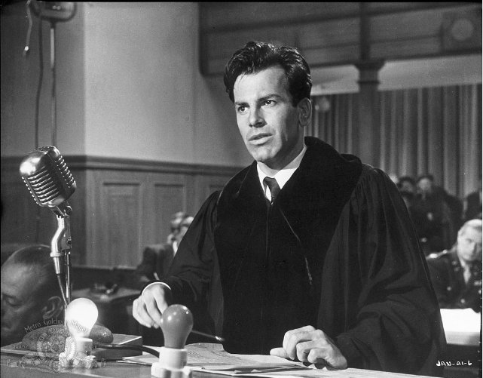
Max Schell

Slide 17
Questions?
Any additional questions? Please contact:
Frank Quern Bart Dahlstrom
X2-4512 x3-9605
fquern@mit.edu bartd@mit.edu
OR
Your SAP team lead:
HR-Payroll: Frank Quern
Financial-Logistics-EHS : Siobhan Cunningham
Technical Services: Wai-ming Li

