Slide 1
Trivial Pursuits
G
What takes place every July in Pamplona?
E
What city was the setting for Gunsmoke?
H
What did the B&O Railroad's initials stand for?
Who was Lancelot's son in Arthurian legend?
AL
SN
How many dimensions does a solid have?
SL
What's the site of the annual All-American Soap Box Derby?

Slide 2
And the answers are …
G
What takes place every July in Pamplona?
The running of the bulls
What city was the setting for Gunsmoke?
Dodge City, Kansas
E
H
What did the B&O Railroad's initials stand for?
Baltimore and Ohio
Who was Lancelot's son in Arthurian legend?
Galahad
AL
SN
How many dimensions does a solid have?
Three
SL
What's the site of the annual All-American Soap Box Derby?
Akron, Ohio

Slide 3
2012 Year End Support Pack Project
IS&T
Update
November 27, 2012

Slide 4
Agenda
Review of Scope
Testing Status
Issues
Cutover Plan

Slide 5
Project Scope Update
What are we updating?
  Let’s jump to the project wiki
    2012 SP Wiki

Slide 6
Other Non-SP Projects
Other non-support pack project work (during SP project timeline)
  APR 3.0/HR Transactions (SE1 development environment)
  Facilities Discovery (SE1)
    Other activities
    AP YE Tax Report Changes (w/ SPs)
    SAP logon user exit enhancement

Slide 7
Where are we now? Test execution
Test Status
  Unit – complete
    FLE: 459 transactions
    HRP: 277 transactions (includes EL)

Slide 8
Where are we now? Test execution
Test Status
  SIT – complete:
    Some testing details …
  Quality Center (QC)
Area | Total
E_Learning (Automated) | 3
E_Learning (Manual) | 69
HR_Payroll - Automated | 41
HR_Payroll - Manual | 160
EHS - Automated | 25
EHS-Manual | 32
Finance - Automated | 144
Finance - Manual | 280
IST Automated | 1
Logistics - Automated | 120
Logistics - Manual | 188
 | 1063

Slide 9
Issues
Is it worth it?
Well, yes …
  We can jump to RT for details: https://help.mit.edu/
Phases Issues were identified in …
(as of 11/27/12)
Issue type | Unit | SIT |  | Open
Required an SAP fix | 5 | 4 |  | 2
Required an MIT fix | 7 | 10
Infrastructure Related | 6 | 8
User/Data Error | 3 | 4
Duplicate | 1 | 3
Production Issue - to be addressed after SP | 1 | 2
Totals | 23 | 31 | 54 | 2

Slide 10
Issues (cont.)
How does it compare to prior years?
 | 2010 | 2011 | 2012
Issues | 64 | 41 | 54
SAP fix required | 3 | 8 | 9
MIT fix required | 23 | 17 | 17
Total fixes required | 26 | 25 | 26

Slide 11
Next Steps
11/26/2012 - 11/27/2012 Retest of any outstanding issue resolutions
11/30/2012 - 12/3/2012 Go-live weekend!
Meaning … we’ll have to execute a cutover plan!!
  Let’s jump to the project wiki’s Cutover Plan page and take a look at the plan …
  2012 SAP SP Wiki

Slide 12
Not-soTrivial Pursuits
G
How can I find out the status of the cutover?
Call this number 617-324-7468
E
Who performs the validations?
Assigned business personnel as defined in the cutover plan.
H
When will the SAP system be brought down?
5:00 PM Friday 11/30/2012
Where can I find the cutover plan?
On the project wiki
AL
SN
What are we updating?
The SAP ERP System
SL
When is go-live weekend?
11/30-12/3/2012

Slide 13
Questions?
Any additional questions? Please contact:
Frank Quern Bart Dahlstrom
X2-4512 x3-9605
fquern@mit.edu bartd@mit.edu
OR
Your SAP testing coordinator:
HR-Payroll: Mary Donovan
Financial-Logistics-EHS : Kristen Hann
Technical Services: Wai-ming Li
R3-Administration: Ron Parker

Slide 14
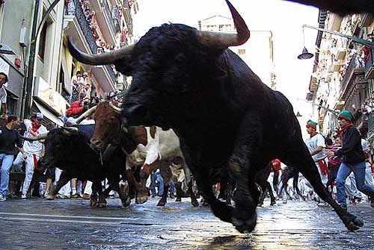
the running of the bulls …
Support Packs are Coming!
Support Packs are Coming!

