Slide 1
Trivial Pursuits
G
What takes place every July in Pamplona?
E
Who won the best actor Oscar for his portrayal of Popeye Doyle?
H
Who was the first president inaugurated in Washington, D.C.?
What World War II hero's autobiography was titled To Hell and Back?
AL
SN
Which meat on a roast turkey has more calories, white or dark?
SL
What's the traditional dish served at Wimbledon?

Slide 2
And the answers are …
G
What takes place every July in Pamplona?
The running of the bulls
Who one the best actor Oscar for his portrayal of Popeye Doyle?
Gene Hackman
E
H
Who was the first president inaugurated in Washington, D.C.?
Thomas Jefferson
What World War II hero's autobiography was titled To Hell and Back?
Audie Murphy's
AL
SN
Which meat on a roast turkey has more calories, white or dark?
Dark
SL
What's the traditional dish served at Wimbledon?
Strawberries and Cream

Slide 3
2012 Year End Support Pack Project
SAPbiz
Update
November 14, 2012

Slide 4
Agenda
Quick Review of the Project Scope
Update on Project Risks
High Level Time Line (& where are we now?)
Testing
Important Dates Revisited
Next Steps

Slide 5
Project Scope Update
What are we updating?
  Let’s jump to the project wiki
    https://2012 SP

Slide 6
Project Risks
Identified Risks
  QA Resource Turnover
    Unfamiliarity with QC
    Unfamiliarity with QTP Scripts (Automated test cases) – getting up to speed
  Two Phase Testing Approach
    Requires tight coordination and resource availability between the Business & IS&T
    But … we have two years experience with this approach
  Resource availability for the project (both Business & IS&T)
  Delay of implementation of pre-Support Pack Projects
    OE (on schedule; confirmation statements go out tomorrow)
  Pre-Support Pack Oracle & Operating System Upgrades

Slide 7
Other Non-SP Projects
Other non-support pack project work (during SP project timeline)
  APR 3.0/HR Transactions (SE1 development environment)
  Facilities Discovery (SE1)
    Other activities
    AP YE Tax Report Changes (w/ SPs)
    SAP logon user exit enhancement

Slide 8
High Level Timeline
10/31/2012 - Plan, convert/create/update test scripts in QC, move pending support & project work into production
10/11/2012 – SAP release of year end base level support pack
10/20-21/2012 – Production outage; upgrade to DB & OS
10/22/2012 - End of day production snapshot to be used to refresh test environments
10/22/2012 - Development Freeze begins
11/01/2012 - Last date to implement support & enhancement changes until freeze ends on 12/5/2012
10/26/2012 - 11/2/2012 Unit test
11/5/2012 - 11/27/2012 System Integration Test
12/1/2012 - 12/2/2012 Go-live weekend!
12/5/2012 - Development Freeze ends

Slide 9
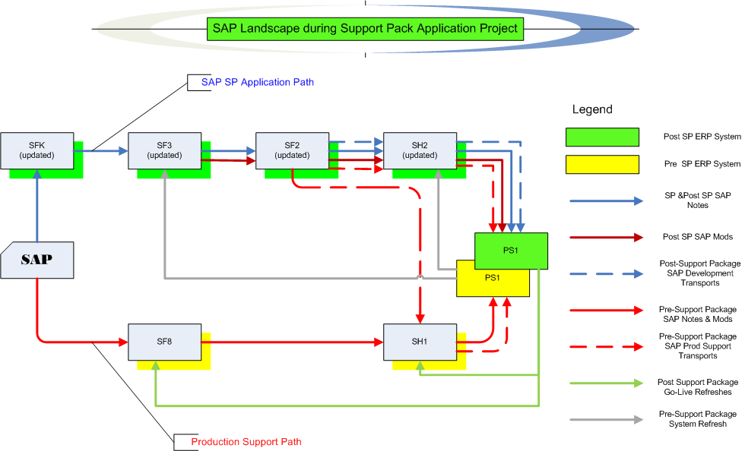
Where are we now?
Project Landscape

Slide 10
Testing Timeline Details
  Let’s look at the Plans and Schedule on the wiki …
  2012 SP Project Wiki

Slide 11
Where are we now? Test execution
Test Status
  Unit – complete
    FLE: 459 transactions
    HRP: 277 transactions (includes EL)
  SIT – in process
    FIN: 431 test cases
    HRP: 201 test cases
    EL: 71 test cases
    EHS: 59 test cases
    LOG: 291 test cases
    Some testing details …
  Quality Center (QC)

Slide 12
Where are we now? Test execution
Test Status (as of 11/14/2012)
  Details can be found in QC
    Quality Center (QC)
Area | Total |  | Complete | Remaining
Enterprise Learning | 71 |  | 79% | 21%
HR_Payroll - Automated | 41 |  | 39% | 61%
HR_Payroll - Manual | 160 |  | 88% | 13%
EHS - Automated | 27 |  | 78% | 22%
EHS-Manual | 32 |  | 47% | 53%
Finance - Automated | 144 |  | 98% | 2%
Finance - Manual | 287 |  | 22% | 78%
IST Automated | 2 |  | 50% | 50%
Logistics - Automated | 120 |  | 94% | 6%
Logistics - Manual | 171 |  | 12% | 88%
Totals | 1055 |  | 56% | 44%

Slide 13
Testing Recap
(continued)
  If I find an issue during testing how do I report it?
  - let’s go back to the wiki …
  2012+Year+End+SAP+Support+Pack+Project

Slide 14
Issues
Is it worth it?
Well, yes …
  We can jump to RT for details: https://help.mit.edu/
Phases Issues were identified in …
(as of 11/14/12)
Issue type | Unit | SIT |  | Open
Required an SAP fix | 5 | 4 |  | 4
Required an MIT fix | 7 | 11 |  | 8
Infrastructure Related | 6 | 6 |  | 4
User/Data Error | 3 | 0
Duplicate | 1 | 2
Production Issue - to be addressed after SP | 1 | 0
Totals | 23 | 23 | 46 | 16

Slide 15
Recap of Important Dates
10/31/2012 - Plan, convert/create/update test scripts in QC, move pending support & project work into production
10/11/2012 – SAP release of year end base level support pack
10/20-21/2012 – Production outage; upgrade to DB & OS
10/22/2012 - End of day production snapshot to be used to refresh test environments
10/22/2012 - Development Freeze begins
11/01/2012 - Last date to implement support & enhancement changes until freeze ends on 12/5/2012
10/26/2012 - 11/2/2012 Unit test
11/5/2012 - 11/27/2012 System Integration Test
12/1/2012 - 12/2/2012 Go-live weekend!
12/5/2012 - Development Freeze ends

Slide 16
Next Steps
Now - 11/23/2012 Complete SI/UA Testing (Business & IS&T)
11/26/2012 - 11/27/2012 Retest of any outstanding issue resolutions
Prepare go-live (All)
11/28/2012 – SAPbiz (Review cut-over plan)
12/1/2012 - 12/2/2012 Go-live weekend!

Slide 17
Not-soTrivial Pursuits
G
What environment are we testing in?
E
When should we have our testing complete?
H
How do I a report an issue?
Where can I find project related information?
AL
SN
What’s our completion rate so far?
SL
When is go-live weekend?

Slide 18
Questions?
Any additional questions? Please contact:
Frank Quern Bart Dahlstrom
X2-4512 x3-9605
fquern@mit.edu bartd@mit.edu
OR
Your SAP testing team coordinator:
HR-Payroll (HRP): Mary Donovan
Financial-Logistics-EHS (FLE): Kristen Hann

Slide 19
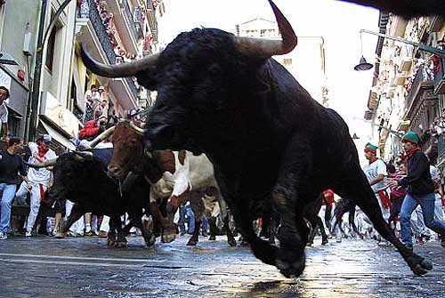
the running of the bulls …
Support Packs are Coming!
Support Packs are Coming!

