Slide 1
Trivial Pursuits
G
What takes place every July in Pamplona?
E
What comedian was born Allen Stewart Konigsberg?
H
What has to be produced in a writ of habeas corpus?
What novel has the ghost of Catherine appearing to Mr. Lockwood?
AL
SN
What's the great and proud claim to fame of Thomas Crapper?
SL
How much does Ventnor Avenue cost in Monopoly?

Slide 2
And the answers are …
G
What takes place every July in Pamplona?
The running of the bulls
What comedian was born Allen Stewart Konigsberg?
Woody Allen
E
H
What has to be produced in a writ of habeas corpus?
The body
What novel has the ghost of Catherine appearing to Mr. Lockwood?
Wuthering Heights
AL
SN
What's the great and proud claim to fame of Thomas Crapper?
The flush toilet
SL
How much does Ventnor Avenue cost in Monopoly?
$260

Slide 3
2013 Year End Support Pack Project
IS&T Update
(cutover)
December 2, 2013

Slide 4
Agenda
High Level Time Line (& where are we now?)
Testing
Issues
Cutover Plan
Next Steps

Slide 5
High Level Timeline
Now – October : Plan, convert/create/update test scripts in QC, move pending support & project work into production
10/10/2013 : SAP release of year end base level support pack
10/21/2013 : End of day production snapshot to be used to refresh test environments
10/19/2013 : Development Freeze begins
10/31/2013 : Last date to implement support & enhancement changes until freeze ends on 12/5/2013
10/25/2013 - 11/1/2013 : Unit test
11/4/2013 - 12/2/2013 : System Integration Test !!!!
12/7/2013 - 12/8/2013 : Go-live weekend
12/11/2013 : Development Freeze ends

Slide 6
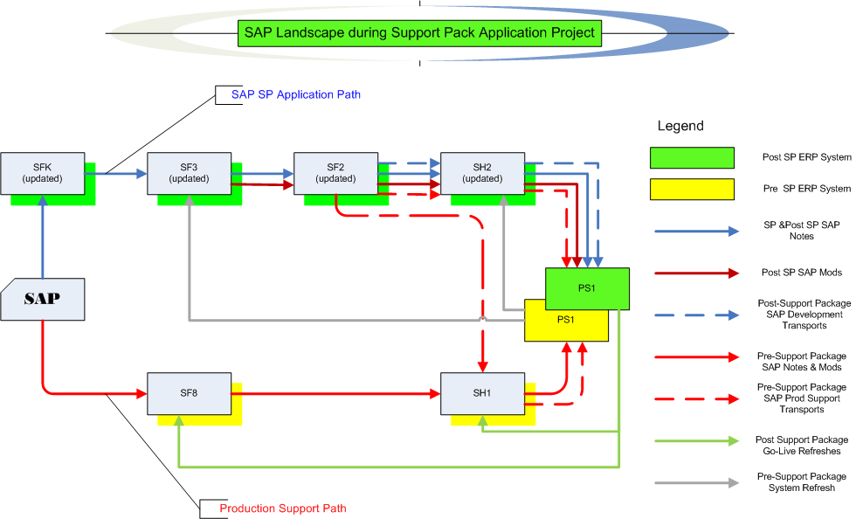
Where are we now?
Project Landscape

Slide 7
Where are we now? Test execution
Test Status
  Let’s look at the Test Plan page on the wiki …
  https://2013_SAP_Support_Packs
    Some testing details …
  Quality Center (QC)

Slide 8
Issues
Is it worth it?
Well, yes …
  We can jump to RT for details: https://help.mit.edu/
Phases Issues were identified in …
(as of 12/2/13)
Issue type | Unit | SIT |  | Total
Required an SAP fix | 12 | 11 |  | 23
Required an MIT fix | 10 | 9 |  | 19
Infrastructure Related | 5 | 17 |  | 22
User/Data Error | 0 | 5 |  | 5
Duplicate | 1 | 7 |  | 8
Production Issue | 3 | 6 |  | 9
Totals | 31 | 55 |  | 86

Slide 9
Issues (cont.)
How does it compare to prior years?
 | 2010 | 2011 | 2012 | 2013
Issues | 64 | 41 | 54 | 86
SAP fix required | 3 | 8 | 9 | 23
MIT fix required | 23 | 17 | 17 | 19
Total fixes required | 26 | 25 | 26 | 42

Slide 10
Next Steps
12/2/2013 Retest of any outstanding issue resolutions
12/3/2013 Steering Committee Go/no-go
12/4/2013 Transport Review (2:00pm)
12/4/2013 Action Log Review (3:00pm)
12/6/2013 (5:00pm) - 12/8/2013 Go-live weekend!
Meaning … we’ll have to execute a cutover plan!!

Slide 11
Cutover
Preparation work
System Isolation
Support Pack Application
Post Upgrade Processes (conversions, validations)
Go-live
  Let’s jump to the project wiki’s Cutover Plan page and take a look at the plan …

Slide 12
Not-soTrivial Pursuits
G
How can I find out the status of the cutover?
Call this number 617-324-7468
E
Who performs the validations?
Assigned business personnel as defined in the cutover plan.
H
When will the SAP system be brought down?
5:00 PM Friday 12/6/2013
Where can I find the cutover plan?
On the project wiki
AL
SN
What are we updating?
The SAP ERP System (including Portal & GRC)
SL
When is go-live weekend?
12/6 (5:00pm) -12/8/2013

Slide 13
Questions?
Any additional questions? Please contact:
Frank Quern Bart Dahlstrom
X2-4512 x3-9605
fquern@mit.edu bartd@mit.edu
OR
Your SAP testing team coordinator:
HR-Payroll (HRP): Desiree Roberts
Financial-Logistics-EHS (FLE): Ken Levie

Slide 14
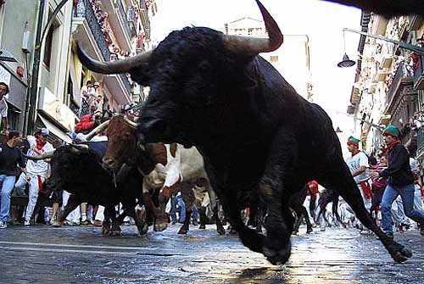
the running of the bulls …
Support Packs are Coming!
Support Packs are Coming!

