Slide 1
Trivial Pursuits
G
What takes place every July in Pamplona?
E
What comedian was born Allen Stewart Konigsberg?
H
What has to be produced in a writ of habeas corpus?
What novel has the ghost of Catherine appearing to Mr. Lockwood?
AL
SN
What's the great and proud claim to fame of Thomas Crapper?
SL
How much does Ventnor Avenue cost in Monopoly?

Slide 2
And the answers are …
G
What takes place every July in Pamplona?
The running of the bulls
What comedian was born Allen Stewart Konigsberg?
Woody Allen
E
H
What has to be produced in a writ of habeas corpus?
The body
What novel has the ghost of Catherine appearing to Mr. Lockwood?
Wuthering Heights
AL
SN
What's the great and proud claim to fame of Thomas Crapper?
The flush toilet
SL
How much does Ventnor Avenue cost in Monopoly?
$260

Slide 3
2013 Year End Support Pack Project
SAPbiz
Update
November 13, 2013

Slide 4
Agenda
Quick Review of the Project Scope
Update on Project Risks
High Level Time Line (& where are we now?)
Testing
Important Dates Revisited
Next Steps

Slide 5
Project Scope Update
What are we updating?
  Let’s jump to the project wiki
    https://2013_SAP_Support_Packs

Slide 6
Project Risks
Identified Risks
  Two Phase Testing Approach
    Requires tight coordination and resource availability between the Business & IS&T
    But … we have three years experience with this approach
  Resource availability for the project (both Business & IS&T)
  Delay of implementation of pre-Support Pack Projects
    OE (complete and on time)
  Impacts from other requested updates
    Atlas Java Application
    PM Modernization Project
    SAPweb Help Migration to KB

Slide 7
High Level Timeline
Now – October : Plan, convert/create/update test scripts in QC, move pending support & project work into production
10/10/2013 : SAP release of year end base level support pack
10/21/2013 : End of day production snapshot to be used to refresh test environments
10/19/2013 : Development Freeze begins
10/31/2013 : Last date to implement support & enhancement changes until freeze ends on 12/5/2012
10/25/2013 - 11/1/2013 : Unit test
11/4/2013 - 12/1/2013 : System Integration Test !!!!
12/7/2013 - 12/8/2013 : Go-live weekend
12/11/2013 : Development Freeze ends

Slide 8
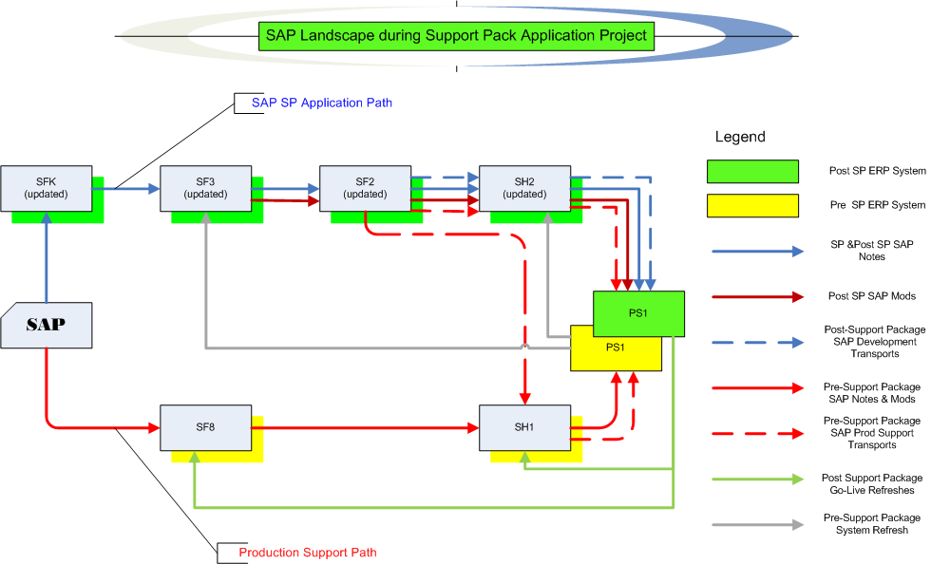
Where are we now?
Project Landscape

Slide 9
Testing Timeline Details
  Let’s look at the Plans and Schedule on the wiki …
  https://2013_SAP_Support_Packs

Slide 10
Where are we now? Test execution
Test Status
  Let’s look at the Test Plan page on the wiki …
  https://2013_SAP_Support_Packs
    Some testing details …
  Quality Center (QC)

Slide 11
Testing Recap
(continued)
  If I find an issue during testing how do I report it?
  - let’s go back to the wiki …
  https://2013_SAP_Support_Packs

Slide 12
Issues
Is it worth it?
Well, yes …
  We can jump to RT for details: https://help.mit.edu/
Phases Issues were identified in …
(as of 11/14/12)
Issue type | Unit | SIT |  | Open
Required an SAP fix | 9 | 4 |  | 6
Required an MIT fix | 7 | 8 |  | 7
Infrastructure Related | 8 | 2
User/Data Error | 0 | 0
Duplicate | 1 | 0
Production Issue - to be addressed after SP | 6 | 0
Totals | 31 | 14 | 45 | 13

Slide 13
High Level Timeline
Now – October : Plan, convert/create/update test scripts in QC, move pending support & project work into production
10/10/2013 : SAP release of year end base level support pack
10/21/2013 : End of day production snapshot to be used to refresh test environments
10/19/2013 : Development Freeze begins
10/31/2013 : Last date to implement support & enhancement changes until freeze ends on 12/5/2012
10/25/2013 - 11/1/2013 : Unit test
11/4/2013 - 12/1/2013 : System Integration Test
12/7/2013 - 12/8/2013 : Go-live weekend!
12/11/2013 : Development Freeze ends

Slide 14
Next Steps
Now - 11/25/2013 Complete SI/UA Testing (Business & IS&T)
11/26/2013 - 12/02/2013 Retest of any outstanding issue resolutions
Prepare go-live (All)
11/27/2013 – SAPbiz (Review cut-over plan)
12/6/2012 (after 5pm) - 12/8/2012 Go-live weekend!

Slide 15
Not-soTrivial Pursuits
G
What environment are we testing in?
E
When should we have our testing complete?
H
How do I a report an issue?
Where can I find project related information?
AL
SN
What’s our completion rate so far?
SL
When is go-live weekend?

Slide 16
Questions?
Any additional questions? Please contact:
Frank Quern Bart Dahlstrom
X2-4512 x3-9605
fquern@mit.edu bartd@mit.edu
OR
Your SAP testing team coordinator:
HR-Payroll (HRP): Desiree Roberts
Financial-Logistics-EHS (FLE): Ken Le Vie

Slide 17
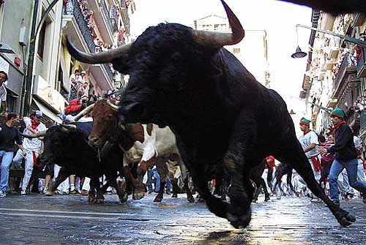
the running of the bulls …
Support Packs are Coming!
Support Packs are Coming!

