Slide 1
Genetic shift register

Slide 2
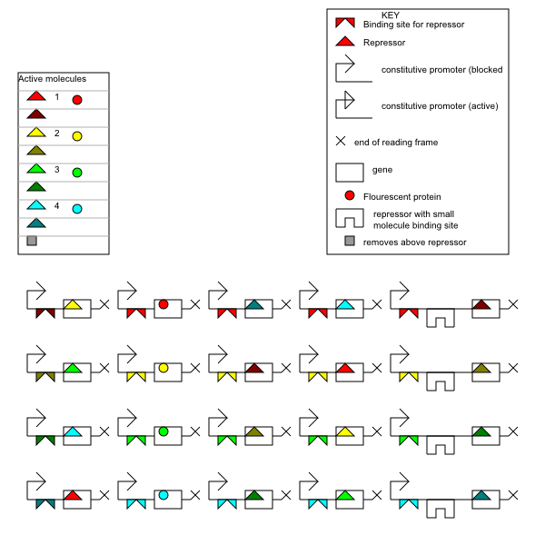
format
I didn’t use this symbol

Slide 3
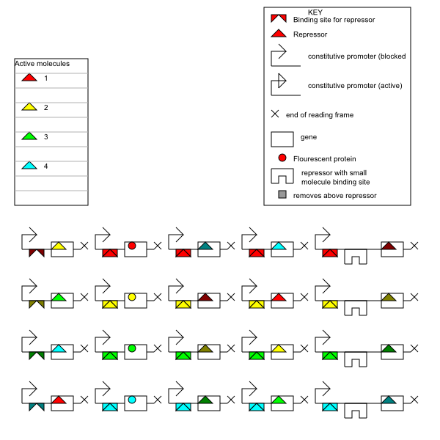
Initial state

Slide 4
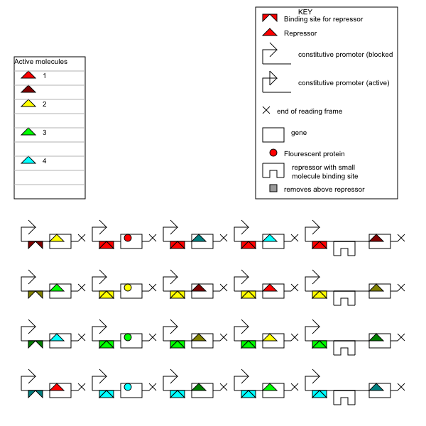
Added red’ repressor

Slide 5
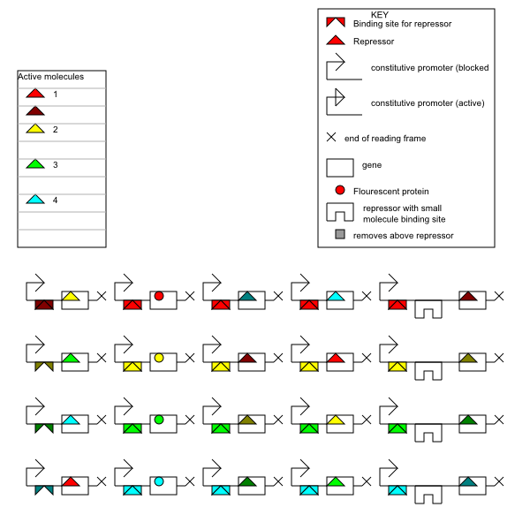

Slide 6


Slide 7
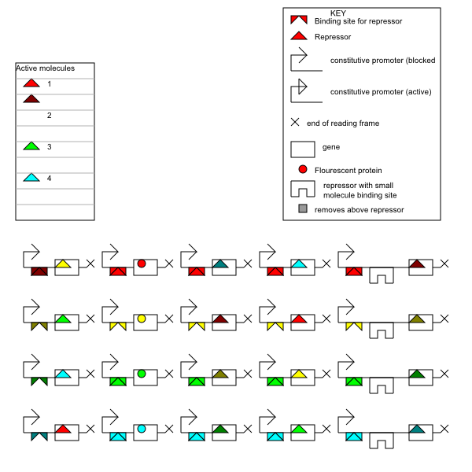

Slide 8


Slide 9

Added advance signal

Slide 10
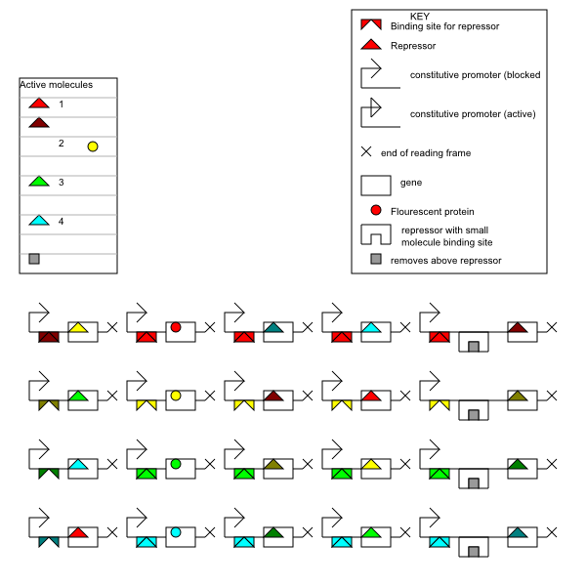

Slide 11


Slide 12


Slide 13
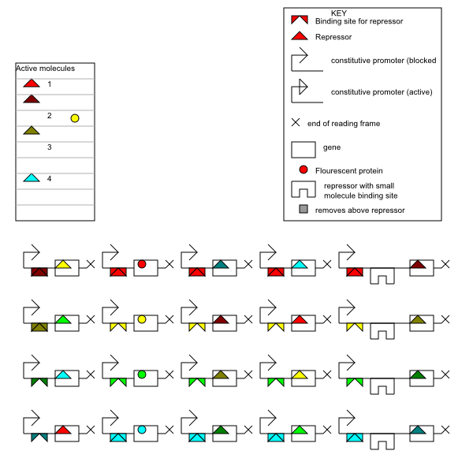

Slide 14


Slide 15
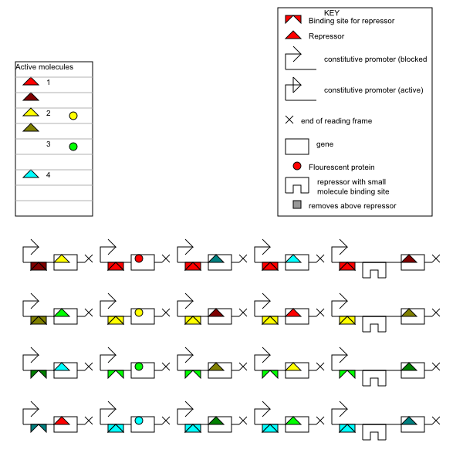

Slide 16
