Slide 1
A bottom up explanation of the shift register

Slide 2
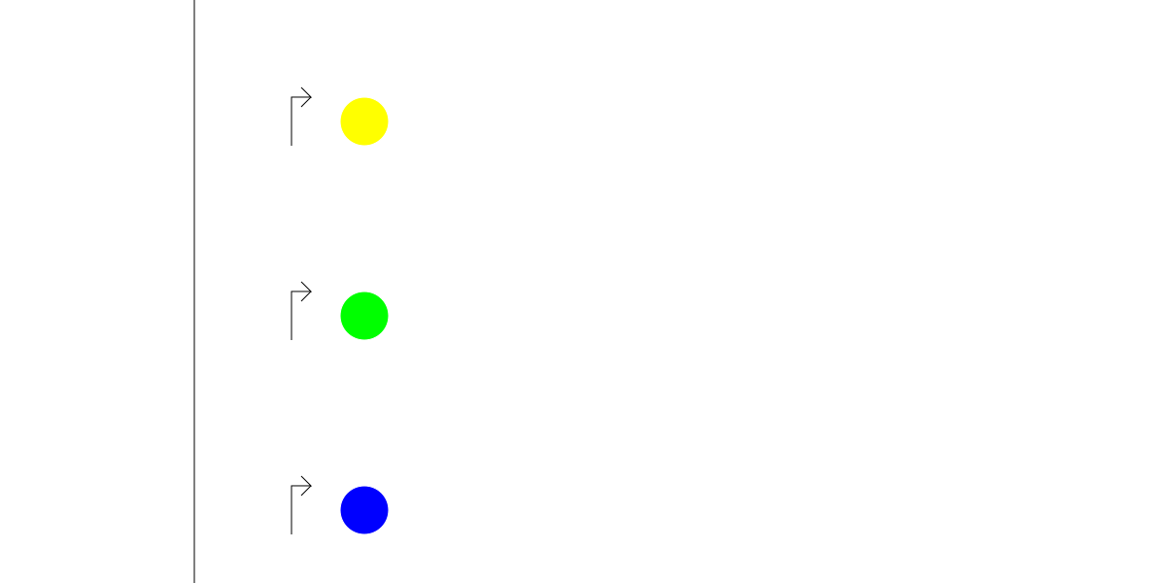
First, we want distinct active states. Each dot is a unique protein, this will be the output. The color is the ID of the state

Slide 3
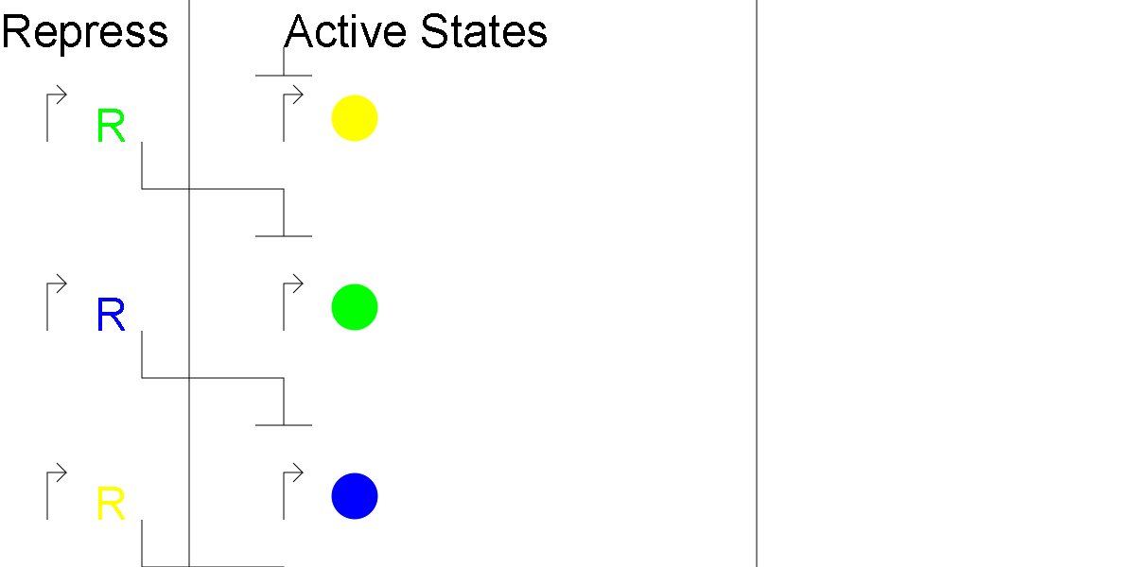
But not all active at once. The left region represses the state ahead of it, so each state is being repressed, and each state only interacts with its immediate neighbors. R represses the state of its color.

Slide 4
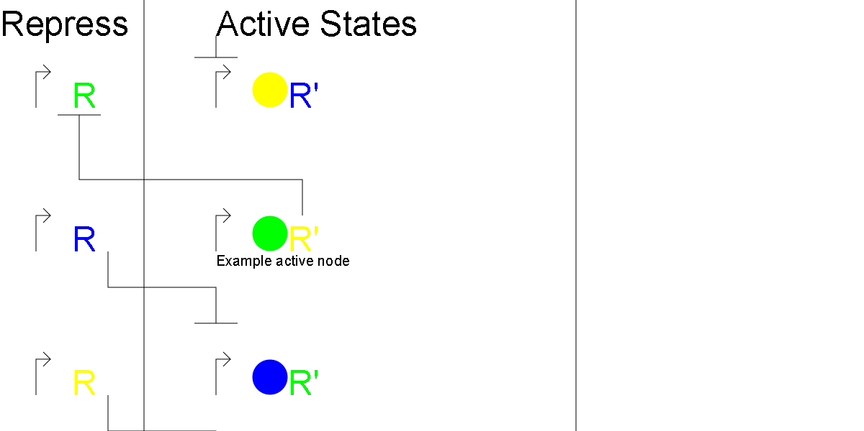
But we want one active. When a state is active, it represses the repressor behind it, so it reinforces its on behavior.

Slide 5
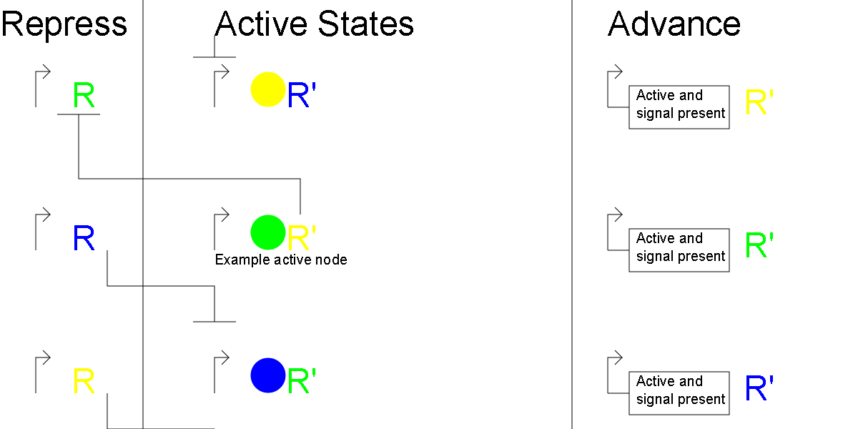
Next, we want to advance on a signal. When he advance signal is present, the active state n turns on the n+1 state.

Slide 6
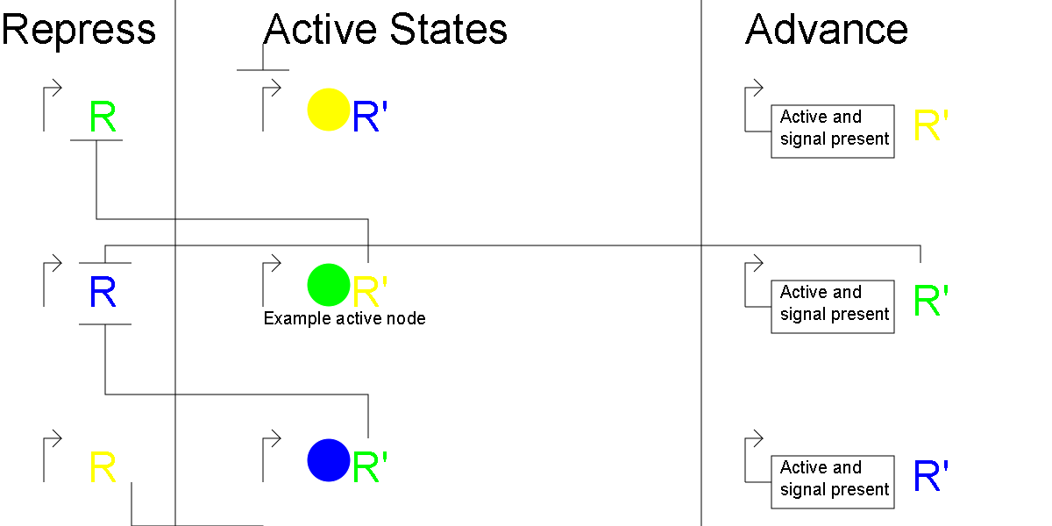
Next state active, but old state still active, is problem

Slide 7
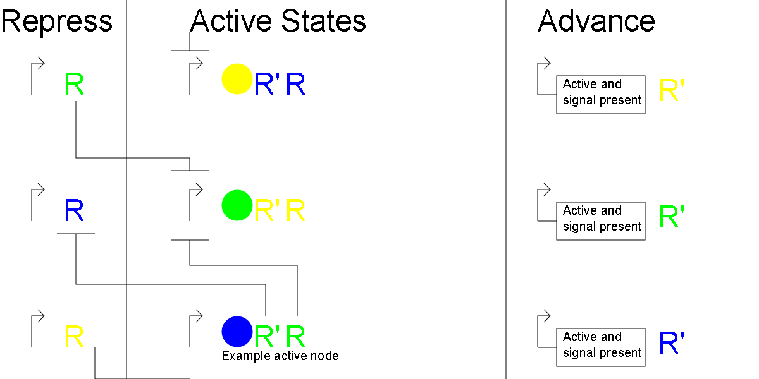
Next state now only active state. Each state represses the state before it, so if two states are active, the system will proceed to only the latter one being active.

Slide 8
Loop or not loop
Pointing the forward looking parts of the last state to the first state and the backwards looking parts of the first state to the last state makes it loop.
Disconnecting only the advance signal part of the last state makes it stop at the end, do not disconnect anything else.

Slide 9
Adding more state
Since each state only interacts with its neighbors, just insert between two states and fix the connections

Slide 10
Applications
Tell what time it is (in some capacity)
Have one organism do a multi step process, like brewing beer or making pharmaceuticals
If a chemical process has parts that interfere with each other, you can separate them temporally (they don’t both exist at the same time)
As a safety precaution, have the cells self terminate after some number of divisions so they don’t escape into the wild
Make really big AND gates (have the reporter be a logic circuit that sends advance when some signal is present, so if all the signals are present, the circuit advances all the way to the end)
Administer a series of vaccines in one visit to the doctor (injecting a whole lot at once tends to not cause the desired immune response)

Slide 11
Advance signal issue
A single advance signal means that it could advance more than 1 state at a time with imperfect timing.
This can be fixed by having even states use advance A and odd use advance B, so the 1->2 transition uses a different signal than the 2-> 3 signal
By adding a toggle switch that output either A or B (but not both) that toggles on the change of C from not present to present, it behaves like C is the single advance signal
This requires an even number of states, but being clever with having a state output the advance signal should cause that state to be skipped.

Slide 12
Potential future possibilities
Each state has a unique DNA reference, so you could make a system to do something like turn state 4 on or something
If each state codes for a command then this works like a computer program with GOTO statements.
Each state’s active behavior could be a complete circuit, so you could have a bunch of circuits (like addition, subtraction, multiplication, and division) stored in this and use one at a time.

