Slide 1
A bottom up explanation of the shift register

Slide 2
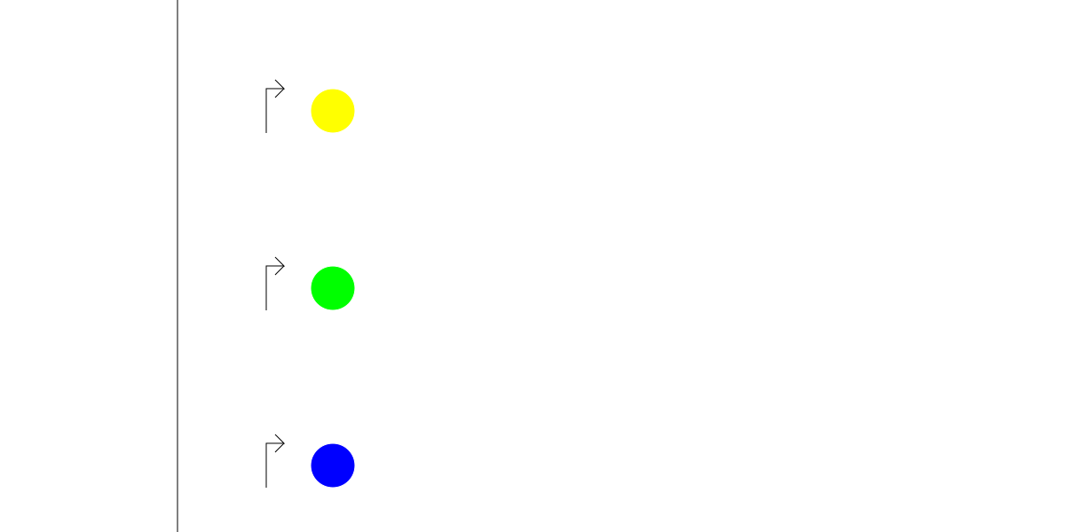
First, we want distinct active states

Slide 3
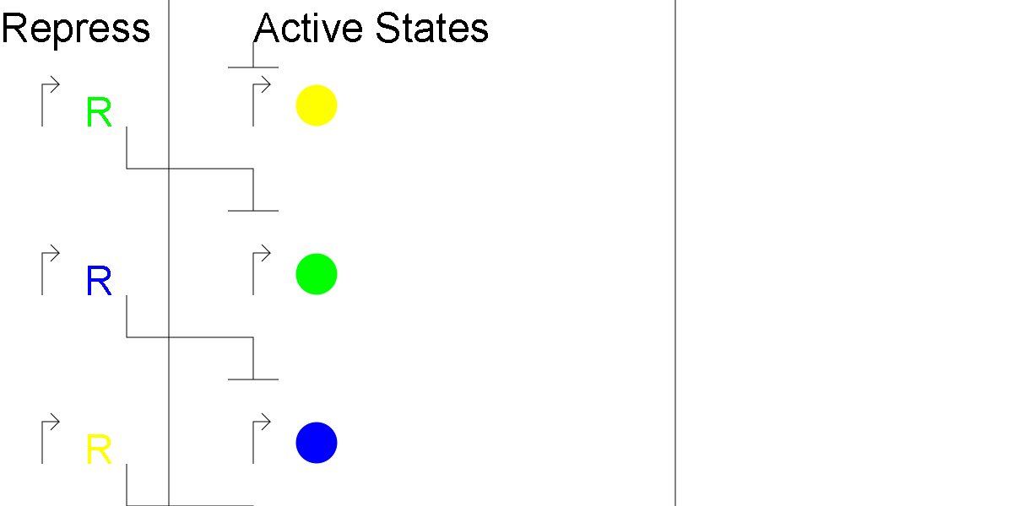
But not all active at once

Slide 4
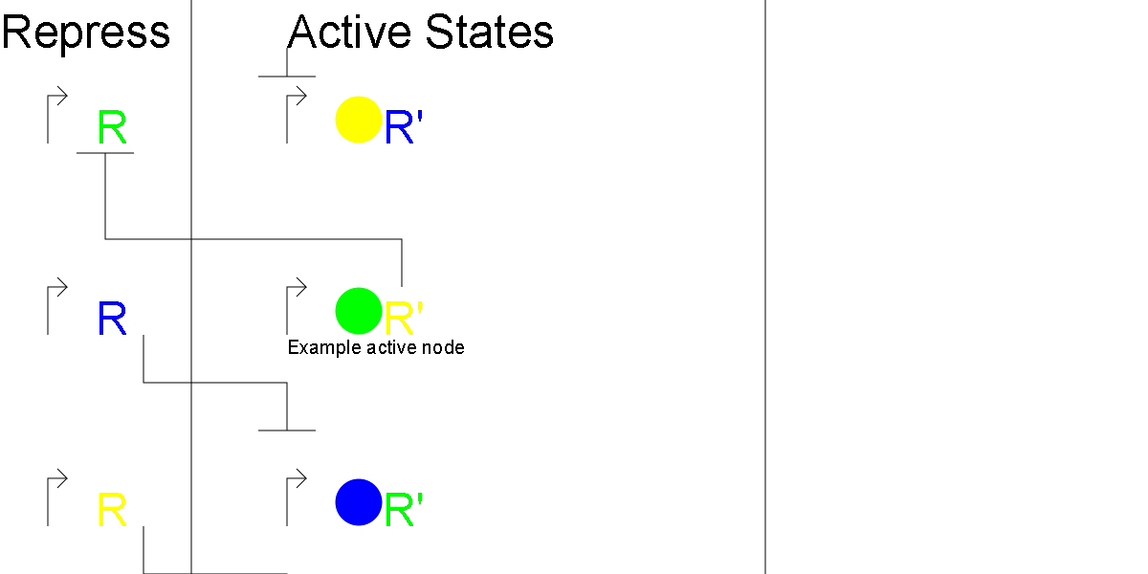
But we want one active

Slide 5
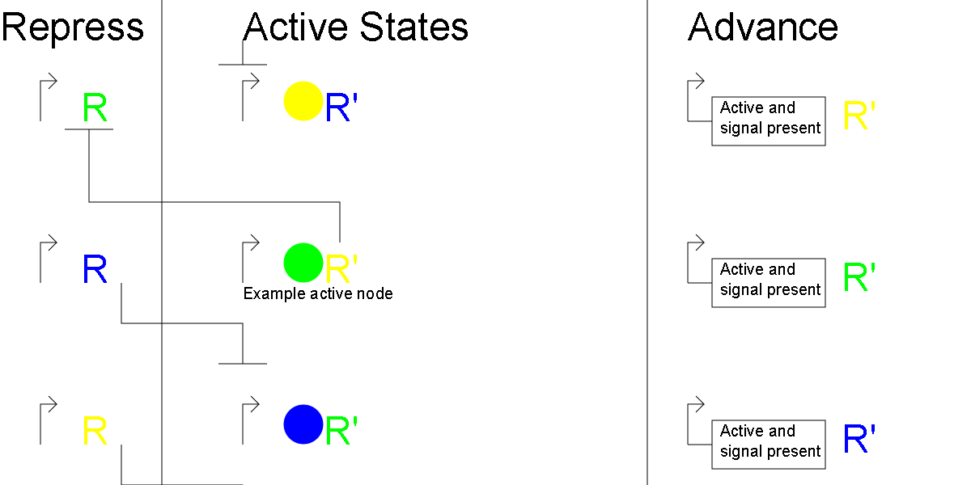
Next, we want to advance on a signal

Slide 6
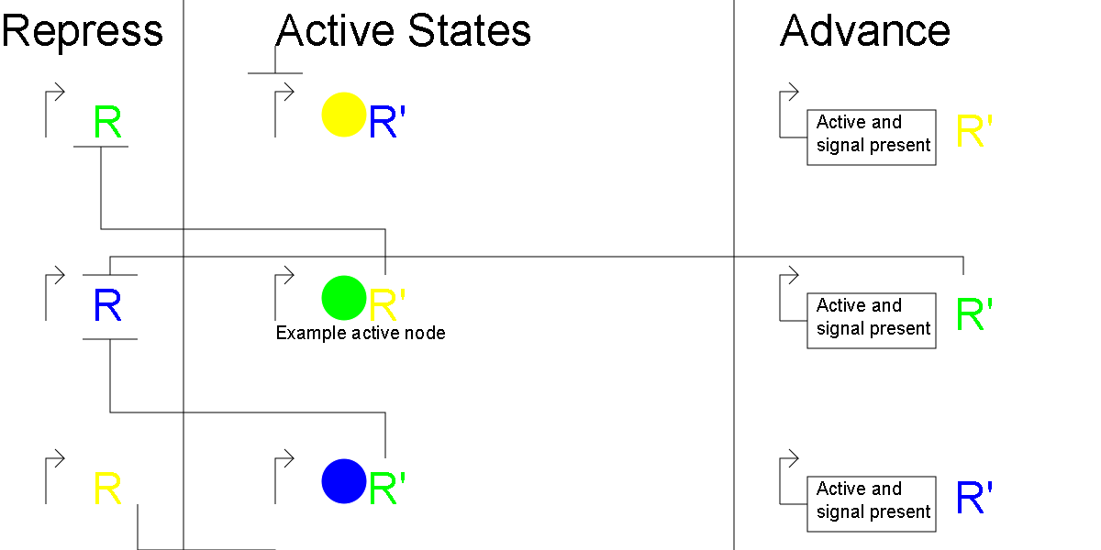
Next state active, but old state still active

Slide 7
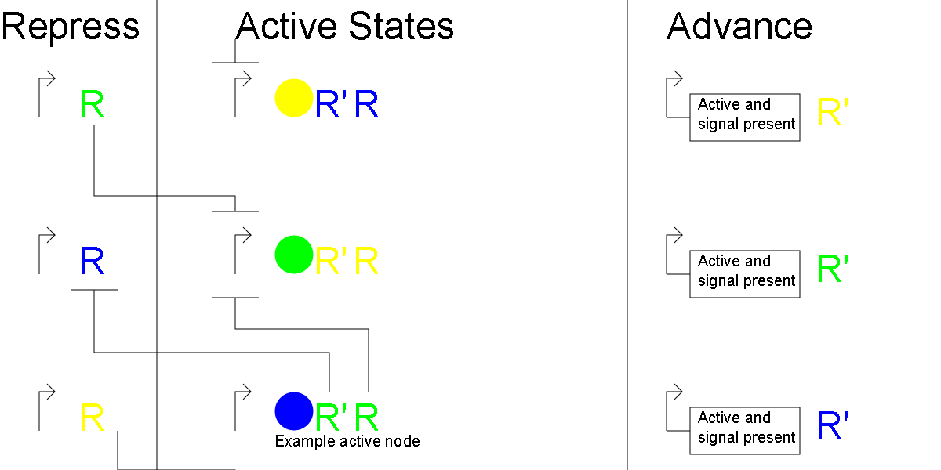
Next state now only active state

